Slide 1
getfame -n names -s series -e expression
A FAME Json api 2025
Erik.Soberg@ssb.no
2025 Supports series w identical series names in different FAME databases, formulas can aggregate from several open databases

Slide 2
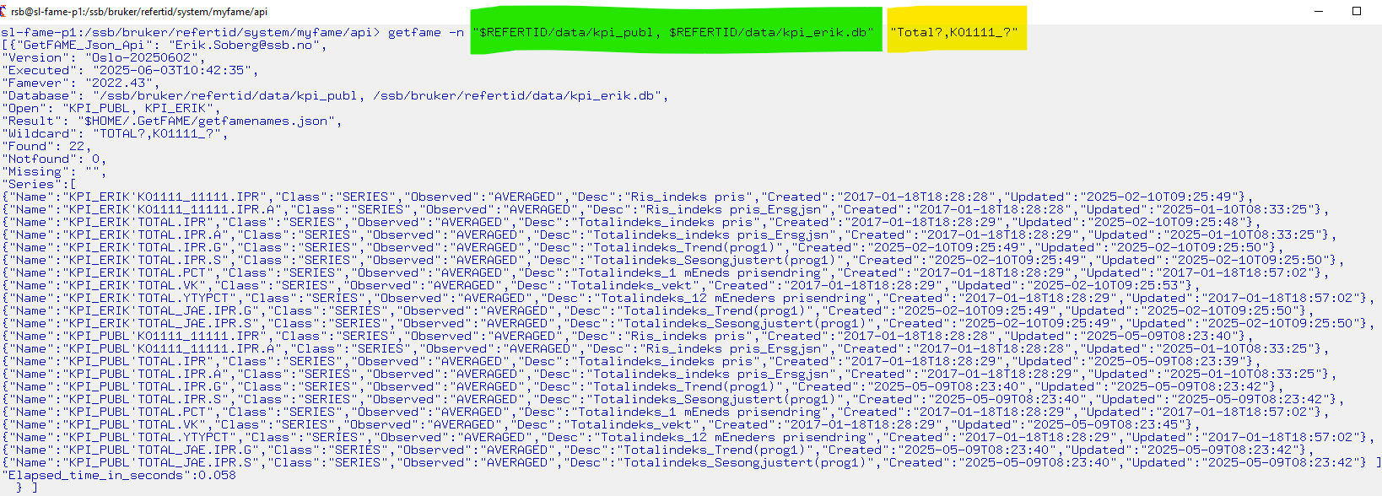
1. getfame -n gets FAME names and metadata

Slide 3
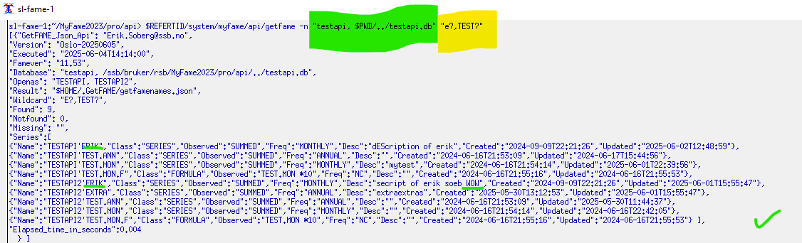
getfame –n with identical databases identical seriesnames different places)

Slide 4
getfame -n flexibility Combine with linux commands to find descriptions, or series with incorrect definitions The command below lists all series in the database but only show the one with the text «SUMM»

Slide 5
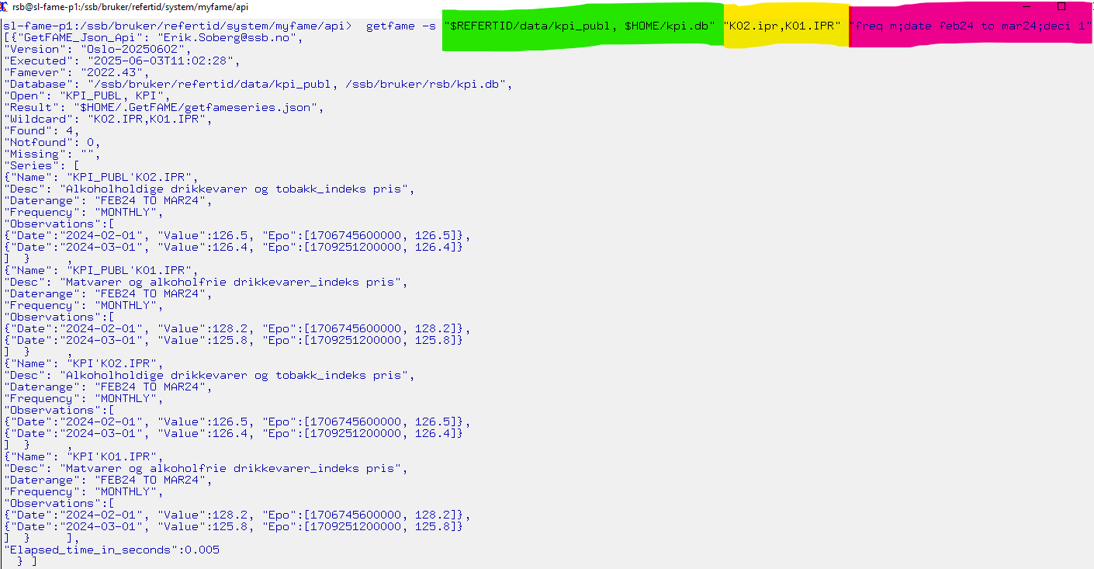
2. getfame -s gets data observations with [time,value] touplets

Slide 6
getfame -s getfameseries samples
$REFERTID/system/myfame/api/getfame -s /ssb/bruker/refertid/data/kpi_publ.db "total.ipr"
getfame -s /ssb/bruker/refertid/data/kpi_publ.db "total.ipr, K0?IPR " "date 2024 "
getfame -s /ssb/bruker/refertid/data/kpi_publ.db total.ipr "freq m; date thisday(m)-5 to * "
getfame -s $REFERTID/data/fornavn.db "?ERIK,KRISTIN,JIM? " "date 2010 to 2012 "
getfame -s " /ssb/bruker/refertid/data/fornavn.db" "?JAN?" "date 2000 to 2005 "
getfame -s " /ssb/bruker/refertid/data/fornavn.db" "JI? " "date 2000 to *; deci 1 "
getfame -s "fornavn.db, name.db" "JI? ,MATT?" "date 2000 to * ; deci 2 "
getfame -s "pi1.db, cpi2.db,cpi_form.db" "Total.ipr" "date 2025 ; deci 2"

Slide 7
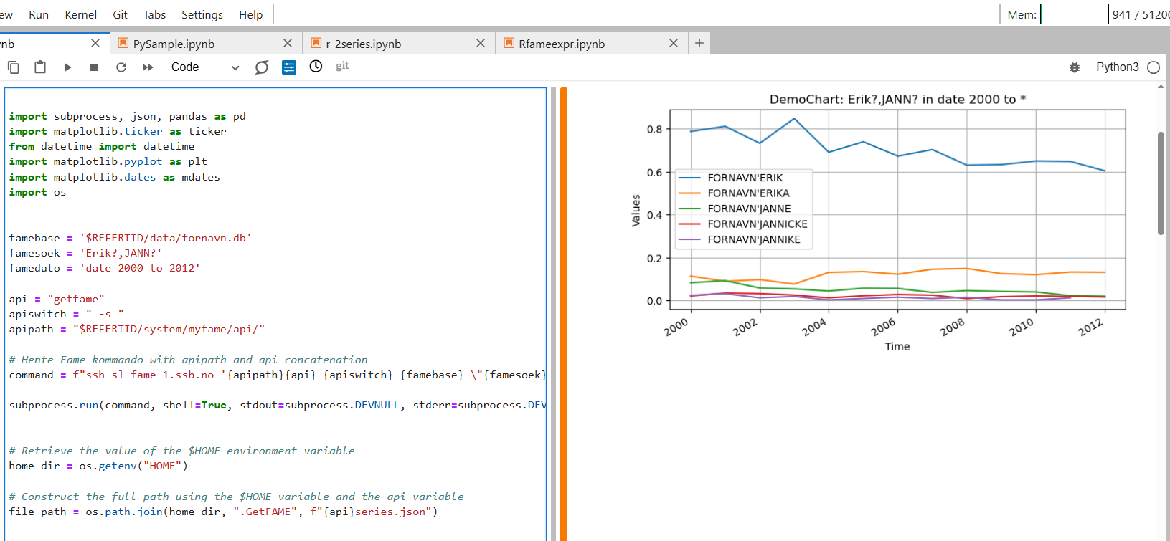
getfame –s used from om JupyterLab with Python3:

Slide 8
3. getfame -e getfameexpression advanced mode
Data-observations, from FAME database(s) given one FAME-expression:
getfame -e "$REFERTID/data/fornavn.db " "mave(ERIK,2)" "date 2000 to 2010"
getfame -e "$REFERTID/data/fornavn.db " "Lsum(ERIK,EIRIK)" "date 2000 to *"
getfame -e "$REFERTID/data/fornavn.db " "ERIK+EIRIK" "date 2000 to *"
getfame –e "$REFERTID/data/kpi_publ.db, mycpi.db " "convert(total.ipr,annual,constant) " "date *; deci 1 "
getfame -e "$REFERTID/data/kpi_publ.db, mycpi.db " "PCT(mycpi’K09.IPR)" "date 2025; deci 1 "
getfame -e "cpi1.db,cpi2.db,cpi_form.db" "cpi1’Total.ipr" "date 2025 ; deci 2"
Be aware to double quote arguments when they contain special char like : , ( ‘ ;

Slide 9
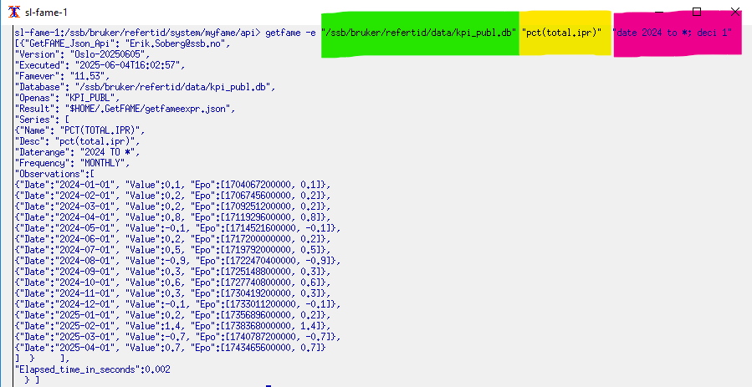
getfame –e gets a fame-expression

Slide 10
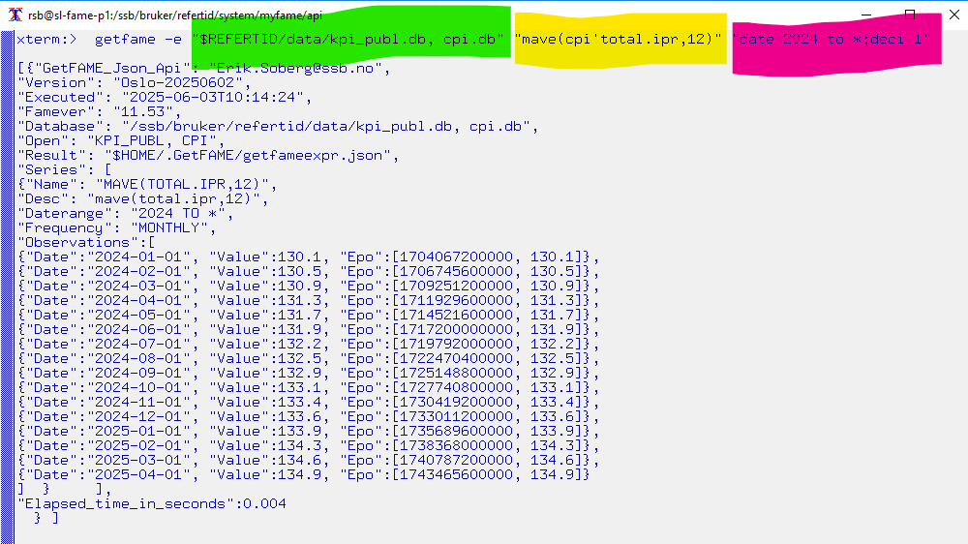
getfame –e with several different databases

Slide 11
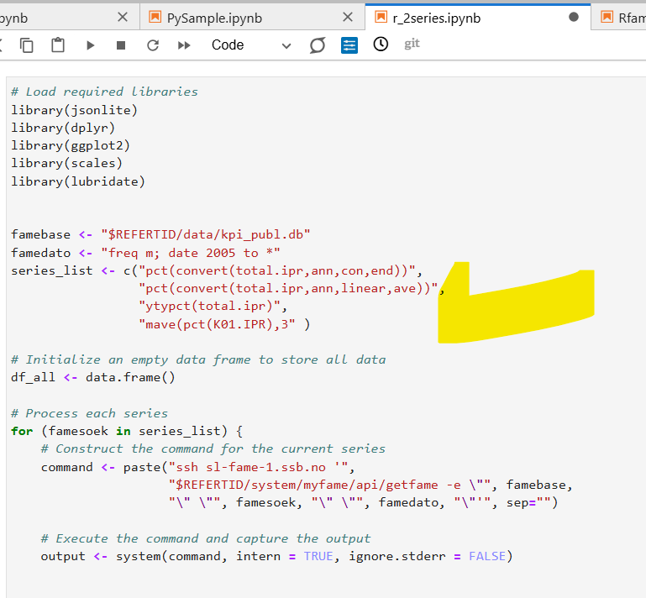
Using the power of FAME by getfame –e with R from Jupiterlab list of expressions

Slide 12
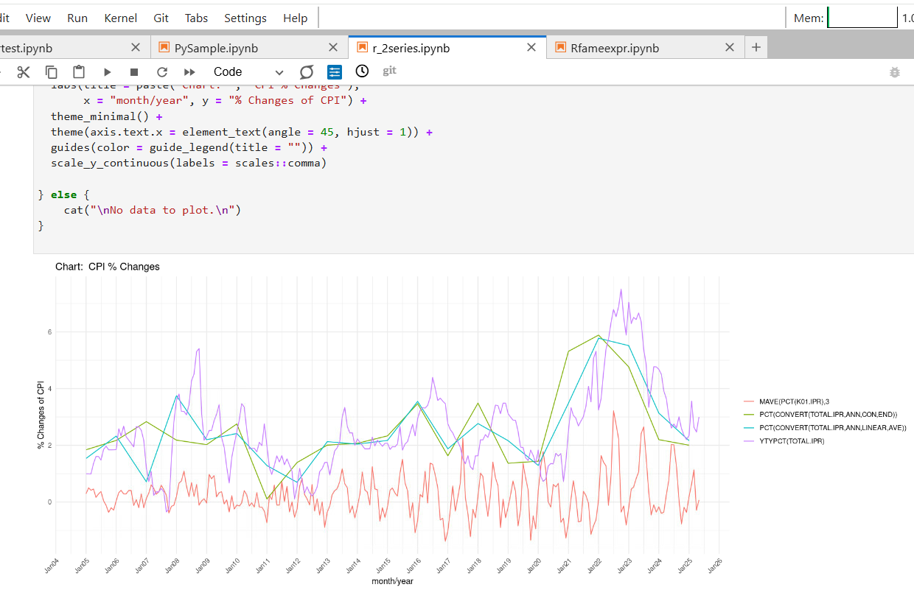
getfame -e Result: different series different frequencies different expressions

Slide 13
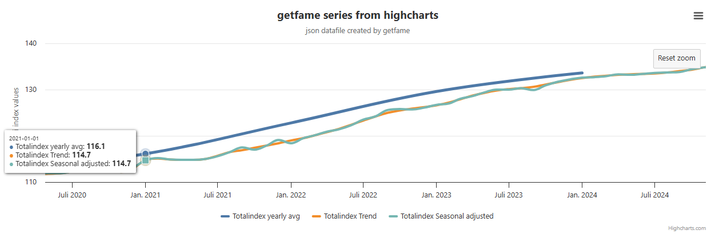
Highchart to view the result in a browser
Zoomable Xaxis using getfame Epoch datetime, tooltip, save as csv, customizable, more samples at www.eriksberg.no

Slide 14
Help : getfame –h or just skip the arguments
1. getfame –n
getfamenames (gets series names & metadata from databases with a list of wildcards
2. getfame –s
getfameseries (gets observations from one or more series from database(s) given a list of serienames or FAME wildcards)
3. getfame -e
getfameexpr (gets observations given 1 FAME expression)
For complete jupyterlab samples, see Github

Slide 15
Summary
The getfame –e option use the full power of FAME and can evaluate formulas, functions, conversions among various series, formulas, frequiencies and databases
To get more series with getfame –e simply loop through expressions and add results to same charts or dataset.
getfame –n is powerful when combining grep | more |head to search for series/formulas names or metadata

Slide 16
Observations & Comments
Possible to introduce powerful and modern visualizations tools like www.highcharts.com The JSON output is designed for highcharts.
Reduce the barrier to use data in FAME, and the power of FAME, when simply calling getfame from Python or R
With the getfame json api you have all functionality needed to build a GUI (like myfame) in DASH, Visual Studio, QT …
getfame can be run i quiet (silent) mode, no output is not shown on the screen: getfame –nq getfame –sq getfame -eg

