Slide 1


Slide 2
getfame -n names -s series -e expression
A JSON API 2025 to use from R Python and more..
Erik.Soberg@ssb.no
2025 Supports series & formulas with identical series names in different FAME databases. Evaluate & aggregate from several databases

Slide 3
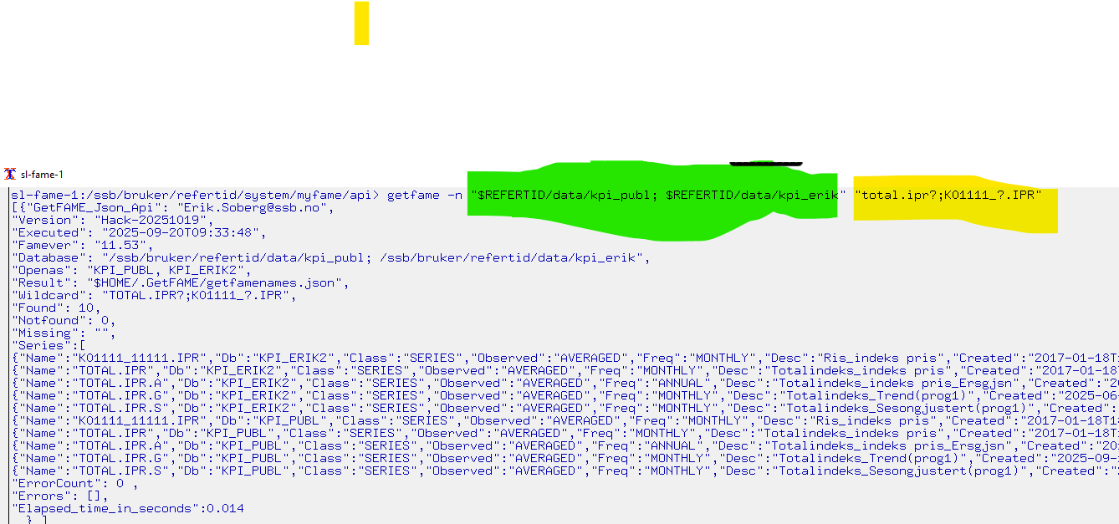
1. getfame -n gets FAME metadata

Slide 4
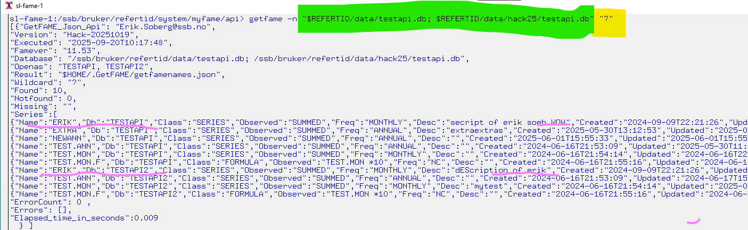
getfame –n identical databasenames & identical seriesnames ..

Slide 5
getfame -n Combine with linux commands to find descriptions / series, with correct or incorrect definitions The command below lists series, given 2 wildcards, but show only the one(s) containing the text «SUM»

Slide 6
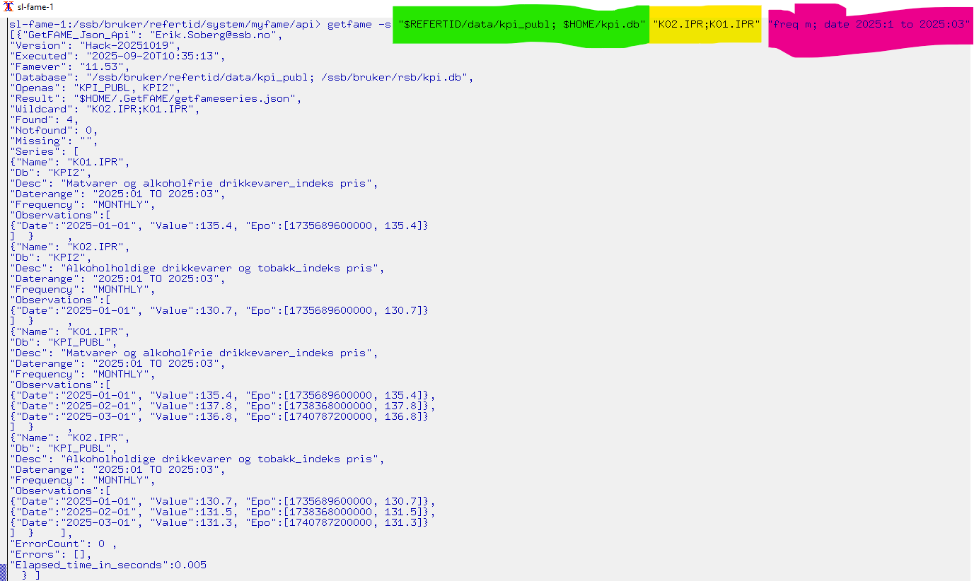
2. getfame -s gets observations from different databases.

Slide 7
getfame -s getfameseries samples
$REFERTID/system/myfame/api/getfame -s " /ssb/bruker/refertid/data/kpi_publ.db " "total.ipr"
getfame -s " /ssb/bruker/refertid/data/kpi_publ.db " "total.ipr; K0?IPR " "date 2024 "
getfame -s " /ssb/bruker/refertid/data/kpi_publ.db " "total.ipr" "freq m; date thisday(m)-5 to *"
getfame -s "$REFERTID/data/fornavn.db " "?ERIK;KRISTIN;JIM?" "date 2010 to 2012 "
getfame -s " /ssb/bruker/refertid/data/fornavn.db" "?JAN?" "date 2000 to 2005 "
getfame -s "pi1.db;cpi2.db;cpi_form.db" "Total.ipr? " " convert on; freq q;date 2025 ; deci 2"

Slide 8
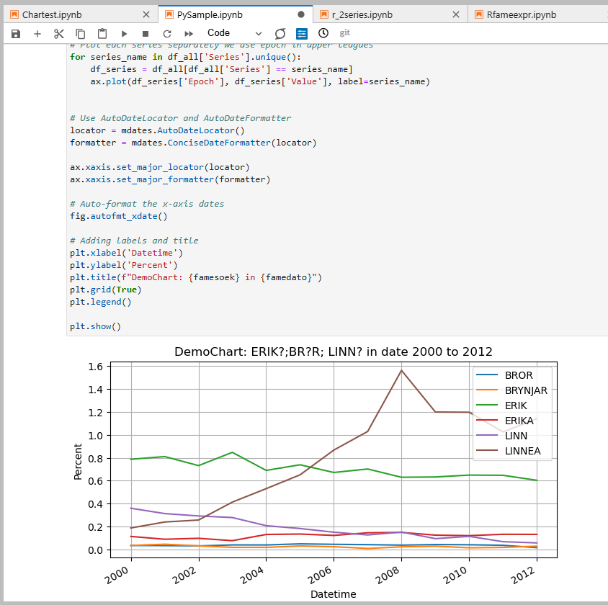
getfame –s jupyter with python:

Slide 9
3. getfame -e getfameexpression using FAME as the engine for calculation advanced mode
Data-observations, from FAME database(s) given one or more FAME-expression:
getfame -e "$REFERTID/data/fornavn.db " "mave(JIMMY,2); mave(LINN,3)" "date 2000 to 2010"
getfame -e "$REFERTID/data/fornavn.db " "Lsum(ERIK,EIRIK)" "date 2000 to *"
getfame -e "$REFERTID/data/fornavn.db " «SOLVEIG+PETER" "date 2000 to 2012"
getfame –e "$REFERTID/data/kpi_publ.db;mycpi.db " "convert(total.ipr,annual,constant) " "date *; deci 1 "
getfame -e "$REFERTID/data/kpi_publ.db; mycpi.db " "PCT(mycpi’K09.IPR)" "date 2025; deci 1 "
getfame -e "cpi1.db;cpi2.db;cpi_form.db" "cpi1’Total.ipr" "date 2025 ; deci 2"
Be aware to double quote arguments when they contain special char like : , ( ‘ ; or more expressions are used.
Fame names are NOT case sensitive.

Slide 10
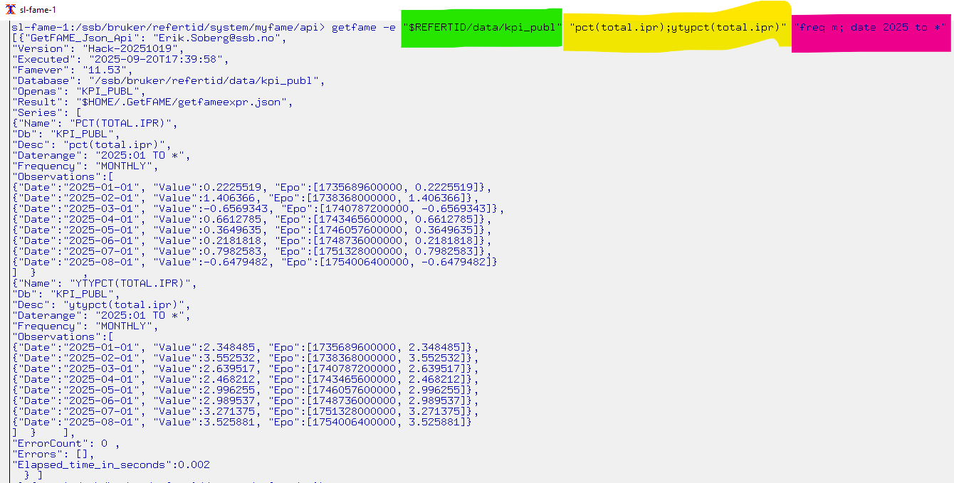
getfame –e fameexpression example

Slide 11
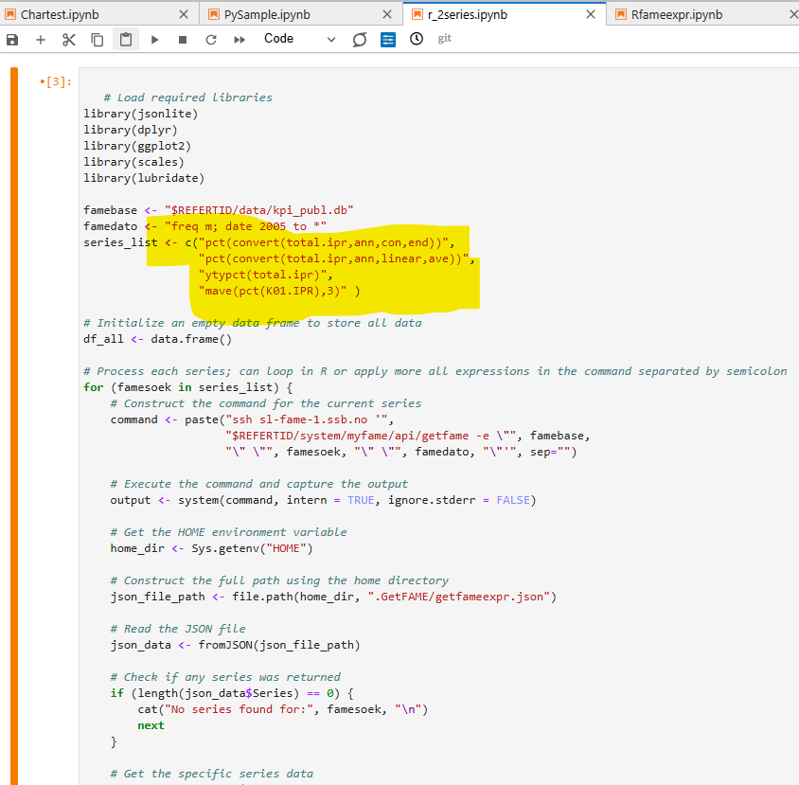
Using the power of FAME by getfame –e with R from Jupyterlab

Slide 12
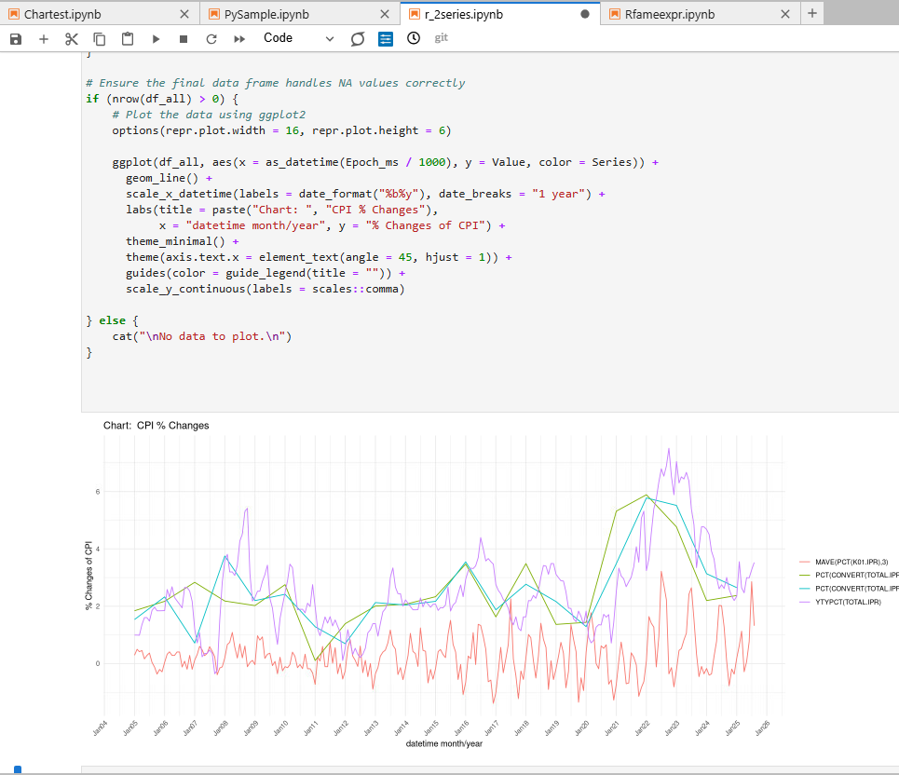
getfame -e R different expressions & frequences & functions

Slide 13
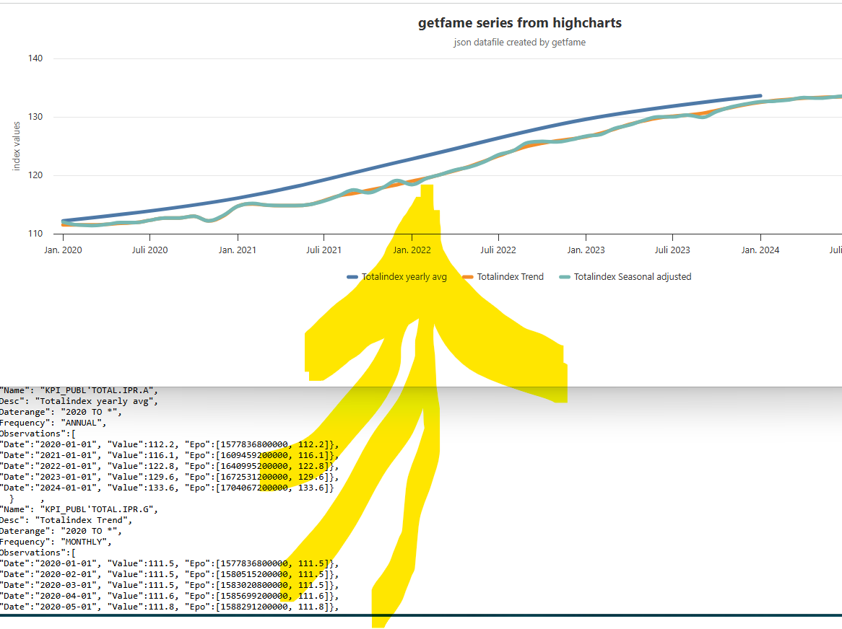
Interactive & zoomable chart with datetime as xaxis getfame –s & -e create JSON prepared for highcharts

Slide 14
Help info - when no arguments passed
getfame –n
getfame –s
getfame -e
For complete samples with R and Python, see Github

Slide 15
getfame Summary
The getfame –e option use the full power of FAME and can evaluate formulas, functions, conversions among various series, formulas,frequiencies and databases
To get more series with getfame –e «simply» loop by expressions and add to same charts or dataset. (R sample)
getfame –n is powerful when combining grep | more |head to search for series/formulas names or metadata
Use the Epo touplet, more robust, no date formatting, and smarter
Silent mode: getfame –nq getfame –sq getfame -eq

