Slide 1
Header
Credits
synopsis
Selected Play Title
Sort By:
Name
Selected play details:
Likely date of composition,
Genre,
wiki link, gutenberg link, Shakespeare.org link
description
Date
List of Plays
View Play Text

Slide 2
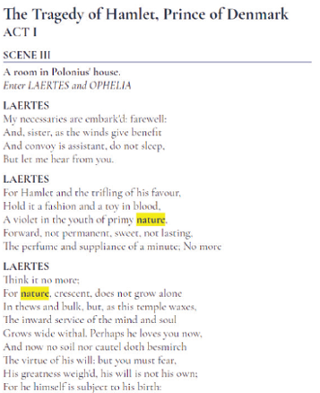
Header
Credits
Hamlet
Sort By:
Name
ACT I
Date
SCENE III
List of Plays
LAERTES
nature
Filter
Close

Slide 3
Header
Credits
Hamlet
ACT I
SCENE III
LAERTES
nature
Filter
Close

Slide 4
Header
Credits
Sort By:
Name
Date
Selected play details:
title, date, wiki link, gutenberg link
description
List of Plays
View Play Text

