Slide 1
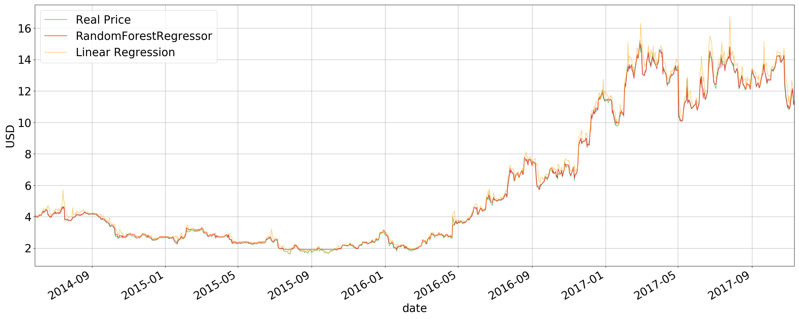
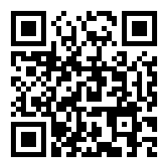
INTRODUCTION
The aim of this project was to use machine learning to predict the future of a certain stock on the stock market. The predictions are made using previously gotten data about a certain stock, up to 2017.
Predicting stocks based on performances through years.
CONCLUSION
RandomForestRegressor seemed to only work fine with the AMD stock. Linear Regression worked with all of the stocks. Although we tried to avoid overfitting using numerous methods, it still looks like the models are overfitting. Our models predicted the AMD stock best, as seen below. We have chosen to display AMD
FINDINGS
The data that is used is from a Kaggle dataset and it was split into three sections. 60% for training the algorithm, 30% for validation of the training and 10% for the for the test. Each stock contained data: date, opening price, highest price, lowest price, losing price and volume - how many transactions took place during that day.
 | AMD | MSFT | AAPL
Lin Reg. Score | 0.998 | 0.996 | 0.999
RandomForest Score | 0.999 | 0.998 | -1.25
Data from: https://www.kaggle.com/borismarjanovic/price-volume-data-for-all-us-stocks-etfs
Kernel as a base: https://github.com/NGYB/Stocks/blob/master/StockPricePrediction/StockPricePrediction_v3_mov_avg.ipynb
TRAINING THE MODEL
We used two machine learning algorithms: linear regression and random forest regressor
Stock: AMD
QR Code to the repo:

