Slide 1
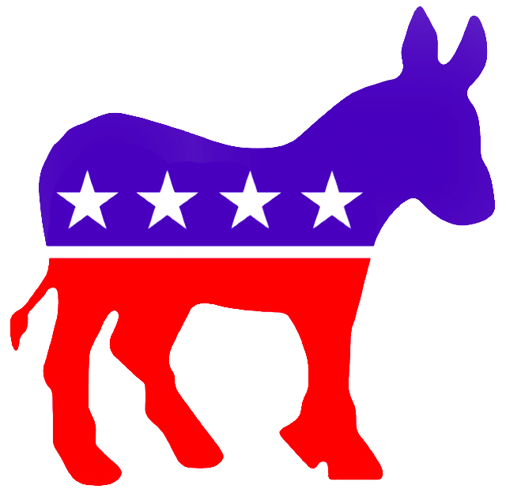

Kevin Kesicki.1
Matt Kujawinski.2
Erik Thiem.3
Partisan Speech
Analysis

Slide 2
What can we learn about political parties from their candidate's speeches?

Slide 3

Data
2 parties
3 elections
36 candidates
~1,000 speeches
~150,000 sentences

Slide 4
Naive Bayes
TODO: Matt

Slide 5
Perceptron
Python
SciPy and NumPy data structures
NLTK word tokenizing
NLTK stopwords

Slide 6
Perceptron Results
(training rate = 0.9)
Iterations | Accuracy | Time
1 | 64.14% | 2m3.836s
5 | 66.61% | 3m11.907s
10 | 66.74% | 4m40.678s
20 | 66.45% | 7m17.807s
50 | 66.96% | 15m20.602s
100 | 66.52% | 30m37.241s

Slide 7
Perceptron Weights
Top 10 Democratic words:
  hillaryclinton.com : 44.0
  bullying : 42.0
  richardson : 40.0
  michelle : 39.0
  ideological : 38.0
  partnering : 38.0
  blows : 36.0
  detection : 36.0
  intending : 36.0
  nurses : 35.0

Slide 8
Perceptron Weights
Top 10 Republican words:
  entitlement : -47.0
  conservatives : -40.0
  marshal : -39.0
  entitlements : -39.0
  enterprises : -39.0
  rancor : -38.0
  statehood : -38.0
  unborn : -37.0
  socialized : -36.0
  l. : -36.0

Slide 9
N-Gram
Python
nltk word_tokenizer
Store list of sentences with start and end tags
      “STARTSTARTSTART”
      “FINISHFINISHFINISH”

Slide 10
N-Gram – Gram Creation
ngrams = []
for each sentence in SENTENCE_DATA:
tokens = tokenize(sentence)
if tokens.length >= n:
for each token in tokens:
ngrams.add
(n-1 consecutive words, start with token)
for each gram in ngrams:
ngramCounter[gram] += 1
return ngramCounter.most_common()

Slide 11
N-Gram – Sentence Generation
Markov Model
P(x_{i} |x_{i-(n-1)}, …, x_{i-1}) = P(x_{i}, x_{i-(n-1)}, …, x_{i-1})/P(x_{i-(n-1)}, …, x_{i-1})
P(<word>|n-1gram) = P(ngram ending in <word>) P(n-1gram)
To generate sentence, begin with start tag, compute all P(<word>|(<start-tag>,<word>) and make a weighted selection

Slide 12
N-Gram – Sentence Generation
Costly computation, so save word-gram-probability combinations
[(<n-1gram>,[(ngram starting w n-1gram, # of occurrences)…])…]
  List of tuples
    Each tuple contains an n-1gram and a list of tuples
      Each tuple contains an ngram and its number of occurrences
Do this computation/storage until the end=tag is reached, at which point you have a sentence!

Slide 13
N-Gram – Sentence Generation
unigramBigramPairs = []
currentWord = “STARTSTARTSTART”
currentBigramList = []
for each (gram, amount) in PARTY_BIGRAMS:
if gram[0] == currentWord:
currentBigramList.add((gram, amount))
unigramBigramPairs.add
(currentWord, currentBigramList)
nextBigram = weighted_choice(currentBigramList)
currentSentence += “ ” + nextBigram[1]
currentWord = nextBigram[1]
while “FINISHFINISHFINISH” not in currentWord:
…

Slide 14
Bigrams
Republican Bigram Sentences:
  We do not outlaw embryo farming.
  Recent report was determined that create jobs and build.
  That’s the existing American Ambassador Wilkins, obligations, Colombia and embrace the Supreme Court will foster parents today than come here.
  None of the processionals who have the liberty because it’s fiscal conservatives believe in Iran’s leading overall reductions will cost our civil rights would never as ever more than most by January 1 percent among dual-parent families came back on less transparent about debates?
Democratic Bigram Sentences:
  We heard a government will get sick.
  Do every family shouldn’t really hope to Dr. Martin O’Malley?
  Senator Hillary Clinton’s shop in just flew in a phony birth announcement about changing how didn’t told me.
  But there was hardest for a Tax Credit so pleased that speaking out, and when say, to make a head of state of predatory loans to policies on the can’t-do, with action.

Slide 15
Trigrams
Republican Trigram Sentences:
  God bless the United States Senator and a time when everybody comes from God.
  Is this the greatest nation on earth?
  Today, too, seemed unimaginable.
  My former colleague, John Paul the Second Amendment, where dreamers can dream about where we stand united, and believing – believing in the false choice that we’re still on the path to equal opportunity in New Hampshire.
Democratic Trigram Sentences:
  We don’t get that cancer.
  It’s a diet of cynicism, in effect to veto our progress is not necessarily our troops today are no longer being deported form the fields of.
  No more excuses.
  That’s the real division lies – in Beijing and Bangalore.
  People are hurting.

Slide 16
Questions?

