Slide 1

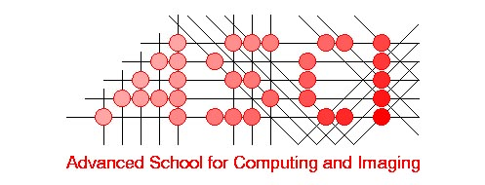
BEYOND THE WEB:
TOWARDS A BILLION-USER
DISTRIBUTED SYSTEM
Andrew S. Tanenbaum
Vrije Universiteit
Scientific Director, ASCI

Slide 2
OVERVIEW
What is the Internet?
What is the World Wide Web
Problems with the World Wide Web
Our research project: Globe
Distributed shared objects
Replication and consistency of objects
Locating objects
Security
Use of agents

Slide 3
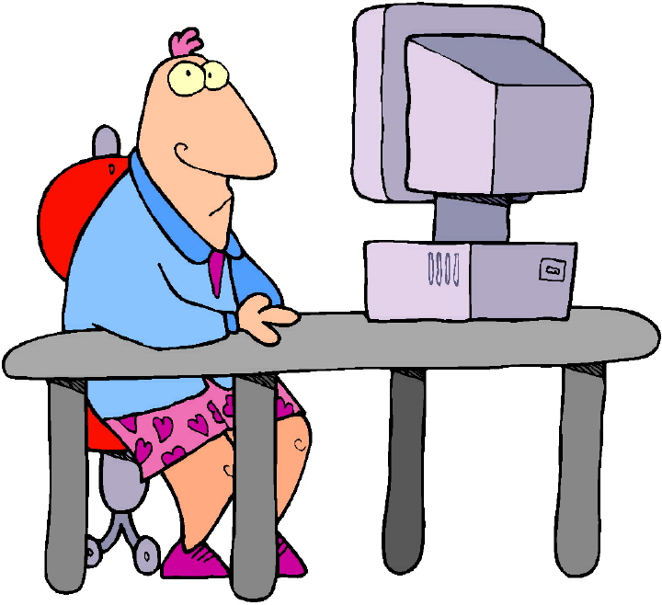
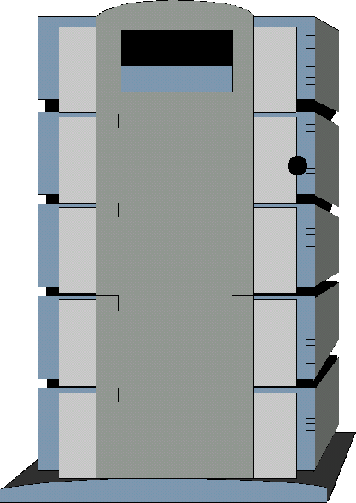
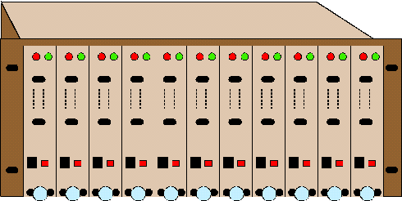
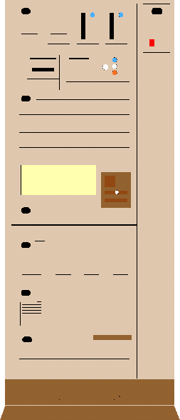
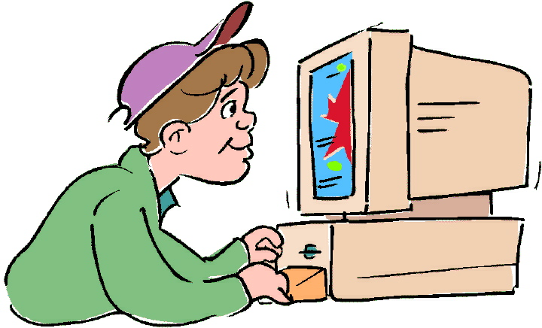
THE INTERNET
Fiber
Server
Router
Client
Leased line
Dial-up line

Slide 4
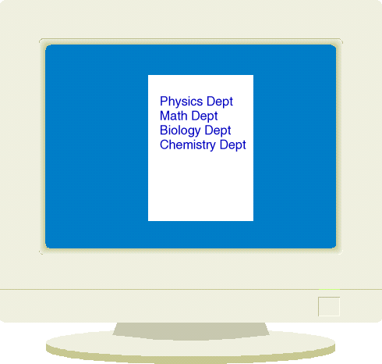
THE WORLD WIDE WEB
The Web is software that runs on the Internet
Other software includes email, FTP, newsgroups
Server side
Client side
Internet
Connection
Browser program
fetches Web pages
Web server
stores pages

Slide 5
THE WEB CONSISTS OF LINKED DOCUMENTS
Vrije Univ.
FEW
Medicine
Law
Economics
FEW
Faculty
Students
Courses
Research
Medicine
Faculty
Students
Courses
Research
Economics
Faculty
Students
Courses
Research
Law
Facu;ty
Students
Courses
Research

Slide 6
PROBLEMS WITH THE WEB
Intellectual model (documents) is too rigid
Does not work for many new applications
Does not scale well to large numbers of users
Security is practically nonexistent
Handles mobility poorly
Performance is terrible and getting worse

Slide 7
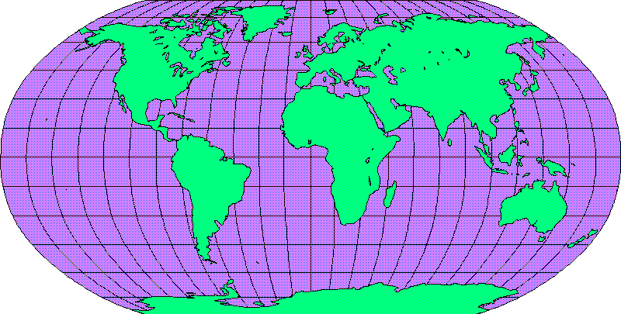
OUR RESEARCH: GLOBE
Invent a software framework for worldwide applications
Think of it as a possible successor to the Web

Slide 8
A DIFFERENT ABSTRACTION: OBJECTS
Instead of using documents, we use objects
An object consists of data plus operations
Examples of objects
  A Web page
  An email mailbox
  An appointment calendar
  A protein database
Objects can do anything their designer wants

Slide 9
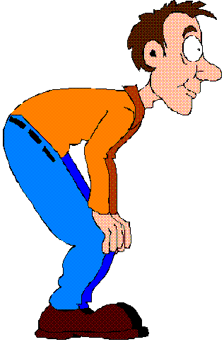


OBJECTS HAVE INTERFACES
An object is a ‘black box’
The user may not look inside an object
Objects have interfaces; all accesses go through them
This design separates functionality from implementation
Interface
Object

Slide 10
OBJECTS RESEMBLE PROGRAM LIBRARIES
Consider a math library in FORTRAN
Subroutines are available for
  square root
  sine
  cosine
  tangent
  …
A program can call a subroutine; not ask how it works

Slide 11
HOW TO USE OBJECTS ON THE INTERNET
Computer
Object A
Simple model: one copy + remote operations
Local operation:100 usec; remote:100 millisec
A
Internet
Operations
are remote

Slide 12
SCALABILITY
What to do if an object gets too many requests?
Replicate it
Can we get any guidance from local systems?

Slide 13
MULTIPLE COMPUTERS IN A ROOM
Mem-
ory
Mem-
ory
Mem-
ory
Mem-
ory
CPU
CPU
CPU
CPU
Multiprocessor
(shared memory)
CPU
Multicomputer
(no shared memory)
Network
CPU
Mem-
ory
CPU
CPU

Slide 14
DISTRIBUTED SHARED OBJECTS
Globe uses objects to simulate shared memory
Each object can distribute its data differently
Computer 1
Computer 2
Program
Local object
Interface
Distributed object
Computer 3
Computer 4

Slide 15
A REPLICATED OBJECT
Computer
Distributed object
A
A
A
Internet
A
A
Some computers have a copy of the data; some do not

Slide 16
READING OBJECTS
Read from
here is
done locally
Computer
A
A
A
Internet
A
A
Read from
here goes
over network

Slide 17
WRITING OBJECTS
Write done
here
More copies: easier reads and harder writes
A
A
A
Internet
A
A

Slide 18

THE CONSISTENCY PROBLEM
1. Write
done
here
Computer
3. Read
B
A
A
Internet
2. Update
4. Read
B
A
User gets obsolete data on operation 4

Slide 19
DISTRIBUTED SHARED OBJECTS (2)
Each object
  encapsulates operations and contents
  can be located on one or more machines
  has its own private replication algorithm
  has its own private consistency policy
  has its own private security policy

Slide 20
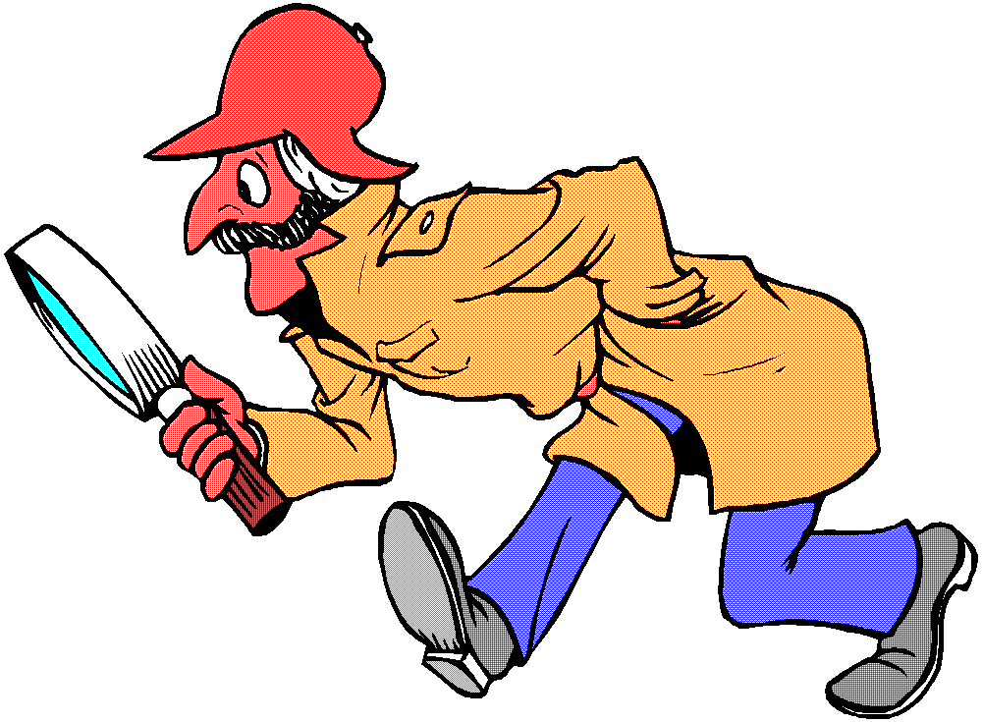
RESEARCH ON LOCATING OBJECTS
The problem
  We expect a trillion objects
  Objects are created and destroyed dynamically
  Objects can move at the speed of light
  How can we locate objects?
Cellular telephones
  Not very many
  Do not move fast
  Home-based solution

Slide 21

OBJECT LOCATION TREE
Before
After
Pointer
record
Europe
World
UK
USA
NL
NH
A’veen
A’dam
Contact
record
inserted
in A’dam
Object in
A’dam

Slide 22

LOOKING UP AN OBJECT
Pointer
record
USA
Request
goes up
the
tree
Contact
record
in A’dam
Lookup done in NY

Slide 23
POINTER CACHING
Cache
Cache
pointer
Cache hit
*
Address found
Lookup done
in Boston

Slide 24


MOBILE OBJECTS
Objects can move
Morning
Evening
If an object wanders, its contact record moves up
Cache pointers are to the stable contact record
Key issue: where to put the contact record

Slide 25



RESEARCH ON PERFORMANCE
Currently a separate connection is needed per item
We are looking at ways of packaging items together
AST’s page
Research
Courses
Papers
Internet
Software
Photos

Slide 26
GLOBEDOC
Idea here is to package content together
Where to place these packages?
Have multiple sites where an object could go
Need to dynamically decide where to place objects

Slide 27
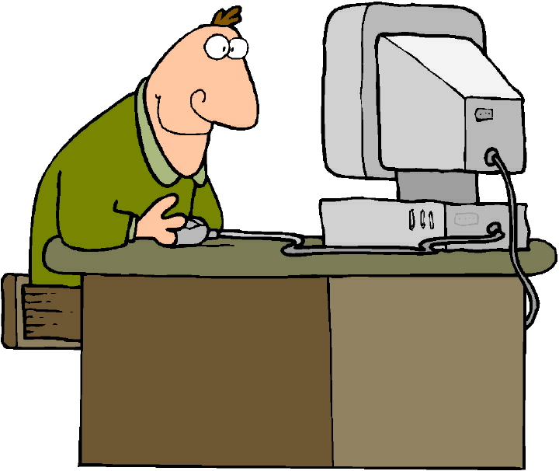
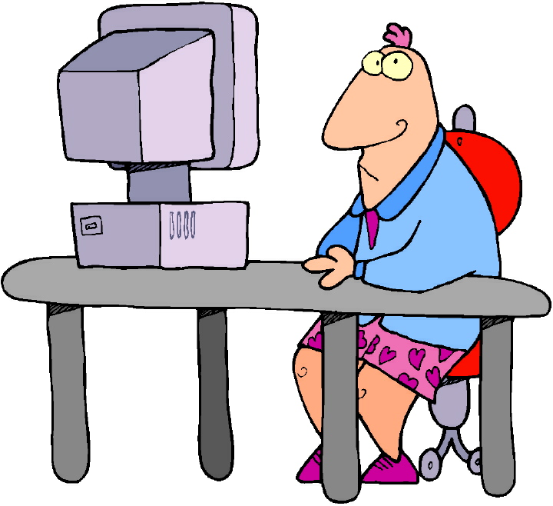
REPLICATION STRATEGIES
?

Slide 28
DYNAMIC PLACEMENT

Slide 29
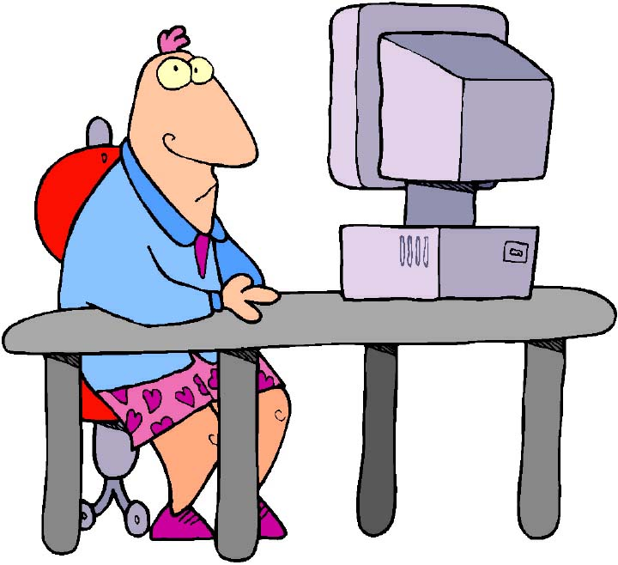
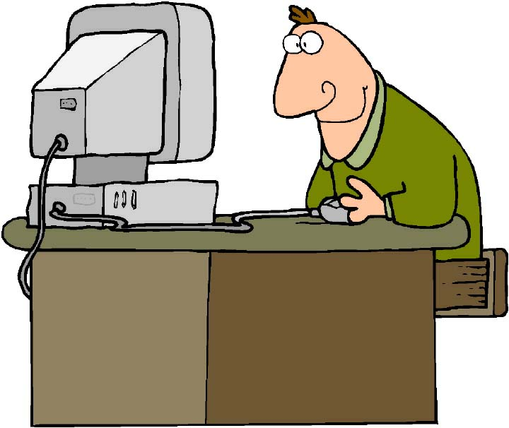
FLASH CROWDS
Document-specific policies

Slide 30
RESEARCH ON SECURITY
Issues
  Privacy (keeping secret data secret)
  Authentication (prove who you are)
  Authorization (who is allowed to do what?)
  Digital signatures (who can you trust?)
  Nonrepudiation (Not being able to deny things later)
Applications
  Electronic commerce
  On-line banking and investing in stocks
  On-line voting

Slide 31
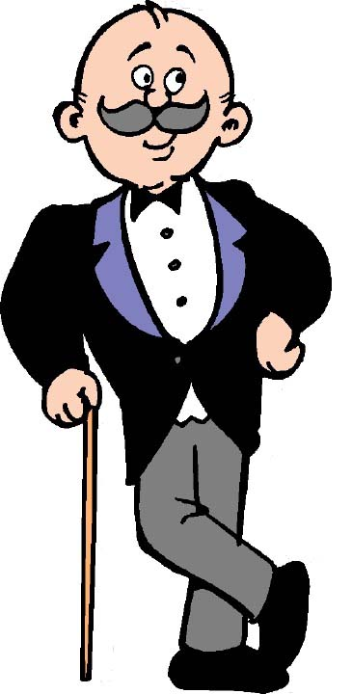
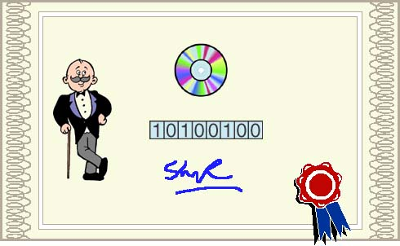
ROLE-BASED SECURITY
Principals
Objects have methods
A set of methods on an object is a role
To use a secure object you need a role certificate
1
0
1
0
0
1
0
0
Principal
Bit map for
an object
Certificate

Slide 32
USE OF ROLE CERTIFICATES

Slide 33
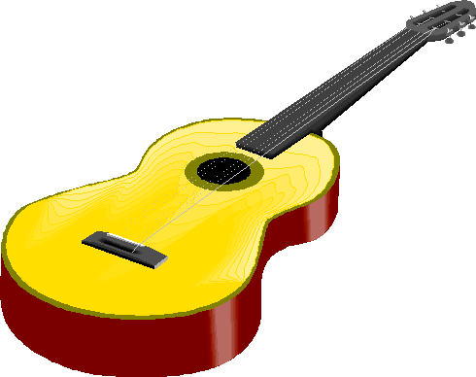

SALE OF E-PRODUCTS
Music
server
Alice buys
some music
How do we prevent
her from giving a
copy to Bob?
Alice
Bob

Slide 34
POSSIBLE SOLUTION
Music
server
Music is encrypted
with a key stored safely
on Alice’s sound card.
It is also fingerprinted
for her machine and
personally water-
marked
Bob doesn’t
have the key
Alice
Bob

Slide 35

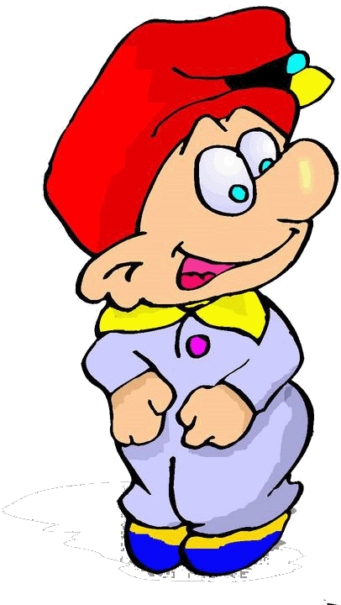
WORLDS AND ROOMS
World
Object
Room
Entry
room
Agent
Agents are active; objects are passive
Changes the model from linked documents to linked rooms

Slide 36

AGENTS
Agent’s
itinerary
Agents are intelligent
They can move from room to room
Agents can negotiate with other agents
Applications: auctions, buying and selling raw materials

Slide 37
GLOBE DISTRIBUTION NETWORK
Globe Distribution Network - Distributing free software
Packaging software distributions
Replication and fault tolerance
Security: don’t vet packages, do arrange for traceability
Poster of a package needs to have signed certificate
If content is later shown to be illicit, poster can be traced

Slide 38
CONCLUSION
Globe is a new way of building Internet applications
It is based on distributed shared objects
Each object has its own policies
  Replication
  Consistency
  Security
  etc.

Slide 39
SUMMARY OF RESEARCH
Object location
Mobile objects
Packaging of components in an object
Replication algorithms
Consistency algorithms
Security
Mobile agents

Slide 40
FOR MORE INFORMATION
www.cs.vu.nl/globe/

