Slide 1


Transposition Driven Work Scheduling in Distributed Search
John W. Romein
Aske Plaat
Henri E. Bal
Jonathan Schaeffer
Department of Computer Science
vrije Universiteit amsterdam
Department of Computing Science
University of Alberta
Notes:
try-out AAAI
audience ... familiar AI & heur srch, ! // & distr
20 min + questions
quest. after talk
present our paper ...
together with ...

Slide 2
Transposition tables
Transposition table contains values for positions that have been searched before
Accessed 1000s times per second
Problem: how to share transposition tables efficiently on a distributed-memory system
TDS solves this problem for 1-person games (puzzles)
2-person TDS would be more complicated

Slide 3
Outline
Traditional parallel search + distributed transposition tables
Transposition Driven Scheduling
Performance comparison
Summarize TDS advantages
Conclusions
Notes:
outline
trad WS ... problems ... large distr sys
new appr: TDS ... issues
extensive perf comp ... show perf res
summ adv ... related work ... concl

Slide 4
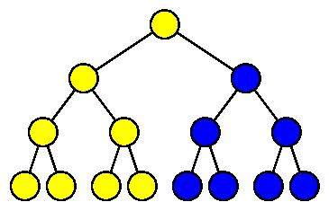
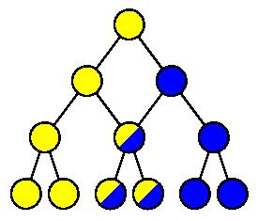
Traditional search: the search algorithm
Parallel IDA*
  Uses work-stealing
Many games have transpositions
  Same position reached through
  different sequence of moves
A transposition table caches positions
that have been analyzed before
Notes:
originally, IDA* without TT
IDA* //ized ... WS ... fig
proc srchs subtr indep
1 proc yellow ...
idle ... sel ... steals unproc’d node
srchs blue ... report
easy impl, little comm ovh
without TT ... dupl work
imagine ... multpl parents ...
TT ... avoid

Slide 5
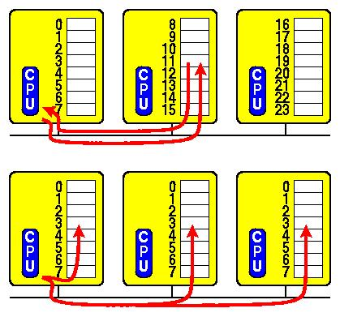
Traditional search: the distributed transposition table
Partitioned (based on a hash function)
  More processors ⇒ increased table size
  high lookup latency (blocking reads)
Replicated
  updates expensive (broadcast writes)
Notes:
distr ... shared ... effective ... seen
not shared → subtr multpl ... not know
several ways
fig ... part ; owns part
adv
11
lookup cont 11 ... req ... waits for repl
repl ... fig
entire
lookup locally ... updates broadcast
< 16: no problem ... many: flooded
br msg rcvd → handling inc msgs
not attr way

Slide 6
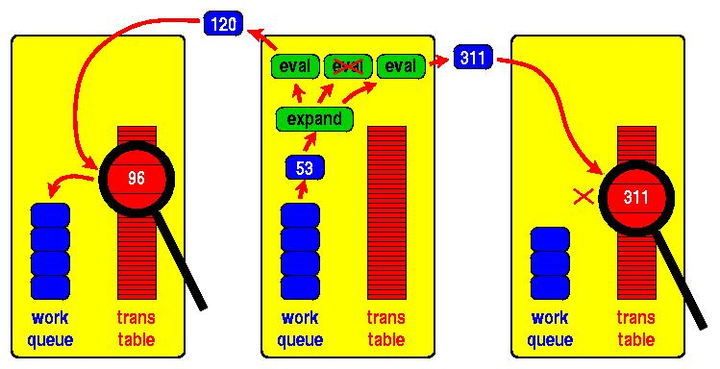
Transposition Driven Scheduling
Integrates IDA* and transposition table
Send work to table (non-blocking)
Advantages:
  All communication is asynchronous
  Asynchronous messages can
  be combined
Notes:
paper ... new appr ... solves
TDS ... integr shed // IDA* with TT
idea ... part ... send work ... data
fig ... expl TDS works
proc ... local work queue + part TT
takes job, expands. destroy
3 children. eval adm ev f.
pruned if ev val > srch bound
not pruned → hashed ... unif distr
sent ... corr TT entry
lookup
not searched → entered TT + queue
found → transp, pruned
target → solved
run out of work → curr IDA* it finished. later

Slide 7
Performance
Approaches:
  TDS : Transposition Driven Scheduling
  WS/Part : Work Stealing + Partitioned tables
  WS/Repl : Work Stealing + Replicated tables
Notes:
extensive perf comp TDS, WS/P, WS/R
3 apps
15-puzzle ... state-of- ...
reduce covh ... remote TT ... WSP & WSR
double-blank ... 15 removed ...
fig ... target
2 blanks ... many transps ... consec .. blanks intch
Rubik’s
perf meas ... distr ... 128 PPros ... 1.2 Gbit/s Myri
optimized

Slide 8
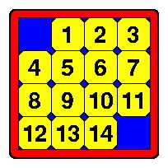
Performance
Applications:
  15-puzzle
  double-blank puzzle
  Rubik’s cube
128 Pentium Pros, 1.2 Gbit/s Myrinet
Highly optimized
  WS/Part uses customized network firmware [ICPP ’98]
Notes:
extensive perf comp TDS, WS/P, WS/R
3 apps
15-puzzle ... state-of- ...
reduce covh ... remote TT ... WSP & WSR
double-blank ... 15 removed ...
fig ... target
2 blanks ... many transps ... consec .. blanks intch
Rubik’s
perf meas ... distr ... 128 PPros ... 1.2 Gbit/s Myri
optimized

Slide 9
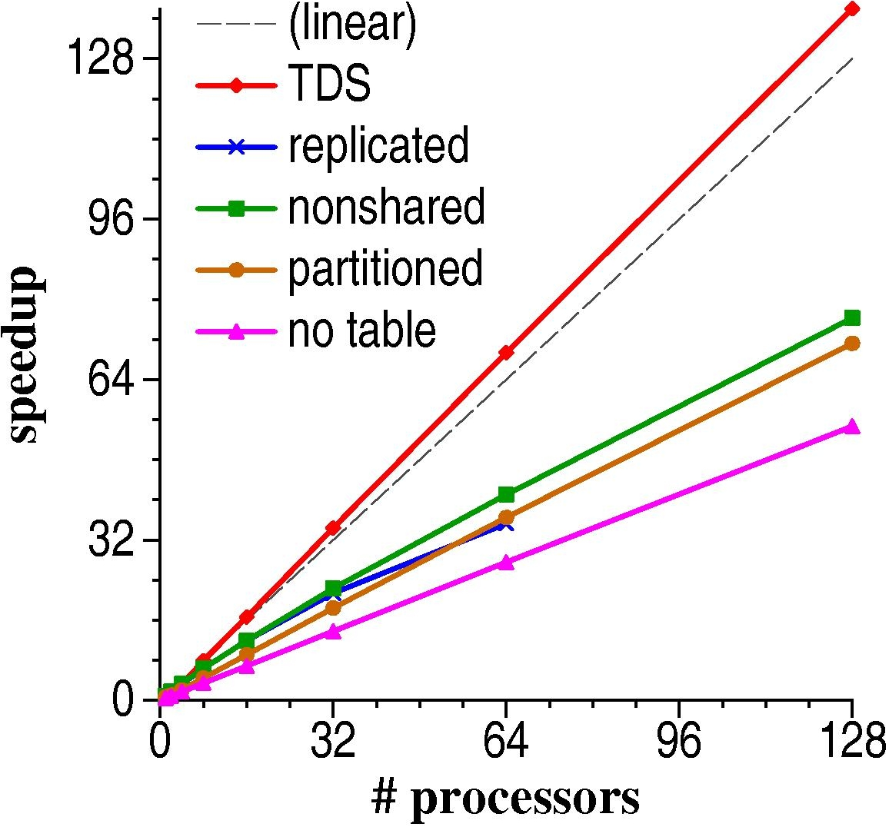
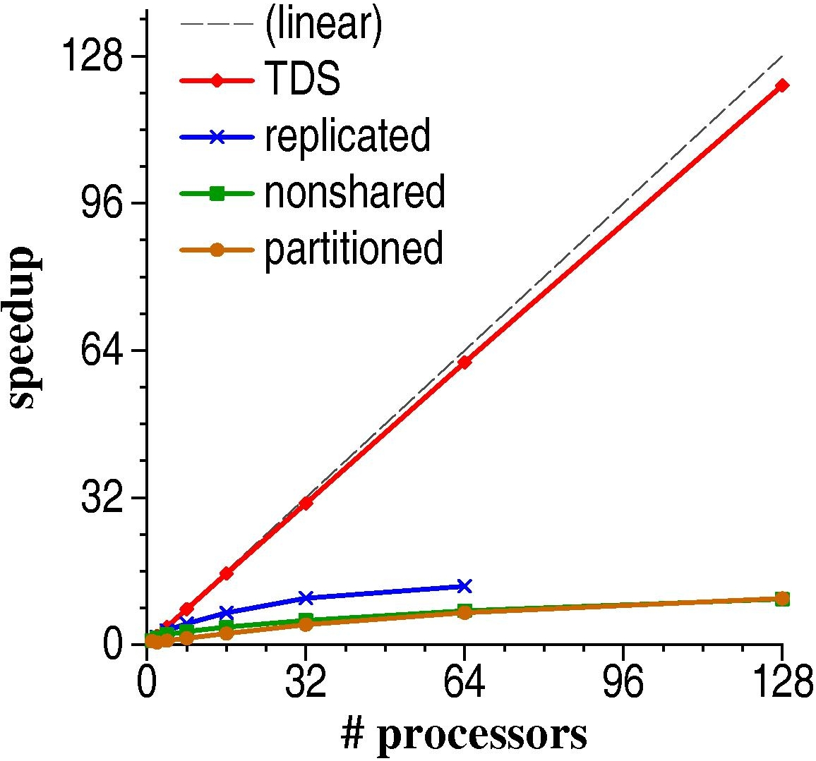
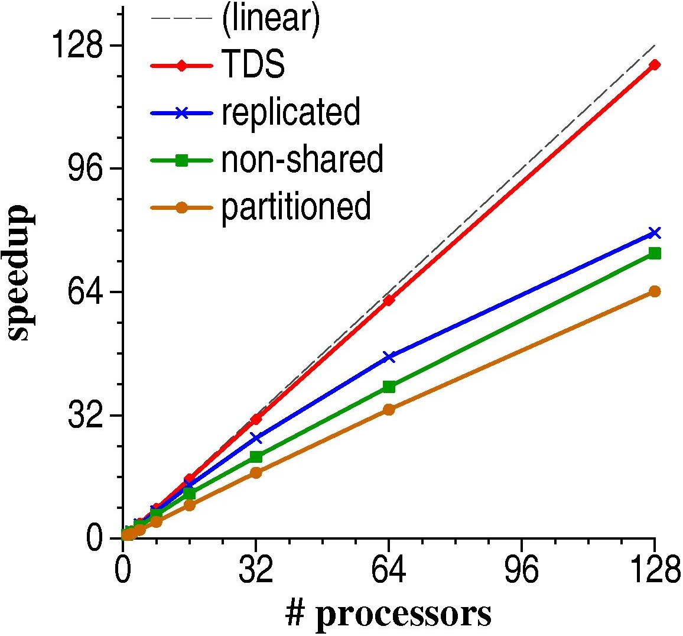
Performance (Cnt’d)
15-puzzle
double-blank puzzle
Rubik’s cube
Notes:
Figs avg speedups ≤ 128 procs
relative
TDS > WSP, WSR
scales ... close to optimal
WSP ... latencies ... network firmware
WSR ... broadcast
next slide

Slide 10
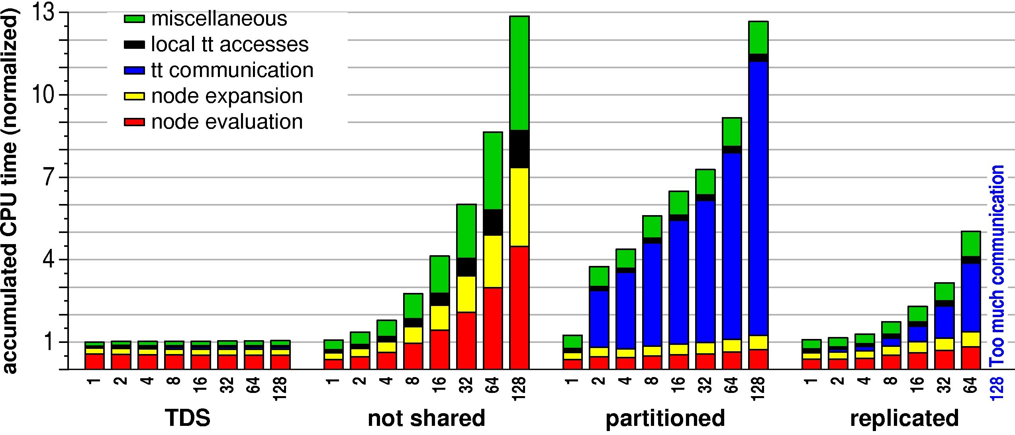
Performance breakdown (double blank puzzle)
Notes:
2 factors ... #proc > : covh & sovh
fig ... ovhs ... double-blank
diff y-axises
left: Sovh=#N(p)/#N(1)
sovh TDS (red) < 1
32 procs ≥ ... 12% < nodes than 1 proc;
incr TT size
WSP too ... still > nodes.
updates after ... same moment
covh=... ; WS/P >80%, WS/R >50%, TDS 18%
Right: speedup, deps on covh and sovh
TDS nearly opt; compensated sovh
ovh WSP & WSR

Slide 11
TDS advantages
No duplicate searches
Table access is local
Communication is non-blocking
Scales well
No separate load balancing
Notes:
adv TDS
TT avoids
read + writes no comm
comm work msg async .. no req-repl
scales
TDS not ... auxiliary load bal
empircal res ... hash func

Slide 12
Conclusions
TDS
  scheduling algorithm for parallel search
  integrates parallel IDA* with transposition table
Performance comparison
  TDS scales well and outperforms work-stealing
Illustrates power of asynchronous communication
Same approach was used to solve Awari
Notes:
conclusions
TDS, new sched alg // single-ag srch
sched alg intergr // IDA* with TT
extensive perf comp TDS & trad WS ... appls
scales ... large #procs
outperfs WS

