Slide 1

Solving Awari using Large-Scale
Parallel Retrograde Analysis
John W. Romein
Henri E. Bal
Vrije Universiteit, Amsterdam
Notes:
new cluster
talked with Henri
challenging apps
solve awari
enthousiastic
3 weeks
let's do it
1:15

Slide 2
introduction: awari
3500-year old board game
best-known mancala variant
  wari, owari, wale, awale, ...
determine score for 889,063,398,406 positions
  retrograde analysis
  144 CPUs, 72 GB RAM, 1.4 TB disks, Myrinet
Notes:
board game
3500 years
Africa; played worldwide
mancala
many names
889 billion positions
retrograde analysis
new cluster
1:45

Slide 3
outline
rules of awari
databases
(parallel) retrograde analysis
performance
verification
new game insights
www: awari oracle
Notes:
1:30

Slide 4
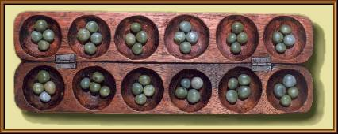
rules of awari
sow counterclockwise
capture if last, enemy pit contains 2 or 3 stones
goal: capture majority of stones
Notes:
board
player: 6 pits
(auxiliary pits)
move from non-empty pit
sow
caputure
(repeat)
goal: >24 stones (humiliate)
ends if cannot move
must give move
repetition
2:20

Slide 5
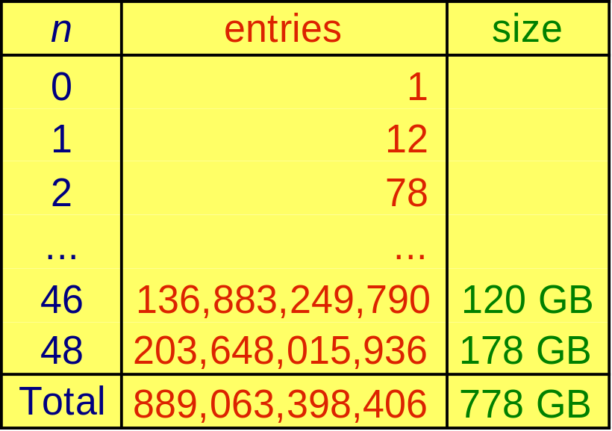
awari databases
build n-stone databases (n = 0, 1, ... , 46, 48)
  entry ⇔ board
  entry contains score (-n ... +n)
  south to move
Notes:
construct databases
split w.r.t. stones on board
entry ⇔ board, functions
-48 <= score <= 48
7 bits
next slide
north to move -> rotate
table
largest: 204 billion, 178 GB
largest DB for whichever game
cannot split
total
2:40

Slide 6
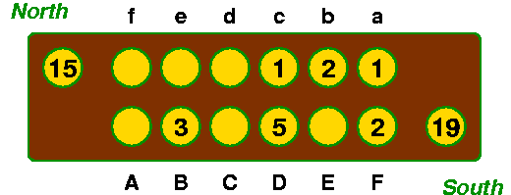
scores
best move depends on remaining stones
  not on captured stones!
final result = Δ captured stones + score
score = eventual division of remaining stones
score = +2 (8−6)
south to move
Notes:
best move depends on remaining stones
not captured
contribute to final
interesting: remaining stones after optimal play
score, stored in DB
example: 14 stones
DB: +2 (south 8, north 6)
south adv +4; eventually +6 (27-21)
1:40

Slide 7
database construction: retrograde analysis
4
initial state
1
4
3
1
6
4
2
3
1
1
4
6
2
4
MiniMax tree (DCG)
search state space bottom-up
final states
Notes:
contruct DB RA
state space
nodes = positions = entries
edges
root
final states
values in final states
negamax
bottom-up
determine root
pos -> win
DCG

Slide 8
10-bit retrograde analysis
best score (7 bits) + nr. unknown children (3 bits)
inform parent if score becomes known
1
2
1
1
0
1
0
1
0
0
0
2
0
2
?
?
?
2
1
2
Notes:
essention simple (nontrivial issues)
7 + 3
inform parent
1:00

Slide 9
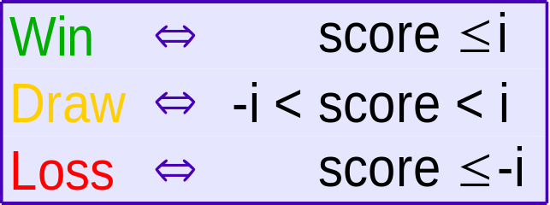
2-bit retrograde analysis
2 bits/entry in RAM: Win/Draw/Loss/Unknown
search n times with widening window (-i, i)
PROCEDURE CreateDatabase(n) IS
FOR i IN 1 ... n DO
Window := (-i, i);
SetLeaves(); // handle terminal states and captures
BottomUpSearch();
CollectScores();
Notes:
tell more about new // alg
based on seq Lincke & Marzeta
2 bits, 4 states:
2:00

Slide 10
bottom-up search
PROCEDURE CheckState(node) IS
IF state [node] = unknown AND AllChildrenAreWins(node) THEN
state [node] := loss;
SetParentsToWin(node);
CheckStateOfGrandParents(node);
W
U
W
U
ÔW
U
ÔL
W
W
W
W

Slide 11
parallel retrograde analysis
partition database
receive queue with work
migrate work (asynchronously)
global termination detection
W
U
W
U
ÔW
U
ÔL
W
W
W
W

Slide 12
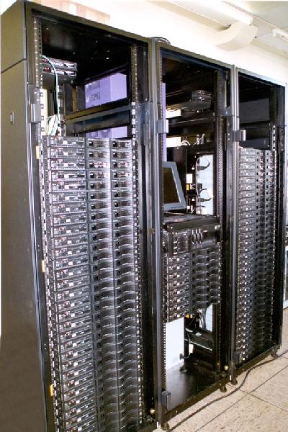
performance (1/3)
72 x
  dual 1.0 GHz Pentium III
  1 GB RAM
  20 GB disk
  2.0 Gb/s Myrinet
Myrinet switch
Notes:
1:00

Slide 13
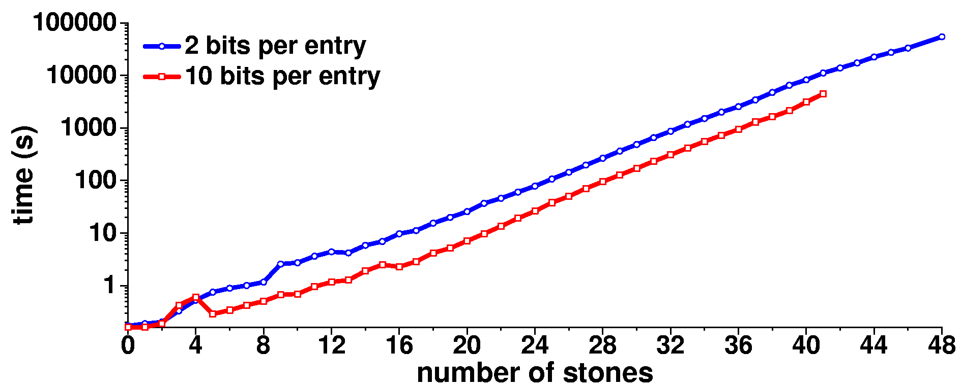
performance (2/3)
48-stones: 15 hours
total: 51 hours
Notes:
This figure shows the computation times for the 2 and the 10-bit algorithm. The 2-bit algorithm is slower, but is able to solve the larger databases, unlike the 10-bit algorithm. There is some noise in the sub-second area. We see that the execution times grow exponentially with the number of stones.
Computation of the 48-stone database took a little over 15 hours, and using the fastest available algorithm, about 51 hours were needed to compute all databases.

Slide 14
performance (3/3)
communication
  20 − 30 MB/s send + receive per SMP node
  1.4 − 2.1 GB/s through switch
  130 TB in total = 1.0 Pb !
disk I/O
  ∼ 10 TB in total
Notes:
0:50

Slide 15
verification
hardware:
  ECC RAM, cache, and Myrinet memory
  CRC communication and disk checksums
software:
  2 algorithms give identical results (up to 41 stones)
  recomputed using 64 SMPs
  NegaMax integrity check
  compared statistics with others (up to 36 stones)
Notes:
We have executed quadrillions of instructions, sent terabytes of data, and stored hundreds of gigabytes of data on disk. How do we known that the databases are correct? The hardware, the application, and the operating system can fail, but there are several indications that errors are unlikely.
The hardware uses error correcting codes on both the main memory and the memory on the Myrinet network card. Moreover, CRC checks are computed and verified for data that is sent over the network and data that is written to disk.
But this does not procect us against errors in the software. During the development of the program, we discovered a few nasty race conditions

Slide 16
new awari insights
awari is a draw
best opening move: F4
  other opening moves are losing!
to capture is not always the best choice
  in 22% of cases, it is not

Slide 17
the awari oracle
web server (being worked on)
  lookup positions
  interactive play
  download
  statistics
requires 5 x 160 GB disks
http://awari.cs.vu.nl/

Slide 18
conclusions
awari is solved and is a draw
parallel retrograde analysis
  overlap computation, communication and disk I/O
required:
  score determination of 889,063,398,406 positions
  large parallel system
    51 hours computation time
    1.0 Pb communication

