Slide 1
The Globus Project:
A Status Report
Ian Foster
Carl Kesselman
http://www.globus.org

Slide 2
Why “The Grid”?
New applications based on high-speed coupling of people, computers, databases, instruments, etc.
  Computer-enhanced instruments
  Collaborative engineering
  Browsing of remote datasets
  Use of remote software
  Data-intensive computing
  Very large-scale simulation
  Large-scale parameter studies

Slide 3
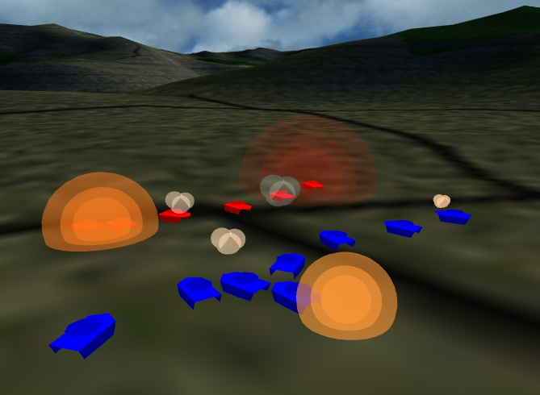
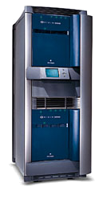
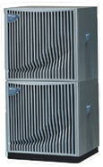

SF-Express: Distributed Interactive Simulation
Caltech
Exemplar
NCSA
Origin
Issues:
  Resource discovery, scheduling
  Configuration
  Multiple comm methods
  Message passing (MPI)
  Scalability
  Fault tolerance
Maui
SP
Argonne
SP
“200 GB memory,
100 BIPs”
P. Messina et al., Caltech

Slide 4
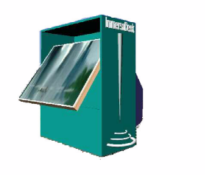


The Grid
“Dependable, consistent, pervasive access to
[high-end] resources”
Dependable: Can provide performance and functionality guarantees
Consistent: Uniform interfaces to a wide variety of resources
Pervasive: Ability to “plug in” from anywhere

Slide 5
Technical Challenges
Complex application structures, combining aspects of parallel, multimedia, distributed, collaborative computing
Dynamic varying resource characteristics, in time and space
Need for high & guaranteed “end-to-end” performance, despite heterogeneity and lack of global control
Interdomain issues of security, policy, payment

Slide 6
The Globus Project
Basic research in grid-related technologies
  Resource management, QoS, networking, storage, security, adaptation, policy, etc.
Development of Globus toolkit
  Core services for grid-enabled tools & applns
Construction of large grid testbed: GUSTO
  Largest grid testbed in terms of sites & apps
Application experiments
  Tele-immersion, distributed computing, etc.

Slide 7
Globus Approach
A toolkit and collection of services addressing key technical problems
  Bag of services model
  Not a vertically integrated solution
Distinguish between local and global services
  “IP hourglass” model

Slide 8
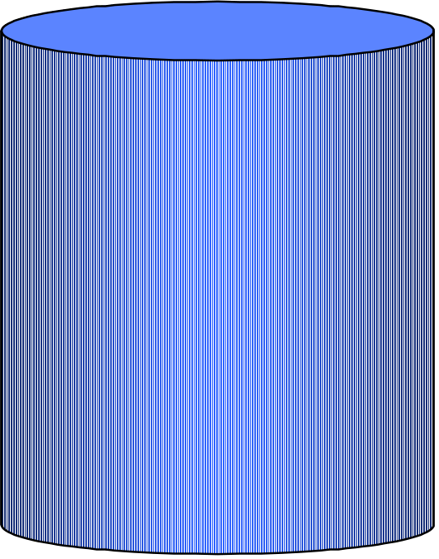
Globus Approach
Focus on architecture issues
  Propose set of core services as basic infrastructure
  Use to construct high-level, domain-specific solutions
Design principles
  Keep participation cost low
  Enable local control
  Support for adaptation
A p p l i c a t i o n s
Diverse global services
Core Globus
services
Local OS

Slide 9
Layered Architecture
Applications
GlobusView
High-level Services and Tools
Testbed Status
DUROC
MPI
MPI-IO
CC++
Nimrod/G
globusrun
Core Services
Nexus
Metacomputing Directory Service
Globus Security Interface
GRAM
Heartbeat Monitor
Gloperf
GASS
Condor
MPI
Local Services
TCP
UDP
LSF
Easy
NQE
AIX
Irix
Solaris

Slide 10
Core Globus Services
Communication infrastructure (Nexus, IO)
Information services (MDS)
Network performance monitoring (Gloperf)
Process monitoring (HBM)
Remote file and executable management (GASS and GEM)
Resource management (GRAM)
Security (GSI)

Slide 11
Sample of High-Level Services
Communication & I/O libraries
  MPICH, PAWS, RIO (MPI-IO), PPFS, MOL
Parallel languages
  CC++, HPC++
Collaborative environments
  CAVERNsoft, ManyWorlds
Others
  MetaNEOS, NetSolve, LSA, AutoPilot, WebFlow

Slide 12

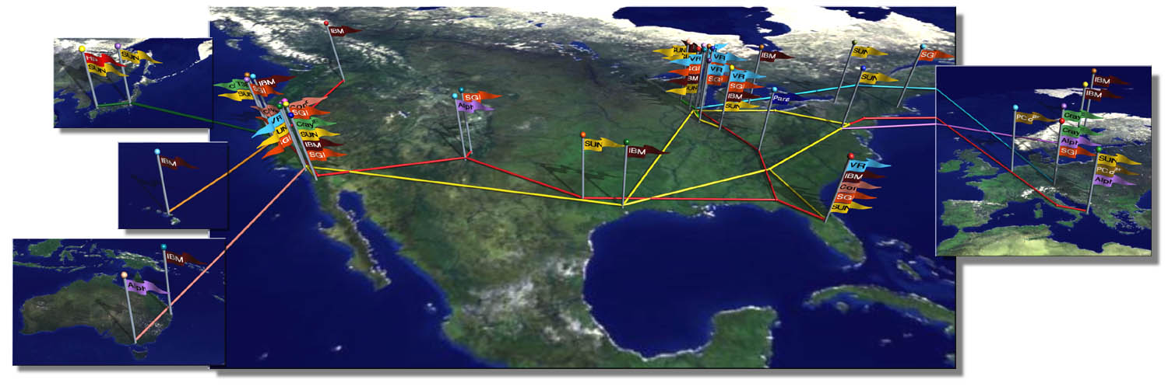
GUSTO Computational Grid Testbed: November 1998

Slide 13
Example Application Projects
Real-time, collaborative analysis of data from X-Ray source (and electron microscope)
Interactive modeling and data analysis
Collaborative engineering (“tele-immersion”)
  CAVERNsoft @ EVL, Metro @ ANL
Distributed interactive simulation
  Record-setting SF-Express simulation
Remote visualization and steering for astrophysics
  Including trans-Atlantic experiments

