Slide 1
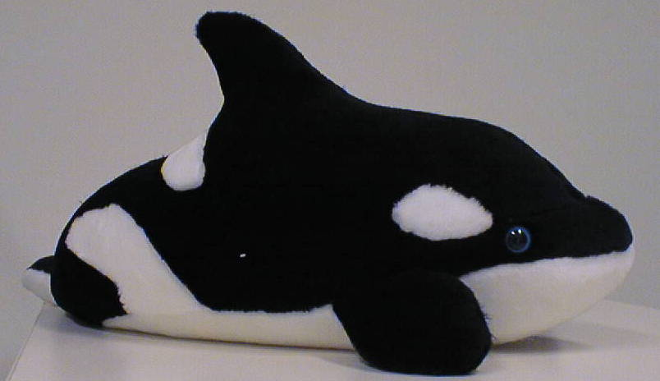
Orca
A language for parallel programming of distributed systems

Slide 2

Orca
Parallel language designed at VU
Design and first implementation (‘88-’92):
  Bal, Kaashoek, Tanenbaum
Portable Orca system (‘93-’97):
  Bal, Bhoedjang, Langendoen, Rühl, Jacobs, Hofman
Used by ~30 M.Sc. Students

Slide 3
Overview
Shared data-object model
Processes
Condition synchronization
Example: TSP

Slide 4
Orca’s Programming Model
Explicit parallelism (processes)
Communication model:
  Shared memory: hard to build
  Distributed memory: hard to program
Idea: shared memory programming model on distributed memory machine
Form of Distributed shared memory (DSM)

Slide 5
Shared Data-object Model
Shared data encapsulated in objects
Object = variable of abstract data type
Shared data accessed by user-defined, high-level operations
Enqueue( )
Object
Local data
Dequeue( )

Slide 6
Semantics
Each operation is executed atomically
  As if operations were executed 1 at a time
  Mutual exclusion synchronization
  Similar to monitors
Each operation applies to single object
  Allows efficient implementation
  Atomic operations on multiple objects are seldom needed and hard to implement

Slide 7
Implementation
System determines object distribution
It may replicate objects (transparently)
CPU 1
CPU 2
CPU 1
CPU 2
Network
Network
Single-copy object
Replicated object

Slide 8


Object Types
Abstract data type
Two parts:
  Specification part
    ADT operations
  Implementation part
    Local data
    Code for operations
    Optional initialization code

Slide 9
Example: Intobject
Specification part
object specification IntObject;
operation Value(): integer;
operation Assign(Val: integer);
operation Min(Val: integer);
end;

Slide 10
Intobject Implementation Part
object implementation IntObject;
X: integer; # internal data of the object
operation Value(): integer;
begin
return X;
end;
operation Assign(Val: integer);
begin
X := Val;
end
operation Min(Val: integer);
begin
IF Val < X THEN X := Val; FI;
end;
end;

Slide 11
Usage of Objects
# declare (create) object
MyInt: IntObject;
# apply operations to the object
MyInt$Assign(5);
tmp := MyInt$Value();
# atomic operation
MyInt$Min(4);
# multiple operations (not atomic)
IF MyInt$Value() > 4 THEN
MyInt$Assign(4);
FI;

Slide 12
Parallelism
Expressed through processes
  Process declaration: defines behavior
  Fork statement: creates new process
Object made accessible by passing it as shared parameter (call-by-reference)
Any other data structure can be passed by value (copied)

Slide 13
Example (Processes)
# declare a process type
process worker(n: integer; x: shared IntObject);
begin
#do work ...
x$Assign(result);
end;
# declare an object
min: IntObject;
# create a process on CPU 2
fork worker(100, min) on (2);

Slide 14
Structure of Orca Programs
Initially there is one process (OrcaMain)
A process can create child processes and share objects with them
Hierarchy of processes communicating through objects
No lightweight treads

Slide 15
Condition Synchronization
Operation is allowed to block initially
  Using one or more guarded statements
Semantics:
  Block until 1 or more guards are true
  Select a true guard, execute is statements
  operation name(parameters);
  guard expr-1 do statements-1; od;
  ....
  guard expr-N do statements-N od;
  end;

Slide 16
Example: Job Queue
object implementation JobQueue;
Q: “queue of jobs”;
operation addjob(j: job);
begin
enqueue(Q,j);
end;
operation getjob(): job;
begin
guard NotEmpty(Q) do
return dequeue(Q);
od;
end;
end;

Slide 17
Traveling Salesman Problem
Structure of the Orca TSP program
JobQueue and Minimum are objects
Slave
Master
JobQueue
Slave
Minimum
Slave

Slide 18
Performance Issues
Orca provides high level of abstraction
  ⇒ easy to program
  ⇒ hard to understand performance behavior
Example: X$foo() can either result in:
  function call (if X is not shared)
  monitor call (if X is shared and stored locally)
  remote procedure call (if X is stored remotely)
  broadcast (if X is replicated)

Slide 19
Performance model
The Orca system will:
  replicate objects with a high read/write-ratio
  store nonreplicated object on ``best’’ location
Communication is generated for:
  writing replicated object (broadcast)
  accessing remote nonreplicated object (RPC)
Programmer must think about locality

Slide 20
Summary of Orca
Object-based distributed shared memory
  Hides the underlying network from the user
  Applications can use shared data
Language is especially designed for distributed systems
User-defined, high-level operations

