Slide 1
OA4118: Music Data
MAJ Oleg Green
LT Erik Vargas
LTJG Mark Mohammed

Slide 2
Objectives
The primary goal of this project is to explore the ability to classify songs into 1 of 6 genres
Determine the most accurate classification model
Explore data using supervised and unsupervised learning techniques
Notes:
A random guess would give us 16.67% chance of correct classification so we wanted to get a model that performed better than this.

Slide 3
BLUF
Classifying a song into a discrete genre is hard
Song features are partly subjective which blurs the line between genres
Doing a binary analysis on two genres leads to better classification accuracy
Notes:
A random guess would give us 16.67% chance of correct classification so we wanted to get a model that performed better than this.

Slide 4

Data Set
Data was generated by using the SpotifyR package in R and Spotify’s API
Pulled 400 tracks each from 6 different genres: Pop, EDM, R&B, Metal, Rap, and Country
Final data set contained 2400 tracks
Ten numerical variables and two categorical variables were used when building our models
Some variables required transformation by taking the log. Some tracks that had 0s for these variables needed to be changed to allow for this.
Notes:
SpotifyR package to scrape data from Spotify's API
Took 6 popular genres of music
Got audio features for all songs that described each track

Slide 5
FEATURE SUMMARY
Name | Definition
Danceability | Describes how suitable a track is for dancing based on tempo, rhythm stability, beat strength, and overall regularity.
Energy | Represents a perceptual measure of intensity and activity, based on dynamic range, perceived loudness, timbre, onset rate, and general entropy.
Key | Key the track is in.
Loudness | The overall loudness of a track in decibels (dB).
Mode | Modality of the track where Major is 1 and Minor is 0.
Speechiness | Describes the prevalence of spoken word on a track.
Acousticness | A confidence measure from 0.0 to 1.0 of whether the track is acoustic.
Instrumentalness | A confidence measure from 0.0 to 1.0 of whether the track contains vocals.
Valence | Based on conveyed musical positiveness (cheerfulness/happiness).
Tempo | The overall estimated tempo of a track in beats per minute (BPM).
Duration | The duration of the track in milliseconds.
Liveness | A confidence measure from 0.0 to 1.0 of whether the track was performed live with an audience.
Notes:
Mostly numerical features but some categorical (key, mode, genre)
Some features needed to be transformed (acousticness, instrumentalness, speechiness) because of their scale

Slide 6
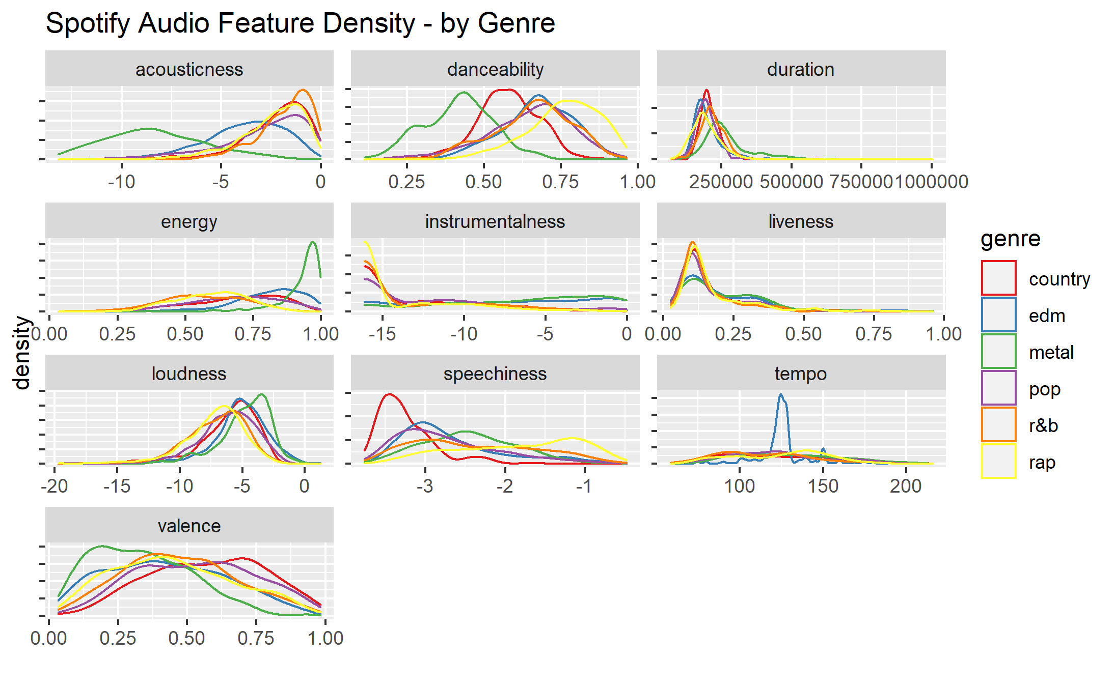
Notes:
More EDA where we plotted each of the numerical predictors to see their density with respect to genre

Slide 7
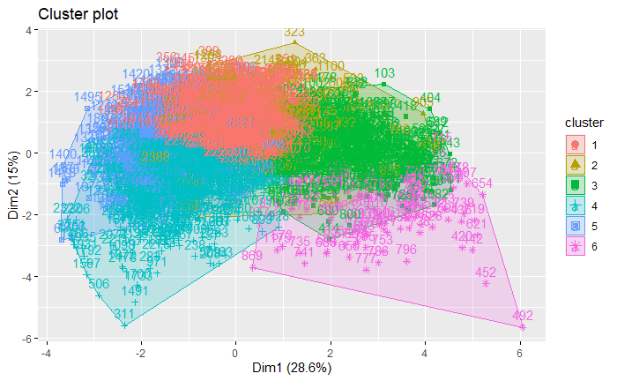
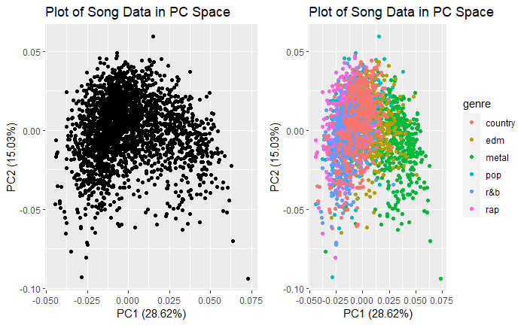
Clustering with 6 Genres
Notes:
SpotifyR package to scrape data from Spotify's API
Took 6 popular genres of music
Got audio features for all songs that described each track

Slide 8
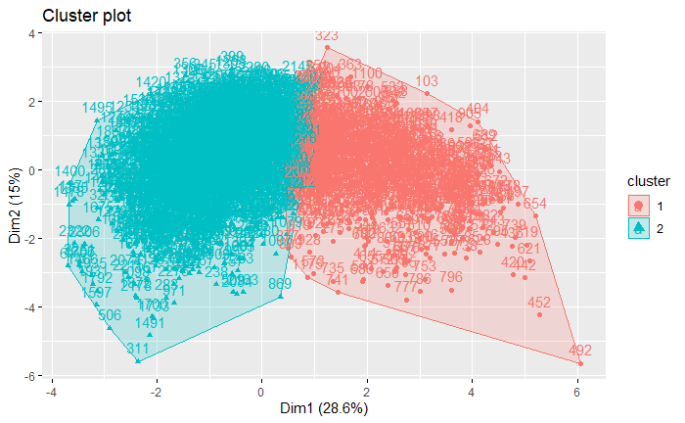
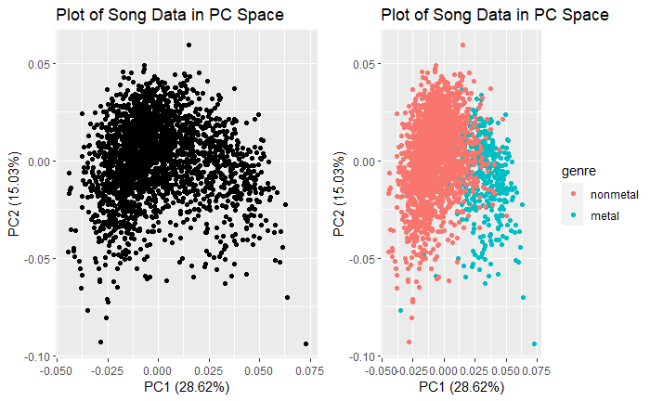
Clustering with metal vs. nonmetal
Notes:
SpotifyR package to scrape data from Spotify's API
Took 6 popular genres of music
Got audio features for all songs that described each track

Slide 9
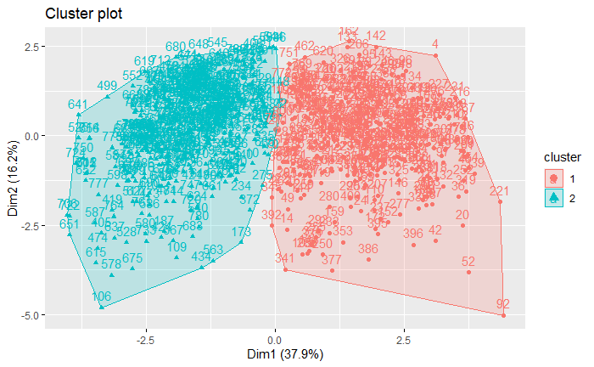
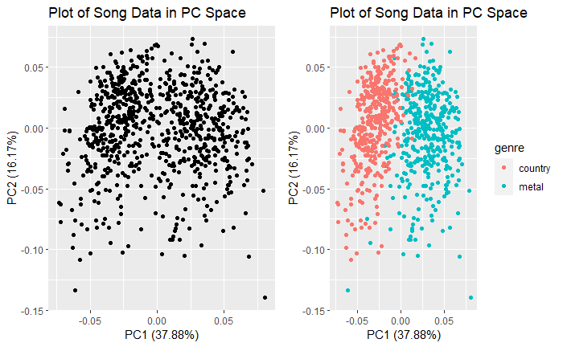
Clustering with metal vs. country
Notes:
SpotifyR package to scrape data from Spotify's API
Took 6 popular genres of music
Got audio features for all songs that described each track

Slide 10
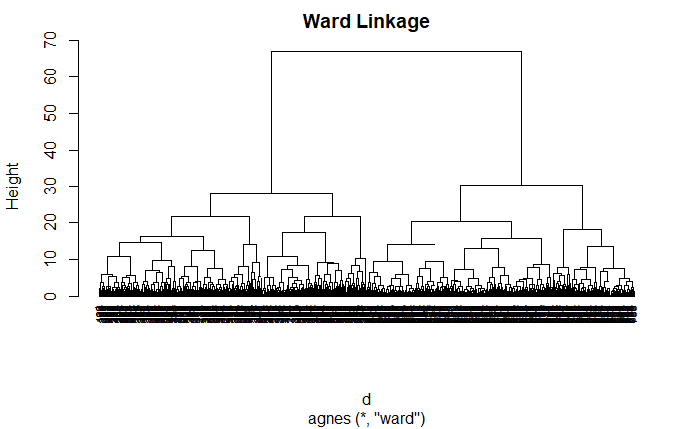
Clustering with metal vs. country
Notes:
SpotifyR package to scrape data from Spotify's API
Took 6 popular genres of music
Got audio features for all songs that described each track

Slide 11
Clustering Results
6 Genre Clustering
18.3% accuracy
2 Genre Clustering (metal vs. nonmetal)
93.3% accuracy
2 Genre Clustering (metal vs. country)
95.5% accuracy
Notes:
SpotifyR package to scrape data from Spotify's API
Took 6 popular genres of music
Got audio features for all songs that described each track

Slide 12
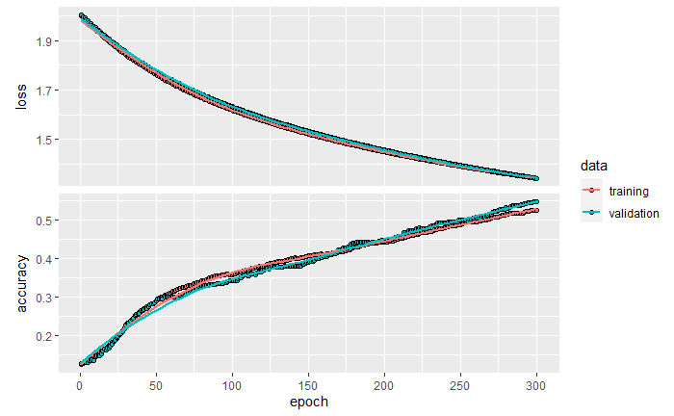
Neural Network on 6 Genres (Keras)
Keras sequential model
500 epochs
Running a neural network on the genres yielded better accuracy
First used all 6 genres (entire dataset)
53% accuracy
Notes:
SpotifyR package to scrape data from Spotify's API
Took 6 popular genres of music
Got audio features for all songs that described each track

Slide 13
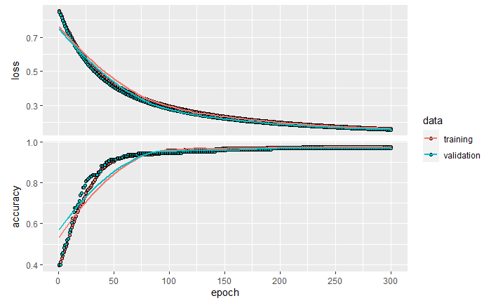
Neural Network on 2 Genres (Keras)
Tried the dataset with only metal and country genres
97.3% accuracy
Notes:
SpotifyR package to scrape data from Spotify's API
Took 6 popular genres of music
Got audio features for all songs that described each track

Slide 14
Random Forest (Ranger)
Point
Notes:
SpotifyR package to scrape data from Spotify's API
Took 6 popular genres of music
Got audio features for all songs that described each track

Slide 15
Conclusions
Many audio features on Spotify’s API are subjective. This makes genre separability difficult
Clustering shows the inherent overlap in the data
Random forest and neural net models both perform well on binary classification
Notes:
For our primary objective, the Random Forest algorithm produced the best model for classifying a song with a response variable of several levels
This was expected since RF handles outliers well and has a low risk of overfitting
Our models were best at classifying Metal using the audio features, likely due to the uniqueness of metal songs
Our models did a poor job at classifying Pop songs using the audio features, but in binary classification models, accuracy improved with the addition of the "track popularity" variable

Slide 16

Questions?
Notes:
For our primary objective, the Random Forest algorithm produced the best model for classifying a song with a response variable of several levels
This was expected since RF handles outliers well and has a low risk of overfitting
Our models were best at classifying Metal using the audio features, likely due to the uniqueness of metal songs
Our models did a poor job at classifying Pop songs using the audio features, but in binary classification models, accuracy improved with the addition of the "track popularity" variable

