Slide 1

UHP 2025-2026 Annual Report
Co-Directors:
Ava Dong and Anthony Acierto

Slide 2
2025 Summer
21 Interns placed at 14 nonprofit organizations in the Greater Cincinnati area
1 new site partnered with UHP
Coordinated 3-part lecture series from community experts on social determinants of health
Organized a Day of Service in collaboration with People Working Cooperatively
Wrapped up the summer with Committed to Community Event

Slide 3
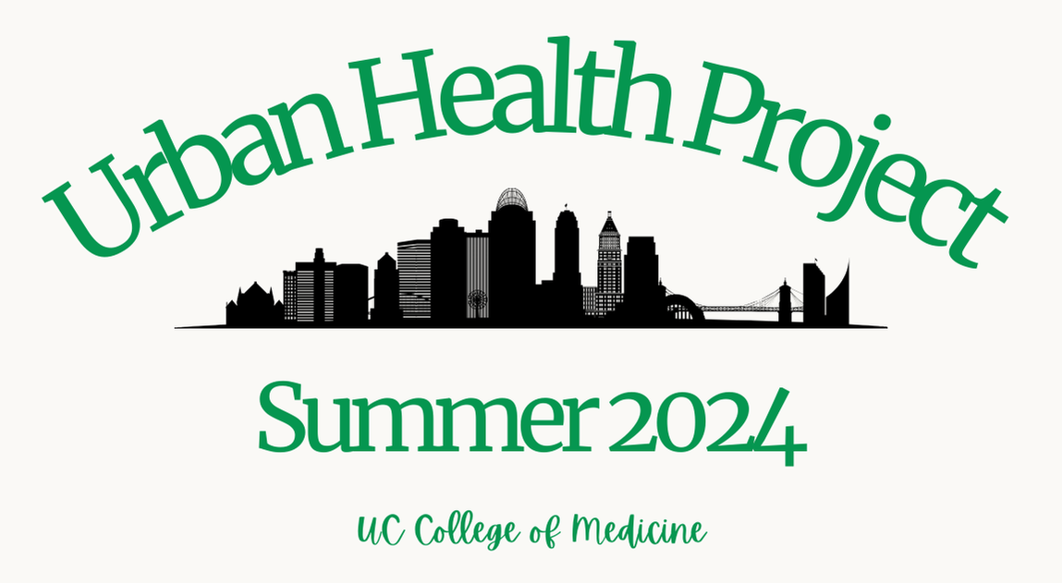
2025 UHP Interns and Site Supervisors
Amanda Tremains at Groundwork ORV with Jaeydah Edwards | Chika Nwakama at Network for Hope with Audrey Hotzman
Eddie Melecio and Haleigh Eckert at BLOC Ministries with Walter Vasquez | Hayden Kuhn and Jonathan Lee at Hospice of Cincinnati with Lori Asmus and Stacey Elliot
Jasmina Duliman, Natalie Morris, and Riley Alverez at The Center for Closing the Health Gap with Renee Mahaffey Harris | Kayona Moore at Belterra Racetrack Clinic with Dr. Joseph Kiesler
Kyndall Gilbert and Walker Chung at Good Samaritan Free Health Center with Kyla Maddox | Miguel Guiterrez and Warren Anderson at Project Connect with Ms. Rhonda Lewis
Naa Dromo at CCHMC with Dr. Maggie Jones | Nick Stanich at Brighton Center with Beth Hodge
Olivia Swonder at Casa de Paz with Paulina Cruz | Radhika Shah at Heart of Northside with Dr. Florence Rothenberg
Sanjana Reddy and Vanessa Leonardo at Clovernook with Dr. Kelly Lusk | Stefy Tene at First Step Home with LaQuita Tucker

Slide 4
Our Mission
Urban Health Project educates, inspires, and challenges medical students through their service to vulnerable populations in Greater Cincinnati to produce more socially responsible physicians who have a greater understanding of factors that impact health.

Slide 5
Our Impact
From Our Interns:
“I think this internship experience will help me a lot in the future as a physician, as working with such a disadvantaged and struggling group of older individuals (and their caretakers) had allowed for me to implement compassionate care and learn how to speak gently and in an understanding way. I have really enjoyed working with Alzheimer's and dementia patients and I hope to possibly work with them in the future as a physician.”
“This summer with UHP was truly the best opportunity to get to know Cincinnati and understand the unique barriers to health that its different communities face. The experience also reminded me of what it is like to work in a job where people rely on you for their wellbeing and happiness. While being a medical student is certainly stressful, there is a different amount of weight one feels when directly responsible for the care of others. It was nice to have an opportunity to form genuine relationships within the community that will only help me become a better provider. While my work with UHP was, to be honest, more than I anticipated, I do feel like the relationships I have made make it all worth it, and I am glad that the women living at Casa de Paz were able to trust me in the care of their families in such a vulnerable time.”
Over 6,000 service hours
Over $110,000 in Community Impact

Slide 6
Thank You to our Donors!
Academy of Medicine of Cincinnati Foundation
Bethesda Foundation
Bethesda Medical/Dental Staff
Charles H. Dater Foundation, Inc.
Cincinnati Children's Hospital Medical Center Medical Executive Committee
The Johnson Family Foundation
Trihealth, Inc.
UC Health - University of Cincinnati Physicians
Western & Southern Financial Group
Dr. Bruce F. Giffin, PhD
Dr. M. Cristina Pacheco, MD
Dr. Thomas J. And Mrs. Katherine Kunkel
Dr. Michael F. Wong, MD
Stephen J. Schuermann

