Slide 1

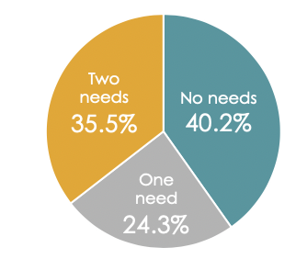
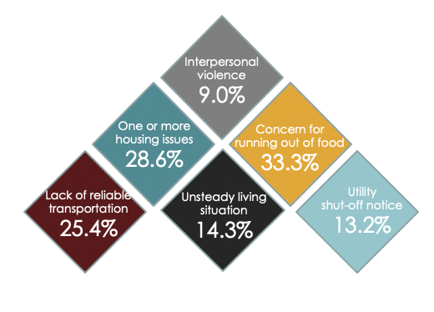
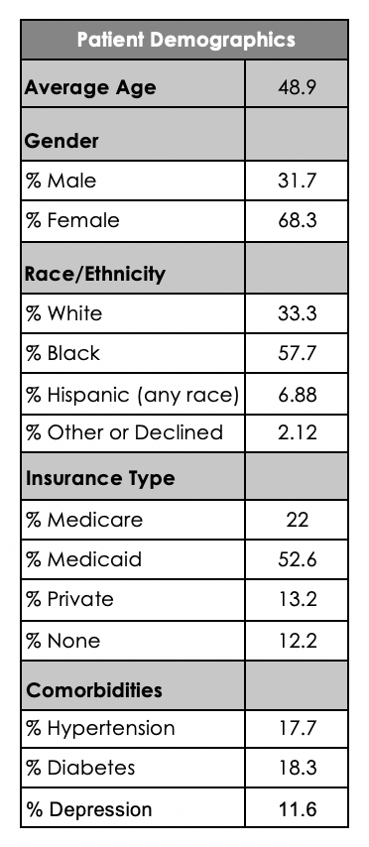
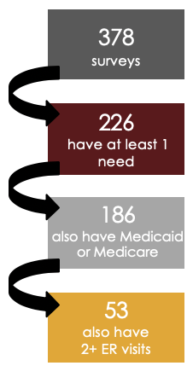
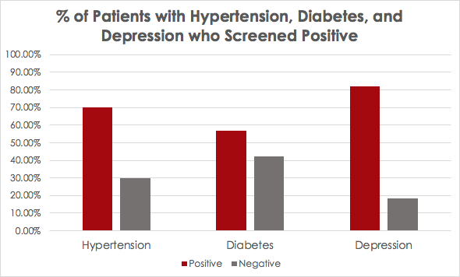

Screening for Health Related Social Needs
at Crossroad Health Center
Alexander R. Drinnan and Kati M. Woodward
Introduction
Social Determinants of Health (SDH) are social structures and conditions that affect our daily life, health, and well-being. These include neighborhood safety, access to healthy food, access to transportation, and educational resources. According to a study based on the 2015 County Health Rankings, only 20% of modifiable contributors to healthy outcomes are due to clinical care, while the other 80% are attributable to social and economic factors, health behaviors, and physical and environmental factors¹. Since social factors have been shown to be powerful predictors of health outcomes, there has been a shift towards addressing these aspects of health in research and clinical settings.
Crossroad Health Center is a Federally Qualified Health Center (FQHC) that serves the Cincinnati community and provides care to patients regardless of ability to pay. There are clinic locations in neighborhoods across the city, including Over The Rhine (OTR), Western Hills, and Harrison. Patients at Crossroad tend to be disproportionately affected by poverty and have limited access to many SDH including food, transportation, and stable housing. Crossroad is one of the many centers across the country that is participating in the Accountable Health Communities Model which has been implemented by the Center for Medicare and Medicaid Services (CMS) in an effort to address health-related social needs. The model consists of screening patients to identify needs, providing referrals to community resources, and assigning navigators to high-risk patients to assist with accessing these resources. The goal is to determine if identifying and addressing SDH in Medicaid/Medicare patients will reduce health care costs and inappropriate emergency room utilization.
We have compiled data from a sample of these screenings to gain a better understanding of the demographics of patients surveyed, the results thus far, and what associations can be observed between social needs and health outcomes.
University of Cincinnati College of Medicine
Prevalence of Social Needs
Survey Results
Discussion
We found that 59.8% of patients surveyed screened positive for at least one health related social need. Of those patients, only 23.5% qualified for navigation through The Accountable Health Communities Model. That leaves 76.5% of patients with an identified need who are in need of referral to appropriate resources. To address this, we created a resource pamphlet with a list of community resources in both English and Spanish. This pamphlet focuses on the following categories of need: housing, food, transportation, safety, and recreational activities. We hope that by providing specific and relevant referrals, patients will be better able to access resources that are important for their health and well-being.
As is shown from our data, the majority of patients at Crossroad have at least one health-related social need, and the implementation of surveys like these are important for increasing awareness of social determinants of health. Although socioeconomic factors have not historically been a part of clinical care, at a minimum having health providers appreciate the social factors affecting their patients will help them develop more effective treatment plans and strengthen the patient-provider relationship². Reaching health equity will also require addressing institutional policies at a state and national level, but this small step will contribute to improving health outcomes for vulnerable patients.
Methods
The health-related social needs screening consists of 11 questions that cover the topics of housing and utility issues, food insecurity, transportation, and interpersonal violence. Adult patients were chosen indiscriminately and were asked questions at some point during their visit by a member of the care coordination team. Verbal responses from the patient were recorded in the EMR system under the Social History section.
The Accountable Health Communities Model focus for screening is on patients with Medicaid and Medicare, but at Crossroad all patients were considered for screening regardless of insurance type. Patients with Medicaid or Medicare had screening data put into Healthify, an online database used to record survey results and provide community resources. ‘Navigation’ was available through Healthify for patients considered “high-risk”. The “high-risk” designation was made if patients had at least two Emergency Room (ER) visits in the past 12 months. In order to qualify for navigation, a patient had to have Medicaid or Medicare, two or more ER visits, and a positive response for at least one social need. Navigation consists of assigning the patient through Healthify to a community organization who would follow up by phone and assist with the patient’s social needs.
Results
We looked at the screening results from 378 adult patients at three Crossroad Health Center sites: OTR, West, and Harrison. 304 surveys were administered at the OTR location, 49 at the Harrison location, and 25 at the West location between June 2018 and July 2019. In addition to breaking down survey responses and demographic information, we also compared disease status to screening results. Namely, we looked at patients with a history of hypertension, diabetes, and depression, then found how many of them screened positive (1+ health-related social needs). We found a significant association between a history of depression and a positive need screening (p=0.0016).
Future Directions
The Accountable Health Communities screening is set to continue at its sites until April 30, 2021. Qualifying patients will continue to be referred via Healthify to community navigators. The resource pamphlet at Crossroad Health Center is currently being designed and once ready we hope to have copies readily available in the waiting area and in the clinic at Crossroad so that all patients have access to the information.
Qualification for Navigation
References
1. Hood C, Gennuso K, Swain G, Caitlin B. “County Health Rankings: Relationships Between Determinant Factors and Health Outcomes.” American Journal of Preventive Medicine (2016). 50(2): 129-135.
2. Braveman P, Gottlieb L. “The Social Determinants of Health: It’s Time to Consider the Causes of the Causes.” Public Health Reports (2014). 129(2): 19-31.
Acknowledgments
We would like to thank all of the Crossroad Health Center staff for their input and support throughout the summer.
Graph comparing the percentage of patients who screened positive (1+ identified need) to those who screened negative (0 identified needs) for those with a past medical history of hypertension, diabetes, and depression. Three contingency tables were made comparing frequency of disease state to frequency of screening results, and the degree of association was calculated for all three using Fisher exact test. A significant association was found for depression only (p=0.0016).
The project described was supported by Funding Opportunity Number CMS 1P1CMS331598-01-00 from the U.S. Department of Health & Human Services, Centers for Medicare & Medicaid Services. The contents provided are solely the responsibility of the authors and do not necessarily represent the official views of HHS or any of its agencies.

