Slide 1

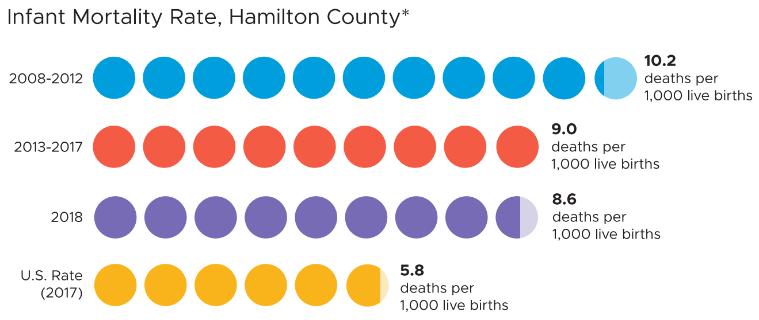
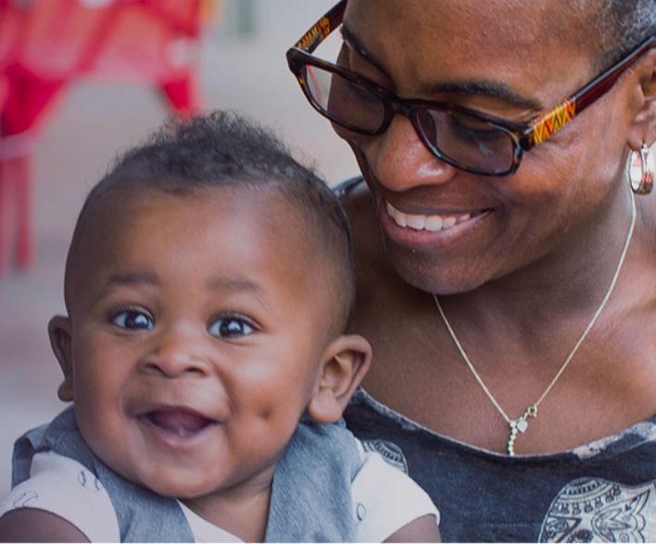
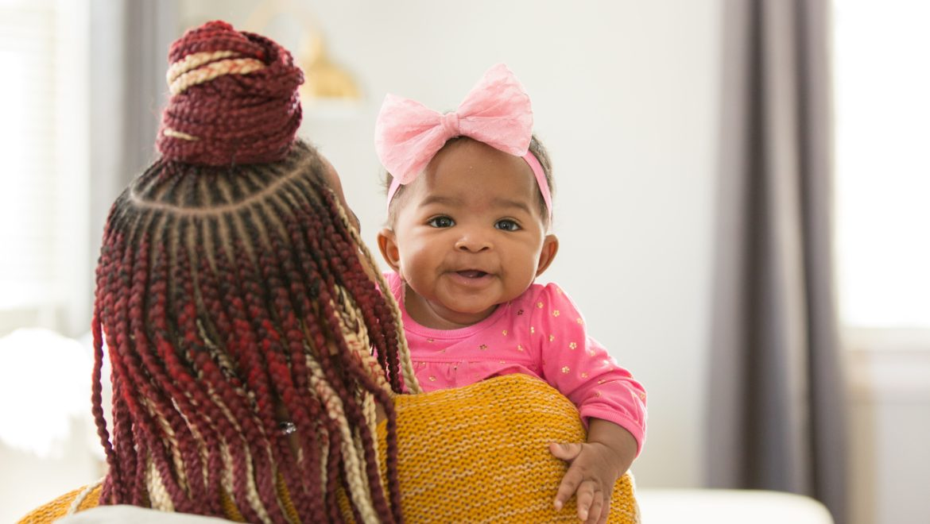
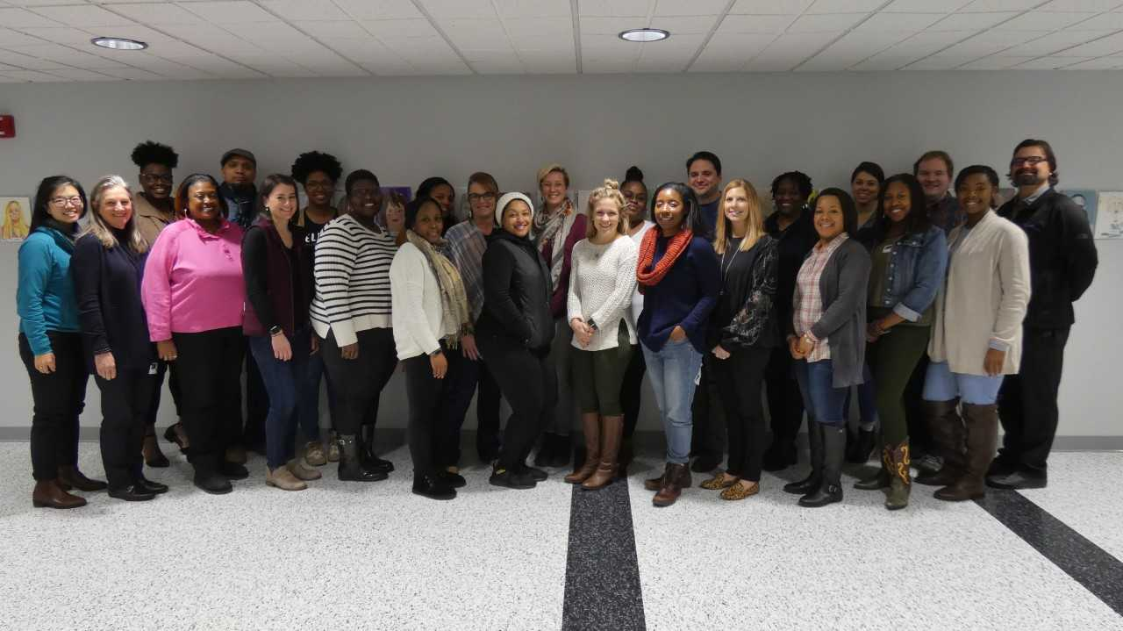
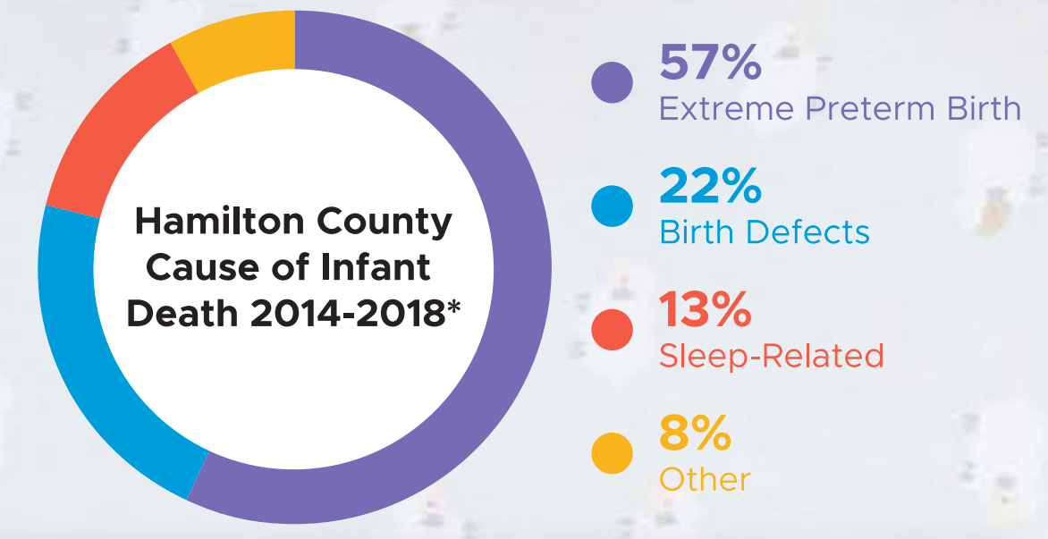
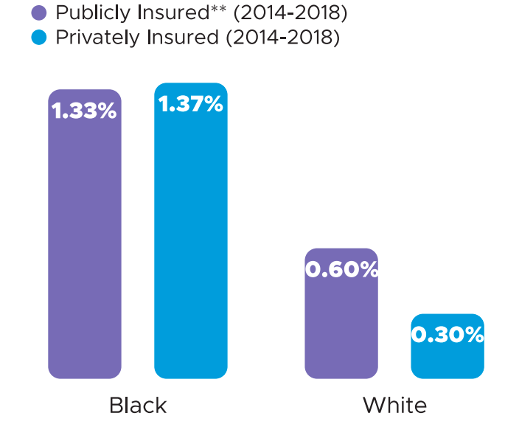

Cradle Cincinnati: Improving infant mortality in Hamilton County
Callyn E. Samuel, University of Cincinnati College of Medicine
Cradle Cincinnati
Cradle Cincinnati is a team of several different organizations, healthcare providers, and community workers all working toward the single goal of decreasing the infant mortality rate in Hamilton County. The subcommittees I worked with in particular include:
Queens Village
A supportive community gathering of powerful black women who come together to relax, re-power and take care of themselves and each other.
Communications Team
Communications experts that work hand-in-hand with community members to create culturally competent messaging that resonates with families.
Learning Collaborative
A network of prenatal care centers with goals of transforming the way prenatal care is provided in Hamilton County through quality improvement science.
Connections Team
Neighborhood-based teams of community health workers, social workers and other specialists are connecting families to the services and resources they need.
Additional Subcommittees:
Policy Committee
Equity Committee
Data Analyst
Our Population
Cradle Cincinnati focuses mostly on the physical and mental health of Black moms and their babies; a population which has been historically failed by the healthcare system. In Hamilton County that failure is even more prominent.
What Is Next For Me
Going forward, I will be continuing my process of interviewing women with the goal of putting together a comprehensive compilation of common experiences, both good and bad, to share with the Learning Collaborative in order to move forward with make the proper changes where possible. I will also be conducting research concerning racial inequity with the disparities in pre term birth rates and other poor birth outcomes.
I hope to keep in contact with Cradle Cincinnati throughout my time at UC and continue to provide a helping hand as well as staying up to date on all our current reports.
What More Can Be Done
As far as Cradle Cincinnati has come in the past few years, there is still a huge gap to bridge in terms of our infant mortality rate and equity between races. As they continue to reach out to women in the community, further developments could include: standardizing client intake forms between all Connections teams, developing a system that increases the follow up rate, and enhancing the education each woman receives at prenatal care visits.
Special Thanks
I’d like to thank all of the staff at Cradle Cincinnati for such a warm welcome to the team and for providing me with an encouraging environment to learn and grow as a student. I give a special thanks to Jessica Seeberger for providing me with guidance and support through all of my endeavors.
I would especially like to thank Namratha Kolur and Isaiah Noel, our UHP Co-Directors for all the work they’ve done and support they’ve offered throughout this program.
My Intern Role
As a Cradle Cincinnati intern, I have found my niche in supplementing the projects of our many subcommittees.
Tobacco Treatment Specialists Integration
With UC Health undergoing major changes in community based teams, I was tasked with troubleshooting and forming an efficient method of integrating Tobacco Treatment Specialists into the daily workflow of the prenatal care center.
Prenatal Care Survey
I am assisting the learning collaborative by collecting qualitative data from women seen by the Connections team. I created a short survey with questions regarding aspects of prenatal care that can be asked in a interview style. We hope to gain better insight on women’s prenatal experience including the process of obtaining care, the relationship they had with their providers and access to resources and information crucial to a healthy pregnancy.
Social Media Outreach
With the communications team I have been working on several social media projects to bring awareness and spread information to Cradle Cincinnati’s following regarding healthy pregnancy practices. I have been gathering FAQ’s about breastfeeding and working with the team to create an inclusive blog post and video on the subject of breastfeeding and its health benefits. I’ve also began teaching a safe sleep class and working to promote the benefits of safe sleep through the Cincinnati Health Department.
Data Analysis
I am assisting with pooling the data we have available on infant deaths from years 2012-2019 into a chart containing only sleep related deaths for each year. The data I put together is being used to present trends and current numbers to our Communications team, who then use this information to determine where Cradle has made an impact, and what still needs to be done.
Notes:
Body Text (24-36 font)
For UC red: go into color > more > custom. Use RGB values of red-224, green-1, blue-34
images should be high res, 300 dpi when placed in the document. Web resolution images will NOT provide acceptable printed quality (to check resolution, zoom to 300-400% to see if picture is blurry)

