Slide 1


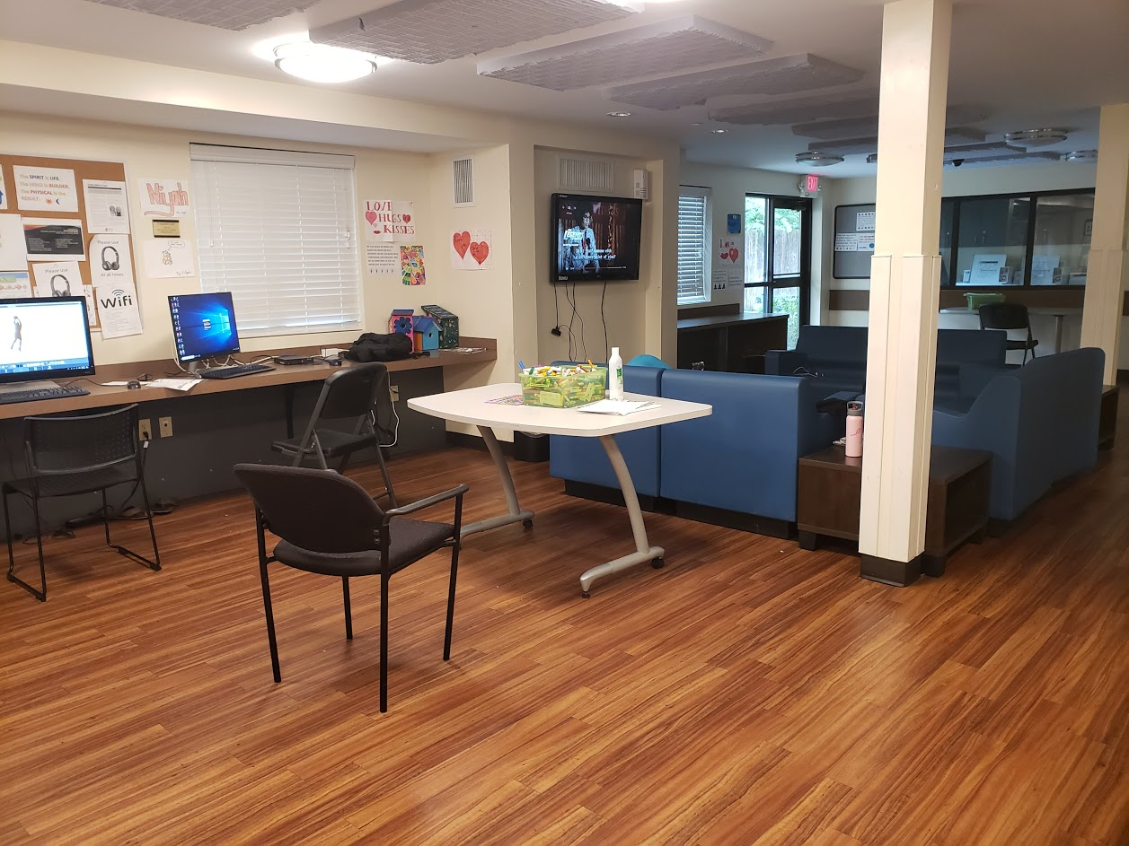

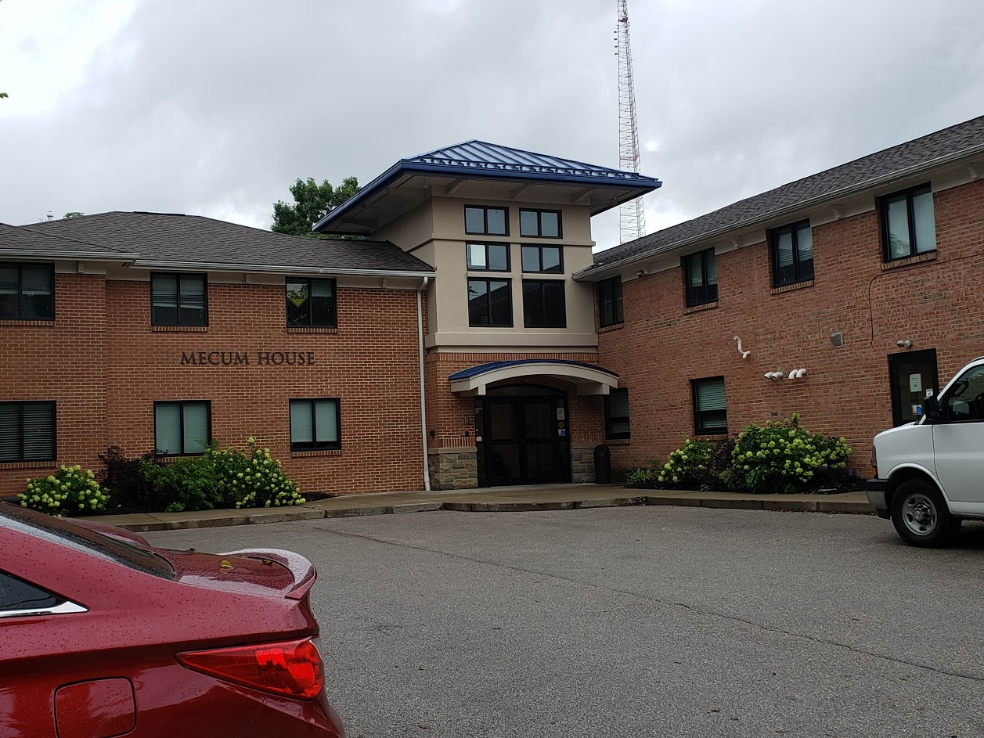
Lighthouse Youth and Family Services: Mecum House
Urban Health Project Summer 2019
Sarah Wagner
Lighthouse Youth and
Family Services
Lighthouse Youth and Family Services was founded in 1969 with the goal of providing a better future for young people and families experiencing homelessness. Today, Lighthouse serves hundreds of individuals on a daily basis. Some of the services that Lighthouse provides include:
Behavioral health and psychiatric services
Residential treatment facilities
Group shelters
Independent living services
Educational support
LGBTQ Cultural Competency Training
UHP Intern Responsibilities
Barriers to Healthcare
My responsibility as an intern was mostly to serve as an extra youth care worker. This entailed helping out wherever I was most useful. A typical day would consist of helping to prepare and serve dinner to youth, accompanying youth and staff on their evening outings, helping to resolve arguments between youth, logging medications, reviewing notes from new intakes, and most importantly, taking time to talk with and build relationships with the staff and residents. I also served as a health education resource for youth at Mecum House.
One of the most important things that I learned through my work at Mecum House was that homeless youth face a number of unique barriers when it comes to getting healthcare. In the future, I would like to work on finding ways to limit these barriers so that homeless children can get the care they need.
The most common barriers to healthcare that I heard about were:
Having to go through guardians or case workers to make appointments or fill prescriptions
Lack of a permanent home
Insufficient number of resources for children experiencing homelessness
Mecum House
Health Education
One of my roles this summer was to serve as a health resource for residents at Mecum House. Most of the youth at Mecum House do not regularly see a physician and have had very little health education. I helped to address any health-related questions or concerns that youth had while they were staying at Mecum House. I helped bandage wounds and treat minor injuries, counseled individual residents about the importance of prenatal care and the importance of taking psychiatric medications consistently, and offered advice wherever possible. I also reviewed intake notes to make sure that any health conditions the youth had were being properly addressed.
Mecum House is a 24-hour shelter for youth ages 10-17 who are experiencing homelessness. It provides a safe place to go for children who are abused, neglected, or for any reason are feel unsafe in their homes. Residents of Mecum House are provided with a room and meals and are able to participate in a variety of educational and recreational activities. It also provides a 24-hour youth crisis hotline as well as individual, family, and group counseling services. Youth are able to stay at Mecum House for as long as they need to until they are able to find a safe place to live.
Special Thanks
I would like to thank my site coordinator David Durr as well as all of the other staff at Mecum House for welcoming me into the organization and providing with guidance and support throughout this experience.
I would also like to thank UHP co-directors Namratha Kolur and Isaiah Noel for all of the work they have done to make this experience possible.

