Slide 1



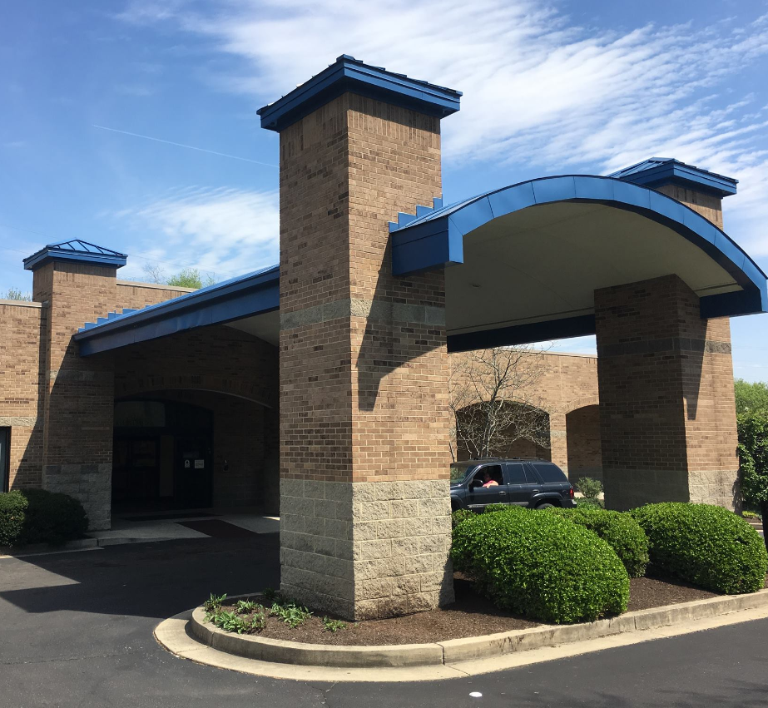

Impact of the Title X Gag Rule on
Women’s Access to Abortion Services
UC-OBGYN Division of Community Women’s Health
Audrey McCartney, University of Cincinnati College of Medicine
About the Site
The Division of Community Women’s Health was created in July of 2010 and provides outpatient services at 13 health center locations in Cincinnati and Hamilton County¹. The division includes four physicians, three nurse midwives, and three nurse practitioners. It is a comprehensive UC Health obstetric practice with 13,500 office visits in 2014 with 700 infant deliveries.
As a UHP intern, I worked under the supervision of Dr. Rocco Rossi as he and other healthcare providers staffed various Cincinnati Health Department Health Centers.
Project Purpose
The purpose of this research study is to determine how women in the Cincinnati, OH area access abortion education and services. There are currently no studies exploring how much Title X family planning clinics provide education to female patients about abortion access and services as opposed to other sources. In light of new legislation, the survey aims to assess the role that such family planning clinics play in giving women information regarding abortion services, and how crucial their role is to women in order to control their reproductive health care decisions.
Methods
Patients meeting the inclusion criteria will be offered surveys at the Cincinnati Health Department clinics such as Elm Street Health Center, Price Hill Health Center, Northside Health Center, Millvale Health Center, and Braxton F. Cann Health Center. We aim to obtain survey results from at least 150 participants. Inclusion criteria includes women 18-65 years of age who read English and are not pregnant. The research team will train clinic staff on how to introduce the survey and who meets inclusion criteria. Females 18-65 years old seen in clinic will be offered the printed announcement and survey.
After accessing the survey in hard copy form, participants will read a brief explanation of the survey including that the survey is entirely voluntary and completely anonymous. The survey will consist of 21 questions and should take between 5-10 minutes for participants to complete. Participants can quit the survey at any time. After completion of survey, participants will return the survey to clinic staff.
Survey Questions
The 21 question survey consists of 9 demographic questions such as age, race, highest level of education and annual income. The next 6 questions assess knowledge about abortion and are either multiple choice or yes/no. The remainder of the survey asks the patient about personal experiences seeking abortion services. Finally, the survey ends with a question about the patient’s knowledge of the Title X Gag Rule.
Sample Questions:
What is the latest week you can terminate (end or abort) a pregnancy in Ohio? 18 weeks, 20 weeks, 22 weeks, 24 weeks, 26 weeks
Do you know what the initials D and E stand for in the expression, ‘D and E abortion’?
Have you ever asked your gynecologist or a primary care provider for information regarding abortion services?
Have you ever wanted abortion services but not been able to receive abortion services due to lack of money?
Are you aware of the possible changes to Title X regulation (i.e. Title X “gag rule”) proposing to deny government funding to clinics where any type of abortion service is provided?
Future Steps
In the final weeks of my internship, I will be distributing the surveys to the 5 participating Cincinnati Health Department clinics. Nurses and Medical Assistants who check in eligible patients are trained in the administration of the survey. Survey results will be collected and the data will be compiled.
The results of the survey will quantify the role that Title X clinics play in helping women access abortion education and services and will thus be an indicator of the impact the Title X Gag Rule may have. The information from the women surveyed can help inform the discourse around Title X and associated legislation and perhaps be used as a springboard for shaping future policies.
References and Acknowledgements
[1]. Division of Community Women's Health. OBGYN | UC Cincinnati College of Medicine. https://med.uc.edu/obgyn/divisions/community-women-health. Accessed July 18, 2019.
[2]. Hasstedt, Kinsey. “Dangerous and Coercive Ttile X Gag Rule Released.” Guttmacher Institute, www.guttmacher.org/article/2019/02/dangerous-and-coercive-title-x-gag-rule-released. Accessed July 18, 2019.
[3]. “Compliance With Statutory Program Integrity Requirements.” Federal Register, www.federalregister.gov/documents/2019/03/04/2019-03461/compliance-with-statutory-program-integrity-requirements. Accessed July 18, 2019.
Special Thanks to all of the staff at the UC-OBGYN Division of Community Women’s Health, especially to Dr. Rossi for his mentorship and guidance throughout the summer.
I would also like to thank Namratha Kolur and Isaiah Noel,
UHP Co-Directors, for their support and for making
this experience possible.
Project Background
The Cincinnati Health Department Health Centers are sub-recipients of Title X funds. The Title X Family Planning Program was enacted under President Nixon in 1970 and is the only federal grant program dedicated exclusively to providing patients with comprehensive reproductive health services. Title X clinics ensure access to a broad range of reproductive health services and preventative care for millions of underinsured and uninsured individuals, providing access to birth control, cancer screening, STI testing and other essential reproductive services.
Although Title X funded clinics are prohibited from using federal grant funding for abortion, providers at Title X funded clinics are allowed to provide information to women seeking abortion services as part of the mandate of informed consent and comprehensive care. The proposed Title X Gag Rule “eliminates Title X program’s long-standing guarantee that pregnant patients receive neutral, factual, and nondirective info on all of their pregnancy options (including parenting, adoption, and abortion”². In a policy opposed by both the AMA and ACOG, the Gag Rule:
Requires both a financial and physical separation of abortion-related activities at Title X funded clinics,
Discourages providers from offering comprehensive pregnancy options, counseling, and referral,
Encourages referral to entities that refuse to offer abortion counseling and referrals, and favoring sites that offer only fertility-awareness based methods^{3,4}.

