Slide 1


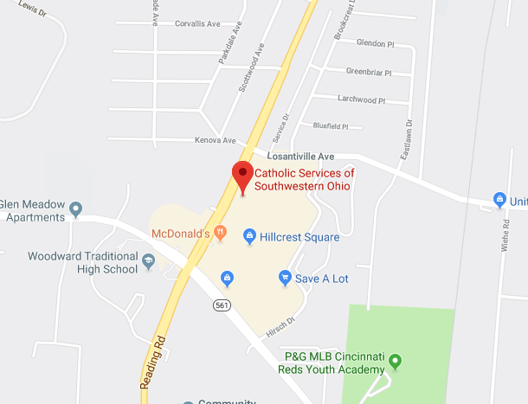
Self-Sufficiency in 90 days
Catholic Charities of Southwestern Ohio
Hassan A. Abdullahi, University of Cincinnati College of Medicine
Catholic Charities
Catholic Charities of Southwestern Ohio is a social service agency that provides a multitude of services to its clients. These services include family & parenting education, emergency food relief, senior services, legal immigration services, mental health catholic, and others. Catholic Charities was established in 1916 and had been operating over 100 years and is a part of a larger network of Catholic charitable organizations across the US.
Refugee Resettlement
The Refugee Resettlement arm of Catholic Charities resettles refugees who come to the US through the US Department of State and the US Conference of Catholic Bishops. Catholic Charities provides services such as English classes, housing, transportation, employment, health assessments, social service connections.
Barriers
For refugees, language is the most obvious barrier, however, most of our refugees have arrived from a refugee camp which requires much more of an adjustment. Things like turning light switches on, using an oven, where to throw trash away are some common things that must be addressed. We provide cultural orientation classes among the other classes that are provided. Transportation is another issue for our clients. The public transportation system can be slow and hard to navigate, and almost all clients do not initially have access to a vehicle to go to classes, work, shopping. There is also the mental and emotional well-being of our clients that needs to be carefully assessed. The violence and trauma incurred during their journey to their new country can sometimes cause irreparable damage to clients
Responsibilities
My role as an intern at Catholic Charities is mainly to provide support and work with case managers and the different coordinators of social service. This includes tasks such as:
Taking clients to medical appointments, and unexpected trips to urgent care/hospital
Providing bus training to clients to promote self-sufficiency
Filling paperwork out (example: High school applications, social security benefits, Medicaid/Cash Assistance, etc.)
Picking donations up from donator homes
Organizing and managing the warehouse which stores all of our donations and items necessary for setting up client move-in
Furnishing client homes before client arrival and cultural orientation on how to navigate their new homes upon arrival.
Finding physicians, dentists, optometrist that can take on new clients.
Reviewing grant proposals when new ones become available
Finding childcare for clients when needed
Assessments and client visits when issues arise (ex. Issue with landlord, neighbors) to promote safety
Client walk-ins to address any issues they have, or to help with
Helping welcome clients in from the airport as they arrive and providing first hot meal in US.
How to Help
Catholic Charities is in constant need of donations, (mainly furniture items such as mattresses and chairs). If you speak other languages, or have taught classes, there are a number of opportunities to help out. Clients have limited access to mental health resources, and Catholic Charities is actively looking for providers that have special training with this population. Finally, World Refugee Day occurs on the 20th of June every year, and Catholic Charities hosts a special event for clients on the weekend of that week. If you have any toys to donate, or if you are able to volunteer your time that would be awesome. General volunteer application, go to https://www.volgistics.com/ex/portal.dll/ap?AP=1525679034
Acknowledgments:
I would like to thank Director Anne Scheid for welcoming me, and my coworker/interns Salamata and Rita for making the experience even more enjoyable. Also I want to thank the entire Refugee Resettlement department for all the work they do for their clients. Finally, thank you to UHP for the events and support through the process
Navigating the Public Benefit System
Clients must be able to manage the funds they receive, and be shrewd enough to make it last before they are able to make income themselves (this requires obtaining work authorization which required to have a job). Fortunately, refugees do qualify for federal benefits and this includes SNAP, Medicaid, Cash Assistance.
When clients do receive benefits, we teach them how to take advantage of these resources, and to sustainably use them until they no longer need it. We organized a field trip to Findlay Market for our clients in part to provide a sense of familiarity (open market and street vendors). This field trip will occur on July 31st, and the objectives are to teach clients how to use their SNAP benefits at the different grocers, what items they can/cannot buy, how prices on items are set and non-negotiable, and to promote healthy nutritional habits.
Notes:
es

