Slide 1
Study of the Hirsch conjecture based on “A quasi-polynomial bound for the diameter of graphs of polyhedra”
Instructor: Dr. Deza Presenter: Erik Wang Nov/2013

Slide 2
Agenda
Indentify the problem
The best upper bound
Summary

Slide 3
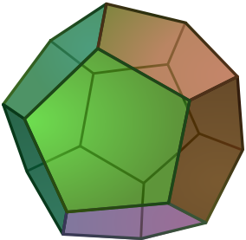
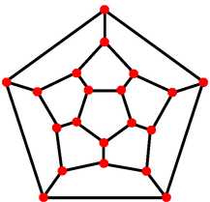
Identify the problem Concepts - Diameter of graph
The “graph of a polytope” is made by vertices and edges of the polytope
The diameter of a graph G will be denoted by δ(G): the smallest number δ such that any two vertices in G can be connected by a path with at most δ edges
D=3, F = 12, E = 30 V = 20
Graph of dodecahedron
δ = 5
Regular Dodecahedron
* A polyhedron is an unbound polytope
Notes:
Another definition for diameter as following (on original version of the slides):
A graph's diameter is the largest number of vertices which must be traversed in order to travel from one vertex to another when paths which backtrack, detour, or loop are excluded from consideration.
Weisstein, Eric W. "Graph Diameter." From MathWorld--A Wolfram Web Resource. http://mathworld.wolfram.com/GraphDiameter.html
Now the definition in the slide was quoted from “Lectures on polytopes”, P83, by Gunter M. Ziegler
Literally
Do-de-ca-hedron
projection

Slide 4
Identify the problem Example – graph and graphs of Polyhedron
Let d be the dimension, n be the number of facets
One given polytope P(d,n) has only one (unique) graph
Given the value of d and n, we can make more than one polyhedron, corresponding to their graphs of G(p)
e.g. A cube and a hexahedron…
The diameter of a P(d,n) with given d and n, is the longest of the “shortest path”(diameter of the graphs) of all the graphs
Notes:
He-ke-se-hedron
This slide try to clarify that give d and n, there should be more than one graph. The research try to find the largest diameter in all the instance of graphs with given d and n.
I will draw a cube and a hexahedron on blackboard, and their graphs

Slide 5
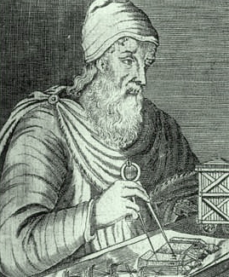
Identify the problem Motivations – Linear Programming
Hmmm..
Let P be a convex polytope, Liner Programming(LP) in a geometer’s version, is to find a point x₀∈P that maximize a linear function cx
The maximum solution of the LP is achieved in a vertex, at the face of P
Diameter of a polytope is the lower bound of the number of iterations for the simplex method (pivoting method)
Vertex = solutions, Facets = constraints
Notes:
Dimension = variables
Euclidean …

Slide 6
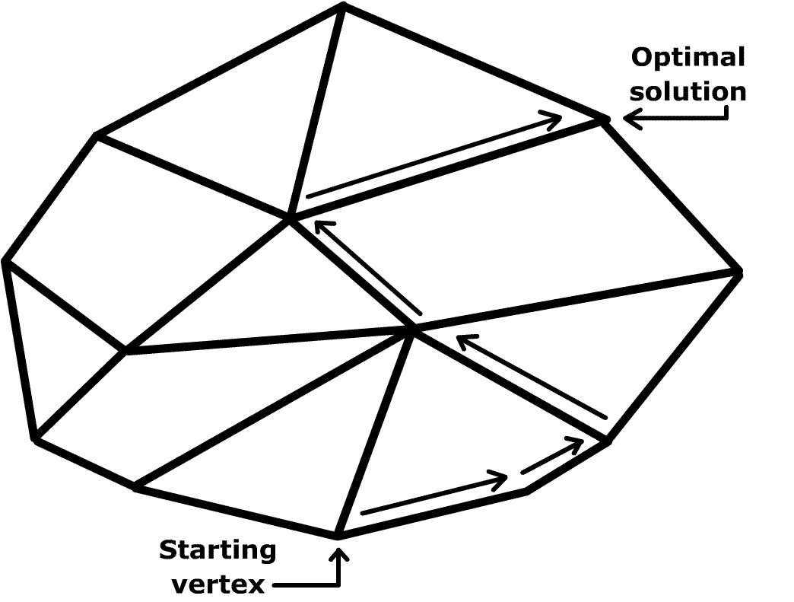
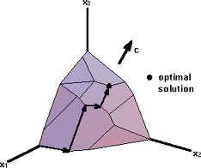
Identify the problem Dantzig’s simplex algorithm
First find a vertex v of P (find a solution)
The simplex process is to find a better vertex w that is a neighbor of v
Algorithm terminate when find an optimal vertex
Notes:
Move from one vertex to next, like move by the edges
LP in geometer’s version is the task to find a point x0 in P that maximize a linear function cx

Slide 7
Identify the problem
Research’s target:
To find better bound for the diameter of graphs of polyhedra
||
Find better lower bound for the iteration times for simplex algorithm of Linear Programming
Notes:
Because it is hard to verify in high dimension, so the approach is target to find better bound

Slide 8
Agenda
Indentify problem
The best upper bound
Summary

Slide 9
Related Proofs
GIL KALAI: A subexponential randomized simplex algorithm, in:
"Proc. 24th ACM Symposium on the Theory of Computing (STOC),"
ACM Press 1992, pp. 475-482. (87-91, 96, 99)
GIL KALAI AND DANIEL J. KLEITMAN: A quasi-polynomial bound for the diameter of graphs of polyhedra
Bulletin Amer. Math. Soc. 26
(1992), 315-316. (87, 96)
Notes:
I will introduce the first approaching

Slide 10

Notations for the proof
Active facet: given any vertex v of a polyhedron P, and a linear function cx, a facet of P is active (for v) if it contains a point that is higher than v
H’(d,n) is the number of facet that may be required to get to the top vertex start from v which the Polyhedron has at most n active facets
For n > d ≥ 2
∆ (d, n) – the maximal diameter of the graph of an d-dimensional polytope
∆u (d, n) – unbound case
∆ (d, n) ≤ ∆u (d, n) ≤ Hu (d, n) ≤ H’ (d, n)
Notes:
“At most n active facets” constrains that v is a bottom vertex

Slide 11
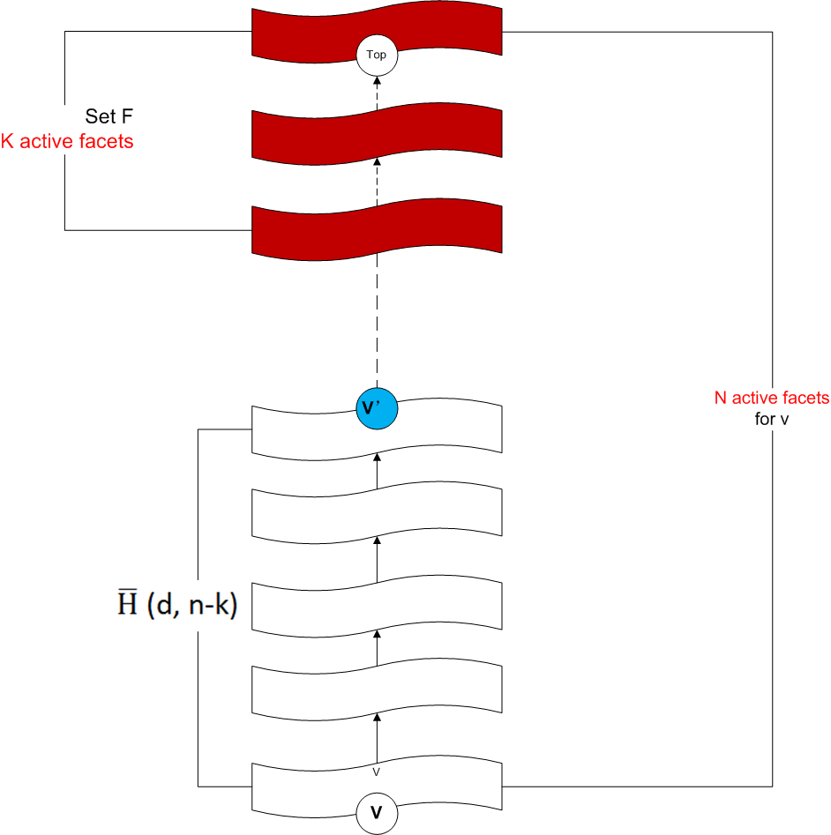

Proof 1/4 – Involve Active facet
Step 1, F is a set of k active facets of P, we can reach to either the top vertex, or a vertex in some facet of F, in at most H’ (d,n-k) monotone steps
For example, if k is very small (close to n facets), it means V’ is very close to the top vertex, so that H’ (d,n-k is very close to the diameter. Thus K is flexible.
Notes:
How to get H’(d,n) ≤ H’(d-1, n-1) + 2H’(d, n/2 (floor))
F (which is the possible steps to the highest vertex ahead).
P’ is a new polyhedron to ensure the question is always to find the lowest v to the highest top vertex, by deleting inactive facets (constraint in LP)

Slide 12
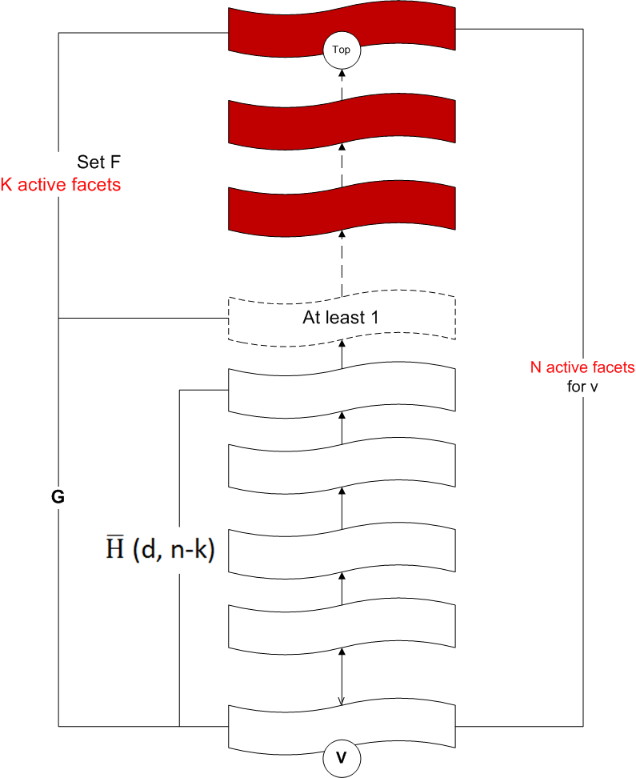

Proof 2/4 – The next 1facet
Step 2, if we can’t reach the top in H’(d,n-k) monotone steps, then the collection G of all active facets that we can reach from v by at most H’(d,n-k) monotone steps constrains at least n-k+1 active facets.
Notes:
Consider if G is very big (it also means k is very small), so the “1” in at least n-k+1 should be something between the ceiling facet of G to the top vertex, it could be at least another 1 facet of P.

Slide 13
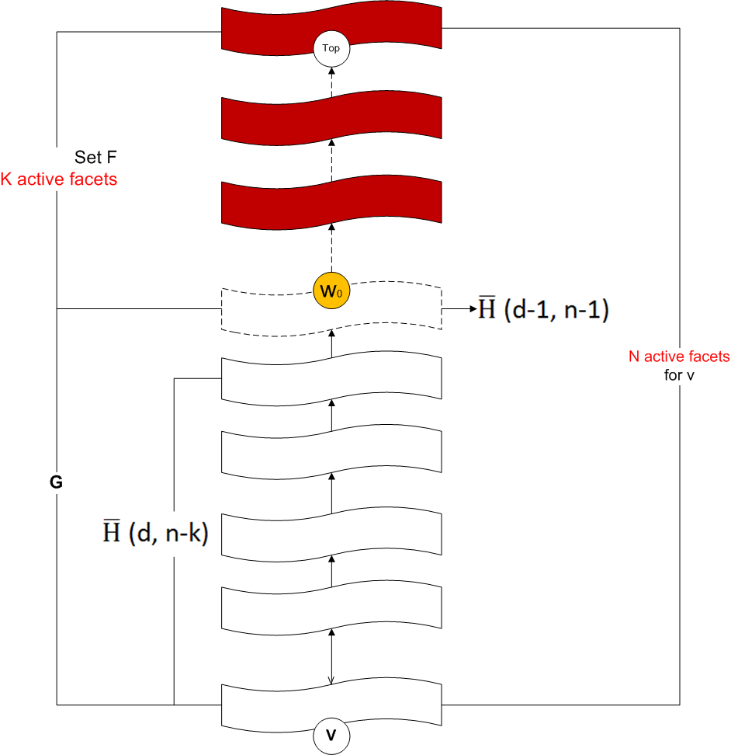

Proof 3/4 – Travel in one lower dimension facet
Step 3, starting at v, we can reach the highest vertex w₀ contained in any facet F in G within at most
monotone steps
Notes:
Vertex is a intersection joint of >= d facets

Slide 14
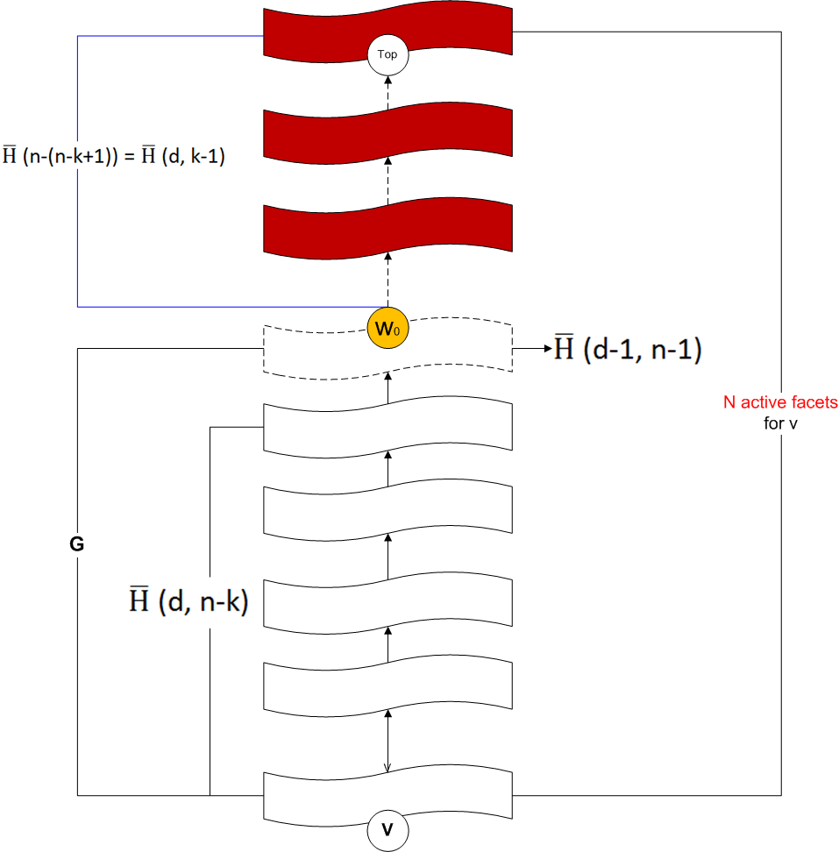



Proof 4/4 – The rest part to the top vertex
Step 4, From w₀ we can reach the top in at most
So the total inequality is
Let k:=
Notes:
Hirsch: ∆ (d, n) ≤ n − d.
Quasi-polynomial

Slide 15

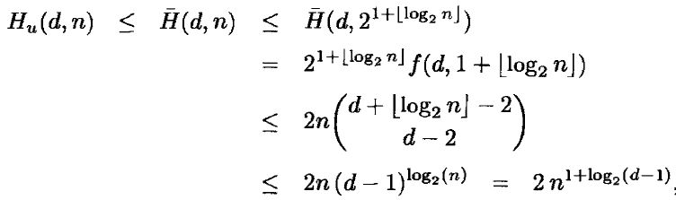


How to derive to final result
Let k :=
Define for t ≥ 0 and d ≥ 2
Sub exponential on d
exponential on d
Former bound given by Larman in 1970
Notes:
For recursion purpose, we get f(d,t) ≤ f(d-1, t) + f(d, t-1)
The following derivation part is not main point in this slide…
The result is qusai-polynomial so the complexity is sub exponential, the growth is much slower than exponential
About Hu and H complement:
There is a vertex u of P on which cx achieves its unique maximum
Hu(d,n) to be the smallest number such that in the situation above, for every v of P, there is a (strictly) monotone path from v to the top, that is, a path from v to u along with cx increases in every single step.
H(d,n) be the same number under the additional assumption that P is a polytope

Slide 16
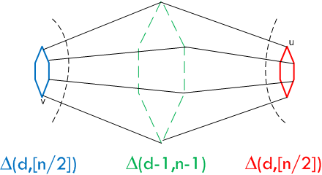
Option: another proof
Let P be a d-dimensional polyhedron with n facets, and let v and u be two vertices of P.
Let kv [ku] be the maximal positive number such that the union of all vertices in all paths in G(P) starting from v [u] of length at most kv [ku] are incident to at most n/2 facets.
Clearly, there is a facet F of P so that we can reach F by a path of length kv + 1 from v and a path of length ku + 1 from u. We claim now that kv ≤ ∆(d, [n/2]), as well as Ku ≤ ∆(d, [n/2])
F is a facet in the lower (d-1 dimension) space with maximum n-1 facets
∆(d,n) ≤ ∆(d-1,n-1)+2∆(d,[n/2])+2
Notes:
The proof was cite from “A quasi-polynomial bound for the diameter of graphs of polyhedra”
At beginning the confusion was caused by the phase “incident to”, it means “connect to” here, but I don’t know this meaning before.
It let a path start from v to travel some vertices and make the vertices incident to n/2 facets, then do the same thing to u
Kv is the length of the path which start from v and the path should satisfy the vertices belong (or to say is a vertex of the facet) to n/2 facets
So there must be at least another one facet can be reached by kv+1, and this facet must be one of the facet in the other n/2 facet set.
∆(d-1,n-1) is the steps to travel in F

Slide 17
Agenda
Indentify problem
The best upper bound
Summary

Slide 18
Summary
The Hirsch Conjecture was disproved
The statement of the Hirsch conjecture for bounded polyhedra is still open

Slide 19
Cites
Gil Kalai and Daniel J. Kleitman
A QUASI-POLYNOMIAL BOUND FOR THE DIAMETER OF GRAPHS OF POLYHEDRA
Ginter M. Ziegler
Lectures on Polytopes - Chapter 3
Who solved the Hirsch Conjecture?
Gil Kalai
Upper Bounds for the Diameter and Height of Graphs of Convex Polyhedra*
A Subexponential Randomized Simplex Algorithm (Extended Abstract)

Slide 20
End
Thank you

Slide 21
Document History
Version | Author | Date | Purpose
Initial | Erik Wang | 11/20/13 | For 749 presentation
1st revision | Erik Wang | 11/21/13 | For Dr. Deza review Revised: [All] Remove research history [All] Spelling check [All] Add more comments for each slide [P3] Revise the definition of diameter of graph [P4] Give definition to d and n [P15] Add comment to the result of diameter, point out the progress is that the complexity was improved from exponential to sub exponential [P16] Arrange the proof, keep main points, add a diagram as demonstration

Slide 22
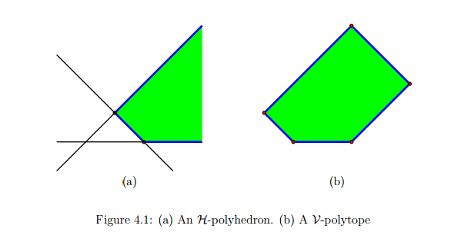
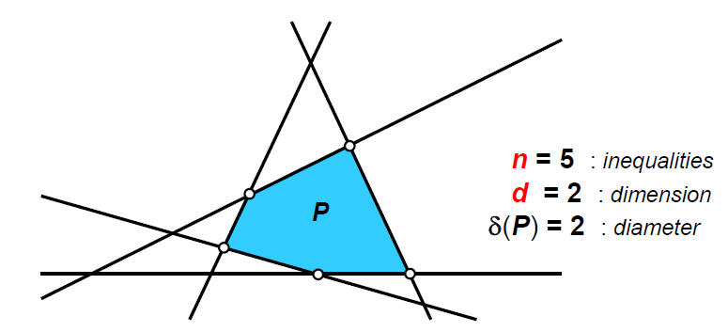
Backup slides

Slide 23

Idea of the proof – Mathematics Induction
Mathematical induction infers that a statement involving a natural number n holds for all values of n. The proof consists of two steps:
The basis (base case): prove that the statement holds for the first natural number n. Usually, n = 0 or n = 1.
The inductive step: prove that, if the statement holds for some natural number n, then the statement holds for n + 1.

Slide 24

Hirsch conjecture - 1957
Warren M. Hirsch (1918 - 2007)
The Hirsch conjecture: For n ≥ d ≥ 2, let ∆(d, n) denote the largest possible diameter of the graph of a d-dimensional polyhedron with n facets.
Then ∆ (d, n) ≤ n − d.

Slide 25

Previous research – best lower bound and improvement
Klee and Walkup in 1967
Hirsch conjecture is false while:
Unbounded polyhedera
The best lower bound of n≥2d, ∆ (d, n) ≥ n-d + [d/5]
Barnette
1967 - Improved upper bound
Larman
1970 - Improved upper bound

Slide 26

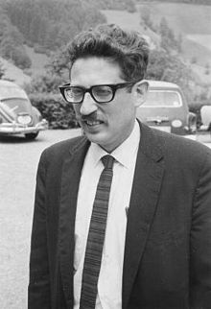


So far the best upper bound
Gil Kalai, 1991
“upper bounds for the diameter and height of polytopes”
Daniel Kleitman in 1992
A quasi-polynomial bound for the diameter of graphs of polyhedra
Simplification of the proof and result of Gil’s
Gil Kalai
Daniel Kleitman
Notes:
By find a quasi-polynomial inequality?
Daniel – here is a substantial simplification that was subsequently found by Daniel

Slide 27

Disprove of Hirsch Conjecture
Francisco “Paco” Santos (*1968)
Outstanding geometer in Polytopes community
Disproved Hirsch Conjecture in 2010, by using 43-dimensional polytope with 86 facets and diameter bigger than 43.
Notes:
I heard that some phd. cried for this disprove who did research based on Hirsch Conjecture

Slide 28

George Dantzig (1914–2005)
Dantzig’s simplex algorithm for LP

Slide 29
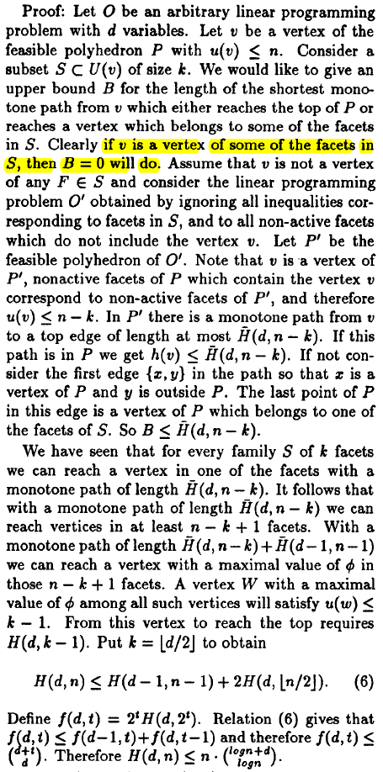
Proof from “A Subexponential Randomized Simplex Algorithm (Extended Abstract)”
Proof from
“A Subexponential Randomized Simplex Algorithm (Extended Abstract)”

