Slide 1
EGO VEMKD Performance Analysis Tool
Symphony Support Toronto Team
Sep 2015

Slide 2
Background
Some issues are caused by VEMKD performance.
We have logs but can’t use them efficiently
Current VEMKD performance log
Hard to understand trend during a period of time
Hard to explain to customer
Goal
Help support engineers and customers to understand VEMKD performance

Slide 3
Check VEMKD performance
By default VEMKD will log all operation time in a cycle
EGO_PERF_LOG_INTERVAL=300
chanPoll + discipline + refreshlock +…. = 300 seconds
chanPoll – large is better, if it is small, then we can check which function took more time

Slide 4
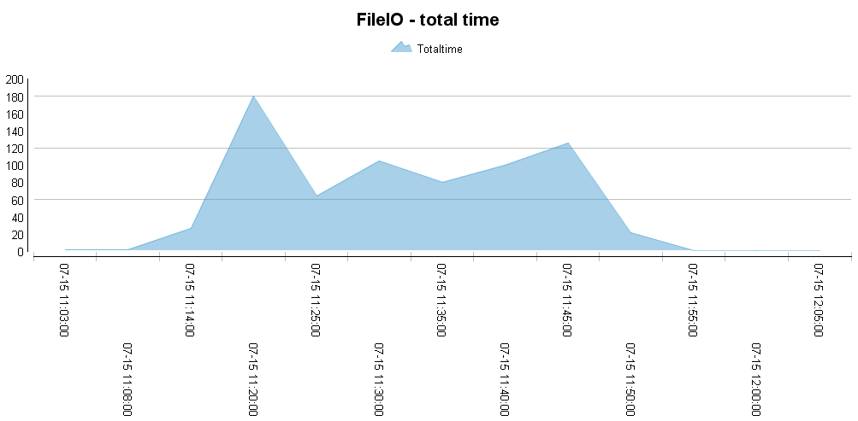
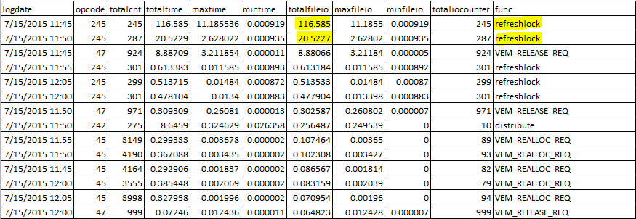
VEMKD Performance logs
VEMKD performance logs
2015-06-08 23:41:49.000 EDT WARN [10662:47427390956096] printPerf: op code <20> totalCnt <2238> totalTime <0.037743> maxTime <0.000735> minTime <0.000007> totalFileIO <0.011466> maxFileIO <0.000034> minFileIO <0.000002> totalIOCounter <2238> totalChanOpenTime <0.000000> maxChanOpenTime <0.000000> minChanOpenTime <0.000000> func <VEM_CONTAINER_STATUS_UPDATE>
2015-06-08 23:41:49.000 EDT WARN [10662:47427390956096] printPerf: op code <35> totalCnt <891> totalTime <0.530613> maxTime <0.019354> minTime <0.000152> totalFileIO <0.000000> maxFileIO <0.000000> minFileIO <0.000000> totalIOCounter <0> totalChanOpenTime <0.000000> maxChanOpenTime <0.000000> minChanOpenTime <0.000000> func <VEM_HOST_INFO>

Slide 5
Symphony Insight Case study
Technical Specifications
Agile
Modularity design
Flexible configuration
Features
Import and parse vemkd performance logs into database
Command line and Web interface
Online view or export to PDF/HTML
Modules
SiShell – Java
Report engine – Eclipse BIRT
Web – Tomcat + JSP

Slide 6
Symphony Insight ( tentative name)
BIRT Report design tool
Symphony
Vemkd perf logs
Report design
Parser
DB module
Report generator
Web
SiShell

Slide 7
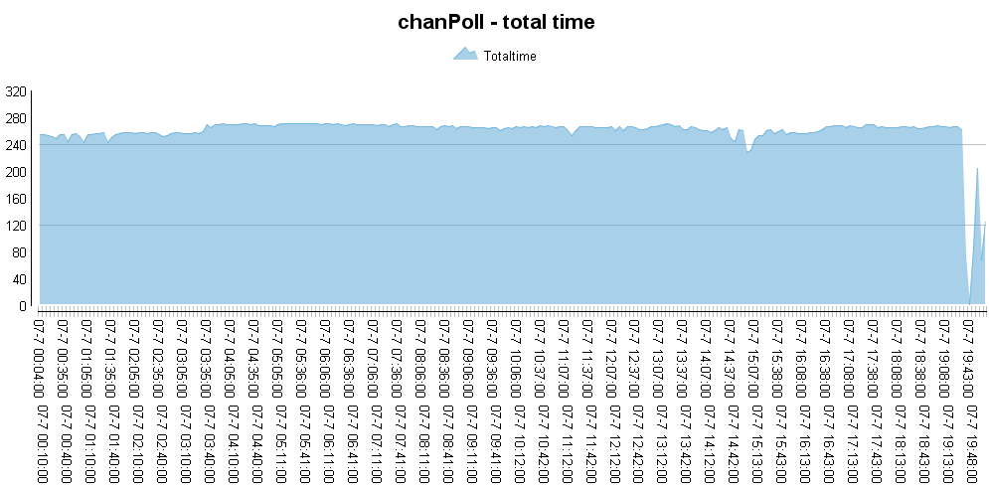
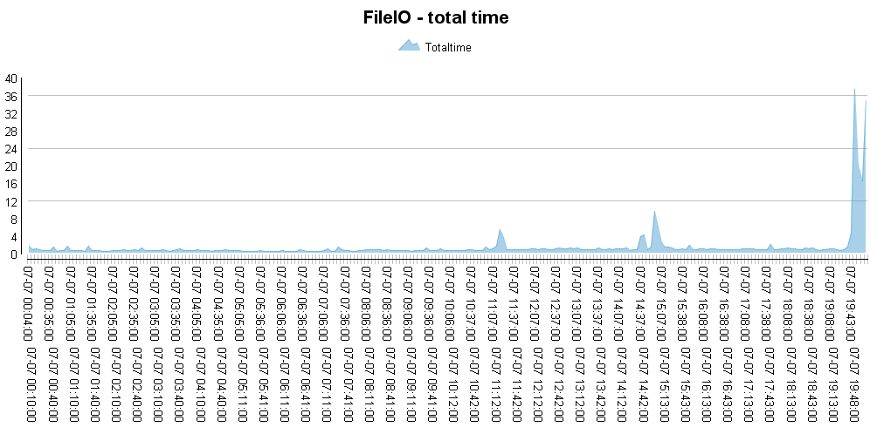
Symphony Insight Case study
PMR:
58838,499,000 LE cluster down
Customer: Fannie Mae
Symptom:
Master host had very low performance - Can ping, can’t ssh
The fail-over was partially completed. Some ego service didn’t start
Investigation:
Use our tool to visulaize VEMKD performance log
chanPoll has a significant decrease corresponding to IO time increasing
Suggested customer to check shared network file system performance
Customer will have new storage vendor in this December

Slide 8
Symphony Insight
DEMO

