Slide 1
CHANGE DATA CAPTURE (CDC)
IN ORACLE
Venki Krishnababu
Senior Oracle DBA
Nordstrom IT

Slide 2
AGENDA
CDC INTRODUCTION
CDC CONCEPTS
CDC CASE STUDY
CDC PROCESS FLOW
CDC PUBLISHER/SUBSCRIBER SETUP
CDC BEST PRACTICE
DEMO
Q & A

Slide 3
INTRODUCTION
CDC is an oracle tool which can help to manage data changes and capture them in consistent manner with predefined APIs.
CDC is not a development solution to perform any validations or transformation or provide any application specific checks etc.
CDC doesn’t require any changes to the existing data model.
CDC most commonly used to capture transactional changes from an OLTP system and publish the changes to one or more subscription systems.

Slide 4
CONVENTIONAL METHOD TO CAPTURE DATA CHANGES
CAPTURING DATA CHANGE
  Table Differencing
    Heavy resource intensive SQLs
    Intermediate change values cannot be captured
    Multiple changes on one transaction cannot be captured
  Change Value Based on Timestamp
    Potentially expensive queries against Source Tables.
    Intermediate change values cannot be captured
    Multiple changes on one transaction cannot be captured
    Possibility of missing a changed record during extract
    Source system have to be design giving consideration to this approach.
  Custom Built Triggers
    Custom Development work.
    Cost associated with extensive development and testing.
    Cost proportional to the complexity of the project.
    If not designed properly can potentially cause performance issues to source system.

Slide 5
WHAT CDC CAN OFFER
CDC offers cost savings by simplifying the extraction of change data from database as its part of Oracle 9i database and later versions.
CDC Captures change data resultant of DML operations including the before and after update values of an update operation.
Data changes are captured automatically to change table.
Very friendly simple to use APIs to publish and subscribe to the changes.
Can be scripted with very little effort.
Asynchronous CDC captures data with very little performance impact. Best of both worlds.
Automatic purge of consumed or obsolete change data captured in change table.
CDC ensures that every subscriber sees all changes.
Efficient tracking of multiple subscribers and provides a shared access to the changed data.

Slide 6
WHAT CDC CANNOT DO?
CDC purely worked based on logged operations, so any nonlogged DML operations are not captured.
CDC doesn’t support direct load insert.
CDC cannot be implemented on table with TDE (Transparent Data Encryption) enabled.
Asynchronous mode capture wont work without supplemental logging.
Although direct select is possible on change table but the extraction of the changed data is valid/supported only via subscriber views.

Slide 7
CDC CONCEPTS
PUBLISHER/SUBSRIBER MODEL
PUBLISHER
SUBSCRIBER
Table#1
Changes# 1
Subscription#1
Table#2
Changes# 2
Subscription#2

Slide 8
SYNCHRONOUS CDC
Based on Triggers
Supported in Oracle 9i and later versions
Triggers on source database captures the change immediately.
Captured data is made part of the source system transaction.
Available with Standard and enterprise edition.
Adds overhead to the source system during the capture time.
Built-in triggers are automatically created by invoking the CDC APIs.

Slide 9
ASYNCHRONOUS CDC (HOTLOG MODE)
Changes are captured from redo log files after the DML transaction is completed.
Changed data is not part of the source transaction.
Minimal latency involved.
Minimal Performance overhead to source system.
Log writer records the committed transactions to online redo logs.
Local Oracle Stream process reads the redo log files and captures the changes to change table.

Slide 10
ASYNCHRONOUS CDC (AUTOLOG MODE)
Changes are captured from set of redo log files managed by redo transport service. (Part of Data Guard Framework).
Autolog Online Mode : Changes are captured from redo log files.
Autolog Archive Mode : Changes are captured from archive log files.
Changed data is not part of the source transaction.
Minimal latency involved.
Minimal Performance overhead to source system.
If the changes are extracted to a change table in a staging the data is transferred via LAN using Oracle Net.
Source and staging database should run same OS and Oracle Version.

Slide 11
CDC TERMINOLOGY
CHANGE SOURCE
  Logical representation of Source Database.
CHANGE SET
  Logical grouping of Change data. This grouping enables to provide transaction consistent images of multiple change tables in the same set.
  Change tables within a change set can be joined.
CHANGE TABLE
  Change data resulting of DML operation are stored in the table.
  This table acts a container/staging area to stage changed data.
  Subscription views are built based on Change table.
PUBLISHER
  Person who captures and publishes changed data.
  DBA creates and maintains schema objects make up part of CDC.
  Usually one publisher per source system.

Slide 12
CDC TERMINOLOGY (Contd..)
SUBSCRIBER
  Applications and individuals who consume the changed data.
  Multiple applications can subscribe to the same set of changes.
STAGING DATABASE
  Database to which the captured change data is applied.
  Source Database can be staging database.
SUBCRIBER VIEW
  View that specifies the change data from a specific publication in a subscription.
SUBSCRIPTION WINDOW
  Range of rows in a publication that the subscriber can view through subscriber views.

Slide 13
CDC Case Study
Capture Supplier information changes from Inventory system.
Near real time Supplier information update.
Average few hundred supplier information changes per day.
Very little coding effort.
Scope is to just capture the changes on supplier master table.
CDC Implementation
  Mode : Synchronous
  Publisher : 1
  Change Set :1
  Subscriber :1

Slide 14
CDC Case Study (Contd..)
Oracle 9i
Change Table
Final/DW Tables
Based On Trigger
Transform
PL/SQL
OLTP
DB
PL/SQL to extract/transform change data
Publish/subscribe paradigm
Parallel transformation of data
Store final processed changed data in staging table.
Or extract the change in a transformed form the change table

Slide 15
CDC CASE STUDY (Contd..)
POSSIBLE FUTURE ENHANCEMENTS
  Upgrade to Oracle 10g Release 2.
  Turn on Supplemental logging on Supplier Master.
  Perform Asynchronous mode data change capture using (Hotlog Mode).
  Disable synchronous mode data change capture.
  Implement Asynchronous CDC to establish CIM (Common Information Model) for product.

Slide 16
CDC SETUP OUTLINE
PUBLISHER SETUP:
Identify the source tables.
Set up a publisher.
Create change tables.
Optionally setup dedicated publisher and subscriber accounts.

Slide 17
CDC SETUP OUTLINE (CONTD.)
SUBSCRIBER ONE TIME SETUP :
  Set up a subscriber.
  Subscribe to the source tables.
  Activate the subscription.
CYCLIC SUBSCRIPTION PROCESS :
  Set up the CDC window and extend the window.
  Consume the changed data using subscriber views.
  Purge the consumed data window.
  Repeat the steps in cycle.

Slide 18
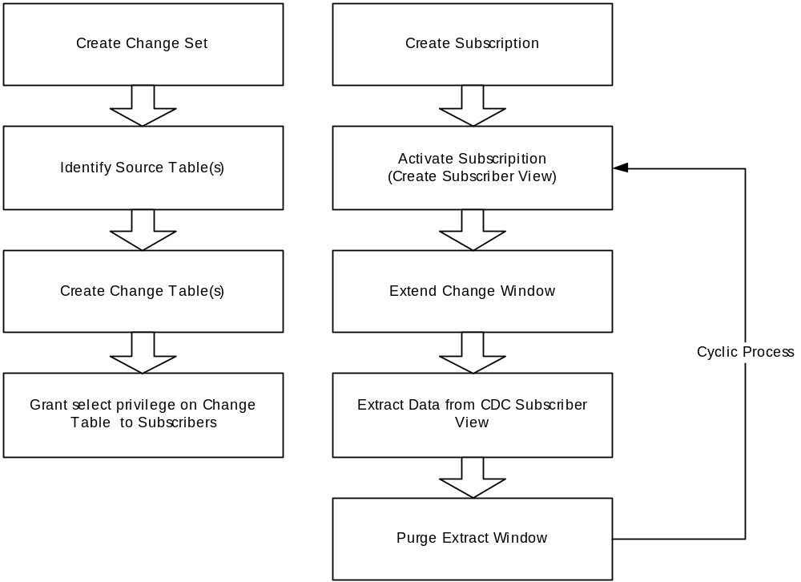
CDC PROCESS FLOW (OVERVIEW)

Slide 19
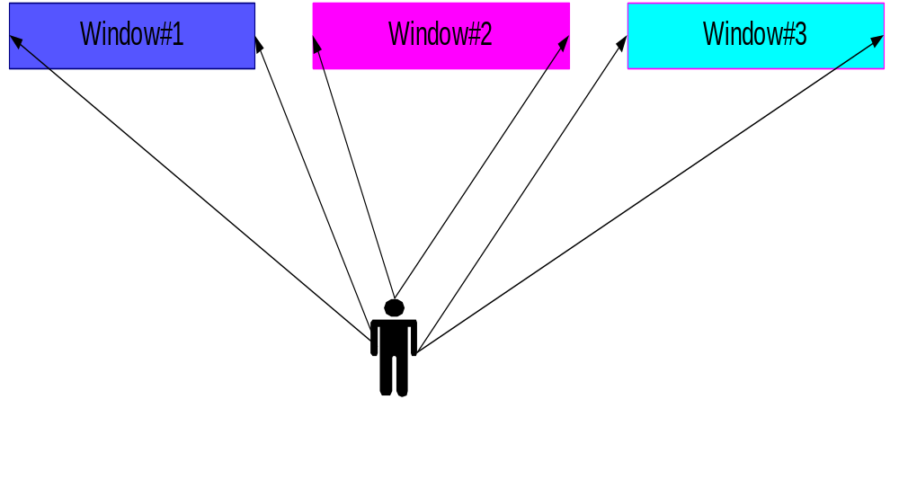
SUBSCRIPTION WINDOW MOVEMENT

Slide 20
PUBLISHER SETUP
--Step1: Create Change Set for cdc_demo publish
begin
dbms_cdc_publish.create_change_set(
change_set_name=>'DEMO_DAILY',
description=> 'Change Set for emp_demo table',
change_source_name=>'SYNC_SOURCE');
end;
/
--Step 2: Create Change Table for cdc_demo publish
begin
dbms_cdc_publish.create_change_table(
owner =>'cdc_pub',
change_table_name=>'emp_demo_changes',
change_set_name => 'DEMO_DAILY',
source_schema =>'HR',
source_table =>'EMP_DEMO',
column_type_list =>'EMPLOYEE_ID NUMBER, FIRST_NAME VARCHAR2(35),
LAST_NAME VARCHAR2(35), SALARY NUMBER(8,2)',
capture_values=> 'BOTH',
RS_ID=> 'Y',
ROW_ID=>'Y',
USER_ID=>'Y',
TIMESTAMP=>'N',
OBJECT_ID=>'N',
SOURCE_COLMAP=>'Y',
TARGET_COLMAP=>'Y',
OPTIONS_STRING => ' TABLESPACE CDC_DATA pctfree 5 pctused 95' );
end;
/
grant select on cdc_pub.emp_demo_changes to cdc_sub;

Slide 21
SUBSCRIBER ONE TIME SETUP
--Step 1: Create Subscription
begin
dbms_cdc_subscribe.create_subscription(
change_set_name => 'DEMO_DAILY',
description => 'Change data for WH',
subscription_name=>'EMP_DEMO_SUB');
end;
/
--Step 2: Subscribe to required columns of source table
begin
dbms_cdc_subscribe.subscribe(
subscription_name=>'EMP_DEMO_SUB',
source_schema=>'HR',
source_table=>'EMP_DEMO',
column_list=>'EMPLOYEE_ID,FIRST_NAME,LAST_NAME,SALARY',
subscriber_view=>'v_emp_demo_changes');
end;
/
--Step 3: Activate Subscription
begin
dbms_cdc_subscribe.activate_subscription (
subscription_name=>'EMP_DEMO_SUB');
end;
/
--Step 4 : Show CDC Subscriber View Definition. (Optional)
desc v_emp_demo_changes

Slide 22
SETUP CYCLIC SUBSCRITPION
--Step 1 Get the change (extend the window).
begin
dbms_cdc_subscribe.extend_window(
subscription_name=>'EMP_DEMO_SUB');
end;
/
--Step 2 Read from the CDC view (capture the change)
select employee_id,first_name,last_name,salary
from v_emp_demo_changes;
--Step 3 Purge the window of consumed data
begin
dbms_cdc_subscribe.purge_window(
subscription_name=>'EMP_DEMO_SUB');
end;
/

Slide 23
SUBSCRIBER VIEW SAMPLE DEFINITION
CREATE OR REPLACE FORCE VIEW "CDC_SUB"."V_EMP_DEMO_CHANGES"
("OPERATION$","CSCN$","COMMIT_TIMESTAMP$","ROW_ID$",
"RSID$","SOURCE_COLMAP$","TARGET_COLMAP$","USERNAME$",
"EMPLOYEE_ID","FIRST_NAME","LAST_NAME","SALARY")
AS
SELECT
OPERATION$,CSCN$,COMMIT_TIMESTAMP$,ROW_ID$,
RSID$,SOURCE_COLMAP$,TARGET_COLMAP$,USERNAME$,
"EMPLOYEE_ID","FIRST_NAME","LAST_NAME","SALARY"
FROM
"CDC_PUB"."EMP_DEMO_CHANGES"
WHERE CSCN$ >= 538180 AND CSCN$ <= 538179
WITH READ ONLY

Slide 24
CDC SOME BEST PRACTICE
Capture overhead is proportional to amount of data we capture, so capture only require/relevant columns while creating change table.
Create dedicated publisher account to administer CDC publications.
Split publications to two subsets to provide secured subset to one set of subscribers and another subset to another set of subscribers.
If old values are not require ensure to capture only new values. (parameter CAPTURE_VALUES=>’NEW’).
Use force logging option to capture even the changes out of direct load insert or inserts with nologging. Use this force logging with caution as it may introduce performance overhead.
To minimize performance impact optionally you can move the source table to a separate tablespace and turn on force logging at tablespace level instead of database level.
Use DBMS_CDC_PUBLISH.PURGE… procedure to purge obsolete data from change table.
Get the audit information as part of the CDC capture.
Capture only selective/relevant control columns on the change table.
Use options_string clause to specify storage clause and parameters.
Do not specify any constraints on change table as it adds further performance overhead during the time of capture. Perform data validations at the destination.
Recommended for Capturing changes from transactional source.

Slide 25
CDC CATALOG VIEWS
PUBLISHER RELATED
  CHANGE_SOURCES
  CHANGE_SETS
  CHANGE_TABLES
  DBA_PUBLISHED_COLUMNS( ALL,USER)
SUBSCRIBER RELATED
  DBA_SOURCE_TABLES (ALL, USER)
  DBA_SUBSCRIPTIONS (ALL,USER)
  DBA_SUBSCRIBED_TABLES
  DBA_SUBSCRIBED_COLUMNS (ALL,USER)

Slide 26
CDC CHANGE TABLE PURGE
Recommended and supported method to purge change table is using CDC native purge procedures.
Cannot purge data which are not yet consumed by subscriber. Only inactive/obsolete data are purged by CDC purge procedures.
DBMS_CDC_PUBLISH.PURGE_CHANGE_TABLE
DBMS_CDC_PUBLISH.PURGE_CHANGE_SET
DBMS_CDC_PUBLISH.PURGE_CHANGE_SOURCE

Slide 27
DEMO
OBJECTIVES:
Capture change from employees table stored in a sample schema.
Use CDC Synchronous Mode
Display metadata of the change table.
Investigate the contents of the change table.
Perform incremental change capture using cyclic subscription process.
If Time permits Demo CDC Aysnchronous HotLog Mode (Oracle 10g).

Slide 28
THANK YOU
Contact : venki.krishnababu@nordstrom.com

