Slide 1
Research Project

Slide 2
Instructions
You MUST have a laptop with the internet browser Google Chrome downloaded and running on your machine.
Navigate to the following URL
Click the button in the middle of the screen labeled “Participate”
Write down the username randomly generated for you on the notecard we provided
Fill in the registration form and wait until you receive further instructions
bit.ly/psyc211w

Slide 3
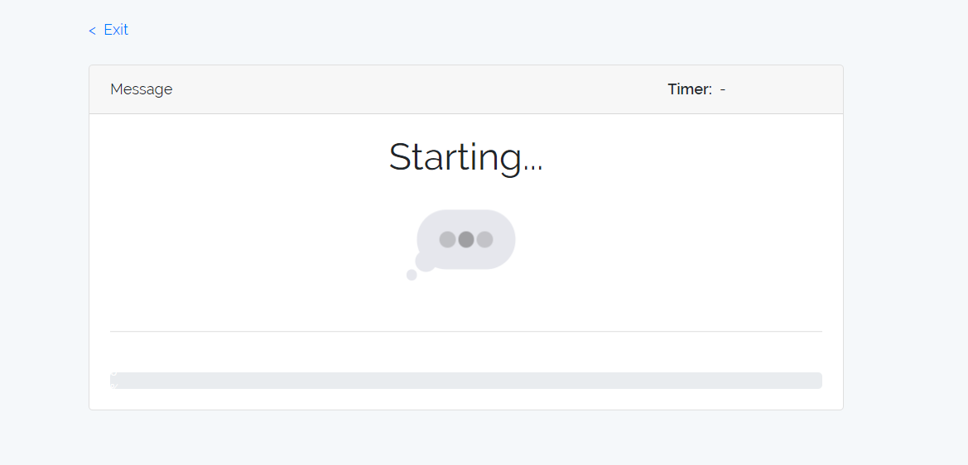
Disclaimer
Some of the information presented to you may be considered offensive, and if at any time you feel uncomfortable you are allowed to exit the experiment. You can do so by clicking the “Exit” button on the top left corner of your screen.
Additionally, you may run into an error when going through the experiment. If you encounter any issues whatsoever, please raise your hand and the experimenter will come help.

Slide 4
Instructions cont.
Please remain quiet during the entire testing period.
You will be presented with a text message followed by a question regarding that message. Please answer the question to the best of your ability.
Each message will only be displayed for 5 seconds. Please read it carefully.
Each question will only be displayed for 10 seconds. A timer will display in the upper right hand corner to indicate the amount of time remaining to answer the question. Please note that the timer may stutter or begin late, but no matter what the timer says, the question display for 10 seconds.
Do your best to answer the question in the allotted time. If you do not answer the question in the time given, it will be marked incorrect. When you are finished with the question, you may click next to continue, regardless of the time remaining.
Your progress will be shown on the green bar at the bottom of the screen.
When you are finished, please remain quiet until all participants have finished.

Slide 5
Thank you!

