Slide 1
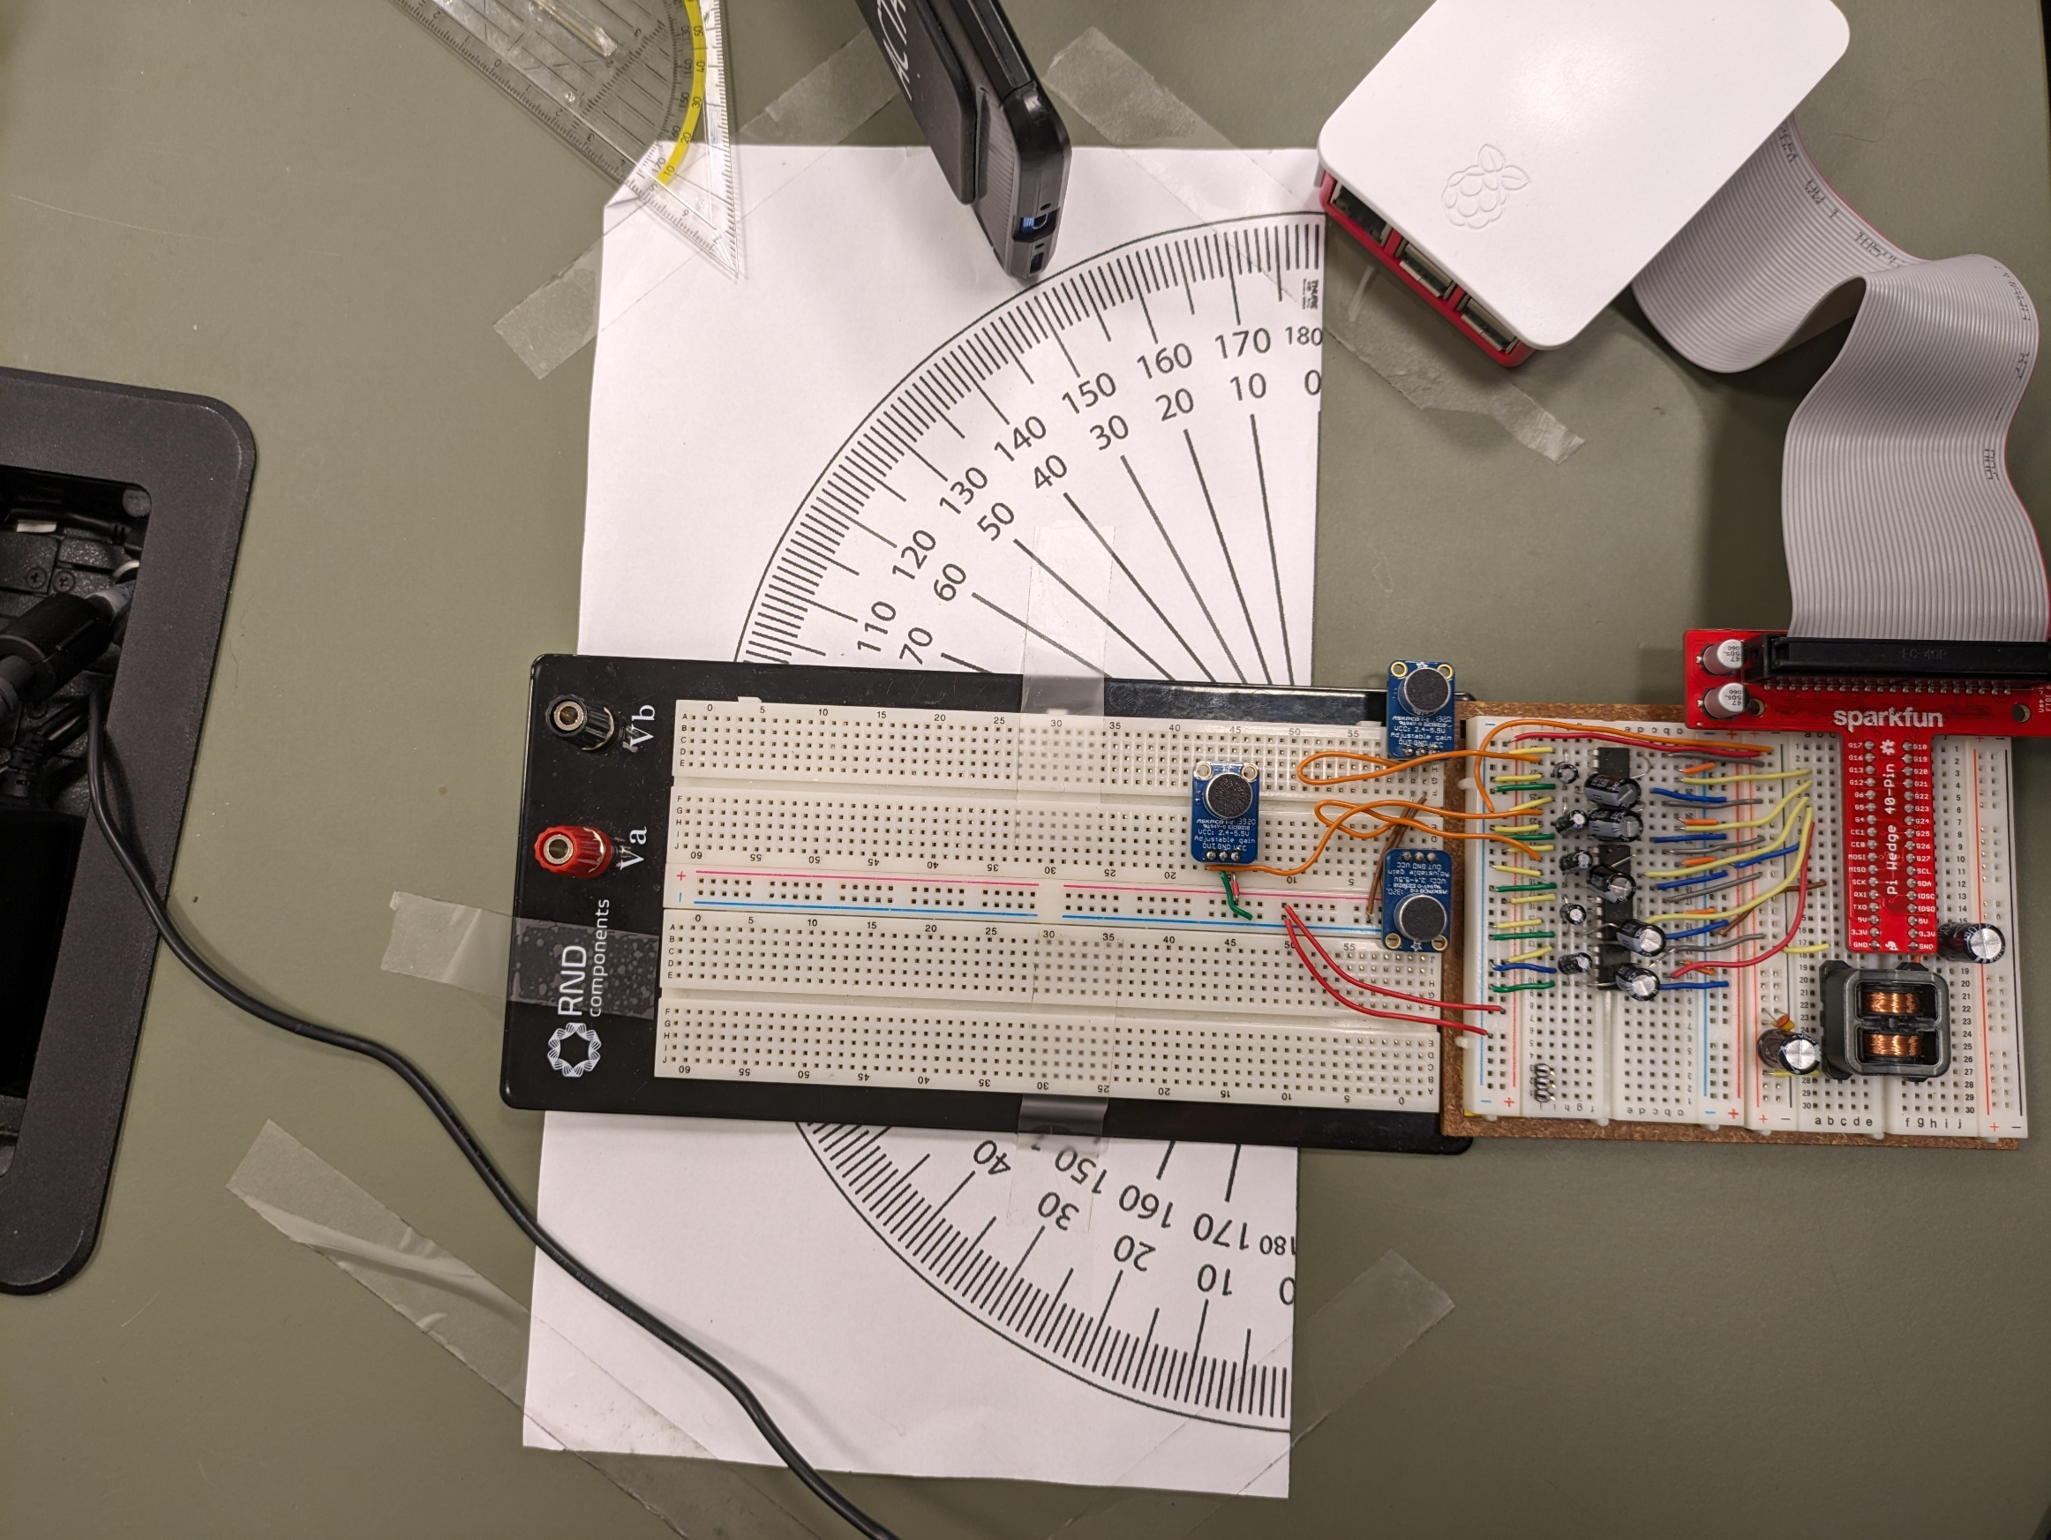
Mic1
Mic2
Mic3

