Slide 1

Alpaka – An Abstraction Library for Parallel Kernel Acceleration
Erik Zenker^{1,2}, Benjamin Worpitz^{1,2}, René Widera¹,Axel Huebl^{1,2},
Guido Juckeland¹, Andreas Knüpfer², Wolfgang E. Nagel², Michael Bussmann¹
¹ Helmholtz-Zentrum Dresden – Rossendorf
² Technische Universität Dresden
Notes:
- Dear Ladies and Gentleman thank you for attending our talk on “...”
- It is a pleasure for us to present our work today.
- My name is … and this is Erik Zenker.
- We are both from the german national lab “Helmholz...”
- Erik and me we are two developer and Maintainer of the Code PIConGPU and the library ALPAKA.
- I give you a brief overview about our talk.
- I start with a short introduction about PIConGPU and the technics to be on of the fastest plasma codes in the world.
- In the second part Erik will introduce the concepts behind the abstraction library for parallel kernel acceleration.

Slide 2

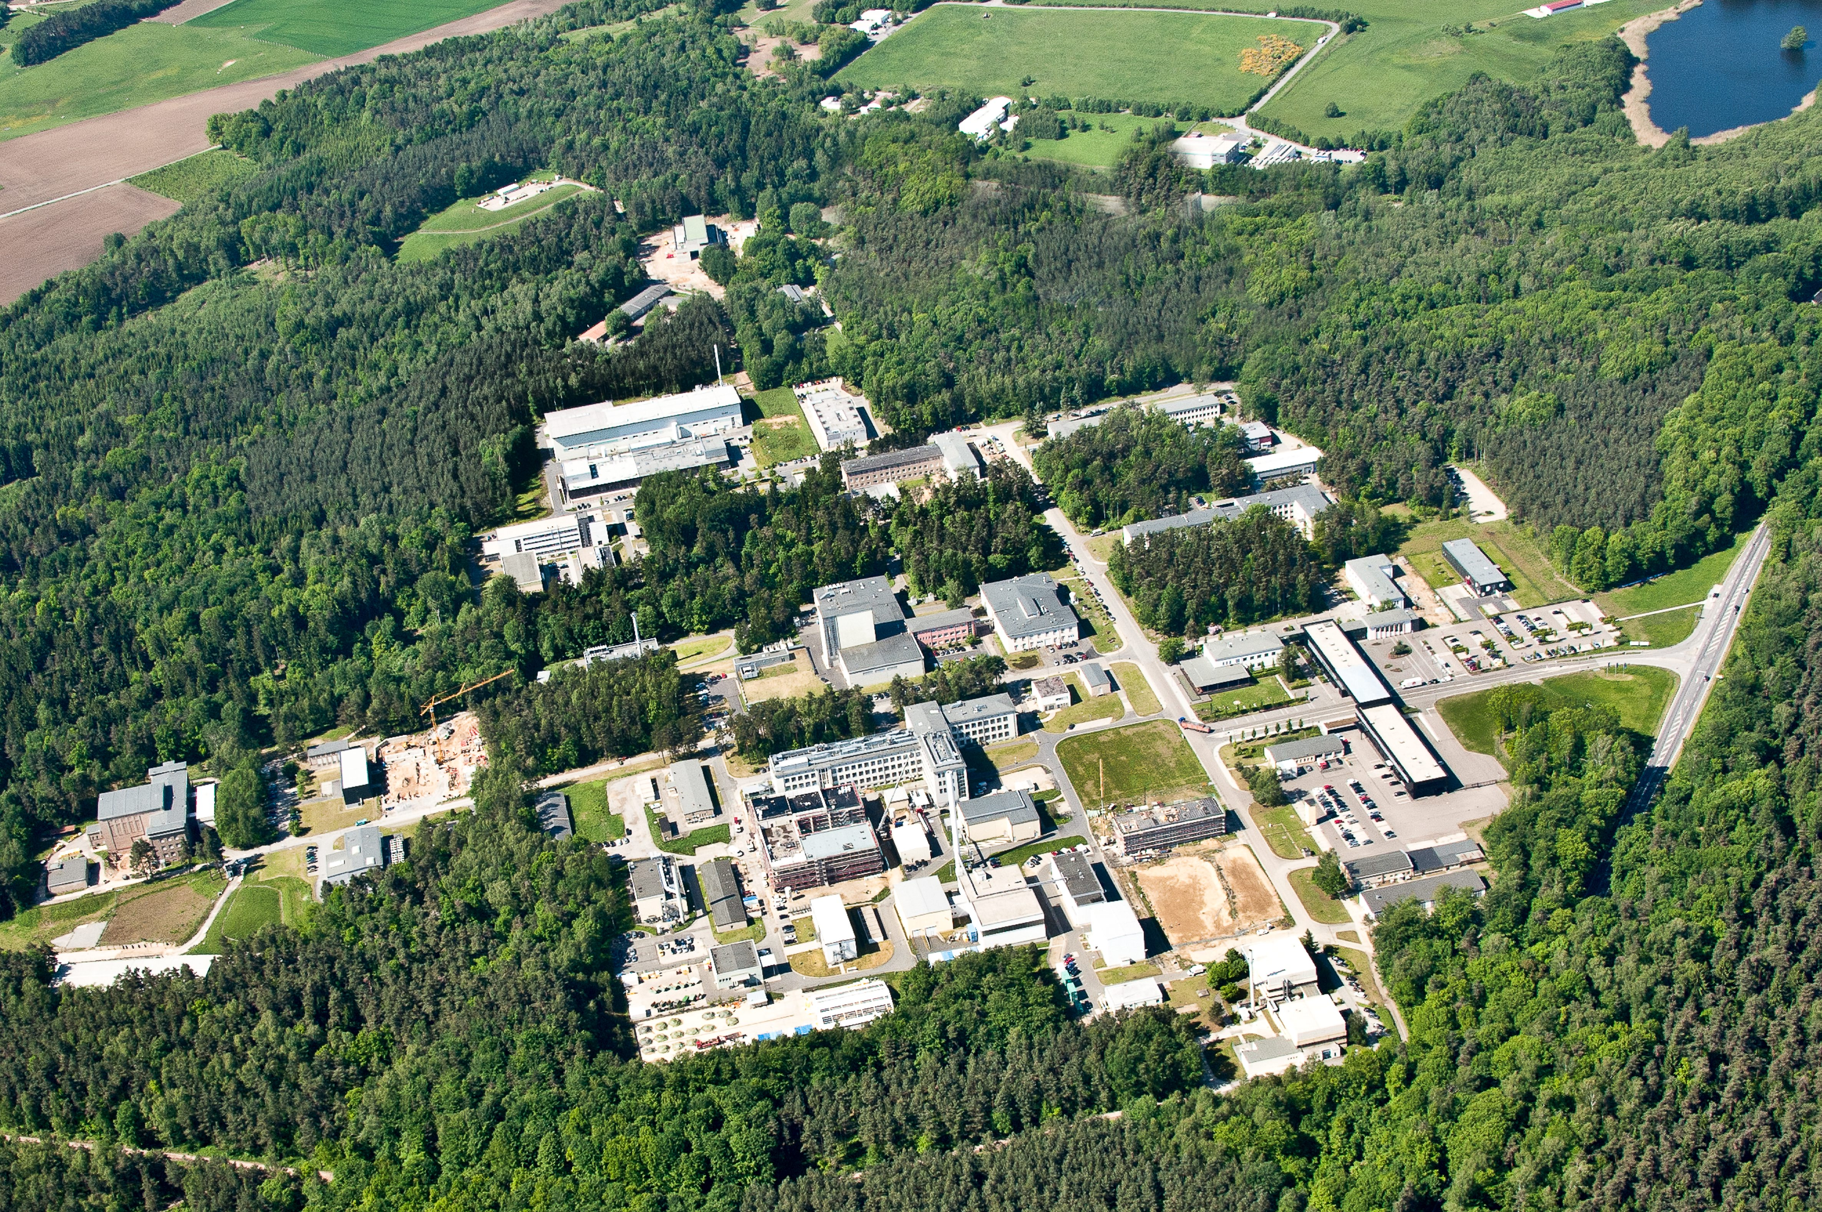
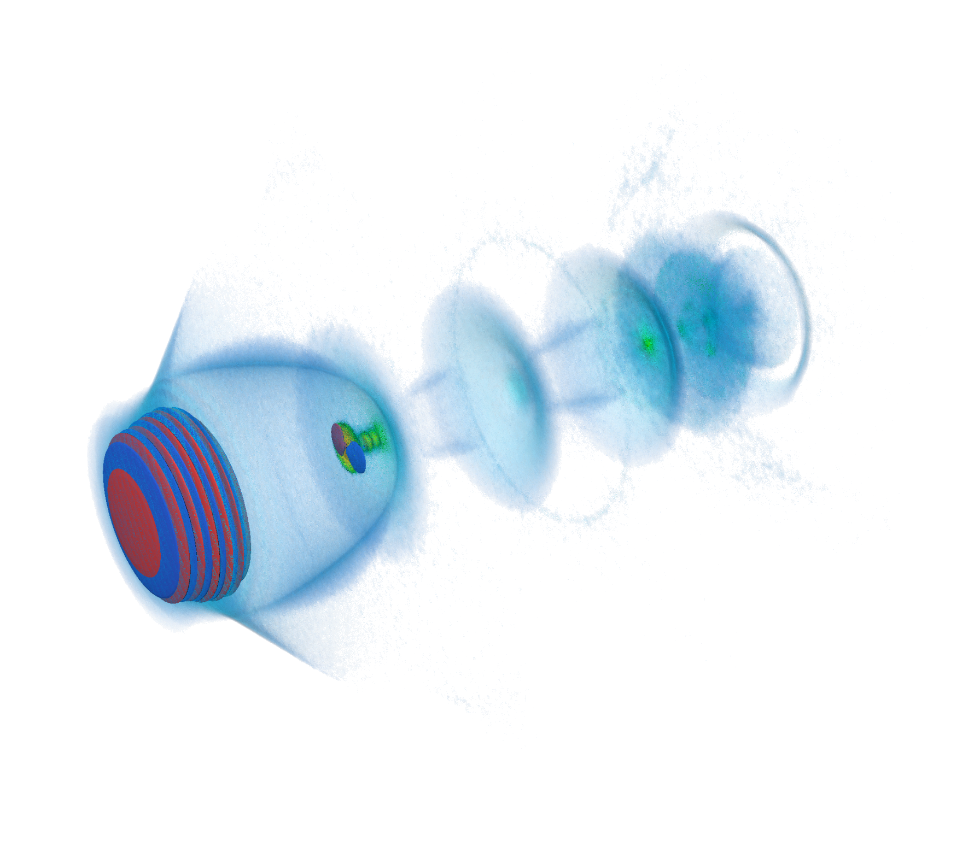
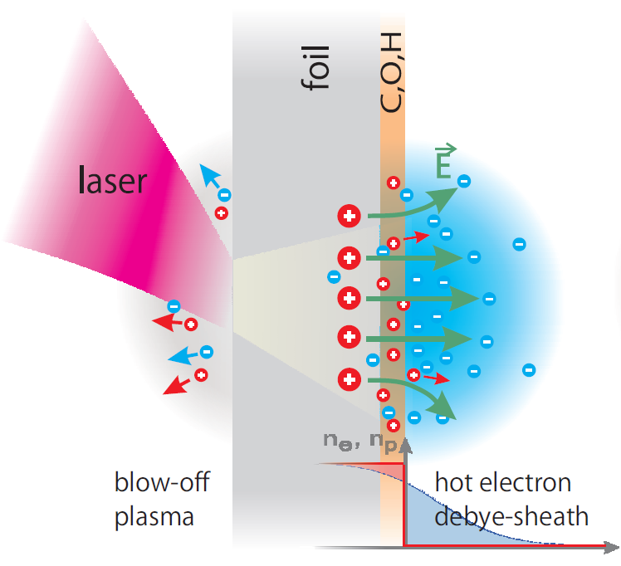
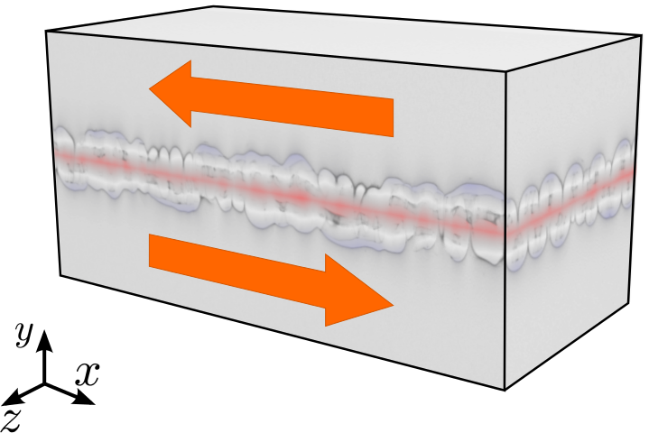
We Have Lasers : Risk of Forest Fires !
Electron Acceleration
with Lasers
Compact X-Ray sources
Ion Acceleration
with Lasers
Tumor Therapy
Plasma Instabilities
Astrophysics
Notes:
- relativistic particle in cell code
- we develop the code since 7 year in coperation with the “center for information services and hight performance computing” of the technical university dresden
- code and the development cycle is fully open source and centered around github.
- A Particle in Cell Code describe the dynamics of a plasma by computing the motion of electrons and ions based on Maxwell's equations
- This code can used to study different phenomenas like “electron acceleration with lasers”
- shoot with a laser on hydrogen gas
- …. ions
- Another application we run is the Kelvin Helmholz instability. With that we were one of the finalists for the gordon bell price in 2013.

Slide 3

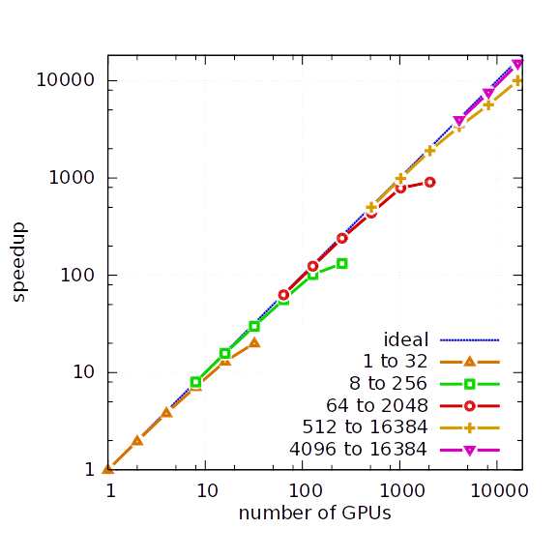
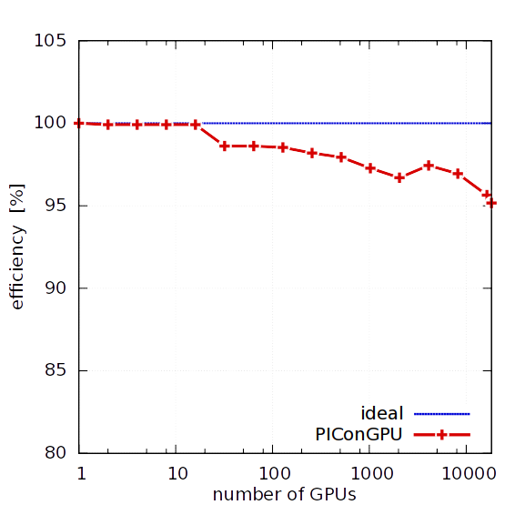
PIConGPU ─ Scales up to 18,432 GPUs
strong scaling
weak scaling efficiency
Efficiency > 95%
6.9 PFlop/s (SP)
Notes:
- We have tested the scaling of PIConGPU on titan, the second largest system in the world which is located at the OAK RIDGE National Laboratory in the US.
- For the strong scaling the global simulated volume is fixed in size and the number of gpu is increased. This means that we get a faster time to solution for the some problem size.
- We evaluated the scaling from 1 to 16k gpus and get this nice scaling result.
- For the weak scaling each gpu gets the same amount of work.
- The total simulation volume is increased with the number of gpus from one to 16k gpus.
- For that case we get a parallel efficiency of over 95% and a measured performance of 6.9 Pflops single precision

Slide 4
Alpaka
Notes:
Because of our long experience with the programming of heterogeneous systems we have some requirement for this kind of interface
Heterogeneous, Testable, Sustainable, Optimizable, Open Source
Can we provide such an interface?
Yes we can, but we do not need to reinvent the wheel we reuse existing solutions.

Slide 5
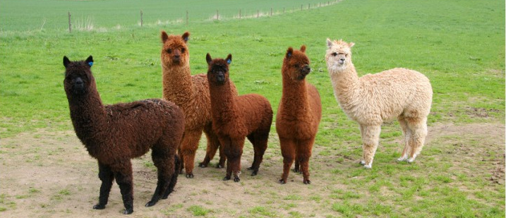



Good News: There are Alpakas on the Compute Meadow
C++
Threads
TBB
Single zero overhead interface to existing parallelism models
Single source C++11 kernels
Data-agnostic memory model
Notes:
Our solution is Alpaka
Alpaka is an abstract interface to existing parallelism models and follows the successful programming model of CUDA where a kernel is offloaded to a multidimensional grid of threads
Alpka code is pure C++11 code and can be compiled to Intel, AMD, NVIDIA and PowerPC Architectures with the need to provide a particular source file for each architecture.
Furthermore, Alpaka does not dicate the use of particular memory containers or memory types, but it provides a data structure agnostic memory model.

Slide 6
A Uniform Interface to All These Programming Models ?
Interface is defined by a set of free functions with template arguments
Template arguments need to fulfill type requirements (concepts)
Interface is extendable through more concepts implementations (models)
Application code
Zero overhead abstraction interface
Lib₁
Lib₂
Lib_{n}
...
C++ compilers are able to almost completely
remove abstraction layers

Slide 7

Heterogeneous Codes Need to be Maintainable
Heterogeneity
Write once, execute everywhere
Testability
Validate once,
get correct results
everywhere
Sustainability
Porting implies
minimal code changes
Optimizability
Tune for good performance at minimum coding effort
Openness
Open source
and
open standards
Single Source
Notes:
Because of our long experience with the programming of heterogeneous systems we have some requirement for this kind of interface
Heterogeneous, Testable, Sustainable, Optimizable, Open Source
Can we provide such an interface?
Yes we can, but we do not need to reinvent the wheel we reuse existing solutions.

Slide 8
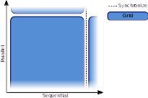
Abstract Hierarchical Redundant Parallelism Model
Notes:
The parallel abstraction model is very similar to CUDA.
The Grid always executes an entire kernel function, but grids are independent of each other
They run either in parallel or sequential and can synchronize with each other
A Grid is divided in a multidimensional set of blocks, where blocks are executed in parallel or sequential but are not able to synchronize
Each block consists of an n-dimensional set of thread and threads are executed in parallel or sequential. All threads within a block are able to synchronize within a block.
The Element level is an explicit sequential level.
But especially architectures with vectorization capabilities can load several elements into their vector register and process these element within one instruction.

Slide 9
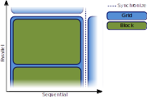
Abstract Hierarchical Redundant Parallelism Model

Slide 10
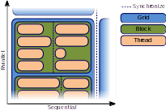
Abstract Hierarchical Redundant Parallelism Model

Slide 11
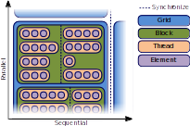
Abstract Hierarchical Redundant Parallelism Model
Element level is an explicit sequential layer

Slide 12
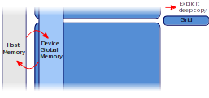
Data Structure Agnostic Memory Model
Notes:
Each parallelization level corresponds to a particular memory
The whole grid has access to a usually large global memory and data needs to be copied explicitly between host and device memory
All threads in an block have access to a small amound of high bandwidth, low latency shared memory.
This memory is usually used for data which is touched multiple times.
Finally each thread has its private register memory
Data transfers between memories has to be done explicitly by the user.
This memory model allows for caching strategies used in PIConGPU
The user can select which data should be put into global or shared memory.

Slide 13
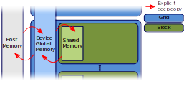
Data Structure Agnostic Memory Model

Slide 14
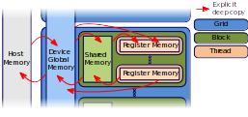
Data Structure Agnostic Memory Model
Notes:
Each parallelization level corresponds to a particular memory
The whole grid has access to a usually large global memory and data needs to be copied explicitly between host and device memory
All threads in an block have access to a small amound of high bandwidth, low latency shared memory.
This memory is usually used for data which is touched multiple times.
Finally each thread has its private register memory
Data transfers between memories has to be done explicitly by the user.
This memory model allows for caching strategies used in PIConGPU
The user can select which data should be put into global or shared memory.

Slide 15
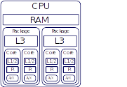
Map the Abstraction Model to your Desired Acceleration Back-End
Explicit mapping of parallelization levels to hardware
Notes:
The advantage of separating the parallelism model and momory model from the real hardware is that we can map these models to various real hardware architecture.
I want to give an example of how to map the abstractio model to a CPU:
The grid is mapped to the full CPU and global memory is located in the main memory
Blocks are mapped to a package of two cores and shared memory is located in the L3 cache
Threads are mapped to cores and thez can use register, L1/L2 cache as private memory
Elements can be processes by the AVX unit of the CPU

Slide 16
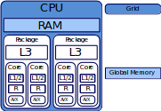
Map the Abstraction Model to your Desired Acceleration Back-End
Explicit mapping of parallelization levels to hardware
Notes:
The advantage of separating the parallelism model and momory model from the real hardware is that we can map these models to various real hardware architecture.
I want to give an example of how to map the abstractio model to a CPU:
The grid is mapped to the full CPU and global memory is located in the main memory
Blocks are mapped to a package of two cores and shared memory is located in the L3 cache
Threads are mapped to cores and thez can use register, L1/L2 cache as private memory
Elements can be processes by the AVX unit of the CPU

Slide 17
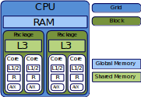
Map the Abstraction Model to your Desired Acceleration Back-End
Explicit mapping of parallelization levels to hardware
Notes:
The advantage of separating the parallelism model and momory model from the real hardware is that we can map these models to various real hardware architecture.
I want to give an example of how to map the abstractio model to a CPU:
The grid is mapped to the full CPU and global memory is located in the main memory
Blocks are mapped to a package of two cores and shared memory is located in the L3 cache
Threads are mapped to cores and thez can use register, L1/L2 cache as private memory
Elements can be processes by the AVX unit of the CPU

Slide 18
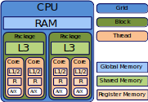
Map the Abstraction Model to your Desired Acceleration Back-End
Explicit mapping of parallelization levels to hardware
Notes:
The advantage of separating the parallelism model and momory model from the real hardware is that we can map these models to various real hardware architecture.
I want to give an example of how to map the abstractio model to a CPU:
The grid is mapped to the full CPU and global memory is located in the main memory
Blocks are mapped to a package of two cores and shared memory is located in the L3 cache
Threads are mapped to cores and thez can use register, L1/L2 cache as private memory
Elements can be processes by the AVX unit of the CPU

Slide 19
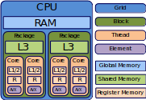
Map the Abstraction Model to your Desired Acceleration Back-End
Explicit mapping of parallelization levels to hardware
Notes:
The advantage of separating the parallelism model and momory model from the real hardware is that we can map these models to various real hardware architecture.
I want to give an example of how to map the abstractio model to a CPU:
The grid is mapped to the full CPU and global memory is located in the main memory
Blocks are mapped to a package of two cores and shared memory is located in the L3 cache
Threads are mapped to cores and thez can use register, L1/L2 cache as private memory
Elements can be processes by the AVX unit of the CPU

Slide 20
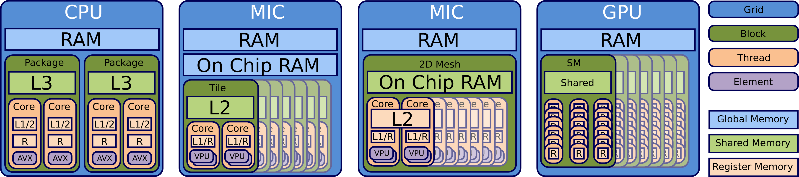
Map the Abstraction Model to your Desired Acceleration Back-End
Specific unsupported levels of the model can be ignored
Abstract interface allows to extend the set of mappings
Notes:
With this abstraction model we can also map to various other architecture such as PowerPC or traditionally to GPUs
Alpaka provides a set of predefined mappings but it is also possible to extend the mapping to new architecture or new version of CUDA
The mapping is totally independent of the user code and can be exchanged independently of the user code.

Slide 21
Alpaka : Vector Addition Kernel
struct VectorAdd
{
template<typename TAcc, typename TElem, typename TSize>
ALPAKA_FN_ACC auto operator()(
TAcc const & acc,
TSize const & numElements,
TElem const * const X,
TElem * const Y) const -> void {
}
};
using alp = alpaka;
auto globalIdx = alp::idx::getIdx<alp::Grid, alp::Threads>(acc)[0u];
auto elemsPerThread = alp::workdiv::getWorkDiv<alp::Thread, alp::Elems>(acc)[0u];
auto begin = globalIdx * elemsPerThread;
auto end = min(begin + elemsPerThread, numElements);
for(TSize i = begin; i < end; ++i){
Y[i] = X[i] + Y[i];
}
Notes:
Because we know the ACC we can use optimized version of functions by C++ template spezialization

Slide 22
Alpaka : Initialization
// Configure Alpaka
using Dim = alpaka::dim::DimInt<3u>
using Size = std::size_t
using Acc = alpaka::acc::AccCpuSerial<Dim, Size>;
using Host = alpaka::acc::AccCpuSerial<Dim, Size>;
using Stream = alpaka::stream::StreamCpuSync;
using WorkDiv = alpaka::workdiv::WorkDivMembers<Dim, Size>;
using Elem = float;
// Retrieve devices and stream
DevHost devHost ( alpaka::dev::DevMan<Host>::getDevByIdx(0) );
DevAcc devAcc ( alpaka::dev::DevMan<Acc>::getDevByIdx(0) );
Stream stream ( devAcc);
// Specify work division
auto elementsPerThread ( alpaka::Vec<Dim, Size>::ones() );
auto threadsPerBlock ( alpaka::Vec<Dim, Size>::all(2u) );
auto blocksPerGrid ( alpaka::Vec<Dim, Size>(4u, 8u, 16u) );
WorkDiv workdiv(alpaka::workdiv::WorkDivMembers<Dim, Size>(blocksPerGrid,
threadsPerBlock, elementsPerThread));
Notes:
An accelerator defines the acceleration strategy by a mapping of the parallelization levels to the hardware architecture
The user needs to decide which accelerator to use for which device
There exists a set of predefined accelerators, but the user can write its own accelerator implementation based on accelerator concepts
Predefined accelerators:
CUDA
OpenMP
Boost Fibers
C++ Threads
Sequential

Slide 23
Alpaka : Call the Kernel
// Memory allocation and host to device memory copy
auto X_h = alpaka::mem::buf::alloc<int, int>(devHost, extent);
auto Y_h = alpaka::mem::buf::alloc<int, int>(devHost, extent);
auto X_d = alpaka::mem::buf::alloc<Val, Size>(devAcc, extent);
auto Y_d = alpaka::mem::buf::alloc<Val, Size>(devAcc, extent);
alpaka::mem::view::copy(stream, X_d, X_h, extent);
alpaka::mem::view::copy(stream, Y_d, Y_h, extent);
// Kernel creation and execution
VectorAdd kernel;
auto const exec(alpaka::exec::create<Acc>(
workDiv,
kernel,
numElements
alpaka::mem::view::getPtrNative(X_d),
alpaka::mem::view::getPtrNative(Y_d)));
alpaka::stream::enqueue(stream, exec);
// Copy memory back to host
alpaka::mem::view::copy(stream, Y_h, Y_d, extent);
Notes:
An accelerator defines the acceleration strategy by a mapping of the parallelization levels to the hardware architecture
The user needs to decide which accelerator to use for which device
There exists a set of predefined accelerators, but the user can write its own accelerator implementation based on accelerator concepts
Predefined accelerators:
CUDA
OpenMP
Boost Fibers
C++ Threads
Sequential

Slide 24
Compile to Almost Same PTX Code (DAXPY)

Slide 25
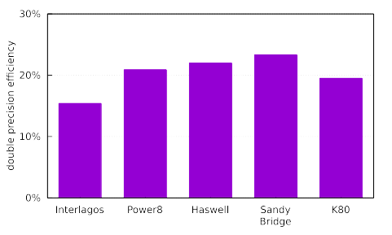
Single Source Alpaka DGEMM Kernel on Various Architectures
480
GFLOPS
560
GFLOPS
540
GFLOPS
150
GFLOPS
1450
GFLOPS
Theoretical
Peak Performance
DGEMM:
C ← αAB + βC
74
117
121
35
283

Slide 26
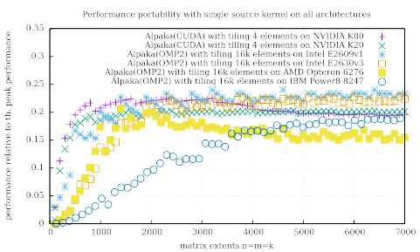
Single Source Alpaka DGEMM Kernel on Various Architectures

Slide 27
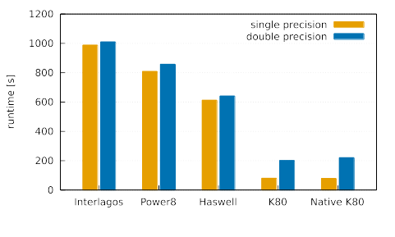
PIConGPU Runtime on Various Architectures

Slide 28
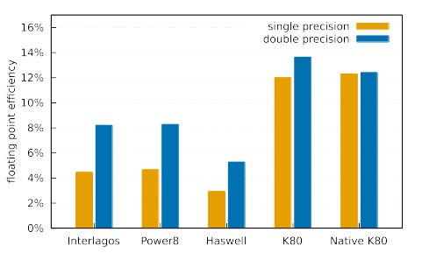
PIConGPU Efficiency on Various Architectures

Slide 29

Clone us from GitHub
https://github.com/ComputationalRadiationPhysics
git clone https://github.com/ComputationalRadiationPhysics/alpaka
git clone https://github.com/ComputationalRadiationPhysics/cupla

Slide 30


