Slide 1


Core Concepts - Zero Overhead Abstractions for Scalable Many-Core Data Analysis
Erik Zenker
Computational Radiation Physics
Helmholtz-Center Dresden Rossendorf

Slide 2
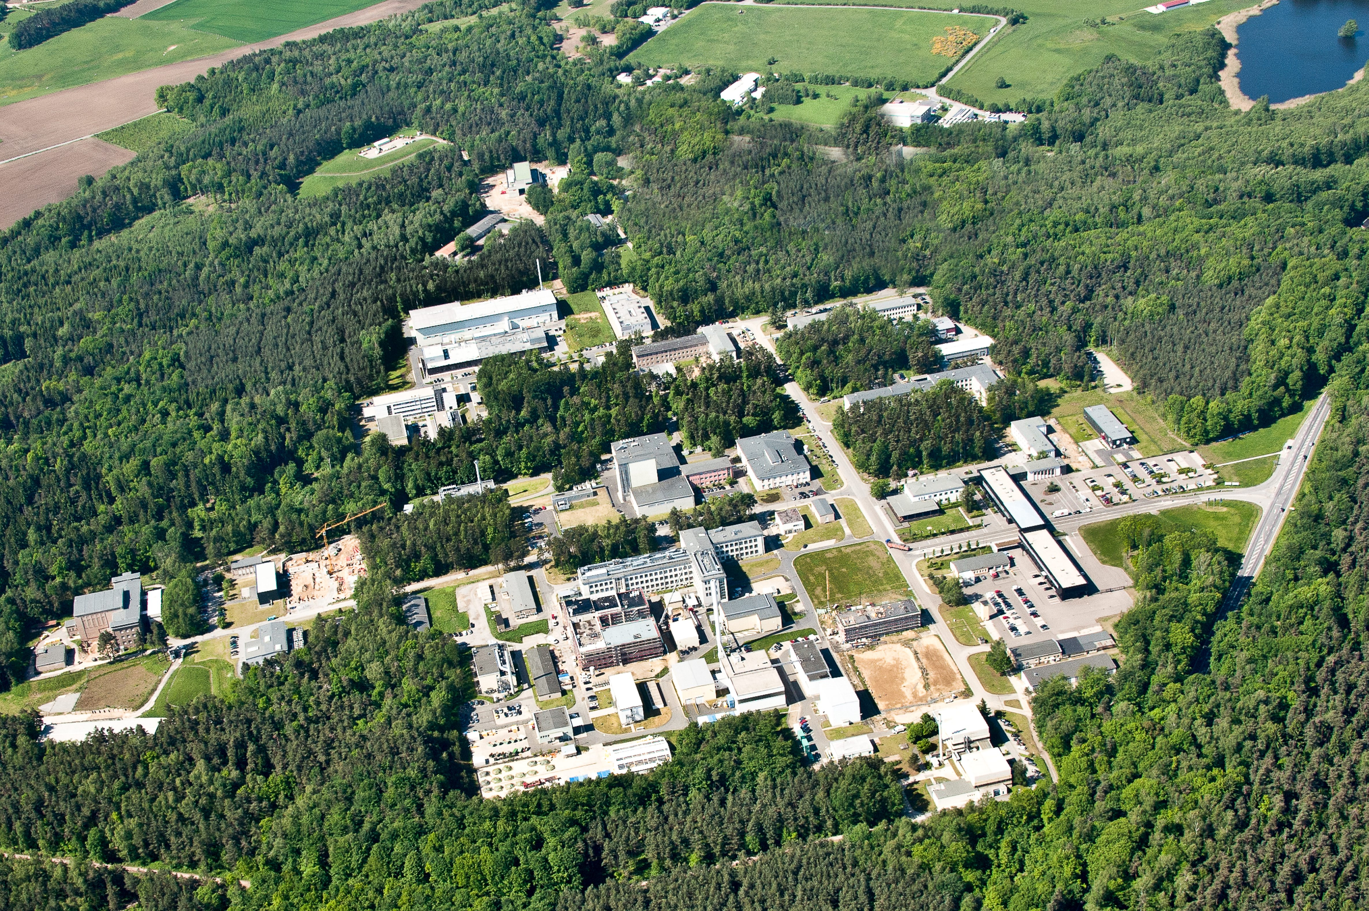
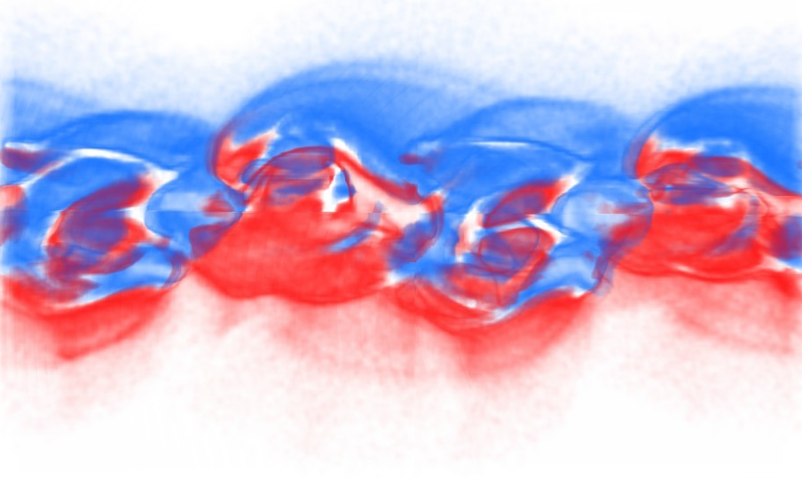
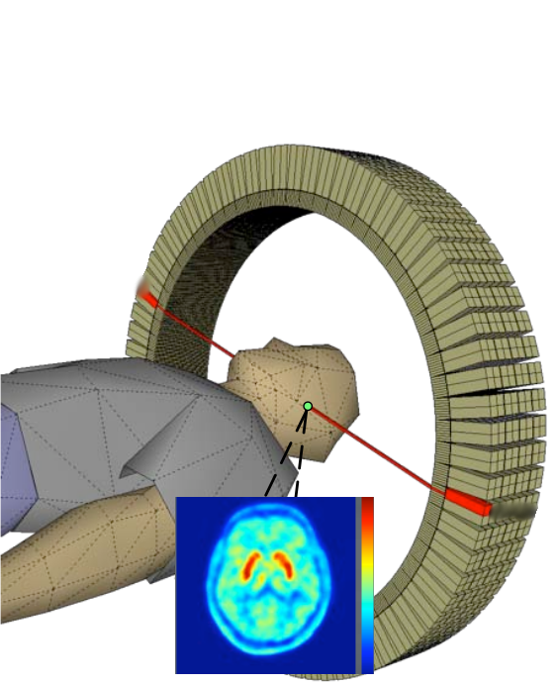
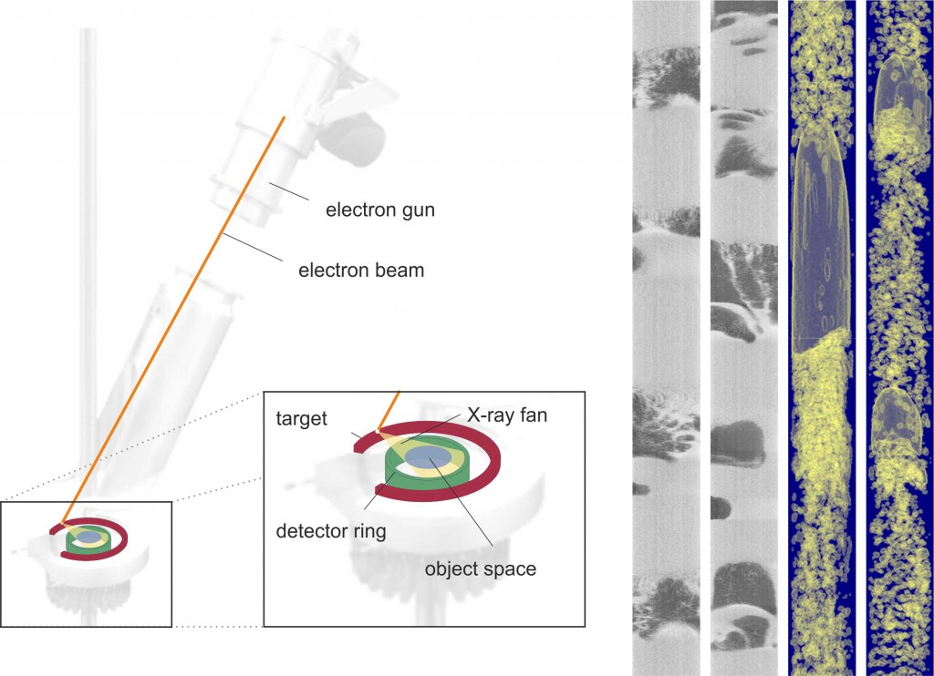
Data is Everywhere
Plasma simulation
Positron emission
tomography (PET)
Electron beam
X-ray tomography

Slide 3
The Data Analysis Pipeline
Simulations
Experiments
Processing
Evaluation
Storage
The pipeline needs to scale with your data !

Slide 4
Problems to Solve
Variable data rates
Ondemand scaling
Various communication protocols
Heterogeneous cluster systems
  GPU, MIC and CPU on the same node
  Various network standards e.g. infiniband, ethernet
  Hierarchical memory architecture
Fast developing compute hardware and
programming models
These Problems should not be solved all at once
Not maintainable, not scaleable, not sustainable
Better solve them by independent building blocks

Slide 5
For All That Already Exist Solutions
We provide interfaces for existing solutions
Each interface supports several solutions
Each interface can be adapted to solutions
Present today Alpaka and Graybat
No overhead with zero overhead abstraction
Application code
Zero overhead abstraction interface
Lib₁
Lib₂
Lib_{n}
...
C++ compilers are able to almost completely
remove abstraction layers

Slide 6
Alpaka

Slide 7
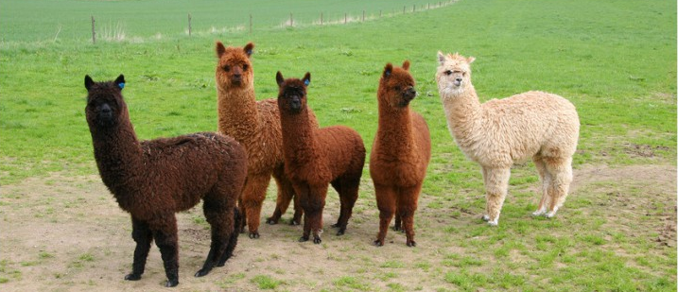




Alpaka: Parallel Kernel Execution
Next parallelism
model
Single abstract interface to existing parallelism models
Single source C++ code using std::c++11
Data-agnostic memory model

Slide 8
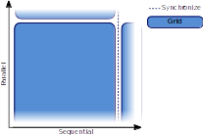
Abstract Hierarchical Redundant Parallelism Model
Notes:
<Foliennummer>
Abstract hierarchical redundant parallelism model
Influenced and based on CUDA and OpenCL abstraction of a multidimensional grid of threads
Four main hierarchies are introduced: grid, block, thread, element
Element level enables for vectorization capabilities

Slide 9
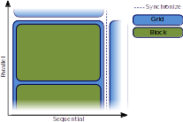
Abstract Hierarchical Redundant Parallelism Model
Notes:
<Foliennummer>
Abstract hierarchical redundant parallelism model
Influenced and based on CUDA and OpenCL abstraction of a multidimensional grid of threads
Four main hierarchies are introduced: grid, block, thread, element
Element level enables for vectorization capabilities

Slide 10
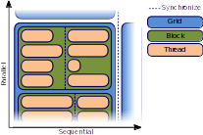
Abstract Hierarchical Redundant Parallelism Model
Notes:
<Foliennummer>
Abstract hierarchical redundant parallelism model
Influenced and based on CUDA and OpenCL abstraction of a multidimensional grid of threads
Four main hierarchies are introduced: grid, block, thread, element
Element level enables for vectorization capabilities

Slide 11
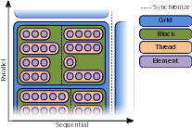
Abstract Hierarchical Redundant Parallelism Model
Notes:
<Foliennummer>
Abstract hierarchical redundant parallelism model
Influenced and based on CUDA and OpenCL abstraction of a multidimensional grid of threads
Four main hierarchies are introduced: grid, block, thread, element
Element level enables for vectorization capabilities

Slide 12
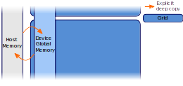
Data Structure Agnostic Memory Model
Explicit deep copies between memory levels
Notes:
<Foliennummer>
No predefined container type such as vector, maps, lists etc.
Not restricted to a specific memory model
Data structure agnostic like new or malloc
Each parallelization level corresponds to a particular memory hierarchy
Global memory(grid), shared memory(block) and register memory(thread)
Requires explicit deep copies between memory levels

Slide 13
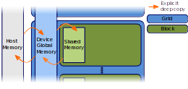
Data Structure Agnostic Memory Model
Explicit deep copies between memory levels
Notes:
<Foliennummer>
No predefined container type such as vector, maps, lists etc.
Not restricted to a specific memory model
Data structure agnostic like new or malloc
Each parallelization level corresponds to a particular memory hierarchy
Global memory(grid), shared memory(block) and register memory(thread)
Requires explicit deep copies between memory levels

Slide 14
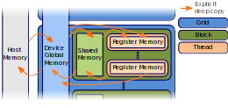
Data Structure Agnostic Memory Model
Explicit deep copies between memory levels
Notes:
<Foliennummer>
No predefined container type such as vector, maps, lists etc.
Not restricted to a specific memory model
Data structure agnostic like new or malloc
Each parallelization level corresponds to a particular memory hierarchy
Global memory(grid), shared memory(block) and register memory(thread)
Requires explicit deep copies between memory levels

Slide 15
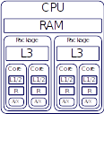
Map the Abstraction Model to the Hardware
Explicit mapping of parallelization levels to hardware
Notes:
<Foliennummer>
An accelerator defines the acceleration strategy by a mapping of the parallelization levels to the hardware architecture
The user needs to decide which accelerator to use for which device
There exists a set of predefined accelerators, but the user can write its own accelerator implementation based on accelerator concepts
Predefined accelerators:
CUDA
OpenMP
Boost Fibers
C++ Threads
Sequentia
Specific unsupported levels of the model can be ignored
Abstract interface allows to extend the set of mappings
l

Slide 16
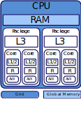
Map the Abstraction Model to the Hardware
Explicit mapping of parallelization levels to hardware
Notes:
<Foliennummer>
An accelerator defines the acceleration strategy by a mapping of the parallelization levels to the hardware architecture
The user needs to decide which accelerator to use for which device
There exists a set of predefined accelerators, but the user can write its own accelerator implementation based on accelerator concepts
Predefined accelerators:
CUDA
OpenMP
Boost Fibers
C++ Threads
Sequential

Slide 17
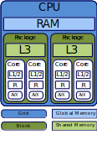
Map the Abstraction Model to the Hardware
Explicit mapping of parallelization levels to hardware
Notes:
<Foliennummer>
An accelerator defines the acceleration strategy by a mapping of the parallelization levels to the hardware architecture
The user needs to decide which accelerator to use for which device
There exists a set of predefined accelerators, but the user can write its own accelerator implementation based on accelerator concepts
Predefined accelerators:
CUDA
OpenMP
Boost Fibers
C++ Threads
Sequential

Slide 18
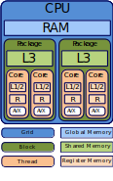
Map the Abstraction Model to the Hardware
Explicit mapping of parallelization levels to hardware
Notes:
<Foliennummer>
An accelerator defines the acceleration strategy by a mapping of the parallelization levels to the hardware architecture
The user needs to decide which accelerator to use for which device
There exists a set of predefined accelerators, but the user can write its own accelerator implementation based on accelerator concepts
Predefined accelerators:
CUDA
OpenMP
Boost Fibers
C++ Threads
Sequential

Slide 19
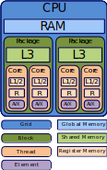
Map the Abstraction Model to the Hardware
Explicit mapping of parallelization levels to hardware
Notes:
<Foliennummer>
An accelerator defines the acceleration strategy by a mapping of the parallelization levels to the hardware architecture
The user needs to decide which accelerator to use for which device
There exists a set of predefined accelerators, but the user can write its own accelerator implementation based on accelerator concepts
Predefined accelerators:
CUDA
OpenMP
Boost Fibers
C++ Threads
Sequential

Slide 20
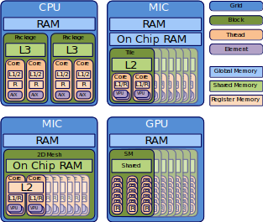
Mapping Allows to Go for Various Architectures
Notes:
<Foliennummer>
An accelerator defines the acceleration strategy by a mapping of the parallelization levels to the hardware architecture
The user needs to decide which accelerator to use for which device
There exists a set of predefined accelerators, but the user can write its own accelerator implementation based on accelerator concepts
Predefined accelerators:
CUDA
OpenMP
Boost Fibers
C++ Threads
Sequential

Slide 21
How Does it Feel ?
struct Kernel
{
template< typename TAcc>
ALPAKA_FN_ACC auto operator()(TAcc const & acc) const
-> void
{
// Do your parallel calculation here
}
};
using Acc = alpaka::acc::AccGpuCudaRt<Dim, Size>;
WorkDiv workdiv(alpaka::workdiv::WorkDivMembers<Dim, Size>(blocksPerGrid,
threadsPerBlock,
elementsPerThread));
Kernel kernel;
auto const exec(alpaka::exec::create<Acc>(
workDiv,
kernel);
alpaka::stream::enqueue(stream, exec);
Notes:
<Foliennummer>
An accelerator defines the acceleration strategy by a mapping of the parallelization levels to the hardware architecture
The user needs to decide which accelerator to use for which device
There exists a set of predefined accelerators, but the user can write its own accelerator implementation based on accelerator concepts
Predefined accelerators:
CUDA
OpenMP
Boost Fibers
C++ Threads
Sequential

Slide 22
Compile to Almost Same PTX Code (DAXPY)
Notes:
<Foliennummer>

Slide 23
Almost Zero Overhead (DGEMM)
Notes:
<Foliennummer>

Slide 24
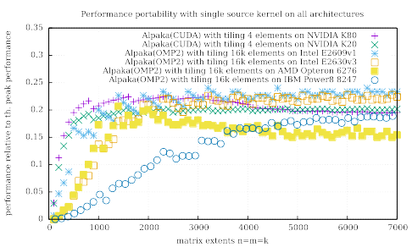
Performance Portable (DGEMM)
Notes:
<Foliennummer>

Slide 25
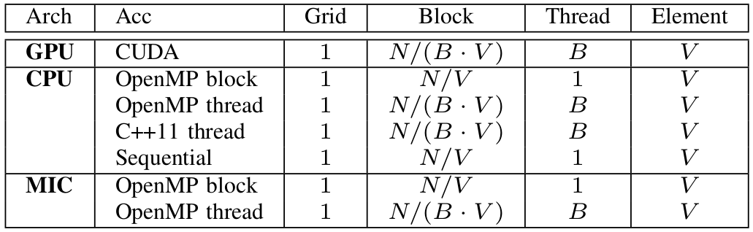
Start Today with the Set of Predefined Accelerators
Notes:
Work division is the multi dimensional domain index decomposition
Accelerators can restrict the work division (ignore abstraction levels)
e.g. OpenMP block accelerator restricts the number of threads to one, but uses auto parallelization instead
Also CUDA accelerator is advanced with element level which can improve existing CUDA codes
Potential to optimize work division for particular hardware

Slide 26
Alpaka Example: Initialization
// Configure Alpaka
using Dim = alpaka::dim::DimInt<3u>
using Size = std::size_t
using Acc = alpaka::acc::AccCpuSerial<Dim, Size>;
using Host = alpaka::acc::AccCpuSerial<Dim, Size>;
using Stream = alpaka::stream::StreamCpuSync;
using WorkDiv = alpaka::workdiv::WorkDivMembers<Dim, Size>;
using Elem = float;
// Retrieve devices and stream
DevHost devHost ( alpaka::dev::DevMan<Host>::getDevByIdx(0) );
DevAcc devAcc ( alpaka::dev::DevMan<Acc>::getDevByIdx(0) );
Stream stream ( devAcc);
// Specify work division
auto elementsPerThread ( alpaka::Vec<Dim, Size>::ones() );
auto threadsPerBlock ( alpaka::Vec<Dim, Size>::all(2u) );
auto blocksPerGrid ( alpaka::Vec<Dim, Size>(4u, 8u, 16u) );
WorkDiv workdiv(alpaka::workdiv::WorkDivMembers<Dim, Size>(blocksPerGrid,
threadsPerBlock,
elementsPerThread));
Notes:
<Foliennummer>
An accelerator defines the acceleration strategy by a mapping of the parallelization levels to the hardware architecture
The user needs to decide which accelerator to use for which device
There exists a set of predefined accelerators, but the user can write its own accelerator implementation based on accelerator concepts
Predefined accelerators:
CUDA
OpenMP
Boost Fibers
C++ Threads
Sequential

Slide 27
Alpaka Example : Call the Kernel
// Memory allocation and host to device memory copy
auto X_h = alpaka::mem::buf::alloc<int, int>(devHost, extent);
auto Y_h = alpaka::mem::buf::alloc<int, int>(devHost, extent);
auto X_d = alpaka::mem::buf::alloc<Val, Size>(devAcc, extent);
auto Y_d = alpaka::mem::buf::alloc<Val, Size>(devAcc, extent);
alpaka::mem::view::copy(stream, X_d, X_h, extent);
alpaka::mem::view::copy(stream, Y_d, Y_h, extent);
// Kernel creation and execution
VectorAdd kernel;
auto const exec(alpaka::exec::create<Acc>(
workDiv,
kernel,
numElements
alpaka::mem::view::getPtrNative(X_d),
alpaka::mem::view::getPtrNative(Y_d)));
alpaka::stream::enqueue(stream, exec);
// Copy memory back to host
alpaka::mem::view::copy(stream, Y_h, Y_d, extent);
Notes:
<Foliennummer>
An accelerator defines the acceleration strategy by a mapping of the parallelization levels to the hardware architecture
The user needs to decide which accelerator to use for which device
There exists a set of predefined accelerators, but the user can write its own accelerator implementation based on accelerator concepts
Predefined accelerators:
CUDA
OpenMP
Boost Fibers
C++ Threads
Sequential

Slide 28
Alpaka Example : Call the Kernel
struct VectorAdd
{
template< typename TAcc, typename TElem, typename TSize>
ALPAKA_FN_ACC auto operator()(
TAcc const & acc,
TSize const & numElements,
TElem const * const X,
TElem * const Y) const -> void {
using namespace alpaka;
auto globalIdx = idx::getIdx<Grid, Threads>(acc)[0u];
auto elemsPerThread = workdiv::getWorkDiv<Thread, Elems>(acc)[0u];
auto begin = globalIdx * elemsPerThread;
if(begin < numElements){
auto end = min(begin + elemsPerThread, numElements);
for(TSize i = begin; i < end; ++i){
Y[i] = X[i] + Y[i];
}
}
}
};
Notes:
<Foliennummer>
An accelerator defines the acceleration strategy by a mapping of the parallelization levels to the hardware architecture
The user needs to decide which accelerator to use for which device
There exists a set of predefined accelerators, but the user can write its own accelerator implementation based on accelerator concepts
Predefined accelerators:
CUDA
OpenMP
Boost Fibers
C++ Threads
Sequential

Slide 29
Too lazy to port your CUDA code ? Cupla !
Notes:
<Foliennummer>
An accelerator defines the acceleration strategy by a mapping of the parallelization levels to the hardware architecture
The user needs to decide which accelerator to use for which device
There exists a set of predefined accelerators, but the user can write its own accelerator implementation based on accelerator concepts
Predefined accelerators:
CUDA
OpenMP
Boost Fibers
C++ Threads
Sequential

Slide 30
Rewrite Kernel Functions
CUDA Kernel
template< int blockSize >
__global__ void fooKernel( int * ptr, float value )
{
// ...
}
Cupla Kernel
template< int blockSize >
struct fooKernel
{
template< typename T_Acc >
ALPAKA_FN_ACC
void operator()( T_Acc const & acc, int * ptr, float value) const
{
// ...
}
};
Notes:
<Foliennummer>
Show systeminformation (lspci)

Slide 31
Rewrite Host Side Kernel Call
CUDA host side kernel call
CUDA host side kernel call
dim3 gridSize(42,1,1);
dim3 blockSize(256,1,1);
// extern shared memory and stream is optional
fooKernel< 16 ><<< gridSize, blockSize, 0, 0 >>>( ptr, 23 );
// ...
dim3 gridSize(42,1,1);
dim3 blockSize(256,1,1);
fooKernel< 16 ><<< gridSize, blockSize, 0, 0 >>>( ptr, 23 );
Cupla host side kernel call
// ...
dim3 gridSize(42,1,1);
dim3 blockSize(256,1,1);
CUPLA_KERNEL(fooKernel< 16 >)( gridSize, blockSize, 0, 0 )( ptr, 23 );
Notes:
<Foliennummer>

Slide 32
Rewrite Shared Memory Allocation
CUDA shared memory
__shared__ int foo;
__shared__ int fooCArray[32];
__shared__ int fooCArray2D[4][32];
extern __shared__ float fooPtr[];
int bar = fooCArray2D[ threadIdx.x ][ 0 ];
Cupla shared memory
sharedMem( foo, int );
sharedMem( fooCArray, cupla::Array< int, 32 > );
sharedMem( fooCArray, cupla::Array< cupla::Array< int, 4 >, 32 > );
sharedMemExtern( fooPtr, float * );
int bar = fooCArray2D[ threadIdx.x ][ 0 ];
Notes:
<Foliennummer>

Slide 33
GrayBat
Notes:
<Foliennummer>
Description of communication pattern as graph and flexible mapping to peers at runtime
The communication back-end can be switched by one line of code e.g.: MPI, ZeroMQ

Slide 34
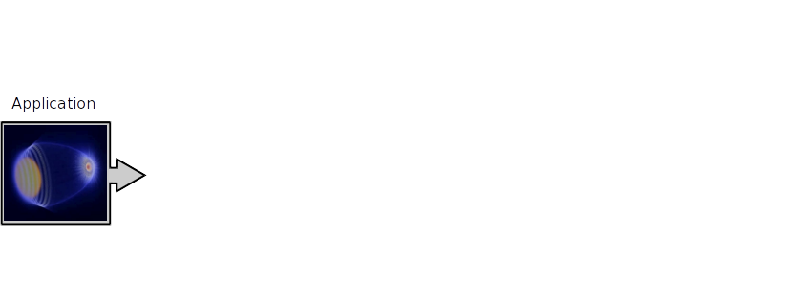
GrayBat: Graph-Based Communication Approach
Notes:
<Foliennummer>

Slide 35
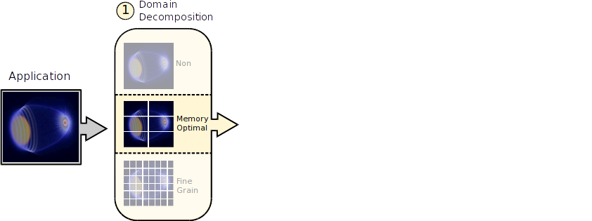
GrayBat: Graph-Based Communication Approach
Notes:
<Foliennummer>

Slide 36
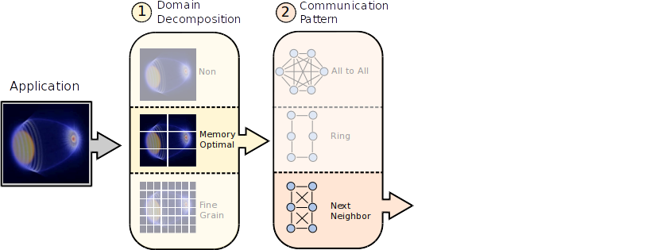
GrayBat: Graph-Based Communication Approach
Notes:
<Foliennummer>

Slide 37
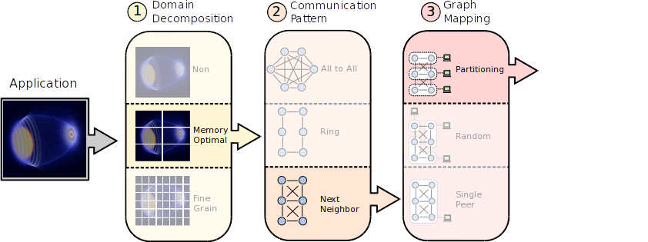
GrayBat: Graph-Based Communication Approach
Notes:
<Foliennummer>

Slide 38
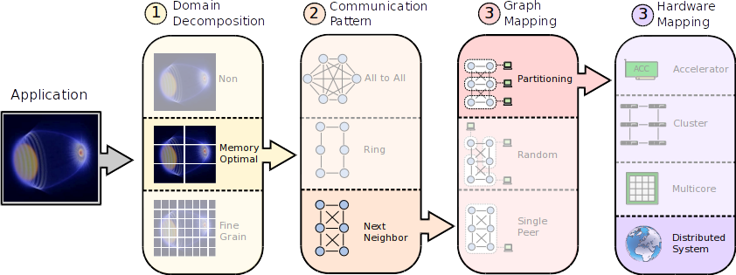
GrayBat: Graph-Based Communication Approach
Notes:
<Foliennummer>

Slide 39
Lets Have a Short Look Into the Code
using CP = graybat::communicationPolicy::BMPI;
using GP = graybat::graphPolicy::BGL<Property>;
using Cage = graybat::Cage<CP, GP> Cage;
Cage cage;
cage.setGraph (graybat::pattern::Chain<GP>(100));
cage.distribute(graybat::mapping::Consecutive());
std::array<unsigned, 1> input, output, intermediate;
const Vertex entry = cage.getVertex(0);
const Vertex exit = cage.getVertex(99);
for(Vertex v : cage.hostedVertices){
if(v == entry)
v.spread(input, events);
if(v != entry and v != exit)
v.forward(intermediate, std::plus<int>());
if(v == exit)
v.collect(output);
}
0
entry
+1
...
+1
98
exit
Notes:
<Foliennummer>

Slide 40
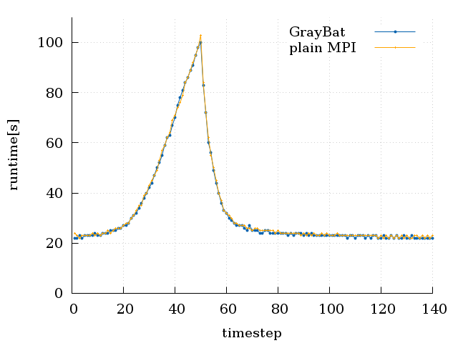
Usage in a Real World Code (HASEonGPU)
No overhead of GrayBat
compared to the plain MPI
version of the code
Notes:
<Foliennummer>

Slide 41
GrayBat Example: Initialization
// Policy configuration
using CP = graybat::communicationPolicy::BMPI;
using GP = graybat::graphPolicy::BGL<Property>;
using Config = CP::Config;
ZMQ;
Chain
pattern
Ring
pattern
// Communication and graph environment configuration
using Cage = graybat::Cage<CP, GP> Cage;
using Vertex = Cage::Vertex Vertex;
...
...
...
// Communication pattern and mapping
Cage cage(config);
cage.setGraph(graybat::pattern::Chain<GP>(100));
cage.distribute(graybat::mapping::Consecutive());
Ring<GP>(100));
GraphPartition());
Notes:
<Foliennummer>

Slide 42
GrayBat Example: Communication Chain
std::array<unsigned, 1> input {{0}};
std::array<unsigned, 1> output {{0}};
std::array<unsigned, 1> intermediate {{0}};
const Vertex entry = cage.getVertex(0);
const Vertex exit = cage.getVertex(99);
for(Vertex v : cage.hostedVertices){
if(v == entry)
v.spread(input, events);
if(v != entry and v != exit)
v.forward(intermediate, std::plus<int>());
if(v == exit)
v.collect(output);
}
0
entry
+1
...
+1
98
exit
Notes:
<Foliennummer>

Slide 43
GrayBat Example: Communication Ring
std::array<std::string, 1> input {{“Hello”}};
std::array<std::string, 1> intermediate;
const Vertex stimula = cage.getVertex(0);
for(Vertex v : cage.hostedVertices){
if(v == stimula){
v.spread(input, events);
}
while(true){
v.collect(intermediate);
intermediate[0] += “ World”;
v.spread(intermediate);
}
}
stimula
...
...
Notes:
<Foliennummer>

Slide 44
MallocMC
Notes:
<Foliennummer>

Slide 45
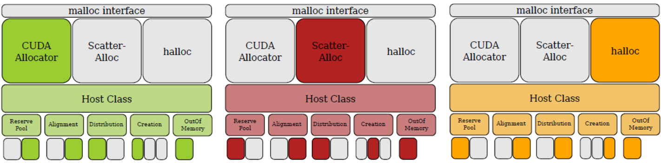
MallocMC : Many-Core Memory Allocation
Fast memory managers on many core accelerators
Notes:
<Foliennummer>
Very fine grain configuration of the memory allocation behavior
ScatterAlloc can be configured to reset the allowed chunk size per page

Slide 46
MallocMC: One Slide Code
using ScatterAllocator = mallocMC::Allocator<
mallocMC::CreationPolicies::Scatter<>,
mallocMC::DistributionPolicies::Noop,
mallocMC::OOMPolicies::ReturnNull,
mallocMC::ReservePoolPolicies::SimpleCudaMalloc,
mallocMC::AlignmentPolicies::Shrink<AlignmentConfig>
> ;
ScatterAllocator mMC(1U*1024U*1024U*1024U);
__device__ int* a;
if(threadIdx.x==0)
a = (int*) mMC.malloc(sizeof(int) * 32);
a[threadIdx.x] = threadIdx.x;
if(threadIdx.x == 0)
mMC.free(a);
mMC.finalizeHeap();
Notes:
<Foliennummer>

Slide 47
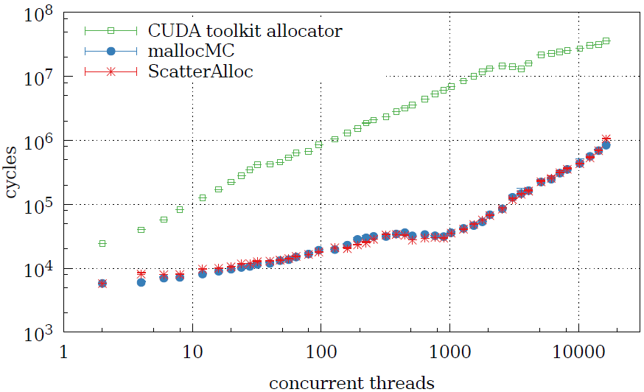
Memory Allocation Benchmark
Notes:
<Foliennummer>

Slide 48
MallocMC Example: Kernel Allocation
__device__ int* arA;
__global__ void exampleKernel(ScatterAllocator::AllocatorHandle mMC){
unsigned x = 42;
if(threadIdx.x==0)
arA = (int*) mMC.malloc(sizeof(int) * 32);
x = mMC.getAvailableSlots(1);
__syncthreads();
arA[threadIdx.x] = threadIdx.x;
if(threadIdx.x == 0)
mMC.free(arA);
}
Notes:
<Foliennummer>

Slide 49
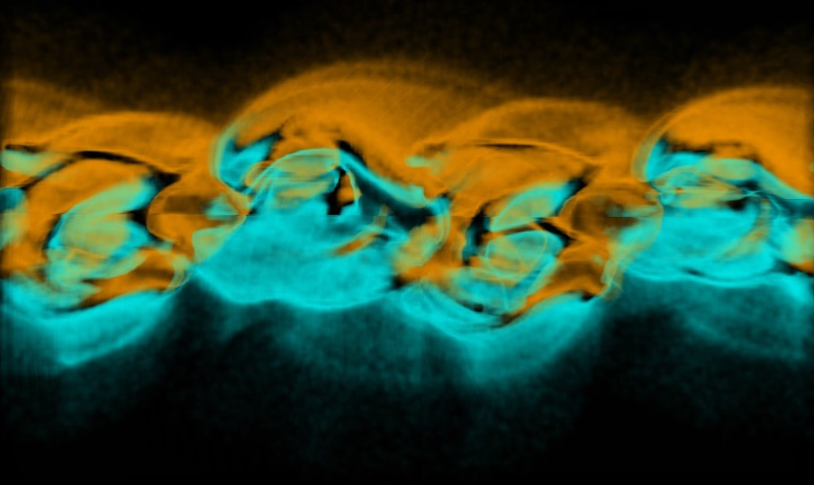
We are Using these Methods Successfully
Notes:
<Foliennummer>

Slide 50
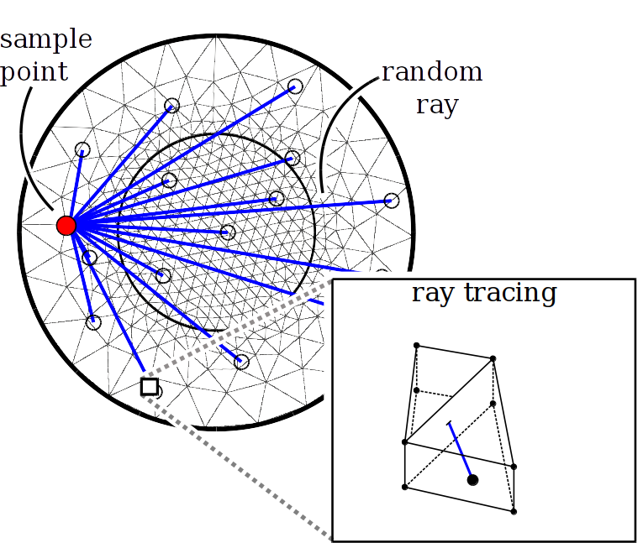
Sucessful Utilized
HASEonGPU – Multi Node Multi GPU ASE Simulation
  Execution on GPU or CPU
  without source duplication by Alpaka
  Dynamic work distribution based on
  MPI or ZeroMQ communicaiton by
  Graybat
  Dynamic work distribution to
  CPU and GPU in the same
  application
PIConGPU – Many GPGPU Particle-In-Cell Code
  Additional usage of CPUs on I/O intensive
  tasks by Alpaka
  Fast dynamic memory allocation for multi
  species simulations by MallocMC
  More complex physical simulations
  and better data analysis capabilities
─
─
+
+
─
─
s₁
s₂
+
─
─
─
─
─
─
─
Notes:
<Foliennummer>
A single node performs ray tracing of random rays to a single sample point
All sample points are distributed on demand from one master to the compute nodes

Slide 51

HASEonGPU – Multi Node Multi GPU ASE Simulation
Alpaka
Execution on GPU or CPU
without source duplication
Graybat
Dynamic work distribution based
on MPI or ZeroMQ communicaiton
Together
Dynamic work distribution to CPU and GPU in the same application
Notes:
<Foliennummer>
A single node performs ray tracing of random rays to a single sample point
All sample points are distributed on demand from one master to the compute nodes

Slide 52
PIConGPU – Many GPGPU Particle-In-Cell Code
─
─
+
─
+
─
s₁
s₂
+
─
─
─
─
─
─
─
Alpaka
Additional usage of CPU on
I/O intensive tasks
MallocMC
Fast dynamic memory allocation
for multi species simulations
Together
More complex physical simulations and better data analysis capabilities
Notes:
<Foliennummer>

Slide 53

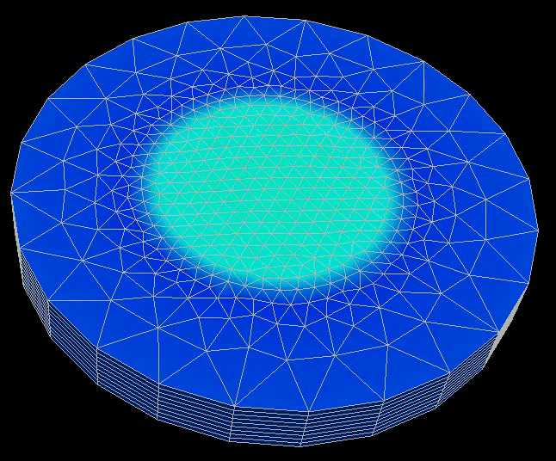

Successfully Utilized
HASEonGPU
There is even more to explore
Abstract Libraries
MallocMC
Halt
Applications
Imresh
Craken (talk today)
Isaac (talk today)
Notes:
<Foliennummer>

Slide 54

Clone us on GitHub
https://github.com/ComputationalRadiationPhysics
git clone https://github.com/ComputationalRadiationPhysics/alpaka
git clone https://github.com/ComputationalRadiationPhysics/graybat

