Slide 1

Alpaka - The Last Programming Model for Parallel Kernel Acceleration You Will Ever Need
Erik Zenker, Benjamin Worpitz, René Widera¹,Axel Huebl^{1,2},
Guido Juckeland¹, Andreas Knüpfer², Wolfgang E. Nagel², Michael Bussmann¹
¹ Helmholtz-Zentrum Dresden – Rossendorf
² Technische Universität Dresden
Notes:
- Dear Ladies and Gentleman thank you for attending our talk on “...”
- It is a pleasure for us to present our work today.
- My name is … and this is Erik Zenker.
- We are both from the german national lab “Helmholz...”
- Erik and me we are two developer and Maintainer of the Code PIConGPU and the library ALPAKA.
- I give you a brief overview about our talk.
- I start with a short introduction about PIConGPU and the technics to be on of the fastest plasma codes in the world.
- In the second part Erik will introduce the concepts behind the abstraction library for parallel kernel acceleration.

Slide 2

Which Architecture Should we Optimize for ?
Best Practice
Programming
Architecture
SW26010
OpenAcc
Almost all systems in the TOP 10 HPC
list have a different architecture
Intel Xeon Phi
TBB, OpenMP
Nvidia Tesla
CUDA
There is not a single programming model
that provides you performance on all
architectures (forget about OpenCL)
IBM PowerPC
OpenMP
Sparc 64
OpenMP
Intel x86
TBB, OpenMP
Notes:
- relativistic particle in cell code
- we develop the code since 7 year in coperation with the “center for information services and hight performance computing” of the technical university dresden
- code and the development cycle is fully open source and centered around github.
- A Particle in Cell Code describe the dynamics of a plasma by computing the motion of electrons and ions based on Maxwell's equations
- This code can used to study different phenomenas like “electron acceleration with lasers”
- shoot with a laser on hydrogen gas
- …. ions
- Another application we run is the Kelvin Helmholz instability. With that we were one of the finalists for the gordon bell price in 2013.

Slide 3
C++ Provides us an Amazing Tool-Kit
Heterogeneity
Write once, execute everywhere
Testability
Validate once,
get correct results
everywhere
Sustainability
Porting implies
minimal code changes
Optimizability
Tune for good performance at minimum coding effort
Openness
Open source
and
open standards
Single Source
Notes:
Because of our long experience with the programming of heterogeneous systems we have some requirement for this kind of interface
Heterogeneous, Testable, Sustainable, Optimizable, Open Source
Can we provide such an interface?
Yes we can, but we do not need to reinvent the wheel we reuse existing solutions.

Slide 4
C++ Provides us an Amazing Tool-Kit !
Uniform interface provides access to multiple programming models
Using C++ templates and meta-programming techniques
Application code
Zero overhead abstraction interface
C++ compilers are able to almost completely remove abstraction layers
Lib₁
Lib₂
Lib_{n}
...

Slide 5

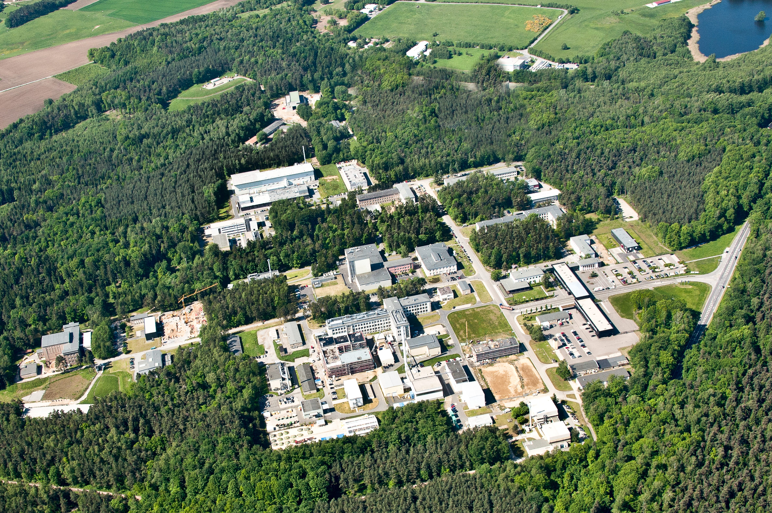
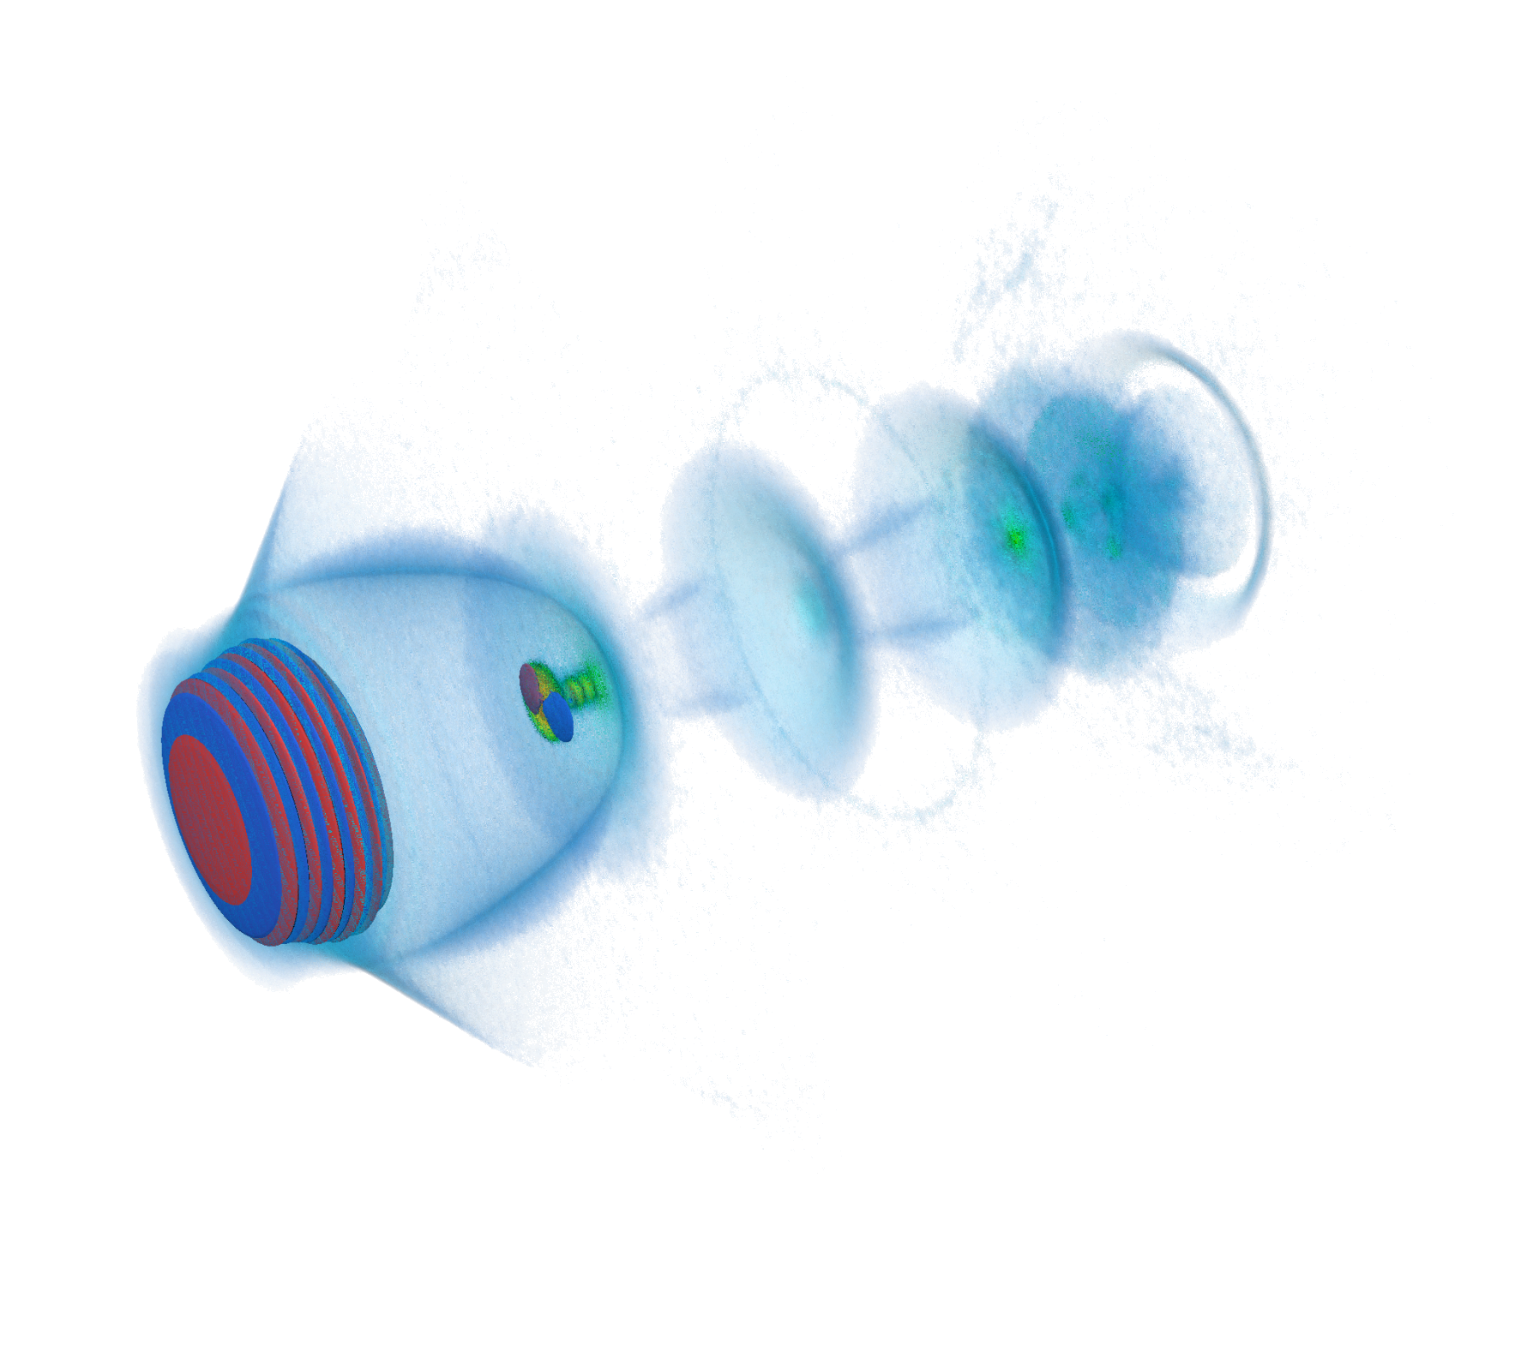
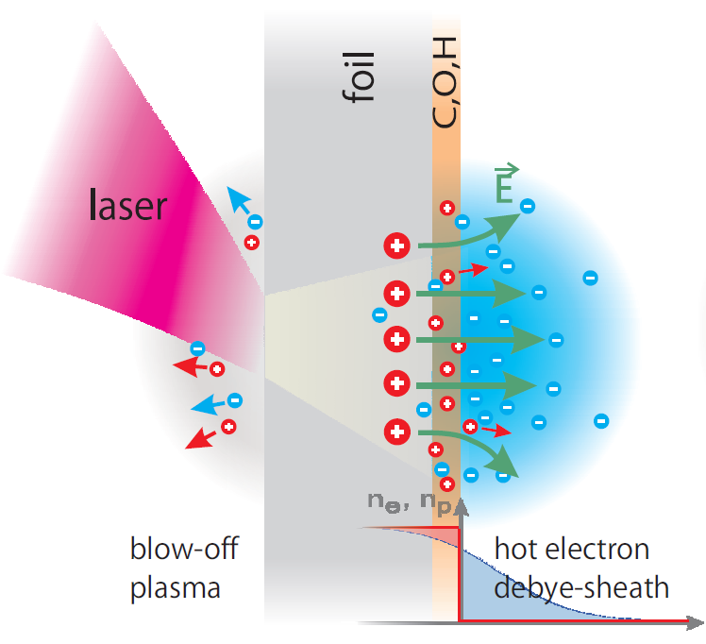
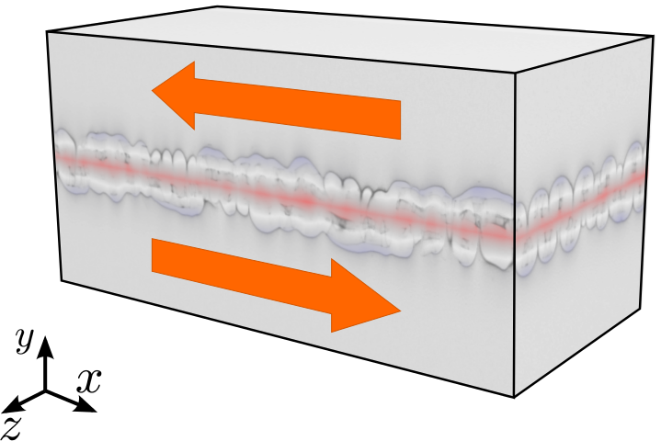
We Have Lasers : Risk of Forest Fires !
Electron Acceleration
with Lasers
Compact X-Ray sources
Ion Acceleration
with Lasers
Tumor Therapy
Plasma Instabilities
Astrophysics
Notes:
- relativistic particle in cell code
- we develop the code since 7 year in coperation with the “center for information services and hight performance computing” of the technical university dresden
- code and the development cycle is fully open source and centered around github.
- A Particle in Cell Code describe the dynamics of a plasma by computing the motion of electrons and ions based on Maxwell's equations
- This code can used to study different phenomenas like “electron acceleration with lasers”
- shoot with a laser on hydrogen gas
- …. ions
- Another application we run is the Kelvin Helmholz instability. With that we were one of the finalists for the gordon bell price in 2013.

Slide 6

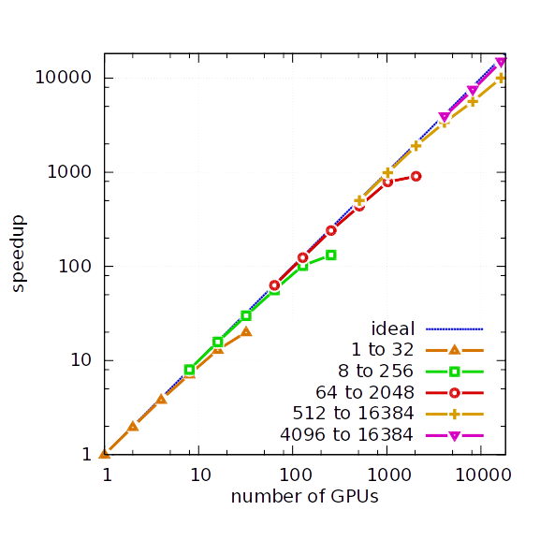
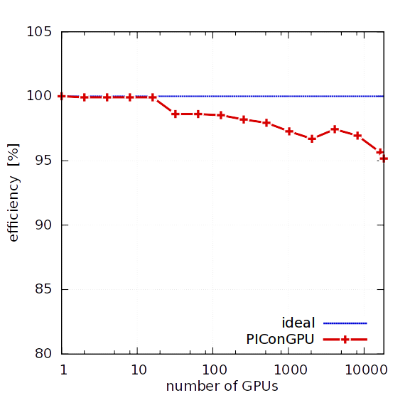
PIConGPU ─ Scales up to 18,432 GPUs
strong scaling
weak scaling efficiency
Efficiency > 95%
6.9 PFlop/s (SP)
Notes:
- We have tested the scaling of PIConGPU on titan, the second largest system in the world which is located at the OAK RIDGE National Laboratory in the US.
- For the strong scaling the global simulated volume is fixed in size and the number of gpu is increased. This means that we get a faster time to solution for the some problem size.
- We evaluated the scaling from 1 to 16k gpus and get this nice scaling result.
- For the weak scaling each gpu gets the same amount of work.
- The total simulation volume is increased with the number of gpus from one to 16k gpus.
- For that case we get a parallel efficiency of over 95% and a measured performance of 6.9 Pflops single precision

Slide 7



Alpaka
Application
C++
Threads
OpenACC
TBB
Notes:
Because of our long experience with the programming of heterogeneous systems we have some requirement for this kind of interface
Heterogeneous, Testable, Sustainable, Optimizable, Open Source
Can we provide such an interface?
Yes we can, but we do not need to reinvent the wheel we reuse existing solutions.

Slide 8
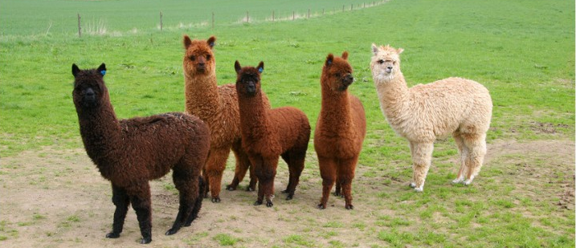
There are Alpakas on the Compute Meadow
Single zero overhead interface to existing parallelism models
Programming model: multi-dimensional set of threads
C++
Threads
TBB
Single source C++11 kernels
Data-agnostic memory model
Notes:
Our solution is Alpaka
Alpaka is an abstract interface to existing parallelism models and follows the successful programming model of CUDA where a kernel is offloaded to a multidimensional grid of threads
Alpka code is pure C++11 code and can be compiled to Intel, AMD, NVIDIA and PowerPC Architectures with the need to provide a particular source file for each architecture.
Furthermore, Alpaka does not dicate the use of particular memory containers or memory types, but it provides a data structure agnostic memory model.

Slide 9
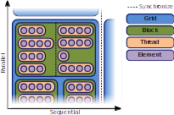
A Single Dimension is not Enough
Element level is an explicit sequential layer

Slide 10
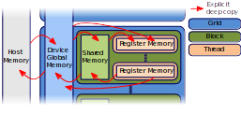
Data Structure Agnostic Memory Model
Notes:
Each parallelization level corresponds to a particular memory
The whole grid has access to a usually large global memory and data needs to be copied explicitly between host and device memory
All threads in an block have access to a small amound of high bandwidth, low latency shared memory.
This memory is usually used for data which is touched multiple times.
Finally each thread has its private register memory
Data transfers between memories has to be done explicitly by the user.
This memory model allows for caching strategies used in PIConGPU
The user can select which data should be put into global or shared memory.

Slide 11
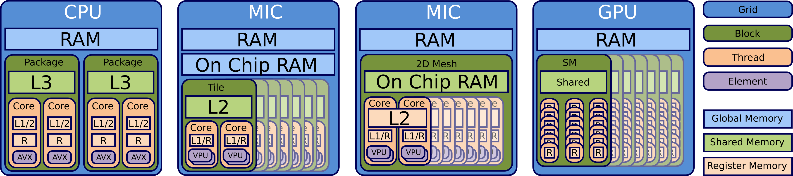
Map the Abstraction Model to your Desired Acceleration Back-End
Specific unsupported levels of the model can be ignored
Abstract interface allows to extend the set of mappings
Notes:
With this abstraction model we can also map to various other architecture such as PowerPC or traditionally to GPUs
Alpaka provides a set of predefined mappings but it is also possible to extend the mapping to new architecture or new version of CUDA
The mapping is totally independent of the user code and can be exchanged independently of the user code.

Slide 12
Sources

Slide 13
Alpaka : Vector Addition Kernel
struct VectorAdd
{
template<typename TAcc, typename TElem, typename TSize>
ALPAKA_FN_ACC auto operator()(
TAcc const & acc,
TSize const & numElements,
TElem const * const X,
TElem * const Y) const -> void {
}
};
using alp = alpaka;
auto globalIdx = alp::idx::getIdx<alp::Grid, alp::Threads>(acc)[0u];
auto elemsPerThread = alp::workdiv::getWorkDiv<alp::Thread, alp::Elems>(acc)[0u];
auto begin = globalIdx * elemsPerThread;
auto end = min(begin + elemsPerThread, numElements);
for(TSize i = begin; i < end; ++i){
Y[i] = X[i] + Y[i];
}
Notes:
Because we know the ACC we can use optimized version of functions by C++ template spezialization

Slide 14
Alpaka : Initialization
// Configure Alpaka
using Dim = alpaka::dim::DimInt<3u>
using Size = std::size_t
using Acc = alpaka::acc::AccGpuCudaRt<Dim, Size>;
using Host = alpaka::acc::AccCpuSerial<Dim, Size>;
using Stream = alpaka::stream::StreamCpuSync;
using WorkDiv = alpaka::workdiv::WorkDivMembers<Dim, Size>;
using Elem = float;
// Retrieve devices and stream
DevHost devHost ( alpaka::dev::DevMan<Host>::getDevByIdx(0) );
DevAcc devAcc ( alpaka::dev::DevMan<Acc>::getDevByIdx(0) );
Stream stream ( devAcc);
// Specify work division
auto elementsPerThread ( alpaka::Vec<Dim, Size>::ones() );
auto threadsPerBlock ( alpaka::Vec<Dim, Size>::all(2u) );
auto blocksPerGrid ( alpaka::Vec<Dim, Size>(4u, 8u, 16u) );
WorkDiv workdiv(alpaka::workdiv::WorkDivMembers<Dim, Size>(blocksPerGrid,
threadsPerBlock, elementsPerThread));
Notes:
An accelerator defines the acceleration strategy by a mapping of the parallelization levels to the hardware architecture
The user needs to decide which accelerator to use for which device
There exists a set of predefined accelerators, but the user can write its own accelerator implementation based on accelerator concepts
Predefined accelerators:
CUDA
OpenMP
Boost Fibers
C++ Threads
Sequential

Slide 15
Alpaka : Call the Kernel
// Memory allocation and host to device memory copy
auto X_h = alpaka::mem::buf::alloc<int, int>(devHost, extent);
auto Y_h = alpaka::mem::buf::alloc<int, int>(devHost, extent);
auto X_d = alpaka::mem::buf::alloc<Val, Size>(devAcc, extent);
auto Y_d = alpaka::mem::buf::alloc<Val, Size>(devAcc, extent);
alpaka::mem::view::copy(stream, X_d, X_h, extent);
alpaka::mem::view::copy(stream, Y_d, Y_h, extent);
// Kernel creation and execution
VectorAdd kernel;
auto const exec(alpaka::exec::create<Acc>(
workDiv,
kernel,
numElements
alpaka::mem::view::getPtrNative(X_d),
alpaka::mem::view::getPtrNative(Y_d)));
alpaka::stream::enqueue(stream, exec);
// Copy memory back to host
alpaka::mem::view::copy(stream, Y_h, Y_d, extent);
Notes:
An accelerator defines the acceleration strategy by a mapping of the parallelization levels to the hardware architecture
The user needs to decide which accelerator to use for which device
There exists a set of predefined accelerators, but the user can write its own accelerator implementation based on accelerator concepts
Predefined accelerators:
CUDA
OpenMP
Boost Fibers
C++ Threads
Sequential

Slide 16
How is This Interface mapped to Varying Programming Approaches ?
Alpaka interface provides a set of free functions
  alpaka::mem::buf::alloc, alpaka::exec::create, alpaka::idx::getidx etc.
Free functions accept template arguments that need to fulfill special requirements
  Type requirements similar to concepts (even if they are not there yet)
Each concept is defined within a particular namespace
New programming model needs to implement the defined concepts
namespace conceptName
{
namespace traits
{
// Type and function requirements
...
}
// free functions of this concept
...
}

Slide 17
A Simple Event Concept
namespace event
{
namespace traits
{
template < class T >
struct Test ;
}
template < class T >
ALPAKA_FN_HOST auto test ( T & t )
-> bool
{
return traits::Test <T >::test ( t ) ;
}
}
Class that needs to be specialized
Free function
Concept interface definition
Allows to fully or partially specialize the trait without affecting overload resolution of the free function

Slide 18
Model the Event Concept
class UserEvent {};
namespace event
{
namespace traits
{
struct Test < UserEvent >
{
ALPAKA_FN_HOST static auto test ( UserEvent & e )
-> bool
{
return true ;
}
};
}
}
Specialization
Concept interface
implementation
Specialization needs to provide the required function with exactly the same interface as the corresponding free function

Slide 19
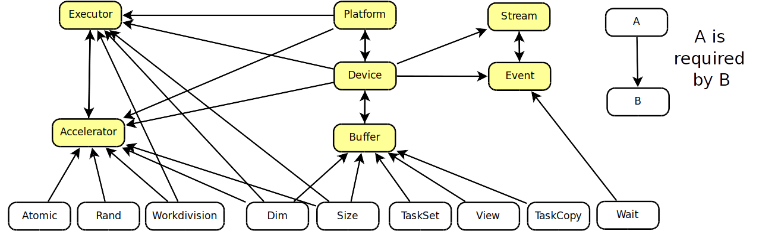
There are Quiete a Lot Concepts

Slide 20
Compose Concepts from Subconcepts
namespace acc
{
class MyAccelerator :
Atomic ,
WorkDivision ,
Rand
{
…
}
}
namespace exec
{
namespace traits
{
struct ExecType < MyAccelerator >
{
using type = MyExecutor ;
};
}
}
Inherit from existing
subconcepts
Provide subconcept
type requirement

Slide 21
Template Specialization Selection on Arbitrary Conditions
// ...
namespace traits
{
template < class T , class TSfinae >
struct Test ;
}
SFINAE
Template argument
class BaseEvent {};
namespace event
{
namespace traits
{
template < class T >
struct Test <T, class std::enable_if < std::is_base_of < BaseEvent , T >:: value >::type >
{
ALPAKA_FN_HOST static auto test ( T & e )
-> bool
{
return false ;
}
};
}
}
Implementation for all
classes inheriting from
BaseEvent

Slide 22
Concept Summary
The Alpaka interface consists of a set of free functions with template arguments.
These arguments need to model particular concepts, otherwise the compiler would complain.
Alpaka declares a fixed set of concepts within corresponding namespaces and traits the user needs to specialize.
Using SFINAE allows to provide trait specialization for various models.
Enables to construct models by a combination of other models.

Slide 23
Benchmarks

Slide 24
Compile to Almost Same PTX Code (DAXPY)

Slide 25
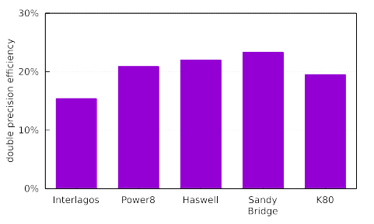
Single Source Alpaka DGEMM Kernel on Various Architectures
480
GFLOPS
560
GFLOPS
540
GFLOPS
150
GFLOPS
1450
GFLOPS
Theoretical
Peak Performance
DGEMM:
C ← αAB + βC
74
117
121
35
283

Slide 26
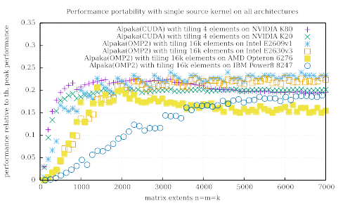
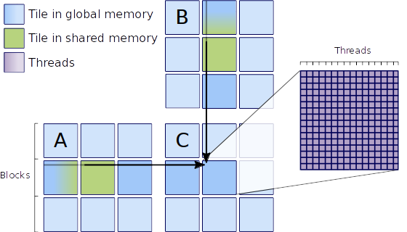
Single Source Alpaka DGEMM Kernel on Various Architectures
Matrix-matrix multiplication with various number of elements per thread

Slide 27

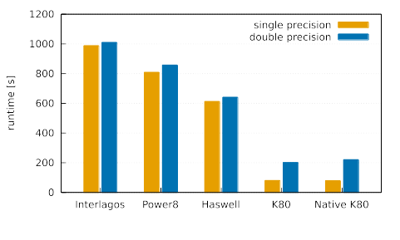

PIConGPU Runtime on Various Architectures

Slide 28
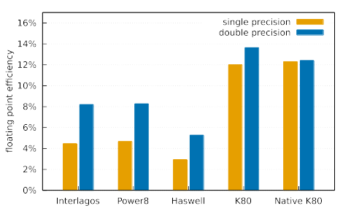
PIConGPU Efficiency on Various Architectures

Slide 29
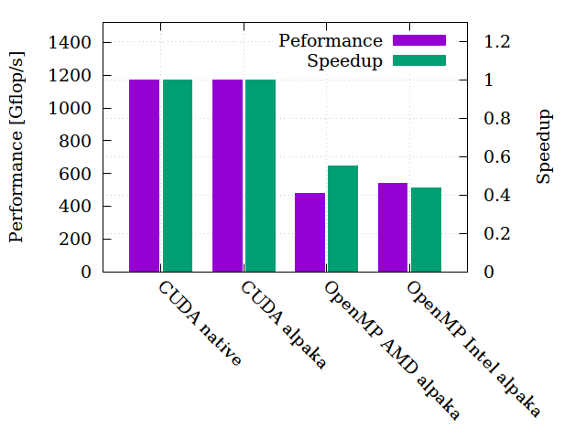
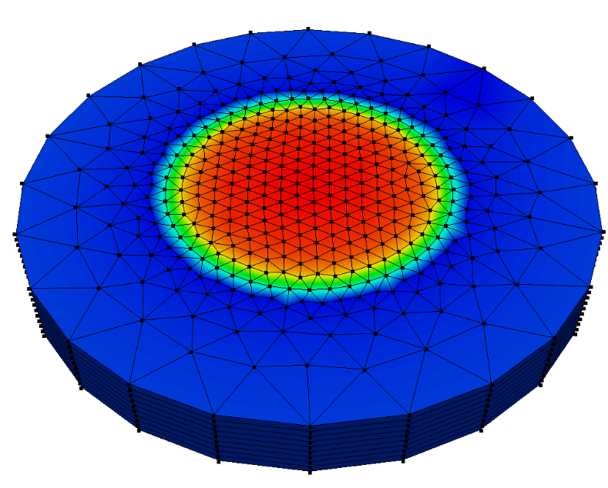
Performance Portability HASEonGPU
Simulating ASE flux in laser gain media through Monte Carlo integration

Slide 30







Conclusion
Alpaka
  Uniform zero overhead C++ interface to various many core programming models
  Single source C++ kernels
  Supports acceleration of all major multi and many core architectures
  Extendable for the upcoming programming models and architectures
C++
Threads
OpenACC
TBB

Slide 31

Clone us from GitHub
git clone https://github.com/ComputationalRadiationPhysics/alpaka

Slide 32


