Slide 1

Porting the Plasma Simulation PIConGPU to Heterogeneous Architectures with Alpaka
René Widera¹, Erik Zenker^{1,2}, Guido Juckeland¹,
Benjamin Worpitz^{1,2}, Axel Huebl^{1,2}, Andreas Knüpfer²,
Wolfgang E. Nagel², Michael Bussmann¹
¹ Helmholtz-Zentrum Dresden – Rossendorf
² Technische Universität Dresden
Notes:
- Dear Ladies and Gentleman thank you for attending our talk on “...”
- It is a pleasure for us to present our work today.
- My name is … and this is Erik Zenker.
- We are both from the german national lab “Helmholz...”
- Erik and me we are two developer and Maintainer of the Code PIConGPU and the library ALPAKA.
- I give you a brief overview about our talk.
- I start with a short introduction about PIConGPU and the technics to be on of the fastest plasma codes in the world.
- In the second part Erik will introduce the concepts behind the abstraction library for parallel kernel acceleration.

Slide 2

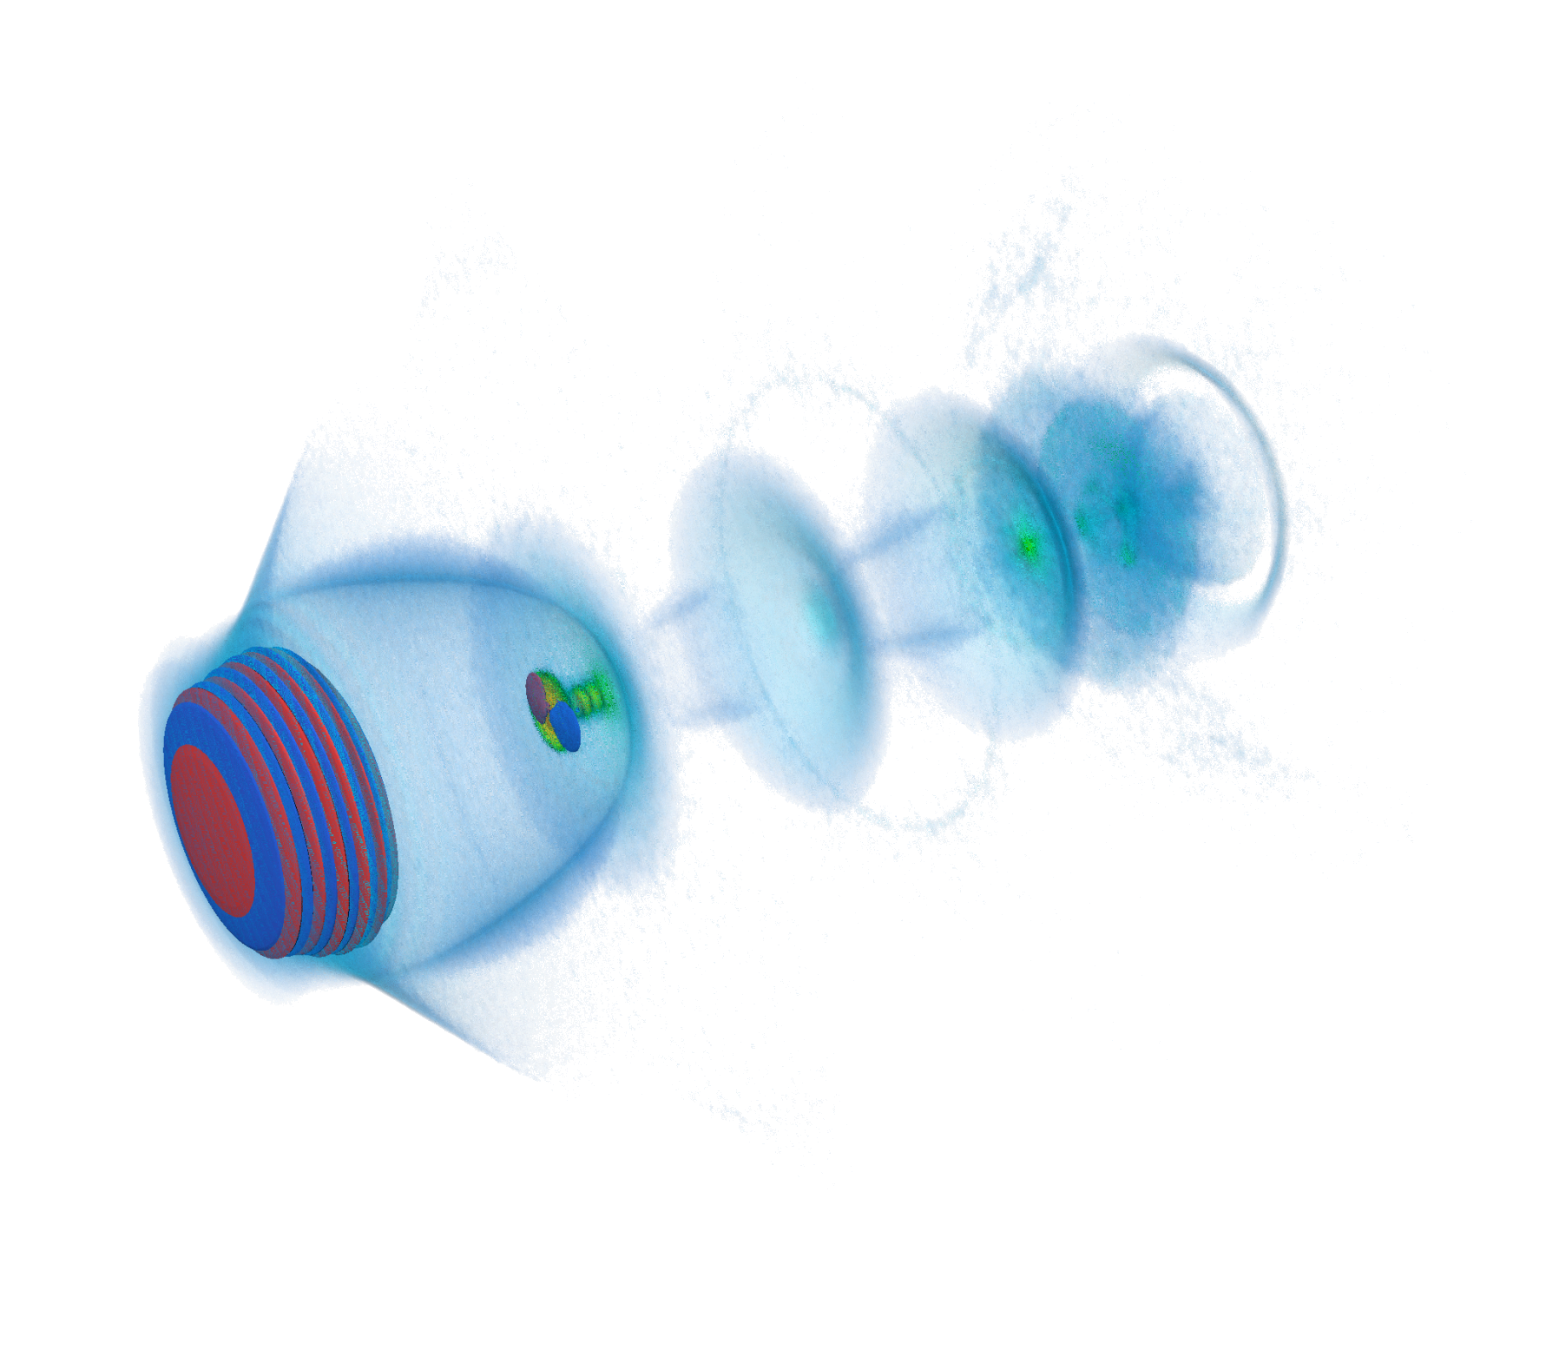
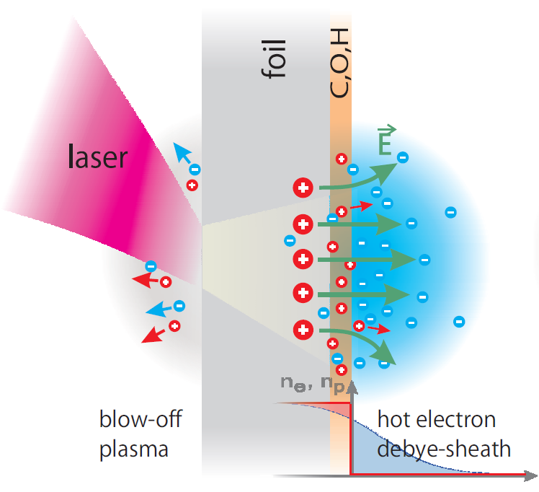
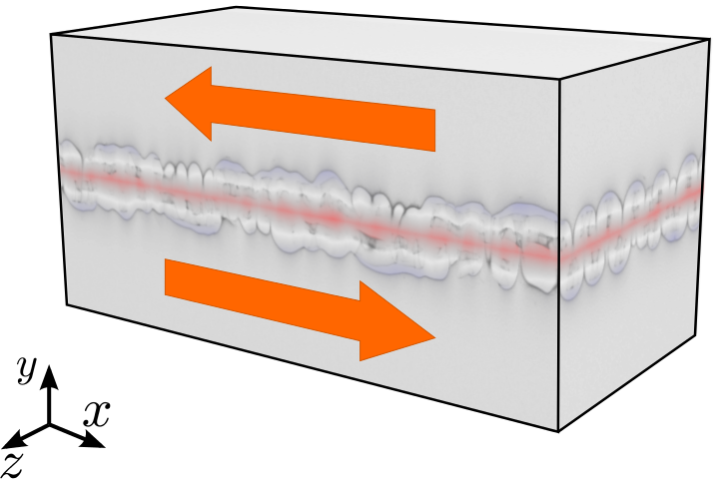
Electron Acceleration
with Lasers
Compact X-Ray sources
Ion Acceleration
with Lasers
Tumor Therapy
Plasma Instabilities
Astrophysics
Notes:
- relativistic particle in cell code
- we develop the code since 7 year in coperation with the “center for information services and hight performance computing” of the technical university dresden
- code and the development cycle is fully open source and centered around github.
- A Particle in Cell Code describe the dynamics of a plasma by computing the motion of electrons and ions based on Maxwell's equations
- This code can used to study different phenomenas like “electron acceleration with lasers”
- shoot with a laser on hydrogen gas
- …. ions
- Another application we run is the Kelvin Helmholz instability. With that we were one of the finalists for the gordon bell price in 2013.

Slide 3
Domain Decomposition ─ Field and Particle Domain
+
─
+
+
─
+
─
+
+
─
+
─
Moving Particles create Fields
Fields act back on Particles
Particles change Cells
─
+
+
─
+
+
─
─
─
─
+
─
+
+
+
─
─
+
+
─
─
+
─
+
+
+
+
─
─
─
Notes:
<Foliennummer>
- To build up a Particle in Cell simulation the volume is decomposed into cells
- Cells contains fields.
- particles are modeled by macro particles and can move free in the volume.
- Typicle species are electrons (green) and ions (red).
- A Particle in Cell cycle can be splitted in independent small algroisms
- First of all the force of the fields on a particle is calculated
- Moving particles create current (following Amperes's law)
- The Current creates magnetic fields
- Magnetic fields create electric field (by Faraday's law)
- if particle leaves the cell it must be copied to the next cell
- this results in random memory accesses which slow down the performance on current many core architectures

Slide 4
Creating Vectorized Data Structures for Particles and Fields
Field Domain
Particle Domain
1
2
Cell 1
Cell 1
+
+
+
+
+
3
4
Cell 2
Cell 4
+
+
+
chunked in supercells
line wise aligned
fixed size frames
struct of aligned arrays
Notes:
<Foliennummer>
- To solve the problem we separates field and particles into two domains.
- Both domains can be optimize independently
- we group fields in supercells with a fixed size (the size is choosen at compile time)
- a supercell is line wise aligned
- particles are grouped in frame.
- a particle contains attributes like “momenta, position and and the location inside of a supercell)
- The attributes are stored in aligned structs of arrays to avoid non contigious memory access.
- the number of particles in a frame is equeal to the number of cells in a supercell
- frames are stored in double linked lists those are connected to the corresponding supercell to allow a arbitrary number of particles in a supercell.

Slide 5
Algorithm Driven Cache Strategy
Global Memory
Shared Memory
Shared Memory
Global Memory
1
2
Cell 1
Cell 1
+
+
3
4
Cell 2
Cell 4
+
+
Notes:
<Foliennummer>
- The previously shown data structures give use the possibility that the user can chose the best fitting caching strategy depending on the work flow of the algorithm.
- if a field is needed only once but the attributes of a particles is high frequently touched the user can keep the fields in the global memory and copy particles to the fast shared memory.
- In the case we scatter particle information to the grid we can stream particle attributes from the global memory and store a copy of the fields in the shared memory.
- The freedom to choose the caching strategy give us the opportunity to optimize the memory access and reduce the complexity of a kernel while we can use fast shared memory atomics.

Slide 6
High Utilization of Threads
Shared Memory
Global Memory
1
2
Cell 1
Cell 1
+
+
3
4
Cell 2
Cell 4
+
+
THREAD BLOCK
THREAD 1
THREAD 2
THREAD 3
THREAD 4
Notes:
<Foliennummer>
- To keep the utilization of the threads in a kernel as high as possible the number of spawned threads per block is equal to the number of cells in a supercell.
- This allows use to switch the context from collective field operations to particle operations within a kernel without leaving threads idle.
- In this case the first thread interacts with the cell first cell and can switch to the firs particle at in the frame.
- Each theoretical context is considered as interdependent therefore the second thread can interact with the seconds particle even if the particle is located in the first cell.
- the other threads follow the some rules.
- With the shown techniques we get a high utilization of one GPU, but PIConGPU is a multi GPU code
- for that we need to communicate the overlapping field domains and particles which leaves the domain of a gpu.
- This can result in a bad device utilization during the communication

Slide 7
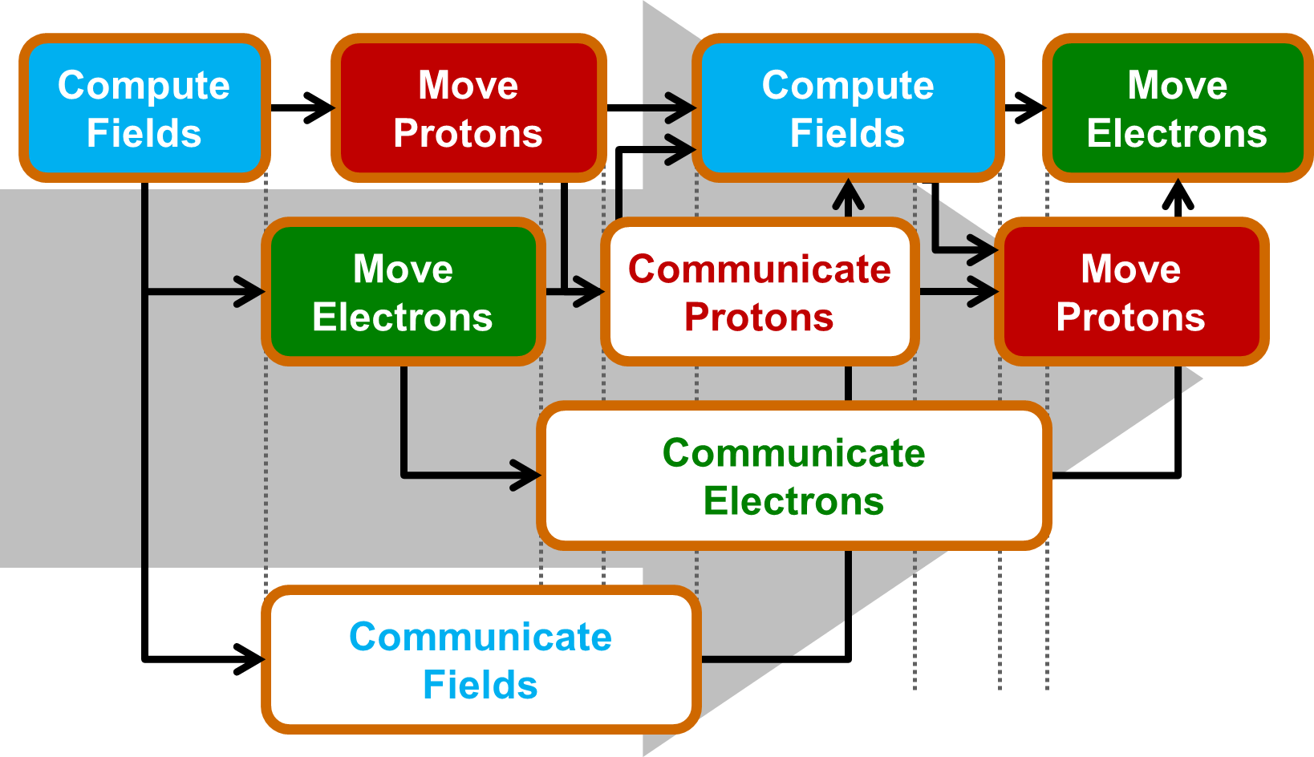
Task-Parallel Execution of Kernels + Asynchronous Communication
Notes:
<Foliennummer>
- As I descried at the beginning of the talk, the PIC cycle can be spitted in independent tasks.
- Dependencies between the the tasks are automatically solved by our eventsystem.
- while fields are communicated the particles can be pushed.
- If both are finished the next fields can be computed.
- PIConGPU contains all the shown techniques and can therefore scale up to 10-thousands of gpus.

Slide 8

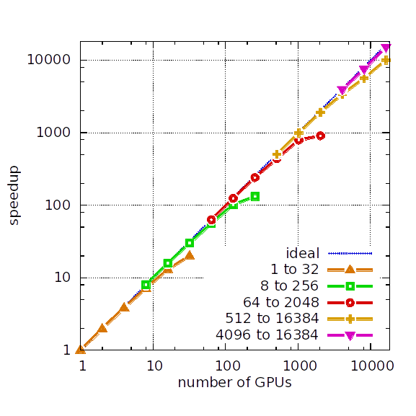
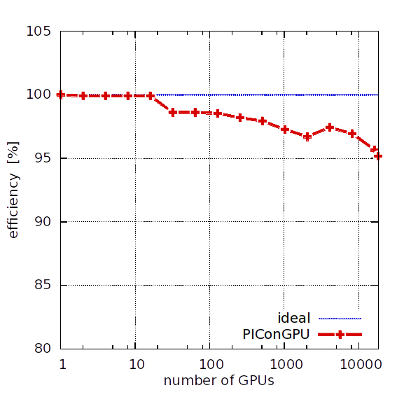
PIConGPU ─ Scales up to 18,432 GPUs
strong scaling
weak scaling efficiency
Efficiency >95%
6.9 PFlop/s (SP)
Notes:
- We have tested the scaling of PIConGPU on titan, the second largest system in the world which is located at the OAK RIDGE National Laboratory in the US.
- For the strong scaling the global simulated volume is fixed in size and the number of gpu is increased. This means that we get a faster time to solution for the some problem size.
- We evaluated the scaling from 1 to 16k gpus and get this nice scaling result.
- For the weak scaling each gpu gets the same amount of work.
- The total simulation volume is increased with the number of gpus from one to 16k gpus.
- For that case we get a parallel efficiency of over 95% and a measured performance of 6.9 Pflops single precision

Slide 9

More Physics, More Computations, More Power!
Atom-physical
effects
Old atom
state
New atom
state
─
+
t_{1,1} t_{1,2} t_{1,3} … t_{1,n}
t_{2,1} .
t_{3,1} .
… .
t_{n,1} t_{n,n}
s_{1,1}
s_{1,2}
s_{1,3}
...
s_{n,m}
s_{1,1}
s_{1,2}
s_{1,3}
...
s_{n,m}
s₁
s₂
=
─
Really Big Data Task
Random access on big amounts of data > 100 GB
Good job for powerful CPUs
Efficient CPU/GPU cooperation
Notes:
<Foliennummer>
Up to now electrodynamic effects by particle field and field particle interaction
We want to enhance the simulation by atom physical effects such as excitation, emission, absorbtion and decay
Because of the number of transformations an atom can enter, the number of possible configuration a atom can accept is very high.
Therefore we need a lot of memory to store atom states which is not delivered by the current generation of accelerator devices.
But, the OpenPower architecture provides us a platform for fast big data analysis by coupling an efficient Power8 CPU for fast random memory data access and a NVIDIA GPU for fast data processing.
For programming CPU and GPU we want to utilize the same programming interface.
Such that we can determine the hardware to run our kernel very flexible.

Slide 10

Small Open Source Communities need Maintainable Codes
Heterogeneity
Write once, execute everywhere
Testability
Validate once,
get correct results
everywhere
Sustainability
Porting implies
minimal code changes
Optimizability
Tune for good performance at minimum coding effort
Openness
Open source
and
open standards
Single Source
Notes:
Because of our long experience with the programming of heterogeneous systems we have some requirement for this kind of interface
Heterogeneous, Testable, Sustainable, Optimizable, Open Source
Can we provide such an interface?
Yes we can, but we do not need to reinvent the wheel we reuse existing solutions.

Slide 11
Alpaka
Notes:
Because of our long experience with the programming of heterogeneous systems we have some requirement for this kind of interface
Heterogeneous, Testable, Sustainable, Optimizable, Open Source
Can we provide such an interface?
Yes we can, but we do not need to reinvent the wheel we reuse existing solutions.

Slide 12
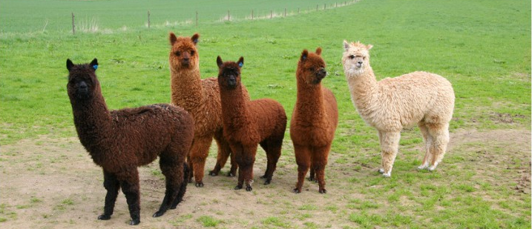



Good News: there are Alpakas on the Compute Meadow
C++
Threads
Next parallelism
model
Single zero overhead interface to existing parallelism models
Single source C++11 kernels
Data-agnostic memory model
Notes:
<Foliennummer>
Our solution is Alpaka
Alpaka is an abstract interface to existing parallelism models and follows the successful programming model of CUDA where a kernel is offloaded to a multidimensional grid of threads
Alpka code is pure C++11 code and can be compiled to Intel, AMD, NVIDIA and PowerPC Architectures with the need to provide a particular source file for each architecture.
Furthermore, Alpaka does not dicate the use of particular memory containers or memory types, but it provides a data structure agnostic memory model.

Slide 13
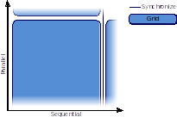
Abstract Hierarchical Redundant Parallelism Model
Notes:
<Foliennummer>
The parallel abstraction model is very similar to CUDA.
The Grid always executes an entire kernel function, but grids are independent of each other
They run either in parallel or sequential and can synchronize with each other
A Grid is divided in a multidimensional set of blocks, where blocks are executed in parallel or sequential but are not able to synchronize
Each block consists of an n-dimensional set of thread and threads are executed in parallel or sequential. All threads within a block are able to synchronize within a block.
The Element level is an explicit sequential level.
But especially architectures with vectorization capabilities can load several elements into their vector register and process these element within one instruction.

Slide 14
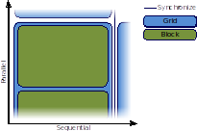
Abstract Hierarchical Redundant Parallelism Model
Notes:
<Foliennummer>

Slide 15
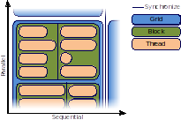
Abstract Hierarchical Redundant Parallelism Model
Notes:
<Foliennummer>

Slide 16
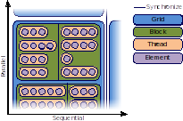
Abstract Hierarchical Redundant Parallelism Model
Element level is an explicit sequential layer
Notes:
<Foliennummer>

Slide 17
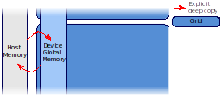
Data Structure Agnostic Memory Model
Notes:
<Foliennummer>
Each parallelization level corresponds to a particular memory
The whole grid has access to a usually large global memory and data needs to be copied explicitly between host and device memory
All threads in an block have access to a small amound of high bandwidth, low latency shared memory.
This memory is usually used for data which is touched multiple times.
Finally each thread has its private register memory
Data transfers between memories has to be done explicitly by the user.
This memory model allows for caching strategies used in PIConGPU
The user can select which data should be put into global or shared memory.

Slide 18
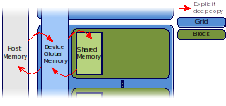
Data Structure Agnostic Memory Model
Notes:
<Foliennummer>

Slide 19
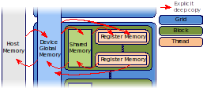
Data Structure Agnostic Memory Model
Notes:
<Foliennummer>
Each parallelization level corresponds to a particular memory
The whole grid has access to a usually large global memory and data needs to be copied explicitly between host and device memory
All threads in an block have access to a small amound of high bandwidth, low latency shared memory.
This memory is usually used for data which is touched multiple times.
Finally each thread has its private register memory
Data transfers between memories has to be done explicitly by the user.
This memory model allows for caching strategies used in PIConGPU
The user can select which data should be put into global or shared memory.

Slide 20
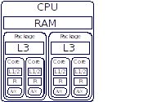
Map the Abstraction Model to your Desired Acceleration Back-End
Explicit mapping of parallelization levels to hardware
Notes:
<Foliennummer>
The advantage of separating the parallelism model and momory model from the real hardware is that we can map these models to various real hardware architecture.
I want to give an example of how to map the abstractio model to a CPU:
The grid is mapped to the full CPU and global memory is located in the main memory
Blocks are mapped to a package of two cores and shared memory is located in the L3 cache
Threads are mapped to cores and thez can use register, L1/L2 cache as private memory
Elements can be processes by the AVX unit of the CPU

Slide 21
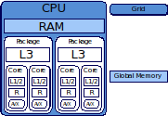
Map the Abstraction Model to your Desired Acceleration Back-End
Explicit mapping of parallelization levels to hardware
Notes:
<Foliennummer>
The advantage of separating the parallelism model and momory model from the real hardware is that we can map these models to various real hardware architecture.
I want to give an example of how to map the abstractio model to a CPU:
The grid is mapped to the full CPU and global memory is located in the main memory
Blocks are mapped to a package of two cores and shared memory is located in the L3 cache
Threads are mapped to cores and thez can use register, L1/L2 cache as private memory
Elements can be processes by the AVX unit of the CPU

Slide 22
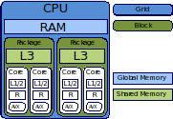
Map the Abstraction Model to your Desired Acceleration Back-End
Explicit mapping of parallelization levels to hardware
Notes:
<Foliennummer>
The advantage of separating the parallelism model and momory model from the real hardware is that we can map these models to various real hardware architecture.
I want to give an example of how to map the abstractio model to a CPU:
The grid is mapped to the full CPU and global memory is located in the main memory
Blocks are mapped to a package of two cores and shared memory is located in the L3 cache
Threads are mapped to cores and thez can use register, L1/L2 cache as private memory
Elements can be processes by the AVX unit of the CPU

Slide 23
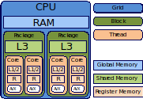
Map the Abstraction Model to your Desired Acceleration Back-End
Explicit mapping of parallelization levels to hardware
Notes:
<Foliennummer>
The advantage of separating the parallelism model and momory model from the real hardware is that we can map these models to various real hardware architecture.
I want to give an example of how to map the abstractio model to a CPU:
The grid is mapped to the full CPU and global memory is located in the main memory
Blocks are mapped to a package of two cores and shared memory is located in the L3 cache
Threads are mapped to cores and thez can use register, L1/L2 cache as private memory
Elements can be processes by the AVX unit of the CPU

Slide 24
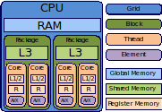
Map the Abstraction Model to your Desired Acceleration Back-End
Explicit mapping of parallelization levels to hardware
Notes:
<Foliennummer>
The advantage of separating the parallelism model and momory model from the real hardware is that we can map these models to various real hardware architecture.
I want to give an example of how to map the abstractio model to a CPU:
The grid is mapped to the full CPU and global memory is located in the main memory
Blocks are mapped to a package of two cores and shared memory is located in the L3 cache
Threads are mapped to cores and thez can use register, L1/L2 cache as private memory
Elements can be processes by the AVX unit of the CPU

Slide 25
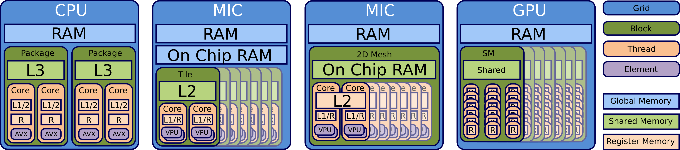
Map the Abstraction Model to your Desired Acceleration Back-End
Specific unsupported levels of the model can be ignored
Abstract interface allows to extend the set of mappings
Notes:
<Foliennummer>
With this abstraction model we can also map to various other architecture such as PowerPC or traditionally to GPUs
Alpaka provides a set of predefined mappings but it is also possible to extend the mapping to new architecture or new version of CUDA
The mapping is totally independent of the user code and can be exchanged independently of the user code.

Slide 26
Alpaka : Vector Addition Kernel
struct VectorAdd
{
template<typename TAcc, typename TElem, typename TSize>
ALPAKA_FN_ACC auto operator()(
TAcc const & acc,
TSize const & numElements,
TElem const * const X,
TElem * const Y) const -> void {
}
};
using alp = alpaka;
auto globalIdx = alp::idx::getIdx<alp::Grid, alp::Threads>(acc)[0u];
auto elemsPerThread = alp::workdiv::getWorkDiv<alp::Thread, alp::Elems>(acc)[0u];
auto begin = globalIdx * elemsPerThread;
auto end = min(begin + elemsPerThread, numElements);
for(TSize i = begin; i < end; ++i){
Y[i] = X[i] + Y[i];
}
Notes:
<Foliennummer>
Because we know the ACC we can use optimized version of functions by C++ template spezialization

Slide 27
Alpaka : Initialization
// Configure Alpaka
using Dim = alpaka::dim::DimInt<3u>
using Size = std::size_t
using Acc = alpaka::acc::AccCpuSerial<Dim, Size>;
using Host = alpaka::acc::AccCpuSerial<Dim, Size>;
using Stream = alpaka::stream::StreamCpuSync;
using WorkDiv = alpaka::workdiv::WorkDivMembers<Dim, Size>;
using Elem = float;
// Retrieve devices and stream
DevHost devHost ( alpaka::dev::DevMan<Host>::getDevByIdx(0) );
DevAcc devAcc ( alpaka::dev::DevMan<Acc>::getDevByIdx(0) );
Stream stream ( devAcc);
// Specify work division
auto elementsPerThread ( alpaka::Vec<Dim, Size>::ones() );
auto threadsPerBlock ( alpaka::Vec<Dim, Size>::all(2u) );
auto blocksPerGrid ( alpaka::Vec<Dim, Size>(4u, 8u, 16u) );
WorkDiv workdiv(alpaka::workdiv::WorkDivMembers<Dim, Size>(blocksPerGrid,
threadsPerBlock, elementsPerThread));
Notes:
<Foliennummer>
An accelerator defines the acceleration strategy by a mapping of the parallelization levels to the hardware architecture
The user needs to decide which accelerator to use for which device
There exists a set of predefined accelerators, but the user can write its own accelerator implementation based on accelerator concepts
Predefined accelerators:
CUDA
OpenMP
Boost Fibers
C++ Threads
Sequential

Slide 28
Alpaka : Call the Kernel
// Memory allocation and host to device memory copy
auto X_h = alpaka::mem::buf::alloc<int, int>(devHost, extent);
auto Y_h = alpaka::mem::buf::alloc<int, int>(devHost, extent);
auto X_d = alpaka::mem::buf::alloc<Val, Size>(devAcc, extent);
auto Y_d = alpaka::mem::buf::alloc<Val, Size>(devAcc, extent);
alpaka::mem::view::copy(stream, X_d, X_h, extent);
alpaka::mem::view::copy(stream, Y_d, Y_h, extent);
Isn't this a little bit too much for the start ?
// Kernel creation and execution
VectorAdd kernel;
auto const exec(alpaka::exec::create<Acc>(
workDiv,
kernel,
numElements
alpaka::mem::view::getPtrNative(X_d),
alpaka::mem::view::getPtrNative(Y_d)));
alpaka::stream::enqueue(stream, exec);
// Copy memory back to host
alpaka::mem::view::copy(stream, Y_h, Y_d, extent);
Notes:
<Foliennummer>
An accelerator defines the acceleration strategy by a mapping of the parallelization levels to the hardware architecture
The user needs to decide which accelerator to use for which device
There exists a set of predefined accelerators, but the user can write its own accelerator implementation based on accelerator concepts
Predefined accelerators:
CUDA
OpenMP
Boost Fibers
C++ Threads
Sequential

Slide 29

Cupla for the rescue : very fast porting !
Fast enough for
live
hack session !
Alpaka
Notes:
Already CUDA code but to lazy to port it, but how much work is it really.
It is fast enough for a live hack session

Slide 30
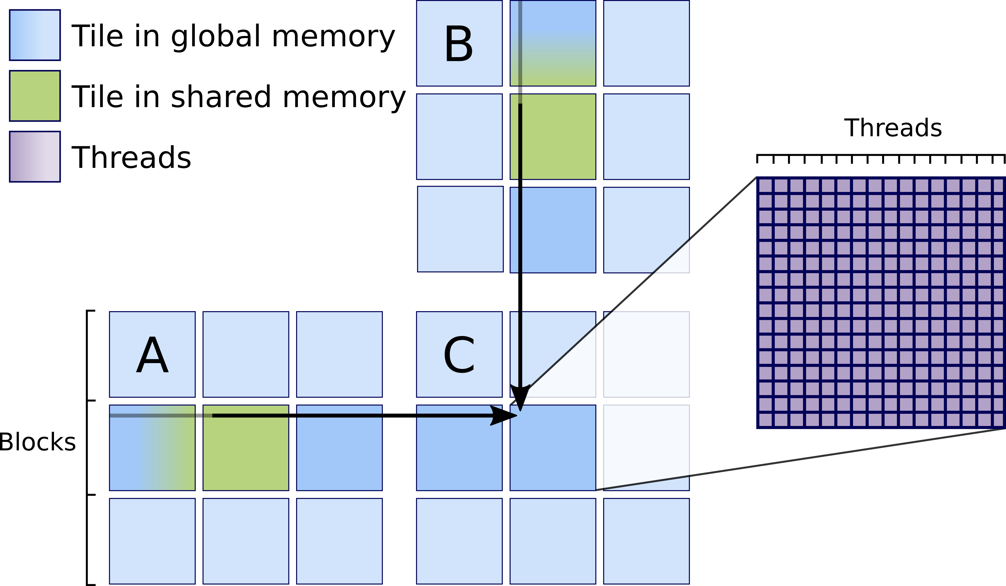
Live Cupla Hack Session
Live port of CUDA to Cupla application
Starting point: matrix multiplication algorithm of CUDA samples
Aim: single source code executed on GPU and CPU hardware
Tiling matrix-matrix multiplication algorithm
Notes:
<Foliennummer>
Compile the native CUDA example with nvcc
Rename files with .cu to .cpp
Replace #include <cuda_runtime.h> by <cuda_to_cupla.hpp>
Wrap kernel function in a C++ functor
Create kernel struct
Replace __global by Alpaka macros
Add Accelerator Template parameter
Replace CUDA shared memory functions by cupla shared memory allocation
Run the Alpaka Cuda version
Run the Alpaka thread parallel OpenMP version
Add support for the Element layer

Slide 31
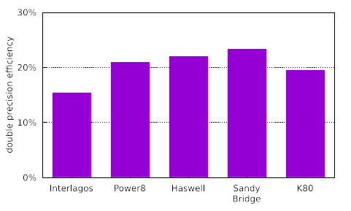
Single Source Alpaka DGEMM Kernel on Various Architectures
480
GFLOPS
560
GFLOPS
540
GFLOPS
150
GFLOPS
1450
GFLOPS
Theoretical
Peak Performance
DGEMM:
C ← αAB + βC
74
117
121
35
283
Notes:
<Foliennummer>

Slide 32

What happend so far...

Slide 33
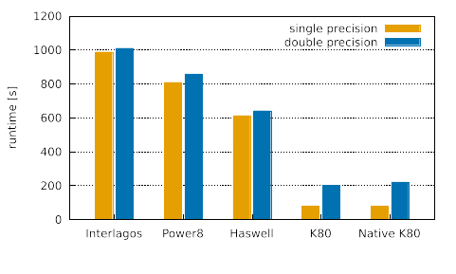
PIConGPU Runtime on Various Architectures

Slide 34
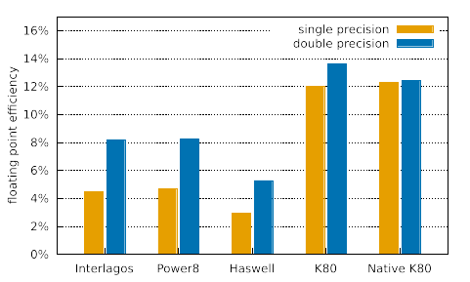
PIConGPU Efficiency on Various Architectures

Slide 35

Clone us from GitHub
https://github.com/ComputationalRadiationPhysics
git clone https://github.com/ComputationalRadiationPhysics/picongpu
git clone https://github.com/ComputationalRadiationPhysics/alpaka
git clone https://github.com/ComputationalRadiationPhysics/cupla
Alpaka paper pre-print: http://arxiv.org/abs/1602.08477

Slide 36
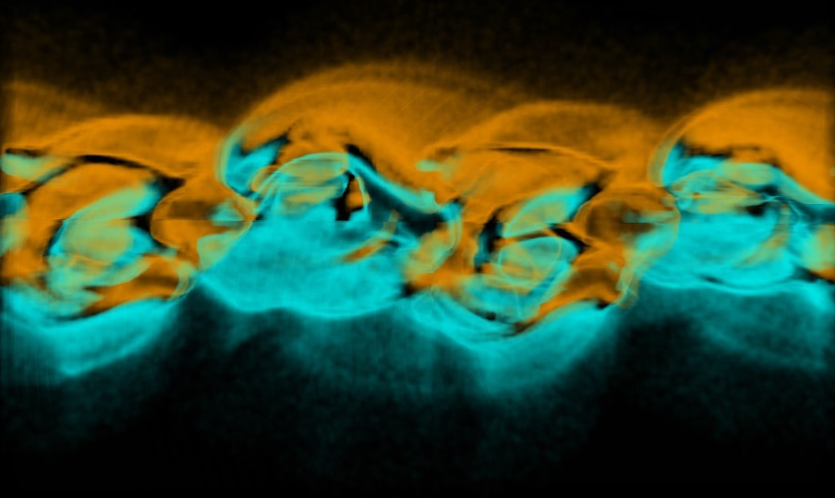
Notes:
<Foliennummer>

