Slide 1
Playzio
Block Puzzle
Nikhil Tadigoppula
Raghu Ram
Syamantak Das
Vishal Batchu

Slide 2
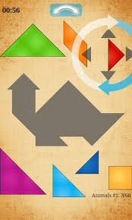
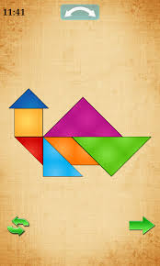
Product Overview
Our product the Block-Puzzle game is a variant of Tangram.
It will have all the features that exist in the current market leaders in the genre and more.

Slide 3
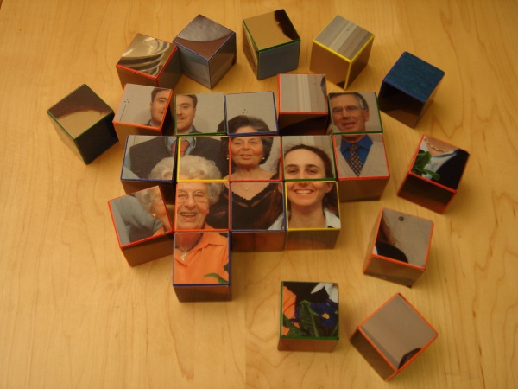
Background
Puzzle games have been popular for centuries.
They were played with physical things like boards etc.
With the onset of the age of smartphones it only makes sense that one should be able to play puzzle games like block puzzle on their smart-phone

Slide 4


Potential users
Type 1: Puzzle solving gamers
  Existing puzzle game lovers.
  Gamers who don’t like puzzle games but are willing to try (because of new attractive features)
Type 2: Casual gamers
  People who spend time commuting. Puzzle games are a stimulating and entertaining pass-time when traveling to work or similar.

Slide 5
Difference between the two types of users
They require very different kind of gameplay
Type 1:
  They burn through levels very fast.
  They are looking for new features.
  Frequent updates will be required to keep this type of user interested.
Type 2:
  They’re looking for a break between their primary activities.
  Will not be pleased with levels that are too hard.

Slide 6
The Solution: Different Game Modes
Modes
  Mode 1 - Timed mode: more challenging, level progression is difficult.
  Mode 2 - Relaxed mode: no timer, levels are easier and shorter.
Other modes: for variety, other modes such as Rotating blocks.

Slide 7
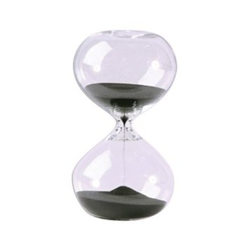
Mode 1: Timed Mode
Puzzles are generated and timer is set according to difficulty level.
Generated puzzle’s difficulty increases as player advances through levels.

Slide 8
Mode 2: Relaxed Mode
No timer.
Hints are available (they can be earned also)
Puzzle difficulty increases as player advances, but the slope is less than Timed Mode.

Slide 9
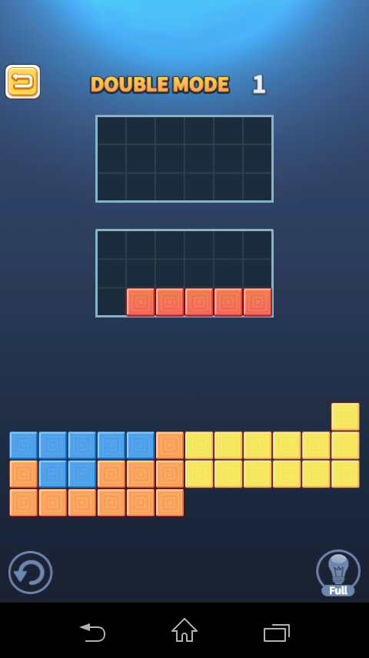
Other Modes
Double: Two solution grids
Shape: Non-rectangular solution grid
Trick: Extra puzzle pieces

Slide 10
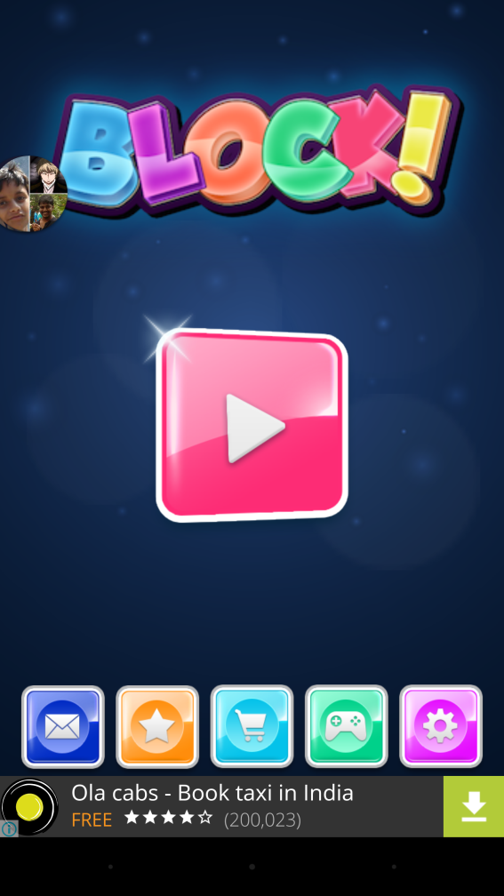
Current Market Leader
Has about 1 million downloads currently.

Slide 11
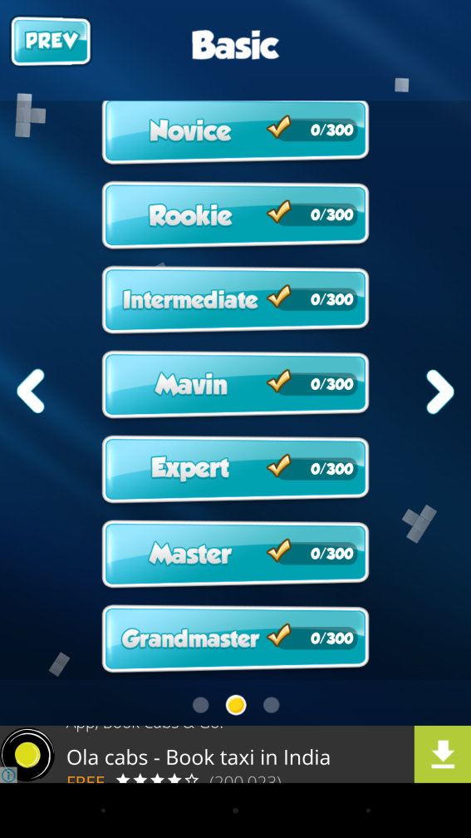
Current Market Leader
They do not have different game modes, only difficulties.

Slide 12
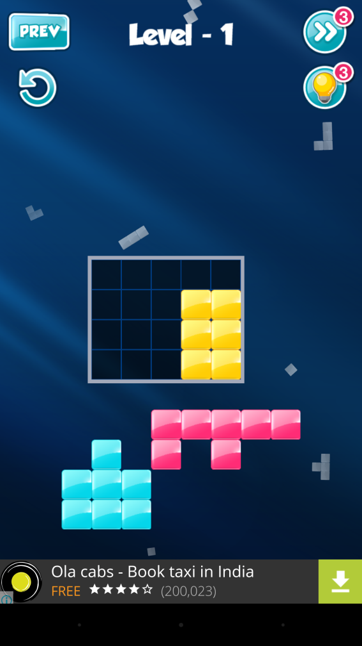
Current Market Leader
Outside grid for available block
Solution grid must be filled to win.
We will adopt a similar approach

Slide 13
Design
PDF

Slide 14
How we will do it (Mgmt Tools)
Communication: Slack
  We can remotely contact other team members and clarify doubts or problems with project manager.
Task Management: Trello
  For easily tracking who is doing what and current progress.
Version Control: GitHub

Slide 15
How we will do it (Production Tools)
Actual Coding: Cocos2d-js
  We have made trial apps using this platform for practice such as Tic-Tac-Toe.
IDE: Cocos IDE
Android SDK

Slide 16
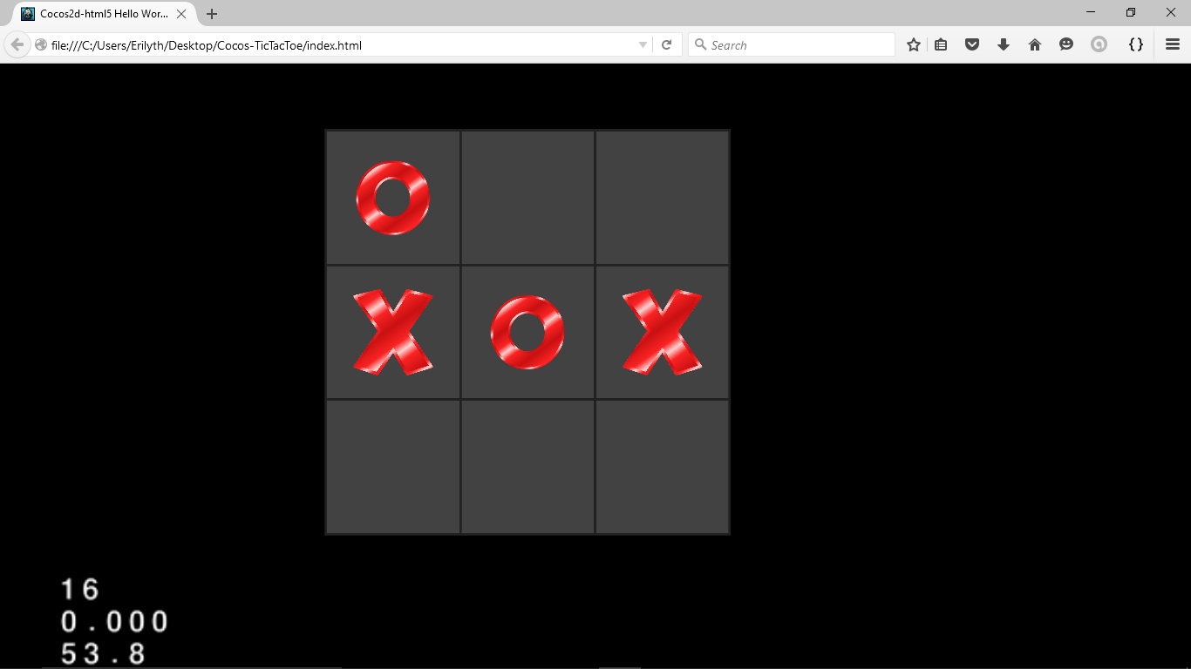
Tic-Tac-Toe

Slide 17
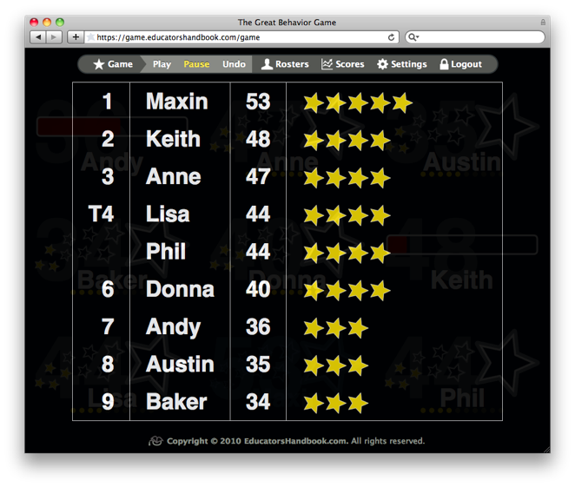
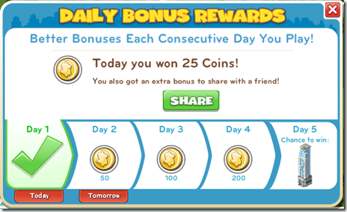
Future Plans
More modes.
Daily sign in gifts/bonus.
Leader-boards (Google Play Integration)

Slide 18
Thank you

