Slide 1
Tomato Garden
An Investigation into Using Real Options for Release Planning
Erin Hughes
40129171

Slide 2
What is Real Options?

Slide 3

Real Options is an approach that allows people to make optimal decisions within their current context
Olav Maassen and Chris Matts, “’Real Options’ Underlie Agile Practices”

Slide 4
Options Example
Let’s say you purchase a fully refundable plane ticket
You now have the flexibility to get your money back if something unexpected happens
In other words, you have the option to get a refund or make changes
But you may not necessarily use that option

Slide 5

Why Software Development?
Developers face risks every time they implement a new feature
What if it takes longer than expected?
What if the client changes their mind?
What if the user doesn’t like it?

Slide 6
Real Options could mitigate the risks of software development
By evaluating a backlog of requirements as a portfolio of assets, options theory can be applied and potentially used to derive value from that backlog.

Slide 7
The Scenario: Team A

Slide 8
The Scenario: Team A
Team A are a software development team that have created and maintain a live application.
They work in two-week sprints, and release at the end of each sprint.

Slide 9
A release is a deployable software package that is the culmination of one or more iterations.

Slide 10
The Scenario: Team A
Team A have an important meeting with their supervisors in 12 weeks, or 6 sprints.
They need to be able to show as much new functionality as possible!

Slide 11
Helping Team A With Planning
Evaluate
Determine the value of each requirement in Team A’s backlog.
Visualise
Display the evaluated requirements in a way that’s easy to understand.
Choose
Add requirements to the release based on their calculated values.

Slide 12
The Scenario: Team A
Team A give each of their requirements a score for value, cost, and risk.
They can only complete 15 cost points per sprint.
Team A also know how much time each requirement has before it’s no longer useful.

Slide 13

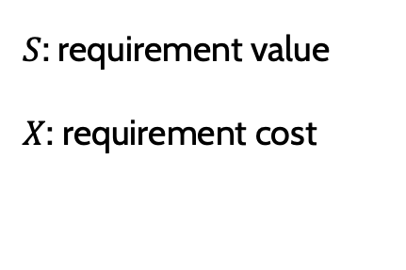



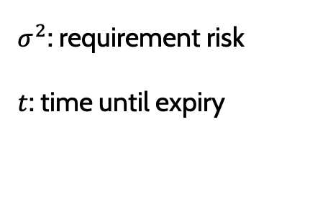
Real Options Equations
$S$: requirement value
$X$: requirement cost
$σ^{2}$: requirement risk
$t$: time until expiry
Value-to-cost
Volatility
$$C= \frac{S}{PV\left(X\right)}$$
$$L=σ\sqrt{t}$$
Scores
$$Z=C+(C∗L)$$

Slide 14
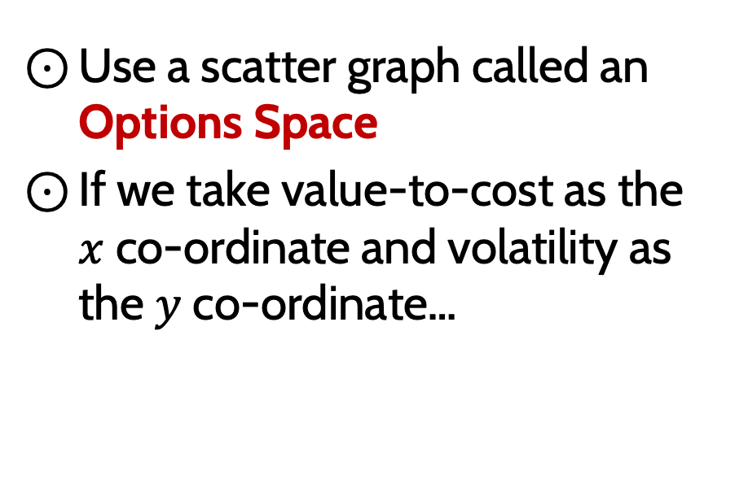
How To Visualise the Requirements
Use a scatter graph called an Options Space
If we take value-to-cost as the $x$ co-ordinate and volatility as the $y$ co-ordinate…

Slide 15
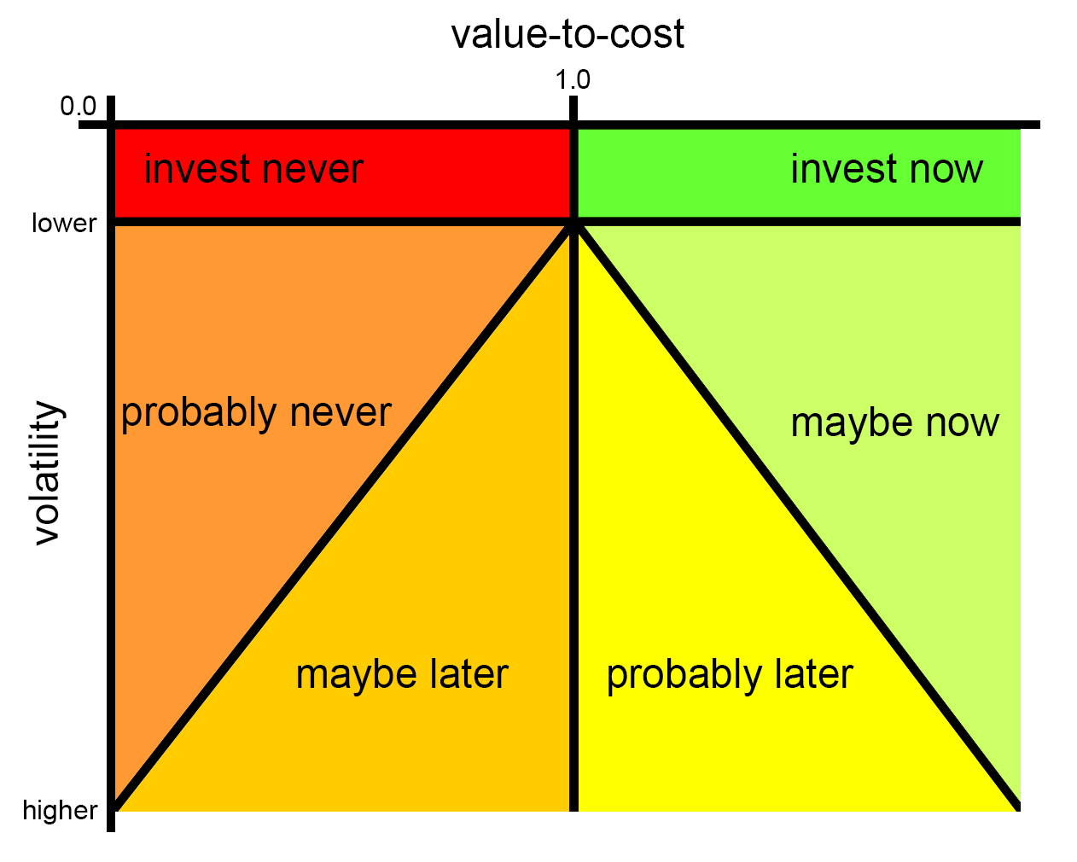
The Options Space

Slide 16
Selection Algorithms
Random Algorithm
Randomly chooses requirements to add to the release
Best Random Algorithm
Does 10 iterations of the random algorithm and picks the most valuable release
Greedy Algorithm
Continuously adds the best scoring requirements to the release
Knapsack Algorithm
Considers how to obtain the most value while not exceeding the cost limit

Slide 17
Tomato Garden Application

Slide 18
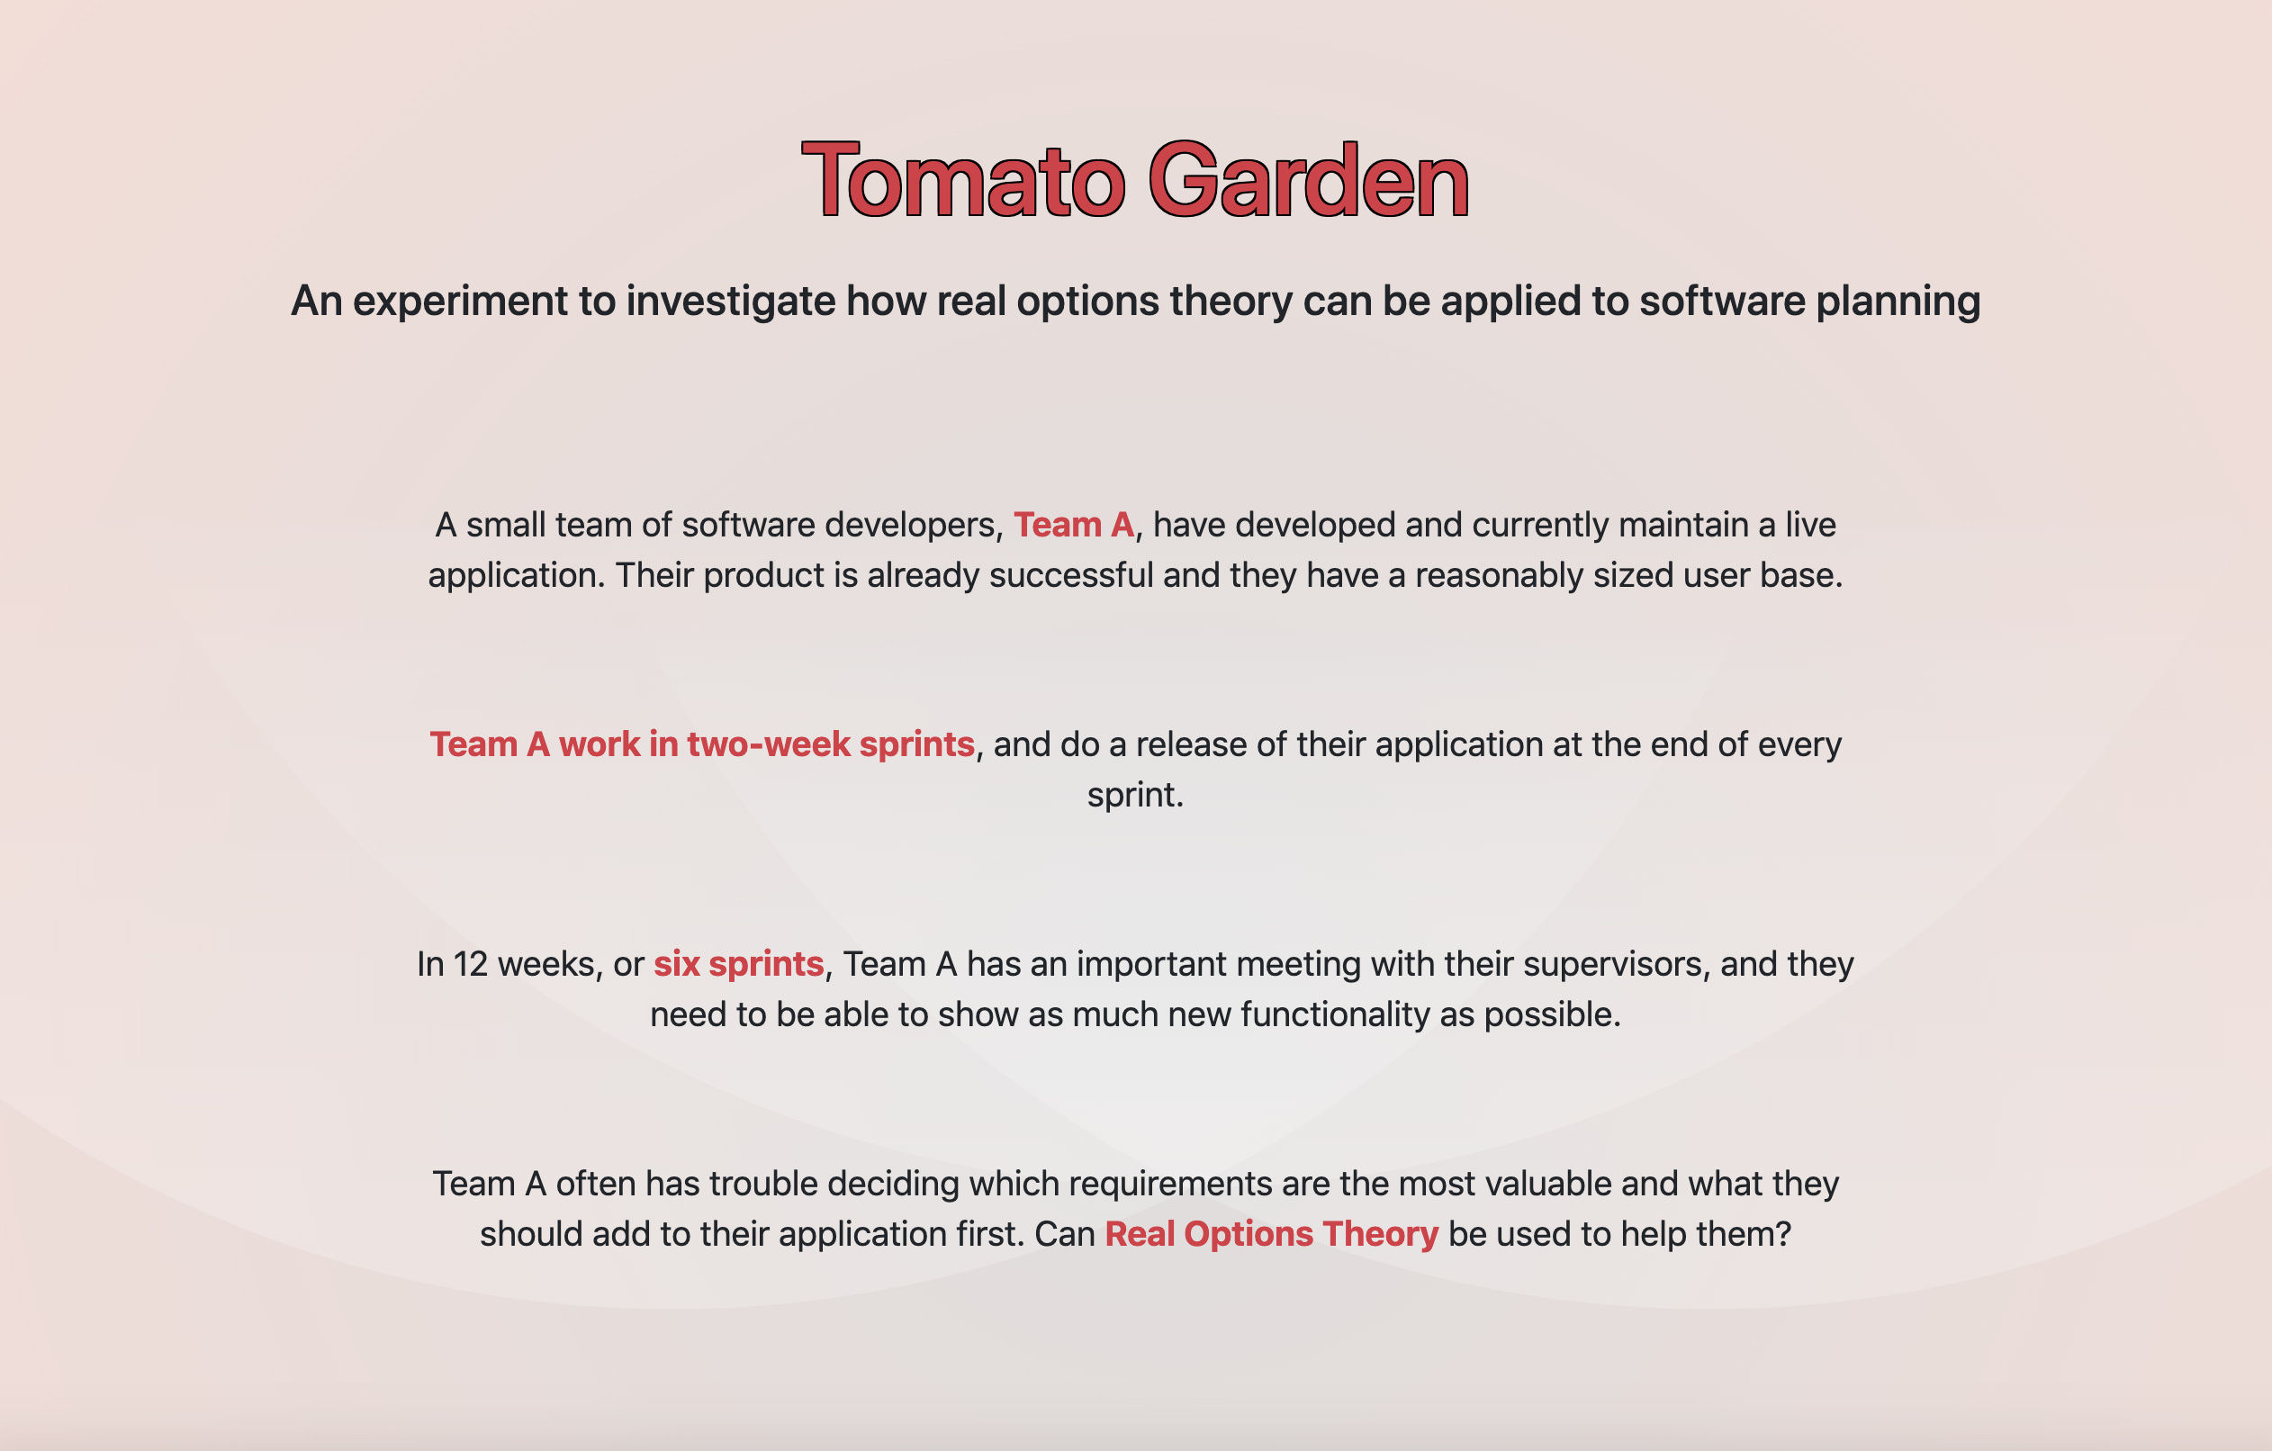
Demo
The Tomato Garden Web Application

Slide 19
Reflection

Slide 20
Have Team A’s Problems Been Solved?
Evaluate
Team A’s requirements were evaluated using the options equations
Visualise
The requirements were then plotted on the interactive options space based on this evaluation
Choose
Requirements were chosen for release using four different selection algorithms

Slide 21
Real Options can therefore be used to plan valuable releases
Based on the results of the Team A experiments

Slide 22
Areas for Improvement
Implement more selection algorithms – is there a better way to select the requirements?
Enhance the application for user input
Conduct user testing with software developers

Slide 23
Thank you!
Any questions?

