Slide 1
Given all of the past state of the union addresses, is it easy to comprehend future addresses?
Erin Kreiling Group 2

Slide 2
Agenda
Project Overview
About the Data
Pre-Processing
Modeling
Conclusion

Slide 3
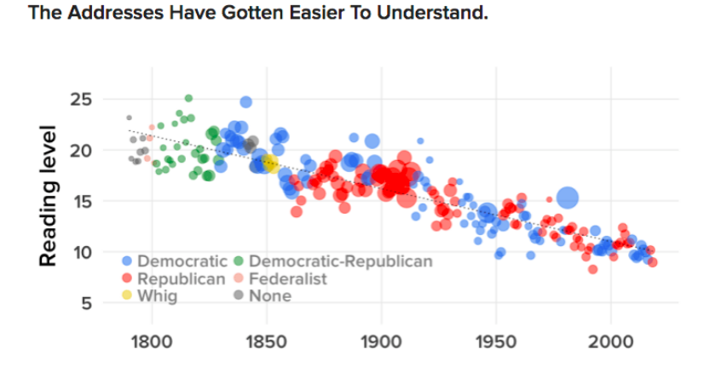
Project Overview
At the beginning of each year, the President of the United States gives a speech that outlines the country’s current economic outlook, upcoming legislature, and a statement on the events of the past year.
Since President Woodrow Wilson’s 1913 address, there have been a total of 83 in-person addresses with similar topics but varying tones and sentiments.
Notes:
https://bigthink.com/philip-perry/whats-the-reading-level-of-state-of-the-union-addresses-and-how-does-trumps-measure-up

Slide 4
About the Data
Transcripts of every State of the Union address
  1797-2018
  Beginning with President John Adams and ending with President Donald Trump
Data pulled from Kaggle
Each transcript in an individual text file
President Trump’s opening for the 2018 State of the Union address:
“Thank you very much. Mr. Speaker, Mr. Vice President, members ofCongress, the first lady of the United States ...... and citizens of America, tonight, as we mark the conclusion of ourcelebration of Black History Month, we are reminded of our nation's pathtoward civil rights and the work that still remains to be done.Recent threats ...Recent threats targeting Jewish community centers and vandalism ofJewish cemeteries, as well as last week's shooting in Kansas City,remind us that while we may be a nation divided on policies, we are acountry that stands united in condemning hate and evil in all of itsvery ugly forms”

Slide 5
Pre-Processing
Randomize
Randomize order of the files for each address
Segment
Segment into Testing and Training sets (70% Training, 30% Testing)
Split
Split Testing in half to create Validation set (and smaller Testing set)
Modify
Modify TensorFlow Mini Project code from Deep Learning GitHub

Slide 6
Modeling

Slide 7
Long Short Term Memory Units in a Recurrent Neural Network
Chosen for their ability to retain information about “long term dependencies in the text”
Measure of Fit -> Perplexity -> the degree of uncertainty a model has in predicting a piece of text
Components of the Model
  Define batch size, step size, hidden size, and vocab size (initialize variables)
  Create Long Short Term Gates
  Calculate wp + b
  Calculate Cost (loss/batch size)
  Optimize with Gradient Descent
Notes:
https://www.oreilly.com/learning/perform-sentiment-analysis-with-lstms-using-tensorflow

Slide 8
Tuning Hyperparameters
Parameter | Value
Learning Rate | 0.1
Number of Layers | 1
Number of Steps | 20
Hidden Size | 1000
Number of Epochs | 10
Batch Size | 35
Vocab Size | 1000
How many words per second? 8,419 in the 10th epoch!

Slide 9
Conclusions
Predicting the next word in a sentence can be very hard but speeches with similar content every year can be a bit easier.
Time may not play as large of a factor as repetitive content.
Data formats and types are very critical for Natural Language Processing (NLP).
For continued research:
  Test out on upcoming 2019 State of the Union address – will it perplex the model?
  Experiment further with different numbers of layers
  Attempt using Keras
  More extensive data cleaning
  Improved understanding of TensorFlow framework and LSTM as a whole

