Slide 1
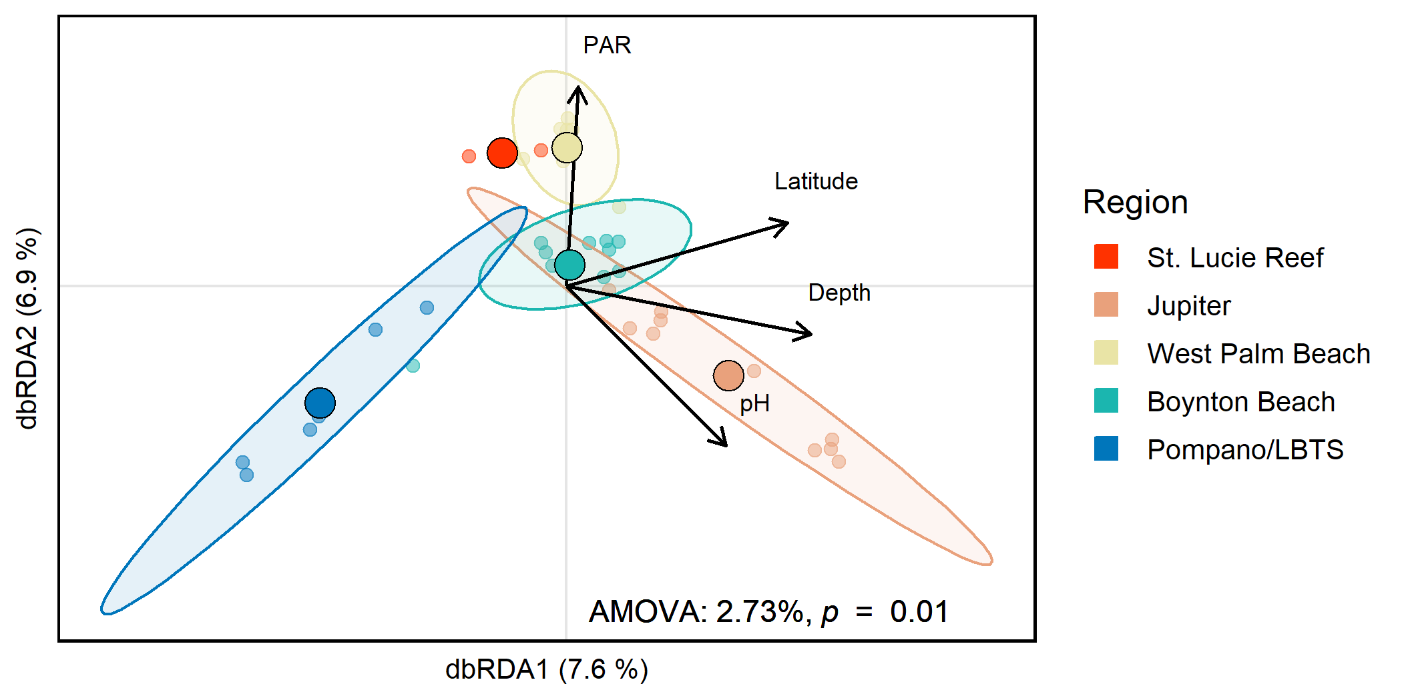
Population
Ft. Lauderdale

