Slide 1
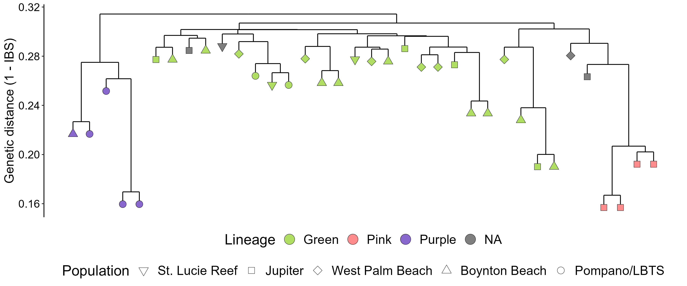
Admixed
Ft. Lauderdale

Slide 2
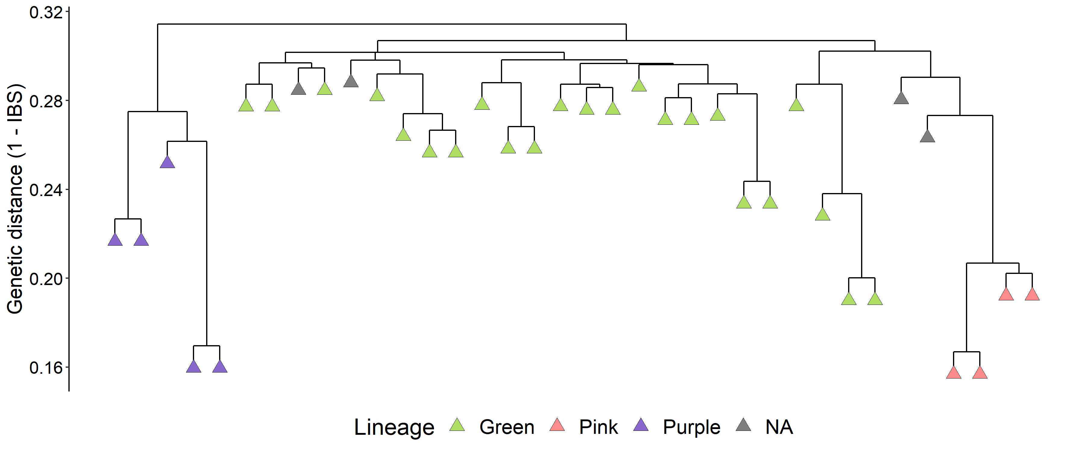
Admixed

