Slide 1

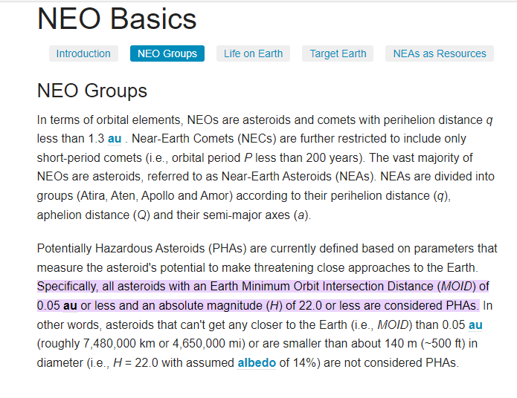

Identification of the Key Predictors for PHA Determination
Near-Earth Objects (NEOs)
79 Variables
Diameter
Absolute Magnitude Parameter
Potentially Harmful Asteroids (PHAs)
Eccentricity
Color Index Magnitude Difference
Number of Observations used in Fit
Mean Motion
Jupiter Tisserand Invariant
Earth Minimum Orbit Intersection Distance (MOID)
Small-Body Database Query (nasa.gov)
35,367 data points

Slide 2
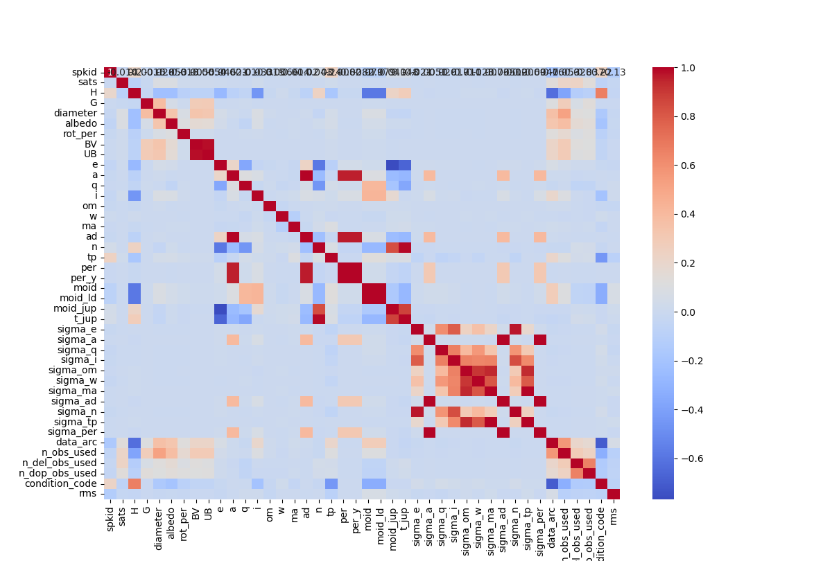
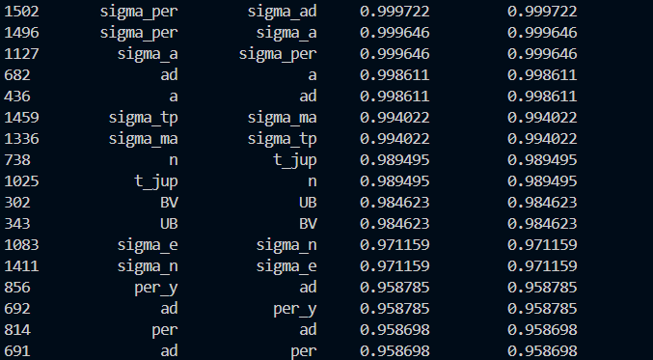
Identification of the Key Predictors for PHA Determination
Correlation Matrix
79 Variables
35,367 data points

Slide 3

Machine Learning Methods
Decision Tree Classification
K-Nearest Neighbors (KNN)
Gradient Boosting Machines (GBM)
Support Vector Machines (SVM)
Linear Regression
Long Short-Term Memory
Random Forest Classification

Slide 4
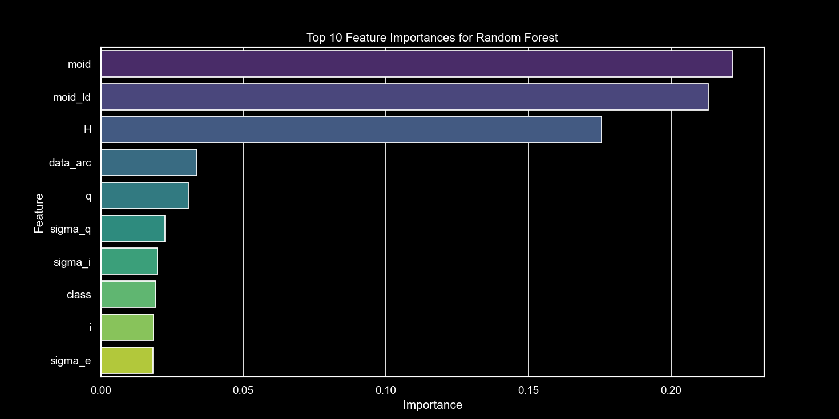
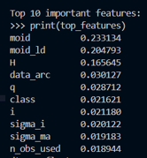
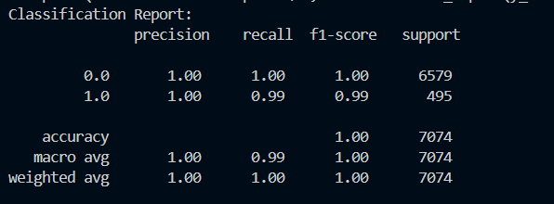

Identification of the Key Predictors for PHA Determination
$R^{2}$= 0.987
Random Forest Classification

Slide 5
Identification of the Key Predictors for PHA Determination
Top Features Of Importance
Earth Minimum Orbit Intersection Distance (au) (moid)
Earth Minimum Orbit Intersection Distance (LD : Lunar Distance) (moid_LD)
Absolute Magnitude Parameter (h)
data_arc : Number of Days spanned by data arc
q: Perihelion distance
class: Orbit Classification
I: inclination
N_obs_used: number of observations utilized

Slide 6
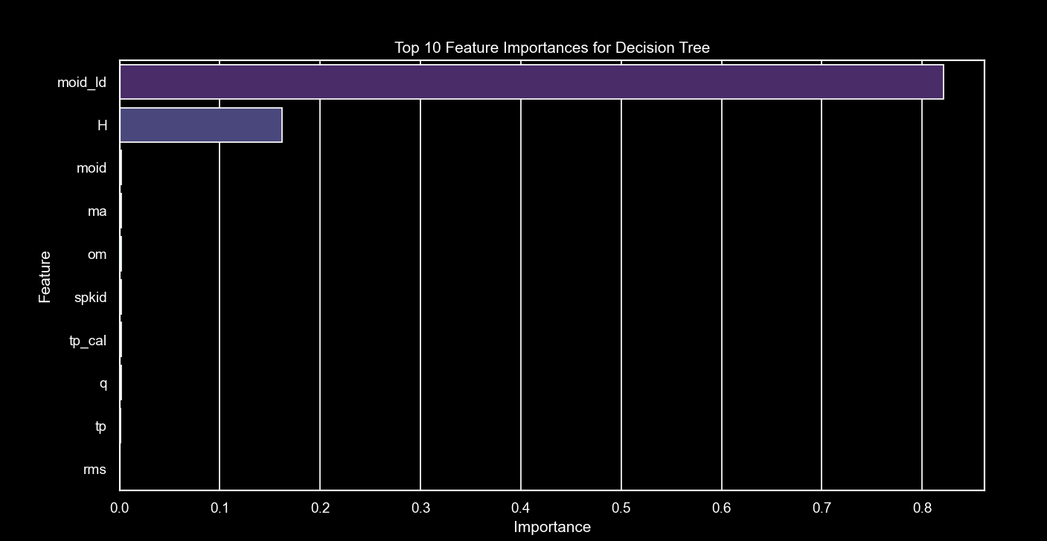
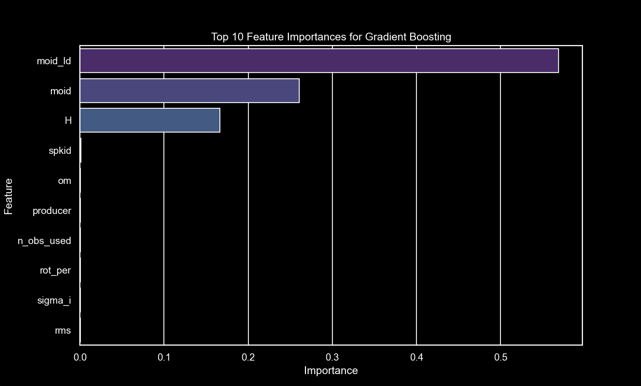


Identification of the Key Predictors for PHA Determination
Decision Tree Classification
Gradient Boosting
$R^{2}$= 0.97
$R^{2}$= 0.9869
Top Features Of Importance
Top Features Of Importance

Slide 7
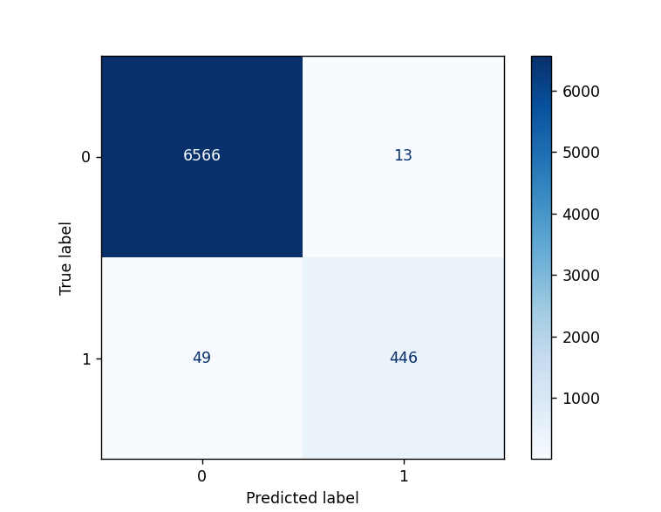
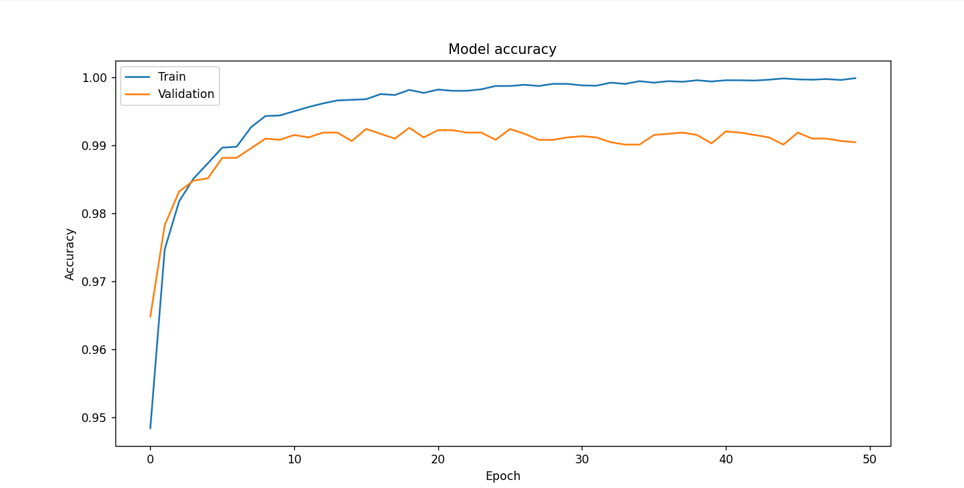

Identification of the Key Predictors for PHA Determination
$R^{2}$= 0.89
Long Short-Term Memory

Slide 8


Decision Tree Classification
KNN
Linear Regression
Long Short-Term Memory
Random Forest
SVM
GBN
$$R^{2}$$
0.97
0.1875
0.6046
0.9869
-758.98
0.8915
0.987
F1 Score
0.94
0.99
0.99
0.54
0.81
.0.99
Precision
0.85
1.00
0.97
1.00
0.87
0.69
Recall
0.99
0.45
0.76
0.99
0.90
0.99
RMSE
0.04
0.2299
0.1604
0.2912
7.032
MSE
49.4582
0.00

Slide 9
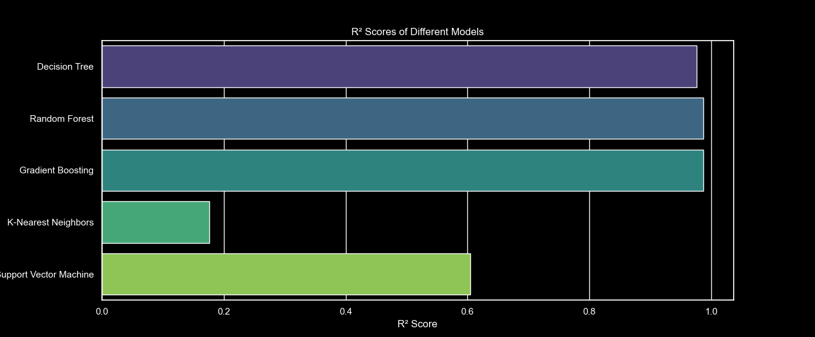
Identification of the Key Predictors for PHA Determination
0.97
0.987
0.9869
0.1875
0.6046

Slide 10

Identification of the Key Predictors for PHA Determination
Earth Minimum Orbit Intersection Distance (au) (moid)
Earth Minimum Orbit Intersection Distance (LD : Lunar Distance) (moid_LD)
Absolute Magnitude Parameter (h)
data_arc : Number of Days spanned by data arc
q: Perihelion distance
class: Orbit Classification
I: inclination
N_obs_used: number of observations utilized

