Slide 1
Identifying hazardous asteroids
Team: Asteroid M
Erin Valdes, Marc Papandreadis,
Matthew Waring, Emily Payne

Slide 2
Agenda
Project Purpose
Data
Models
Analysis
Conclusions

Slide 3
Project Purpose
The probability of an asteroid striking Earth and causing serious damage is very remote, but the devastating consequences of such an impact make predicting their trajectories an important study
NASA’s Jet Propulsion Lab Solar System Dynamics group provides orbits and ephemerides (trajectories) for all known natural objects, including near-earth asteroids
The goal of this project is to develop a machine learning model that can predict the label of an asteroid, “Potentially Hazardous” or “Not Potentially Hazardous”, based on orbit and ephemeride attributes

Slide 4
The Data
Initial Findings

Slide 5
Key Features
pha | a | e | i | om | w | q | data_ arc | n_obs_used | H | ma | n | tp | moid | class | orbit_ id
N | 1.46 | 0.22 | 10.83 | 304.28 | 178.90 | 1.13 | 4.7E+04 | 9.1E+03 | 10.41 | 334.73 | 0.56 | 2.5E+06 | 0.15 | AMO | 659
N | 2.64 | 0.55 | 11.58 | 183.85 | 156.22 | 1.19 | 4.1E+04 | 2.1E+03 | 15.59 | 102.37 | 0.23 | 2.5E+06 | 0.20 | AMO | 266
N | 2.47 | 0.57 | 9.40 | 110.42 | 350.48 | 1.06 | 3.9E+04 | 3.5E+03 | 13.88 | 289.48 | 0.25 | 2.5E+06 | 0.08 | AMO | JPL 450
N | 2.67 | 0.53 | 26.69 | 215.50 | 132.48 | 1.25 | 3.6E+04 | 1.1E+04 | 9.25 | 321.69 | 0.23 | 2.5E+06 | 0.35 | AMO | JPL 1195
N | 1.92 | 0.44 | 11.88 | 171.31 | 26.68 | 1.08 | 3.3E+04 | 6.2E+02 | 17.38 | 197.64 | 0.37 | 2.5E+06 | 0.11 | AMO | 121
Y | 1.08 | 0.83 | 22.80 | 87.95 | 31.44 | 0.19 | 2.7E+04 | 1.7E+03 | 16.57 | 344.76 | 0.88 | 2.5E+06 | 0.03 | APO | JPL 172
N | 2.20 | 0.49 | 52.19 | 62.23 | 159.67 | 1.13 | 2.6E+04 | 1.8E+03 | 14.69 | 258.50 | 0.30 | 2.5E+06 | 0.14 | AMO | 306
Y | 1.25 | 0.34 | 13.33 | 337.16 | 276.98 | 0.83 | 2.6E+04 | 8.2E+03 | 15.27 | 147.60 | 0.71 | 2.5E+06 | 0.03 | APO | 763
N | 1.86 | 0.40 | 8.45 | 133.10 | 167.84 | 1.13 | 3.4E+04 | 1.3E+04 | 12.84 | 78.93 | 0.39 | 2.5E+06 | 0.11 | AMO | 1335
N | 1.37 | 0.44 | 9.38 | 274.21 | 127.26 | 0.77 | 2.8E+04 | 5.6E+03 | 14.28 | 73.06 | 0.62 | 2.5E+06 | 0.05 | APO | JPL 809
pha | Potentially hazardous asteroid (target)
e | eccentricity
a | semimajor axis (au)
q | perihelion distance (au)
i | inclination (deg)
om | longitude of the ascending node (deg)
w | argument of perihelion (deg)
ma | mean anomaly (deg)
tp | time of perihelion passage in Julian day form
n | mean motion (deg/d)
moid | minimum distance between the orbits of Earth and the small-body (au)
H | absolute magnitude (magnitude at 1 au from the Sun and the observer)
data_arc | number of days spanned by the observations used in the orbit determination
n_obs_used | total number of observations of all types used in the orbit

Slide 6
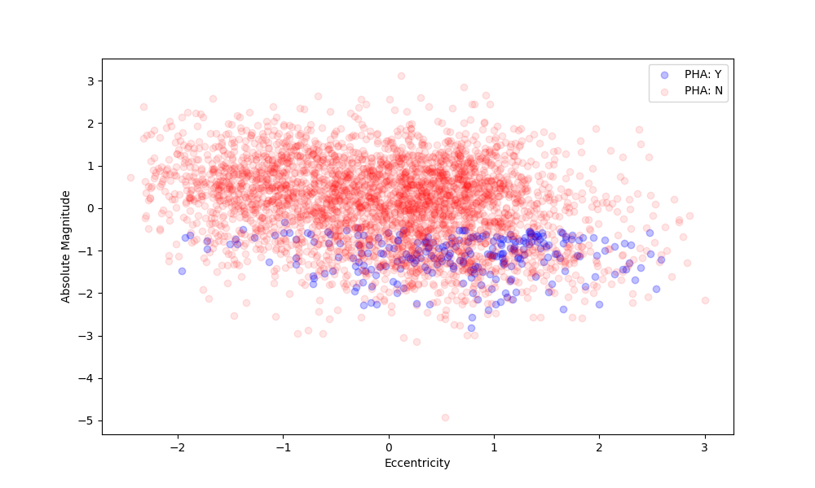
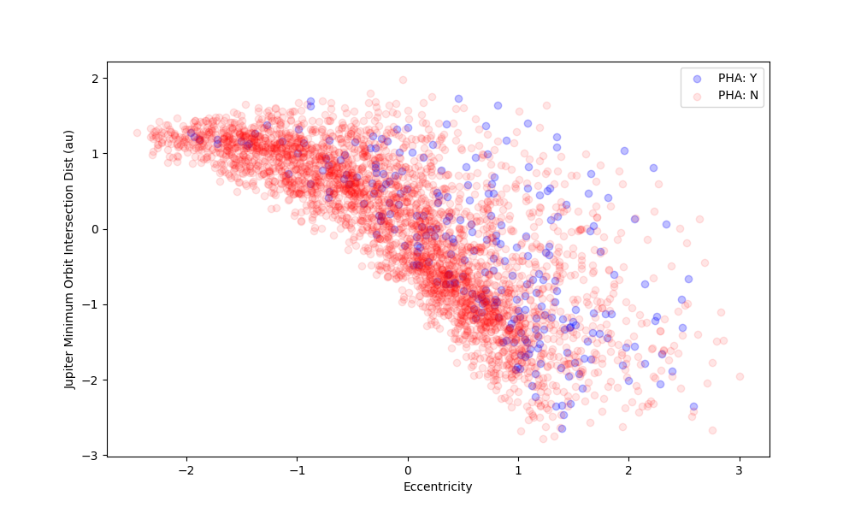
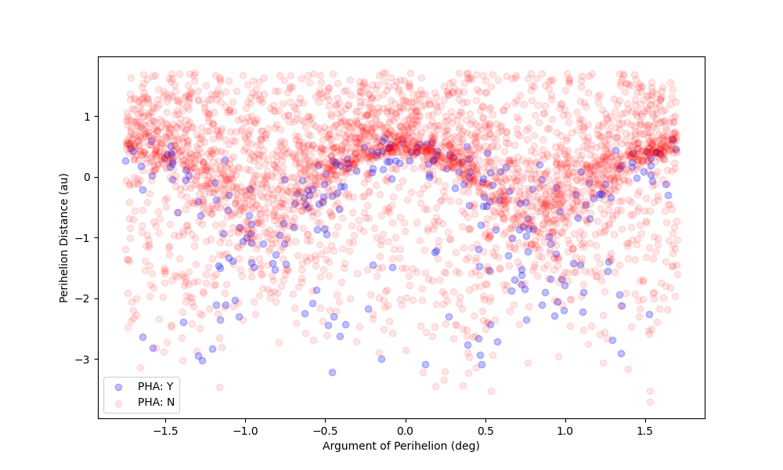
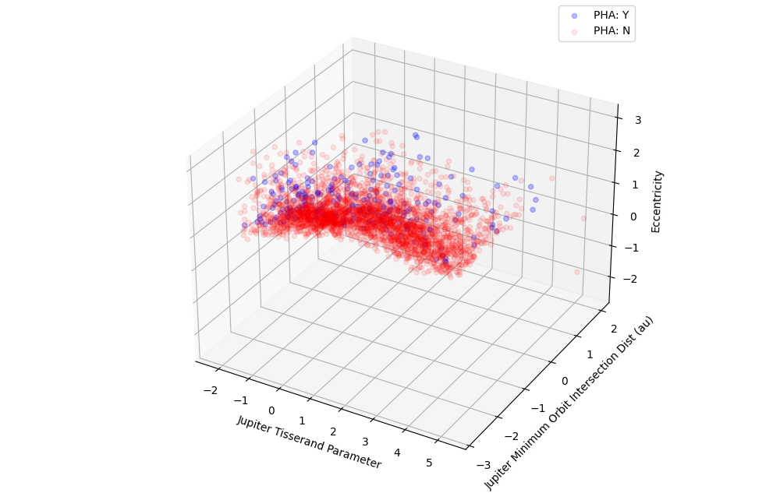
Recall previous findings
Initial analysis revealed linear and non linear boundaries between Potentially Hazardous Asteroids (PHA) in various dimensions.
Thus we proposed building solutions of varying complexity to solve this binary classification problem.

Slide 7
The Models
Simple to complex

Slide 8
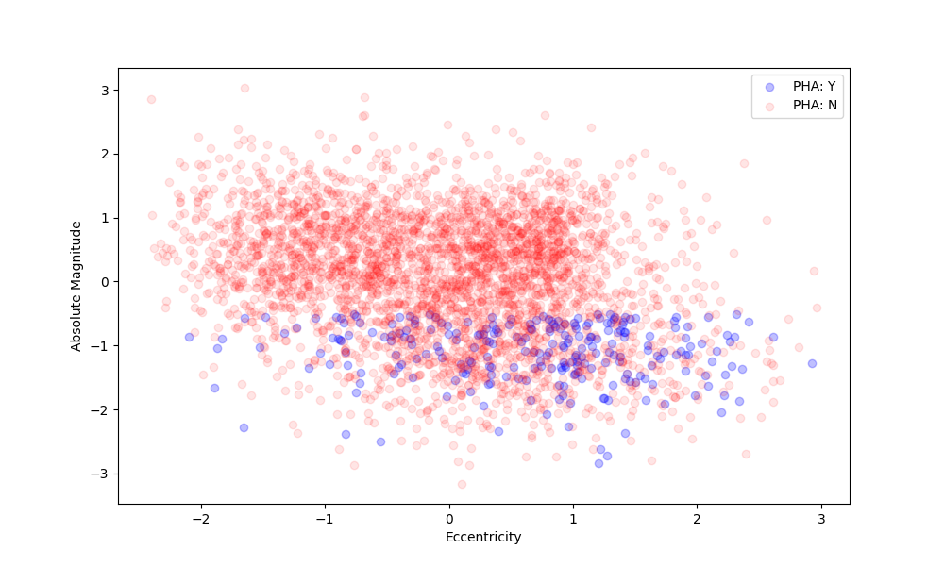
Absolute Magnitude vs. Eccentricity
Visibly linear boundaries suggest simple bivariate linear models would perform well
Logistic Regression, LDA, and SVM with a Linear Kernel would theoretically perform well

Slide 9
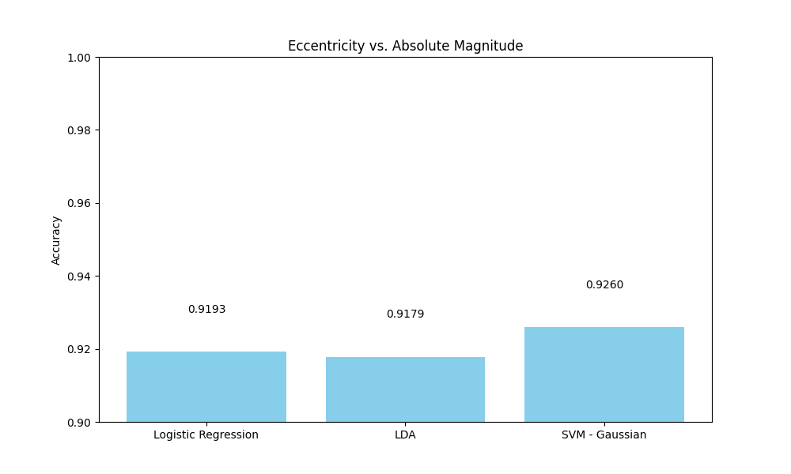
Absolute Magnitude vs. Eccentricity

Slide 10
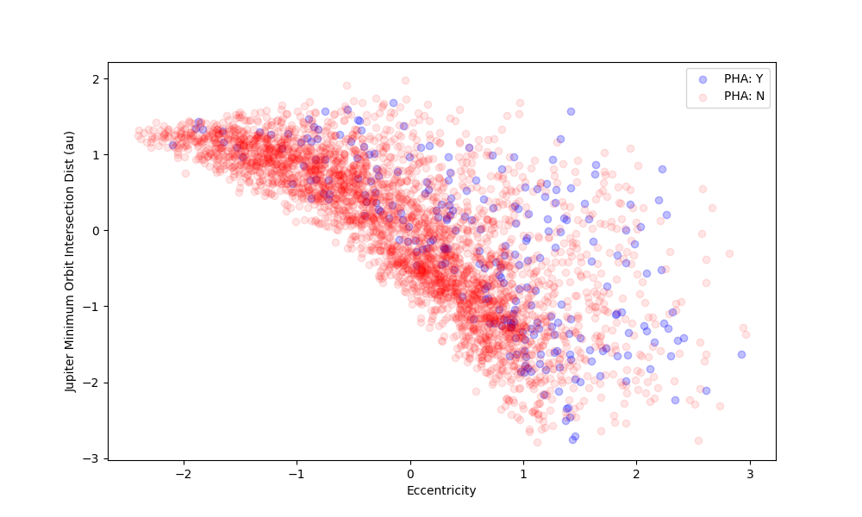
Jupiter Min Orbit Distance vs. Eccentricity
Visibly non-linear boundaries suggest that simple nonlinear models may perform well, even outperforming linear models in the previous section.
QDA, Polynomial Kernel SVM, and Gaussian Kernel SVM may fit well here

Slide 11
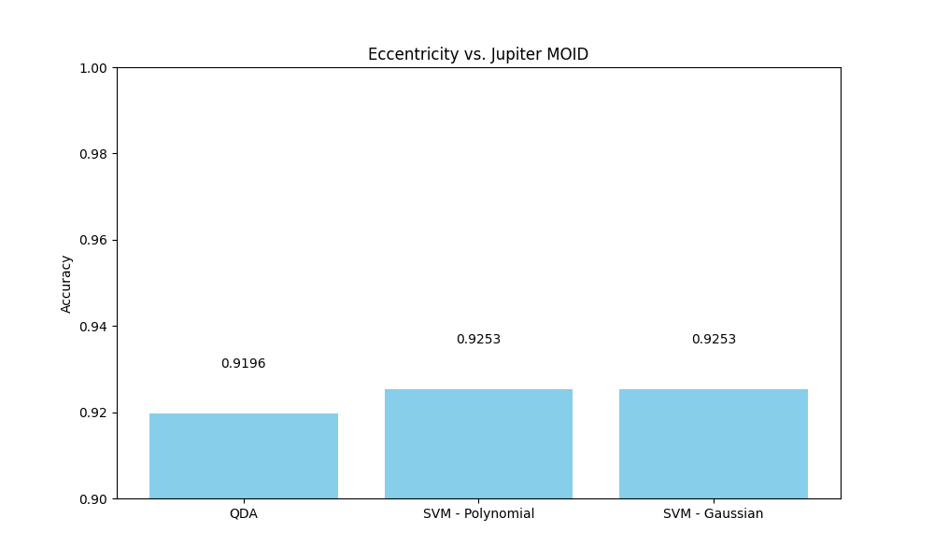
Jupiter Min Orbit Distance vs. Eccentricity

Slide 12
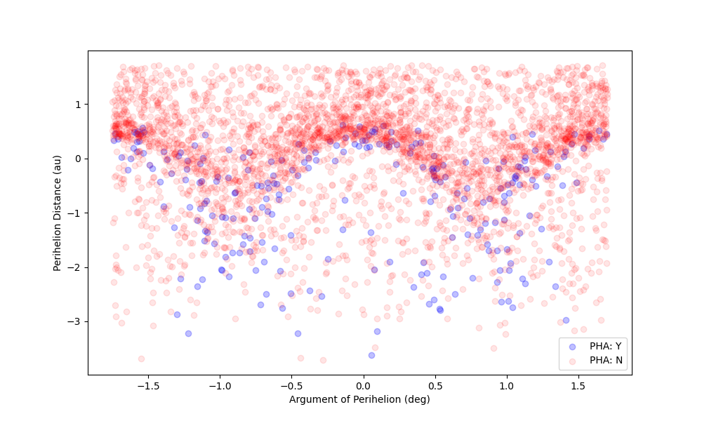
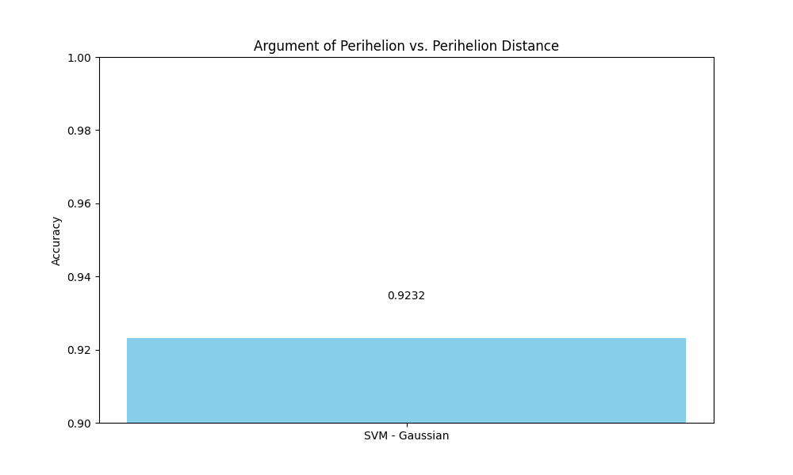
Argument of Perihelion vs. Perihelion Distance

Slide 13
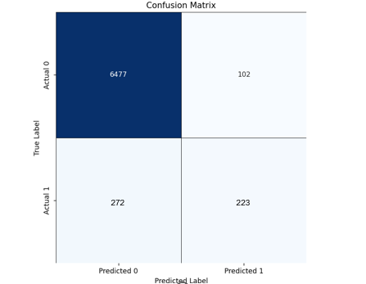
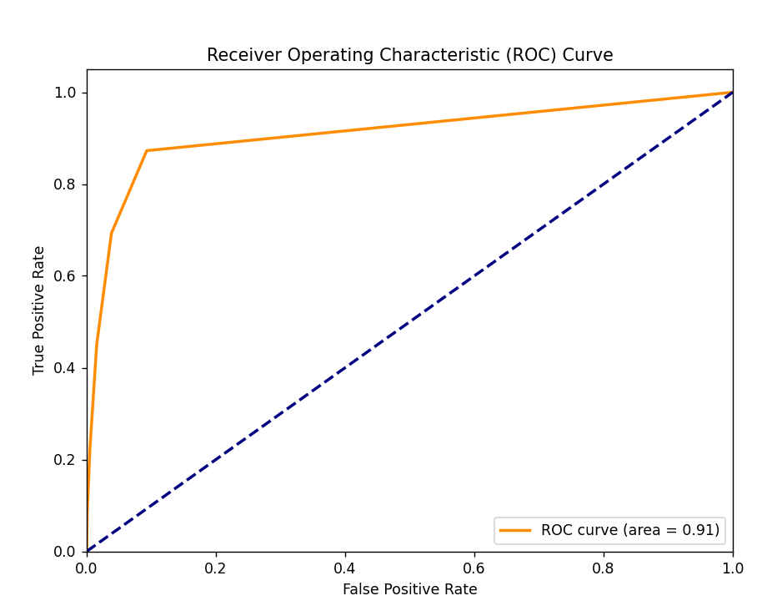
k nearest neighbors initial model
KNN Results | Near Earth Asteroids
R² | 0.1876
ROC/AUC | 0.91
F1 Score | 0.54
RMSE | 0.2299
Metric | Euclidean distance
N Neighbors | 5
272
223

Slide 14
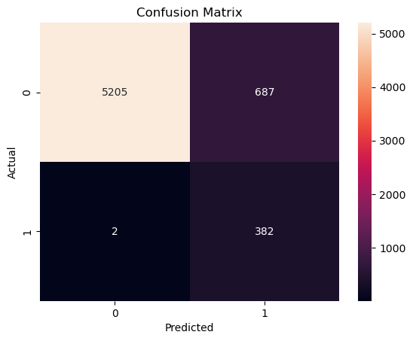
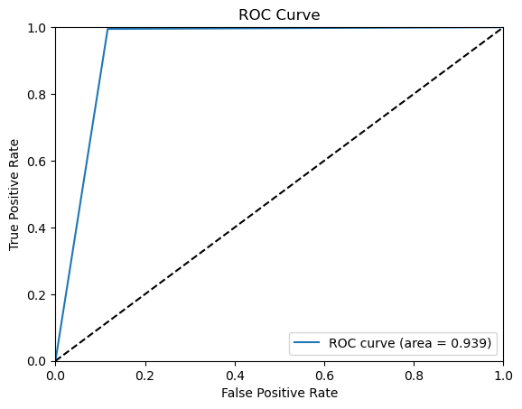
k nearest neighbors Full features & grid search
KNN Results
ROC/AUC | 0.94
F1 Score | 0.53
Accuracy | 0.89
Metric | Manhattan distance
N Neighbors | 11
Weights | Distance
272
223

Slide 15
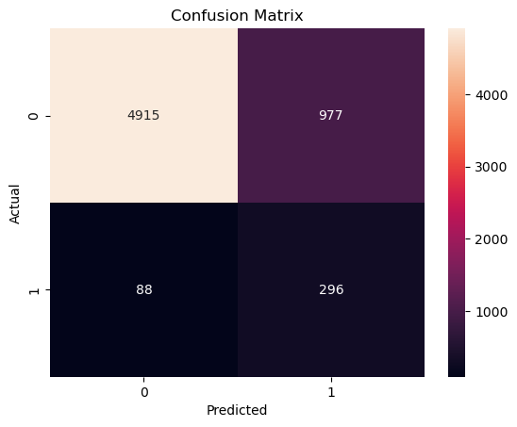
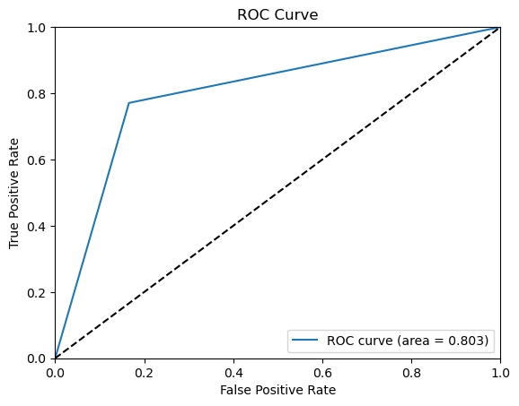
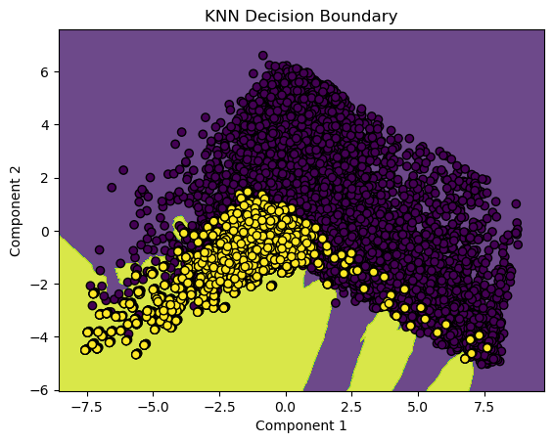
k nearest neighbors 2-component pca
KNN PCA Results
ROC/AUC | 0.80
F1 Score | 0.36
Accuracy | 0.83
272
223

Slide 16
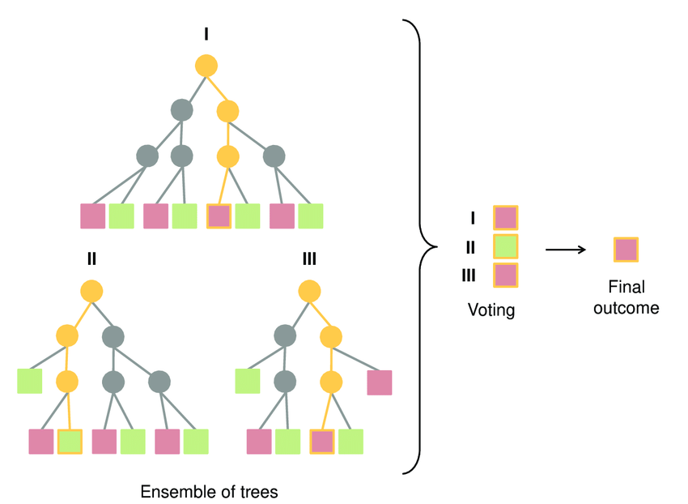
Ensemble methods
Ensemble methods enhance accuracy and generalizability of models by combining predictions from multiple models, called “weak learners”
Bagging (or bootstrap aggregating) selects subsets of the input data with replacement to rain weak learners in parallel, combining final predictions
Boosting is a sequential process in which each new weak learner attempts to correct the errors of the previous
Advantages over methods such as LR include robustness to nonlinearity, correlated features, and interactions

Slide 17
Gradient boosting machine
Gradient boosting machines rely on sequentially training weak decision tree learners. At each iteration, a new tree is fit to the gradient (negative derivative) of the loss function and the new estimator is added to the previous according to some learning rate or calculated weight.
We used GridSearch with 5-fold cross validation to select the best hyperparameters for each model
LightGBM – faster convergence, prone to overfitting
XGBoost – optimized with parallel computing
CatBoost – balanced trees with the same conditions in each tree
Model | Best GS Parameters | F1 | Runtime
LGBM | Lr = 0.1 N_est=100 Max_depth = 5 Num_leaves =31 | 0.885 | <5m
XGB | Lr = 0.1 N_est=100 Max_depth = 5 | 0.866 | <2m
CatB | Lr = 0.1 N_est = 200 Max_depth=7 | 0.986 | <15m
Notes:
Ensemble methods like GBM can improve on accuracy over single models, since they combine outputs from multiple models. GBM’s may be advantageous over models like logistic regression because they do not assume linearity and are robust to correlated features and feature interactions.
XGBoost (eXtreme Gradient Boosting) is a machine learning algorithm that focuses on computation speed and model performance. It builds trees in level by level and in parallel.
LightGBM carries out leaf-wise (vertical) growth that results in more loss reduction and in turn higher accuracy while being faster. But this may also result in overfitting on the training data which could be handled using the max-depth parameter that specifies where the splitting would occur. Hence, XGBoost is capable of building more robust models than LightGBM.
CatBoost builds symmetric (balanced) trees, unlike XGBoost and LightGBM. In every step, leaves from the previous tree are split using the same condition. The feature-split pair that accounts for the lowest loss is selected and used for all the level’s nodes. This balanced tree architecture aids in efficient CPU implementation, decreases prediction time, makes swift model appliers, and controls overfitting as the structure serves as regularization.

Slide 18
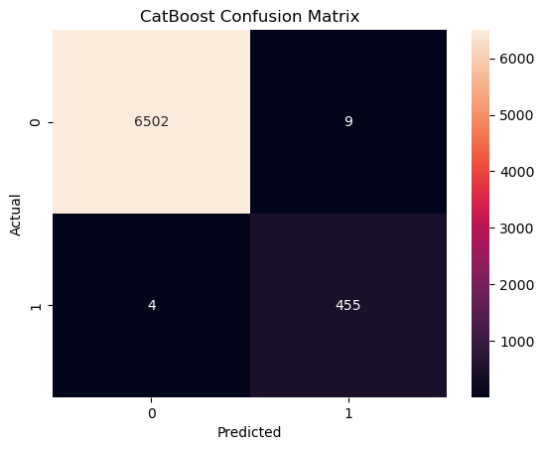
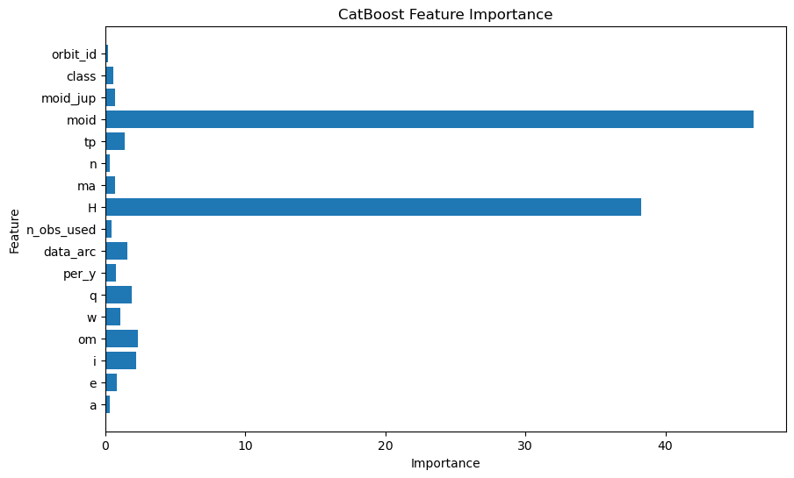
GBM Results catboost has the best overall performance
Notes:
One key reason Catboost tends to perform better than other methods like lgbm and xgboost is that is uses Shapley Additive Values( SHAP) for feature selection.
CatBoost uses SHAP (SHapley Additive exPlanations) to break a prediction value into contributions from each feature. It calculates feature importance by measuring the impact of a feature on a single prediction value compared to the baseline prediction.

Slide 19
Neural network – Background
Neural networks are among the most powerful models in machine learning
Can be used in data analysis, artificial intelligence applications, (in our case) classification
Modeled based on the neurons in the human brain

Slide 20
Neural network – How do they work?
As discussed, NNs are modeled after the neurons in the brain
Each input neuron receives the input data, and these input neurons are connected via edges to the other neurons in deeper layers of the model.
Each layer processes the input via an activation function and send the output, or “signal” to the next layer.
The strength of each signal determined by a weight that is adjusted during model training.
Models are then trained via backpropagation, where the weights in the model are adjusted to minimize the error of the output.

Slide 21
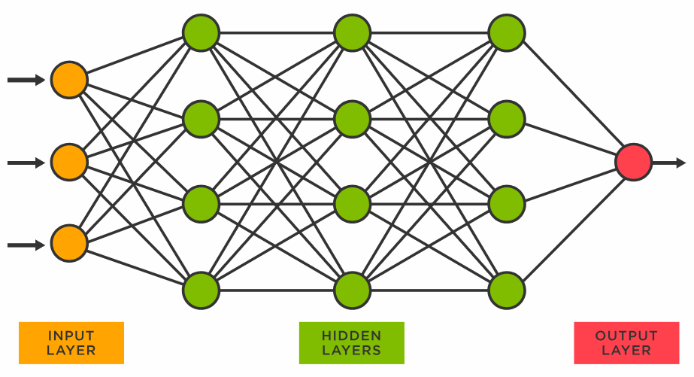
Neural network – How do they work?
https://pub.towardsai.net/building-intuition-on-the-concepts-behind-llms-like-chatgpt-part-1-4cb6654ab67

Slide 22
Neural network – Approach
To build the neural net, we needed to clean the data
Needed to use numerical data, so unfortunately needed to drop certain variables that contained non-numeric data
Activation function: Combination of ReLU and Sigmoid
Decided to use ReLU because this is effective for introducing non-linearity to the output
Sigmoid function was used in the output layer for our binary classification (potentially hazardous asteroid yes/no)
Backpropagation technique: Binary Cross-Entropy Loss
This loss function is most appropriate for binary classification tasks like ours

Slide 23

Neural network – Results and Considerations
Model Results: Accuracy of 93%
For our data, simpler models worked better (discussed in further detail later).
Other considerations
PyTorch vs TensorFlow
Other activation functions, loss functions

Slide 24
The analysis
Comparing model costs and benefits

Slide 25
Final model selection
Model | Accuracy | F1 | Runtime
Logistic Regression | 92% | 0.04 | <1m
KNN | 89.0% | 0.53 | <5m
LDA | 91.7% | 0.05 | <1m
QDA | 92% | 0.096 | <1m
SVM | 92.5% | 0.093 | <1m
GBM | 99.8% | 0.99 | <15m
NN
Based on accuracy, F1 score, and runtime as a measure of efficiency, our conclusion is that GBM, specifically CatBoost, is the best model for predicting potentially hazardous asteroids.
It has very high accuracy on our test set as well as F1 score ~1, indicating that it has near perfect precision and recall. This also indicates that our dataset contains highly predictive features for PHA classification.

Slide 26
Learnings and conclusions
Simple models, such as the bivariate models, seemed to perform well initially with high accuracy rates when cross validated. F1 scores, however, suggest generalizability may be poor.
GBMs appear to offer the best performance and F1 score, but this comes at the cost of runtime, which was drastically larger for this model. Fifteen minutes for <10k records could really add up in real world applications.
The neural net model also comes with the drawback of a longer run time, not quite as long as the GBM but longer than the simpler models for lower accuracy.

Slide 27
references
Hastie, T., Tibshirani, R., & Friedman, J. (2017). Elements of Statistical Learning (2nd ed.). Springer. https://doi.org/10.1007/b94608
NASA (n.d.). Small Bodies. Jet Propulsion Lab California Institute of Technology Solar System Dynamics. https://ssd.jpl.nasa.gov/sb/
John, B. (2023, August 7). When to Choose CatBoost Over XGBoost or LightGBM [Practical Guide]. Neptune Blog. https://neptune.ai/blog/when-to-choose-catboost-over-xgboost-or-lightgbm

Slide 28
THANK YOU
For more information, please see our code base on GitHub.

