Slide 1
Identifying hazardous asteroids
Team: Asteroid M
Erin Valdes, Marc Papandreadis,
Matthew Waring, Emily Payne

Slide 2
Agenda
Project Purpose
Data
Models
Analysis
Conclusions

Slide 3
Project Purpose
The probability of an asteroid striking Earth and causing serious damage is very remote, but the devastating consequences of such an impact make predicting their trajectories an important study
NASA’s Jet Propulsion Lab Solar System Dynamics group provides orbits and ephemerides (trajectories) for all known natural objects, including near-earth asteroids
The goal of this project is to develop a machine learning model that can predict the label of an asteroid, “Potentially Hazardous” or “Not Potentially Hazardous”, based on orbit and ephemeride attributes

Slide 4
The Data
Initial Findings

Slide 5
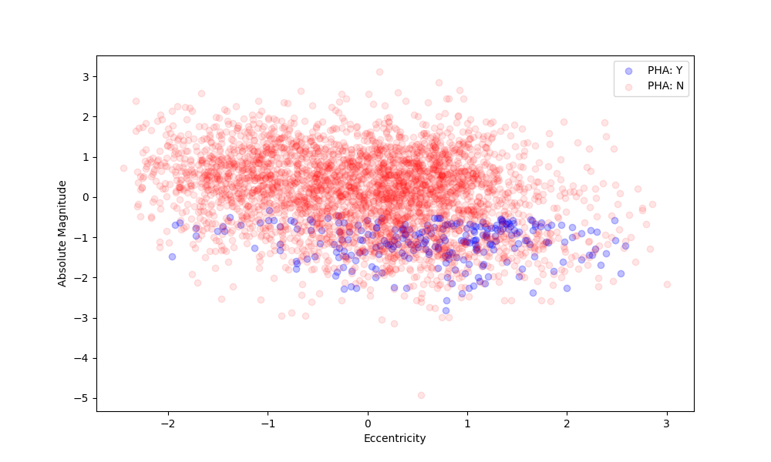
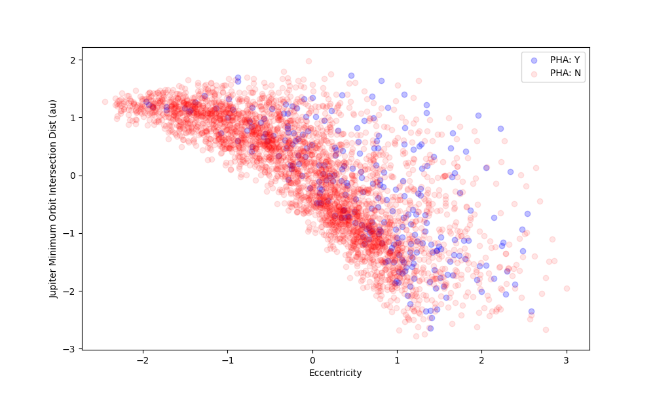
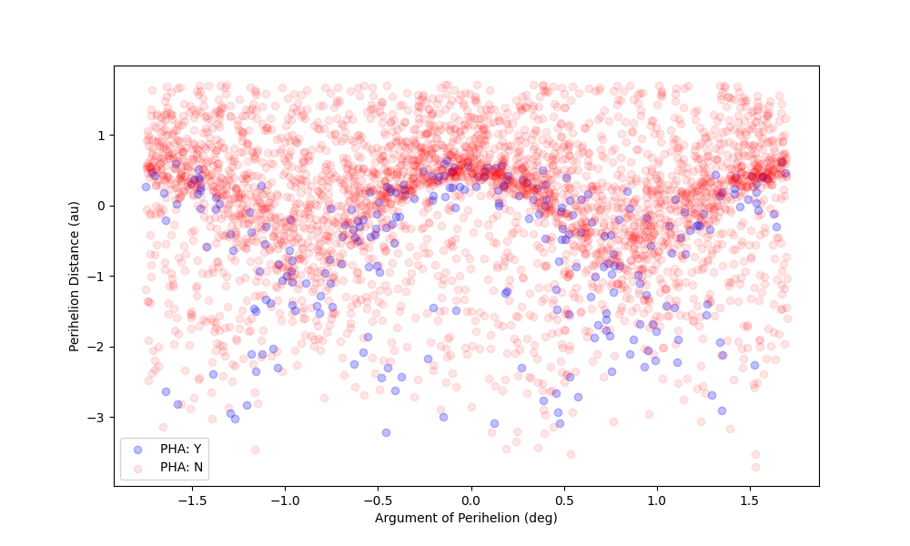
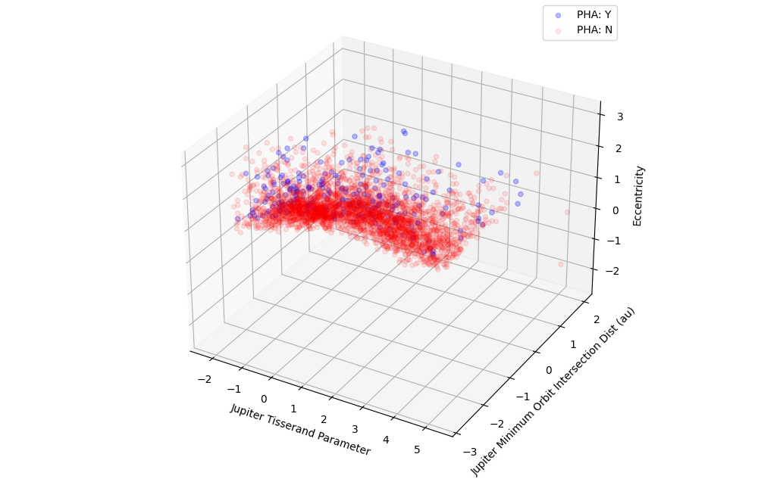
Recall previous findings
Initial analysis revealed linear and non linear boundaries between Potentially Hazardous Asteroids (PHA) in various dimensions.
Thus we proposed building solutions of varying complexity to solve this binary classification problem.

Slide 6
The Models
Simple to complex

Slide 7
Logistic regression
Model results in a table
Some info about the model/how it works

Slide 8
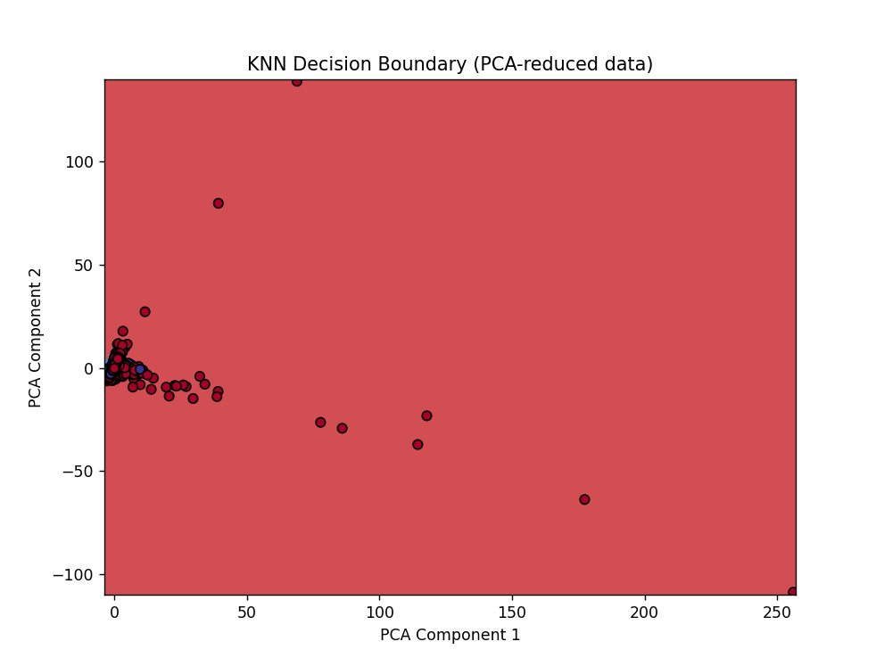
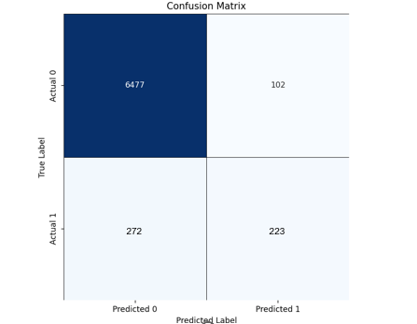
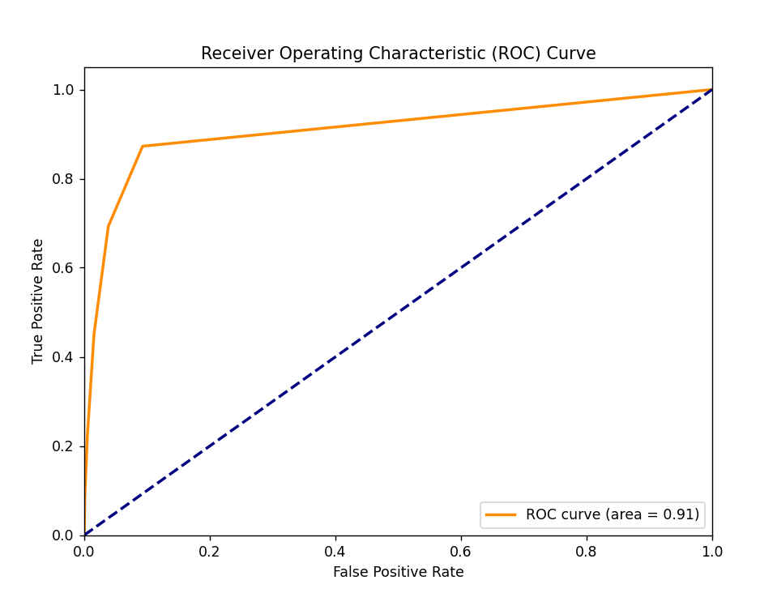
k nearest neighbors
KNN Results
R² | 0.1876
ROC/AUC | 0.91
F1 Score for Class 0 | 0.97
F1 Score for Class 1 | 0.54
RMSE | 0.2299
272
223

Slide 9
Linear discriminant analysis
Model results in a table
Some info about the model/how it works

Slide 10
quadratic discriminant analysis
Model results in a table
Some info about the model/how it works

Slide 11
Support vector machine
Model results in a table
Some info about the model/how it works

Slide 12
Gradient boosting machine
Gradient boosting machines rely on sequentially training weak decision tree learners. At each iteration, a new tree is fit to the gradient (negative derivative) of the loss function and the new estimator is added to the previous according to some learning rate or calculated weight.
Packages Used:
LightGBM – faster convergence, prone to overfitting
XGBoost – optimized with parallel computing
CatBoost – balanced trees with the same conditions in each tree
Model | Best GS Parameters | F1 | Runtime
LGBM | Lr = 0.1 N_est=100 Max_depth = 5 Num_leaves =31 | 0.885 | <5m
XGB | Lr = 0.1 N_est=100 Max_depth = 5 | 0.866 | <2m
CatB | Lr = 0.1 N_est = 200 Max_depth=7 | 0.986 | <15m

Slide 13
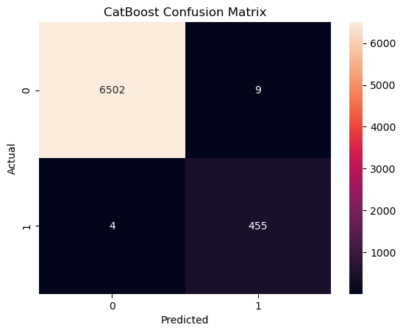
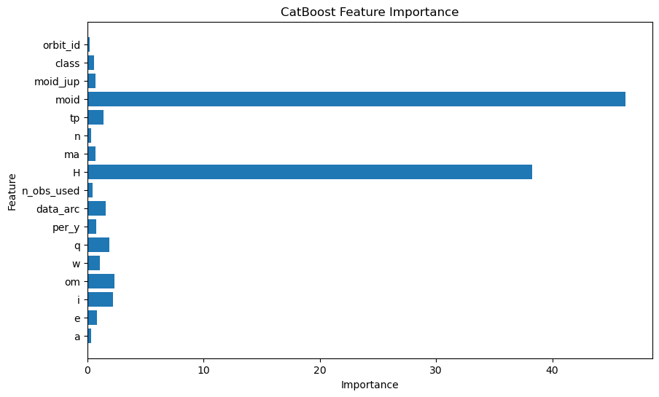
GBM Results

Slide 14
Neural network
Model results in a table
Some info about the model/how it works

Slide 15
The analysis
Comparing model costs and benefits

Slide 16
Final model selection
Model | Accuracy | F1 | Runtime
GBM | 99.8% | 0.986 | <15m
Compare scores for all models here

Slide 17
Learnings and conclusions
Consistent rehearsal
Strengthen your familiarity
Refine delivery style
Pacing, tone, and emphasis
Timing and transitions
Aim for seamless, professional delivery
Practice audience
Enlist colleagues to listen & provide feedback
Seek feedback
Reflect on performance
Explore new techniques
Set personal goals
Iterate and adapt

Slide 18
references

Slide 19
THANK YOU
For more information, please see our code base on GitHub.

