Slide 1

Near Earth Objects: Asteroids
EN625.742 Midterm – Team “TBD”
Erin Valdes, Marc Papandreadis, Matthew Waring, Emily Payne

Slide 2
Team Objective
Team TBD (have to come up with x-men name) wants to prevent potentially hazardous asteroids from hitting earth

Slide 3
Importance Why Study asteroids?
On a daily basis, the Earth is bombarded with tons of interplanetary material. Many of the incoming particles are so small that they are destroyed in the Earth’s atmosphere before they reach the ground.
With an average interval of about 100 years, rocky or iron asteroids larger than about 50 meters would be expected to reach the Earth’s surface and cause local disasters or produce the tidal waves that can inundate low lying coastal areas.
On an average of every few hundred thousand years or so, asteroids larger than a mile could cause global disasters. In this case, the impact debris would spread throughout the Earth’s atmosphere so that plant life would suffer from acid rain, partial blocking of sunlight, and from the firestorms resulting from heated impact debris raining back down upon the Earth’s surface.
The probability of an asteroid striking the Earth and causing serious damage is very remote but the devastating consequences of such an impact suggests we should closely study different types of asteroids to understand their compositions, structures, sizes, and future trajectories.

Slide 4
Data Source
The dataset for this project is sourced from NASA's Jet Propulsion Laboratory (JPL), a federally funded research and development centor administered by the California Institute of Technology founded in 1936.
The laboratory's primary function is the construction and operation of planetary robotic spacecraft, though it also conducts Earth-orbit and astronomy missions.
JPL’s Solar System Dynamics (SSD) group is part of Mission Design and Navigation section. The SSD group focuses on determining the motion and physical parameters of natural planetary objects.
“orbits” refers to orbital elements while “ephemerides” refers to data that represent the trajectory of an object over time. As part of our charter, we provide orbits and ephemerides for all known natural objects in our solar system.

Slide 5
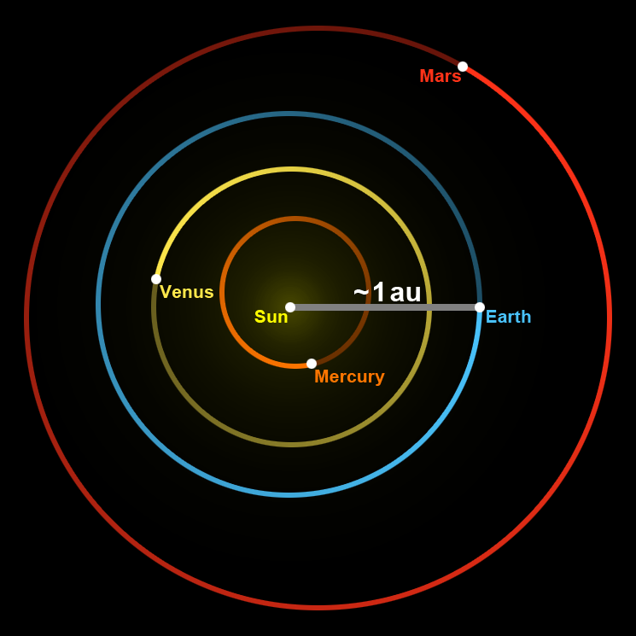
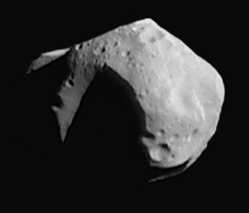
Data Background
The astronomical unit is a unit of length defined to be exactly equal to 149,597,870,700 m
The data chosen for analysis contains Near Earth Objects (NEO’s), specifically asteroids
Asteroids, sometimes called minor planets, are rocky, airless remnants left over from the early formation of our solar system about 4.6 billion years ago.
NEOs are a broad category of small-bodies defined as those with a trajectory that can come within 1.3 au of the Sun. Since the Earth orbits at approximately 1 au, such objects can in principle come within 0.3 au of Earth.
However, being in the NEO category doesn’t mean they are actually close to Earth at any particular time, only that their motion can, at times, bring them close to the Sun and possibly Earth.
Solar System Dynamics. 29 June 2024. Small-Body Database Query. https://ssd.jpl.nasa.gov”
Asteroid 253 Mathilde

Slide 6
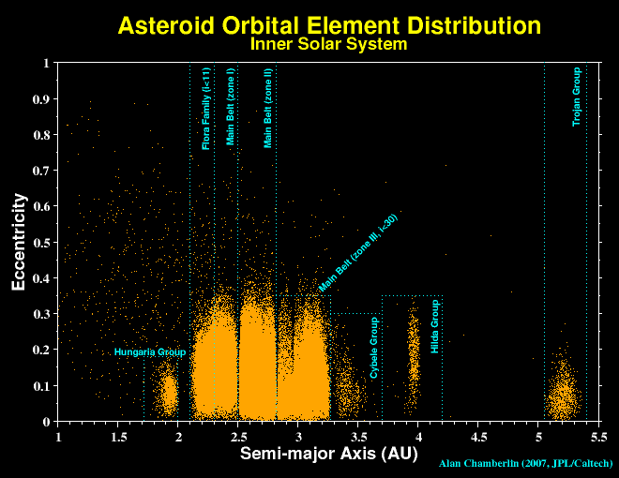
Metadata
Record count: ~35k
Key Fields
spkid – primary key
Orbital elements:
Class – code indicating orbit type
PHA – indicator for potentially hazardous asteroid
MOID –minimum distance between the orbits of Earth and the small-body (au)
Eccentricity - Eccentricity e is the ratio of half the distance between the foci c to the semi-major axis a: e=c/a. For example, an orbit with e=0 is circular, e=1 is parabolic, and e between 0 and 1 is elliptic.
Physical elements:
Diameter
Density
Mass
Glossary: https://ssd.jpl.nasa.gov/glossary/

Slide 7
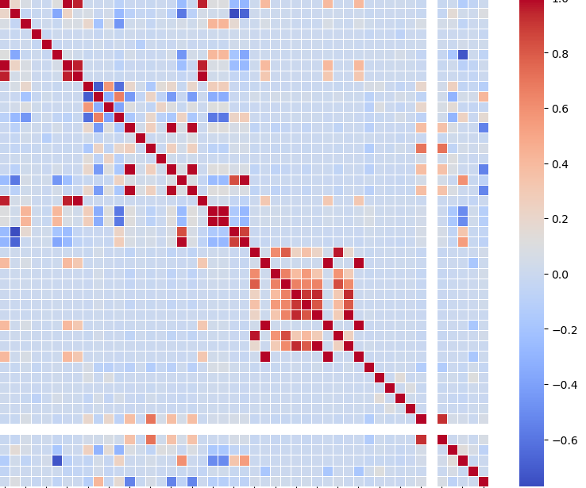
Goal: Explore Latent and Observable Variables to investigate PHAs
To get a quick, naïve, view of the potential predictive power of the dataset, we run Pearson’s correlation between all data elements and check if there are any clear trends
We observe there is strong correlation between certain elements that may be of interest to explore

Slide 8
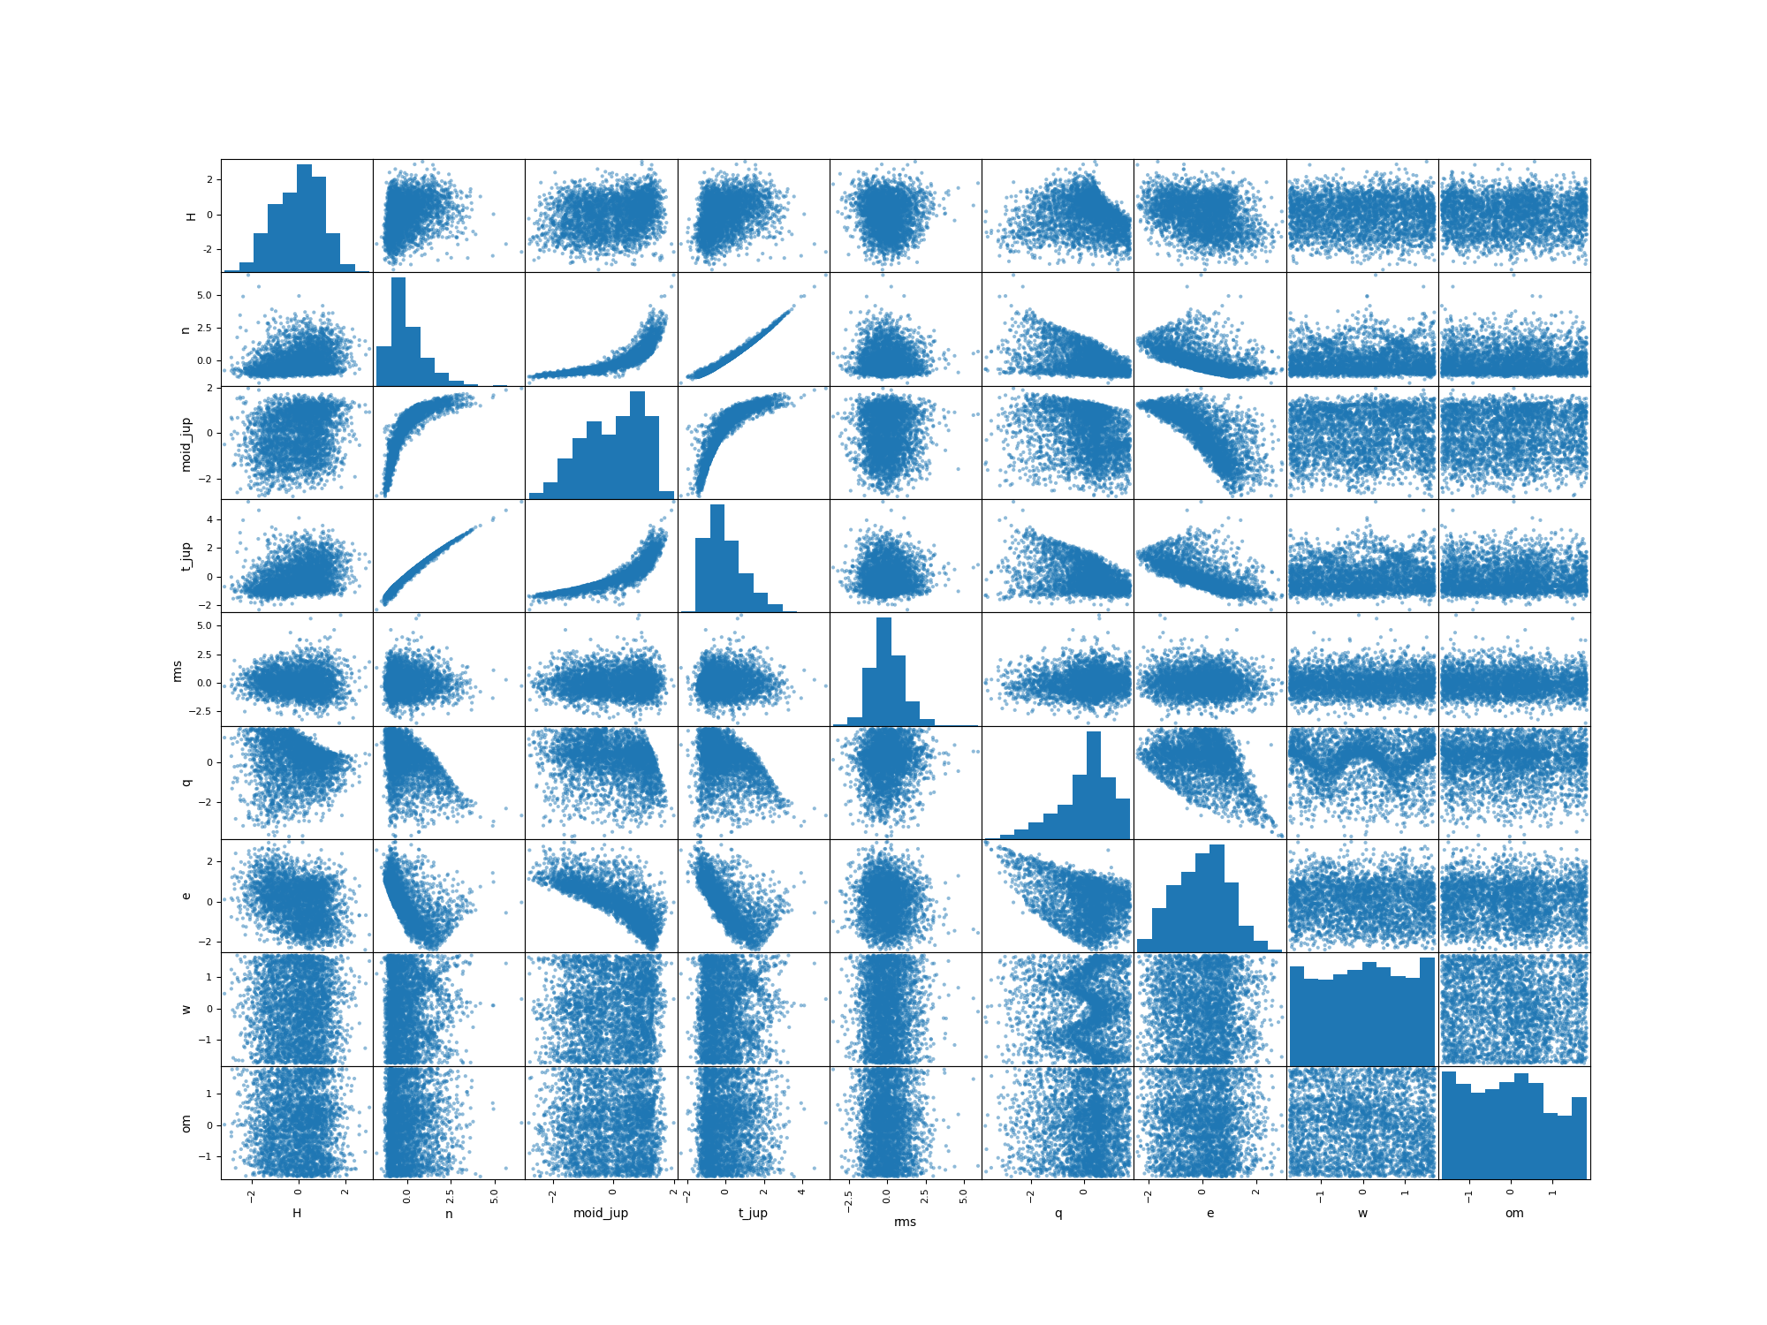
Data Relationships
Many of the observed fields appear to follow “nice” distributions which we can work with
Building off of the previous slide, different variable combinations have weak to strong relationships with one another which we can leverage

Slide 9
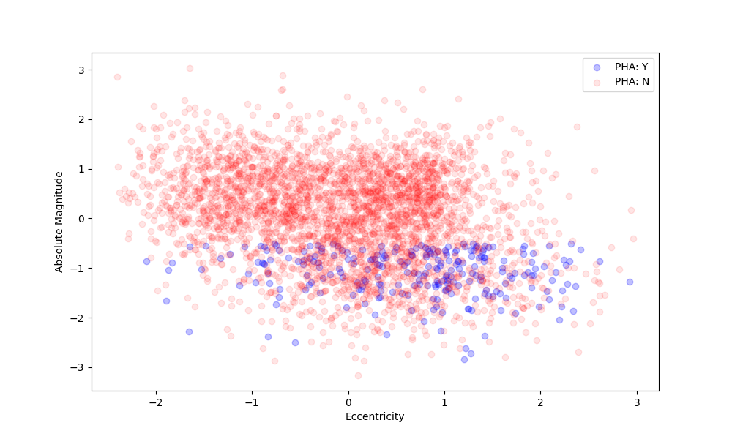
Potential Classification Problems
Some combinations of variables show promising results for simple linear classification algorithms such as LDA and Logistic Regression
A scatterplot of Asteroid Eccentricity vs Absolute Magnitude appears to have a linear boundary

Slide 10
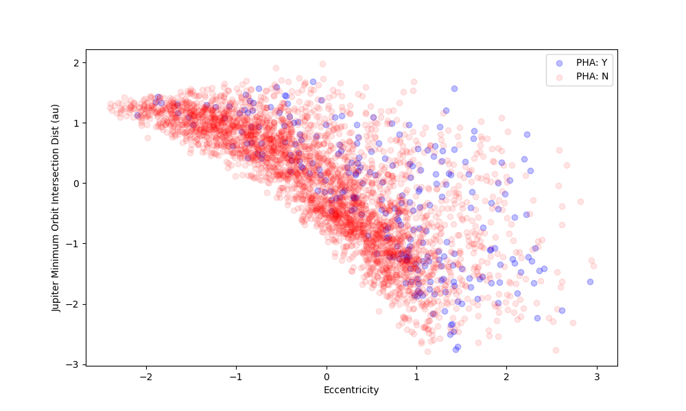
Potential Classification Problems
Other combinations of data appear to define non-linear boundaries between PHA classifications.
Non-linear models such as QDA may be able to separate PHAs

Slide 11
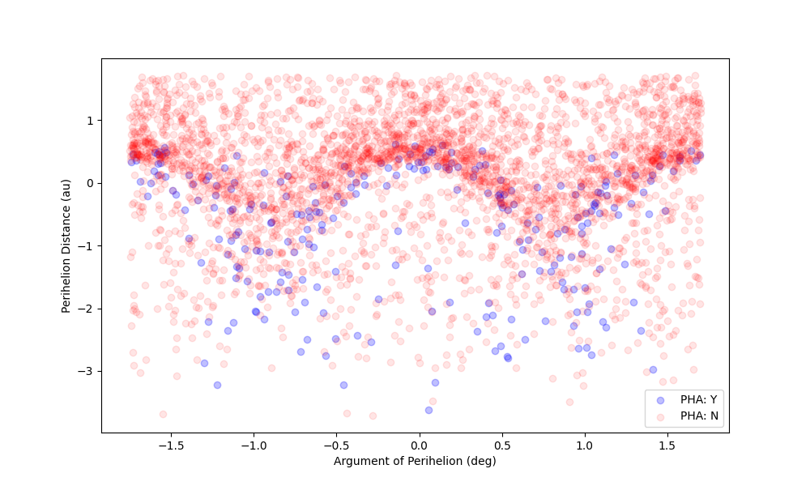
Potential Classification Problems
At their most complex, some combinations of variables exhibit highly non-linear structures where more complex techniques such as basis expansions and cubic splines may be best for determining decision boundaries between classes

Slide 12
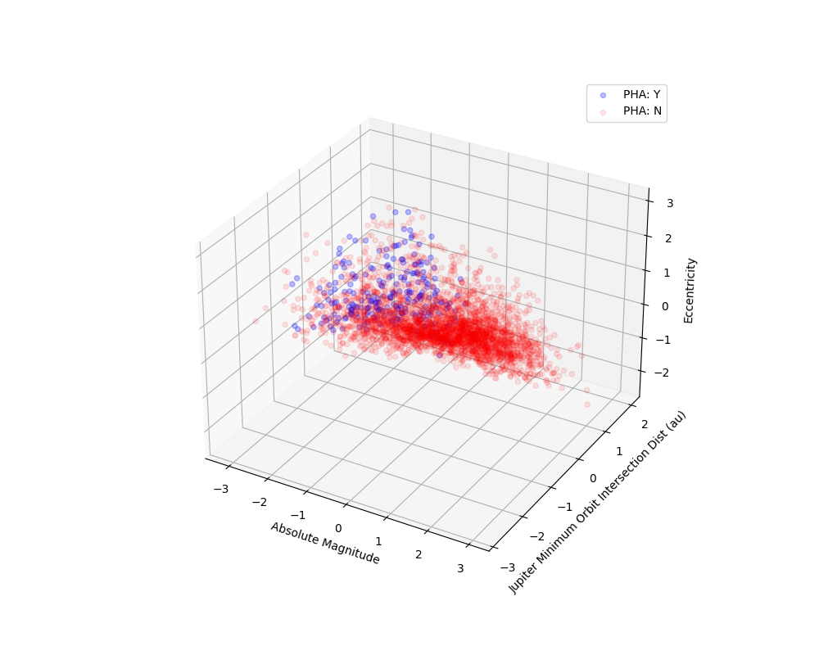
Potential Classification Problems
Models with 2 variables are naturally more simplistic than their higher dimensional equivalents
We explore higher dimensional models of classification to determine if better results exist

Slide 13
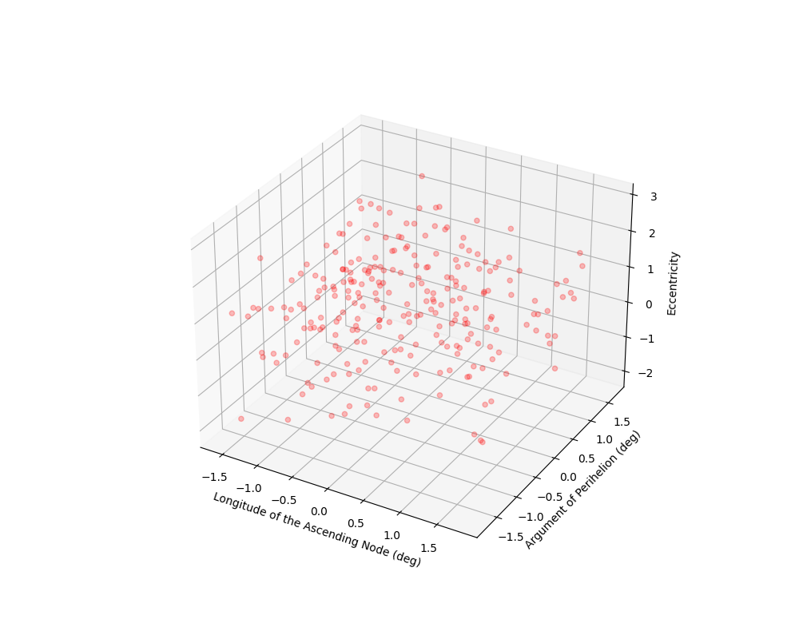
What About Latent Data?
The previous slides explored possible classification algorithms where our training data is already labeled. Alternative data exploration projects may include clustering for anomaly detection

Slide 14
Assumptions, Challenges, Improvements
The dataset is large as discussed (35k rows), and has many sparsely populated columns and rows. Once filtered we may have a materially smaller “usable” dataset than initially thought. Bootstrapping and Cross Validation methods will be needed for model fitting.
Many columns in the dataset take on discrete values beyond the binary (PHA/ Not PHA) classification problem which open up countless combinations for future clustering and classification problems

