Slide 1
Identifying hazardous asteroids
Team: Asteroid M
Erin Valdes, Marc Papandreadis,
Matthew Waring, Emily Payne

Slide 2
Agenda
Project Purpose
Data
Models
Analysis
Conclusions

Slide 3
Project Purpose
The probability of an asteroid striking Earth and causing serious damage is very remote, but the devastating consequences of such an impact make predicting their trajectories an important study
NASA’s Jet Propulsion Lab Solar System Dynamics group provides orbits and ephemerides (trajectories) for all known natural objects, including near-earth asteroids
The goal of this project is to develop a machine learning model that can predict the label of an asteroid, “Potentially Hazardous” or “Not Potentially Hazardous”, based on orbit and ephemeride attributes

Slide 4
The Data
Initial Findings

Slide 5
Key Features
pha | a | e | i | om | w | q | data_ arc | n_obs_used | H | ma | n | tp | moid | class | orbit_ id
N | 1.46 | 0.22 | 10.83 | 304.28 | 178.90 | 1.13 | 4.7E+04 | 9.1E+03 | 10.41 | 334.73 | 0.56 | 2.5E+06 | 0.15 | AMO | 659
N | 2.64 | 0.55 | 11.58 | 183.85 | 156.22 | 1.19 | 4.1E+04 | 2.1E+03 | 15.59 | 102.37 | 0.23 | 2.5E+06 | 0.20 | AMO | 266
N | 2.47 | 0.57 | 9.40 | 110.42 | 350.48 | 1.06 | 3.9E+04 | 3.5E+03 | 13.88 | 289.48 | 0.25 | 2.5E+06 | 0.08 | AMO | JPL 450
N | 2.67 | 0.53 | 26.69 | 215.50 | 132.48 | 1.25 | 3.6E+04 | 1.1E+04 | 9.25 | 321.69 | 0.23 | 2.5E+06 | 0.35 | AMO | JPL 1195
N | 1.92 | 0.44 | 11.88 | 171.31 | 26.68 | 1.08 | 3.3E+04 | 6.2E+02 | 17.38 | 197.64 | 0.37 | 2.5E+06 | 0.11 | AMO | 121
Y | 1.08 | 0.83 | 22.80 | 87.95 | 31.44 | 0.19 | 2.7E+04 | 1.7E+03 | 16.57 | 344.76 | 0.88 | 2.5E+06 | 0.03 | APO | JPL 172
N | 2.20 | 0.49 | 52.19 | 62.23 | 159.67 | 1.13 | 2.6E+04 | 1.8E+03 | 14.69 | 258.50 | 0.30 | 2.5E+06 | 0.14 | AMO | 306
Y | 1.25 | 0.34 | 13.33 | 337.16 | 276.98 | 0.83 | 2.6E+04 | 8.2E+03 | 15.27 | 147.60 | 0.71 | 2.5E+06 | 0.03 | APO | 763
N | 1.86 | 0.40 | 8.45 | 133.10 | 167.84 | 1.13 | 3.4E+04 | 1.3E+04 | 12.84 | 78.93 | 0.39 | 2.5E+06 | 0.11 | AMO | 1335
N | 1.37 | 0.44 | 9.38 | 274.21 | 127.26 | 0.77 | 2.8E+04 | 5.6E+03 | 14.28 | 73.06 | 0.62 | 2.5E+06 | 0.05 | APO | JPL 809
pha | Potentially hazardous asteroid (target)
e | eccentricity
a | semimajor axis (au)
q | perihelion distance (au)
i | inclination (deg)
om | longitude of the ascending node (deg)
w | argument of perihelion (deg)
ma | mean anomaly (deg)
tp | time of perihelion passage in Julian day form
n | mean motion (deg/d)
moid | minimum distance between the orbits of Earth and the small-body (au)
H | absolute magnitude (magnitude at 1 au from the Sun and the observer)
data_arc | number of days spanned by the observations used in the orbit determination
n_obs_used | total number of observations of all types used in the orbit

Slide 6
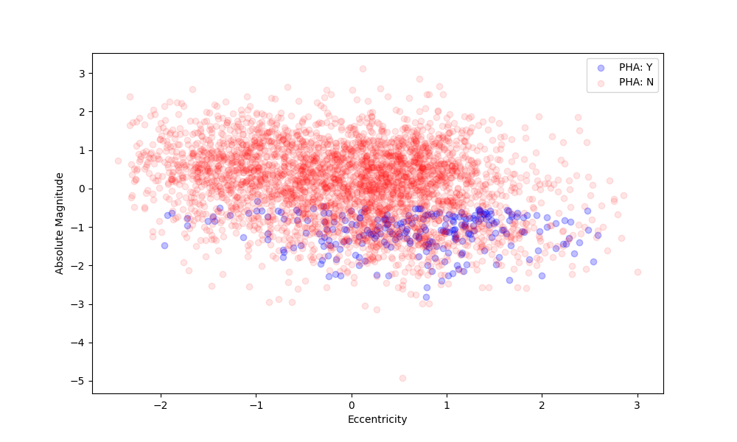
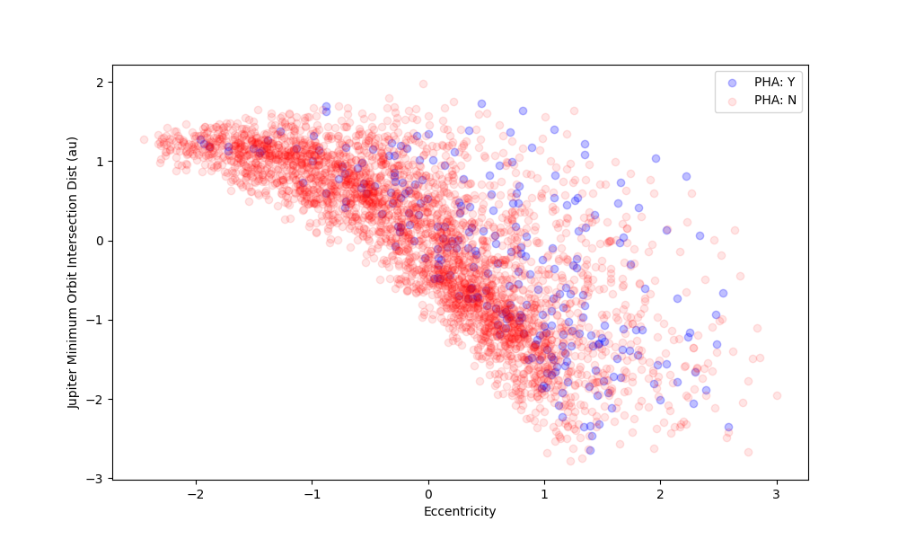
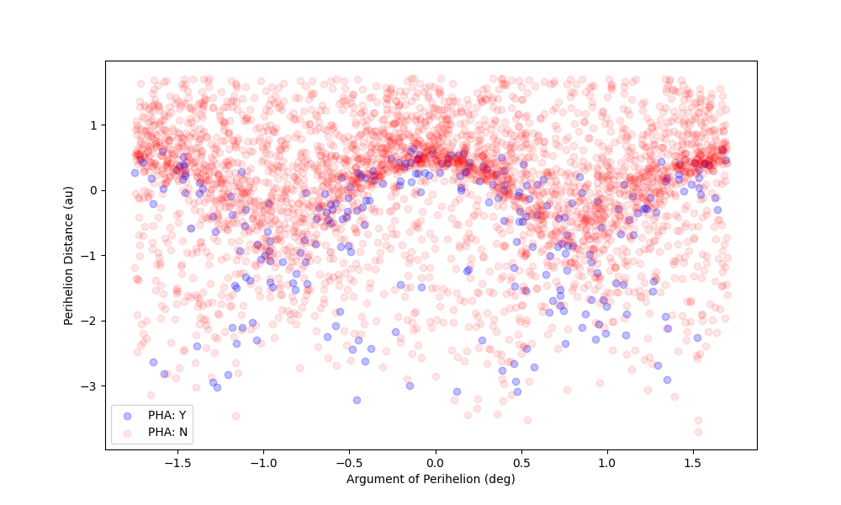
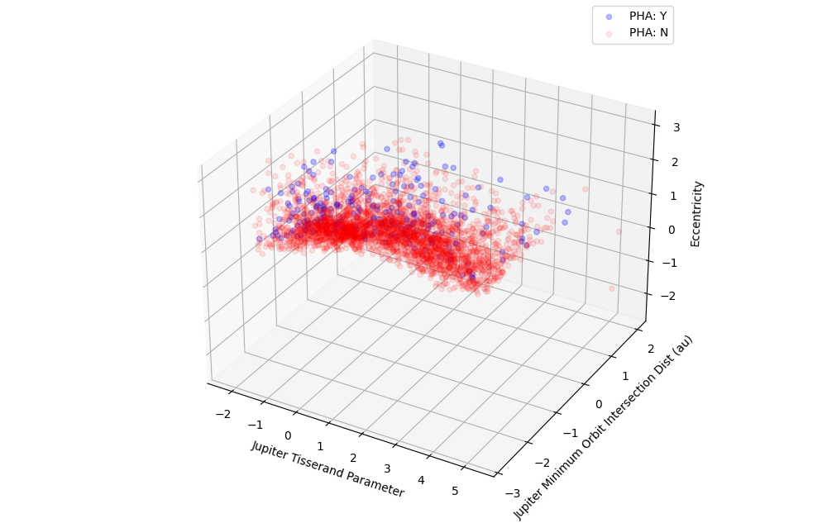
Recall previous findings
Initial analysis revealed linear and non linear boundaries between Potentially Hazardous Asteroids (PHA) in various dimensions.
Thus we proposed building solutions of varying complexity to solve this binary classification problem.

Slide 7
The Models
Simple to complex

Slide 8
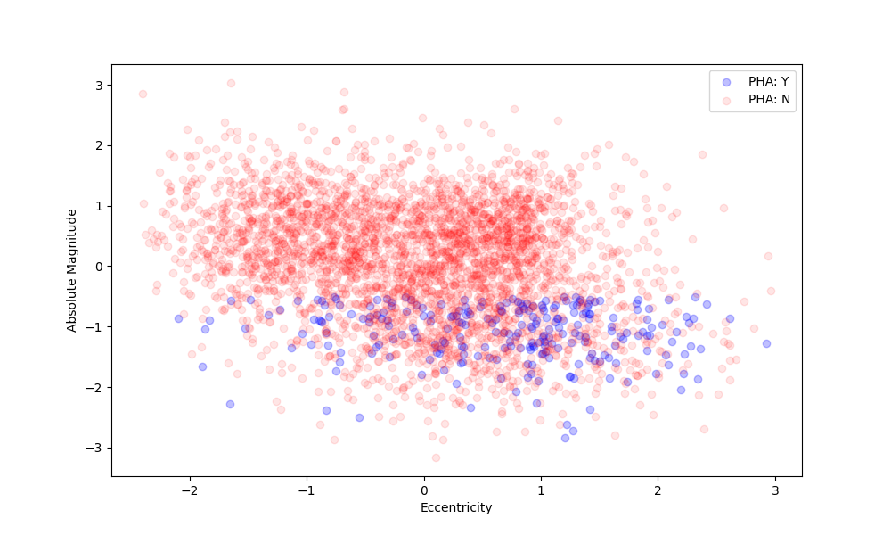
Absolute Magnitude vs. Eccentricity
Visibly linear boundaries suggest simple bivariate linear models would perform well
Logistic Regression, LDA, and SVM with a Linear Kernel would theoretically perform well

Slide 9
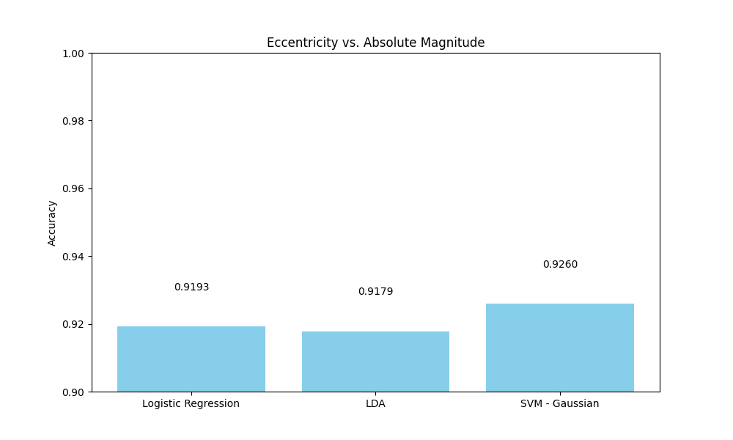
Absolute Magnitude vs. Eccentricity

Slide 10
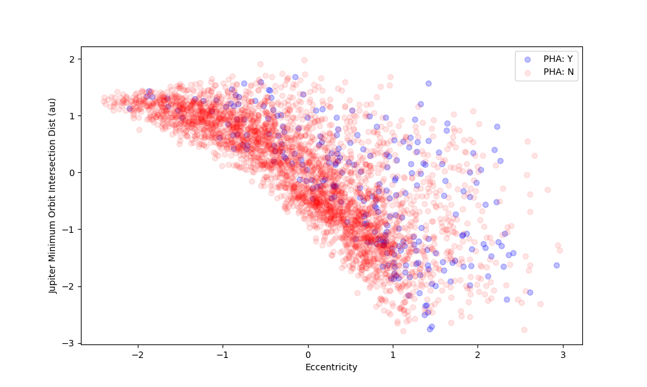
Jupiter Min Orbit Distance vs. Eccentricity
Visibly non-linear boundaries suggest that simple nonlinear models may perform well, even outperforming linear models in the previous section.
QDA, Polynomial Kernel SVM, and Gaussian Kernel SVM may fit well here

Slide 11
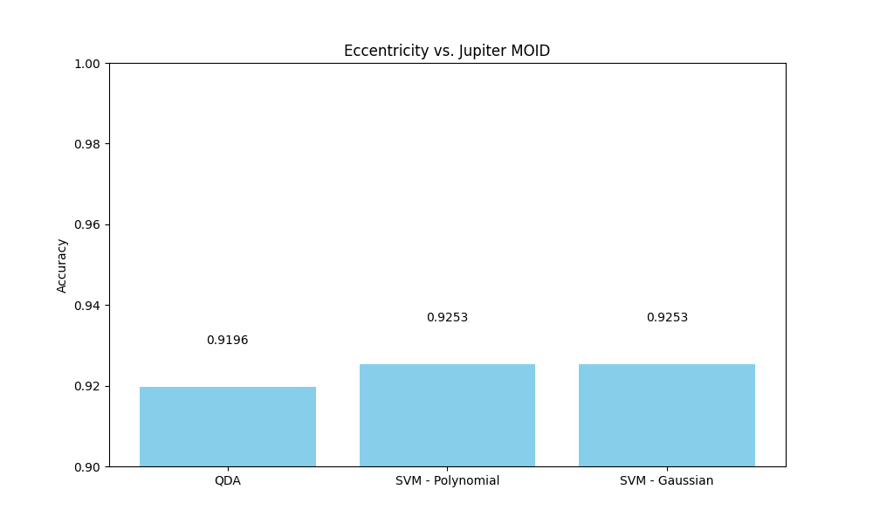
Jupiter Min Orbit Distance vs. Eccentricity

Slide 12
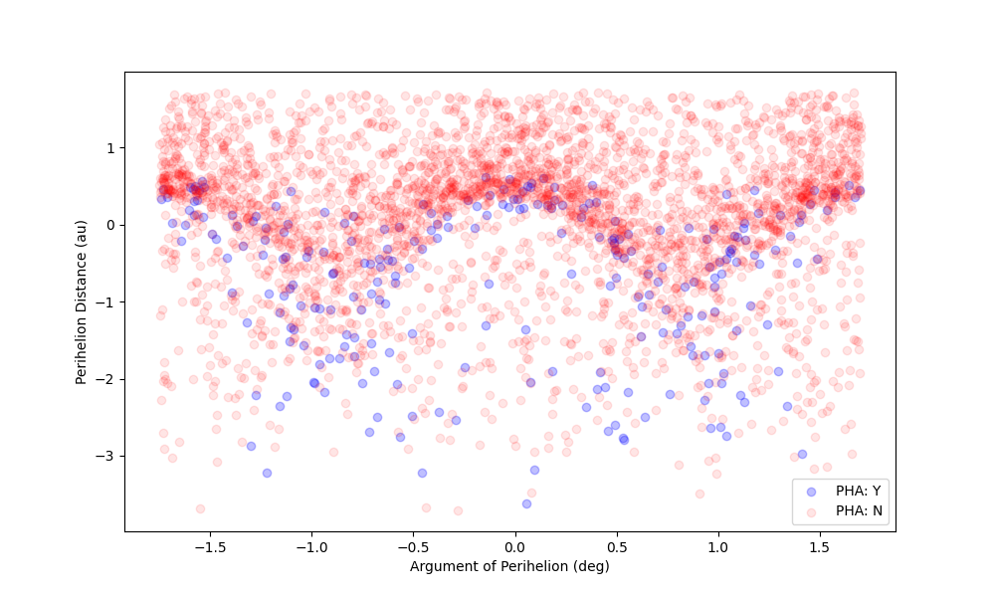
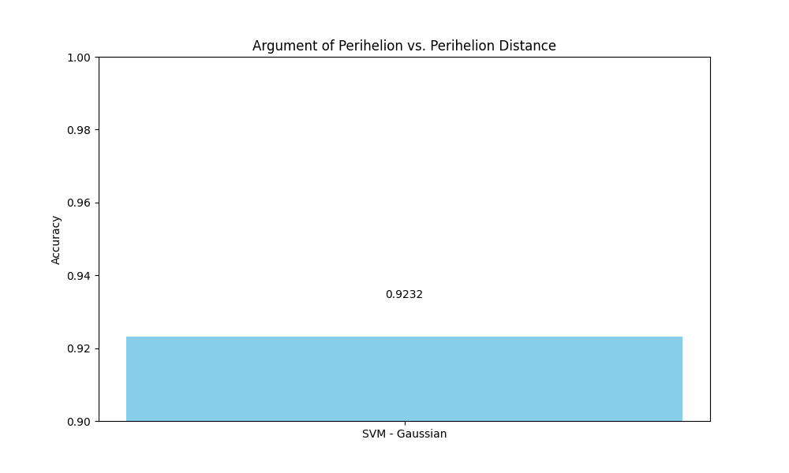
Argument of Perihelion vs. Perihelion Distance

Slide 13
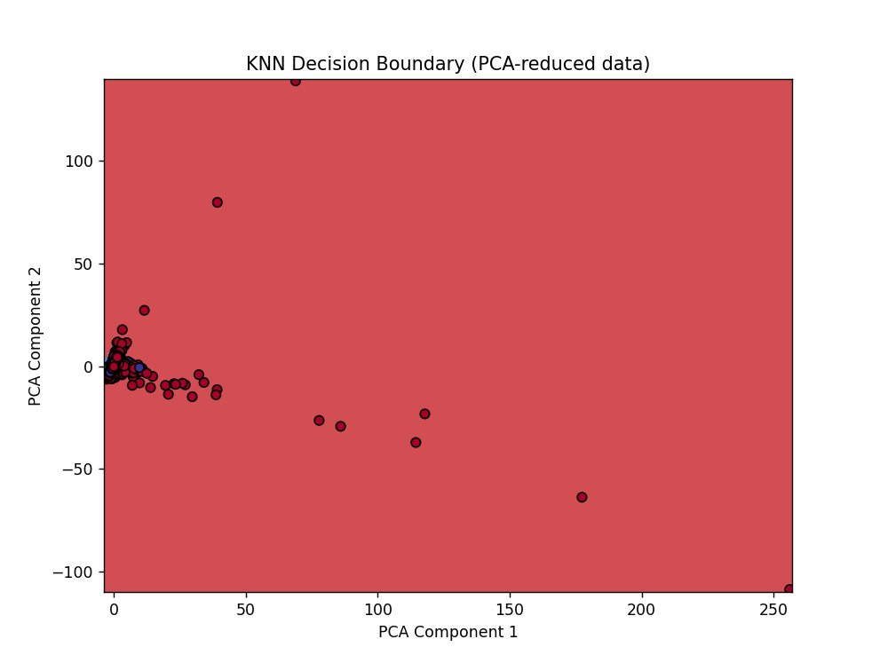
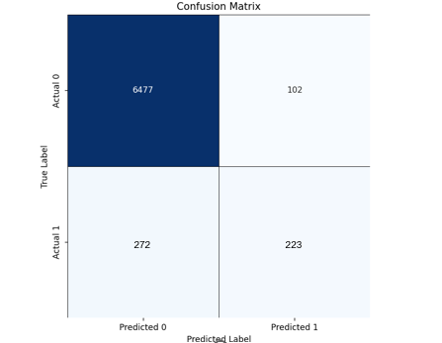
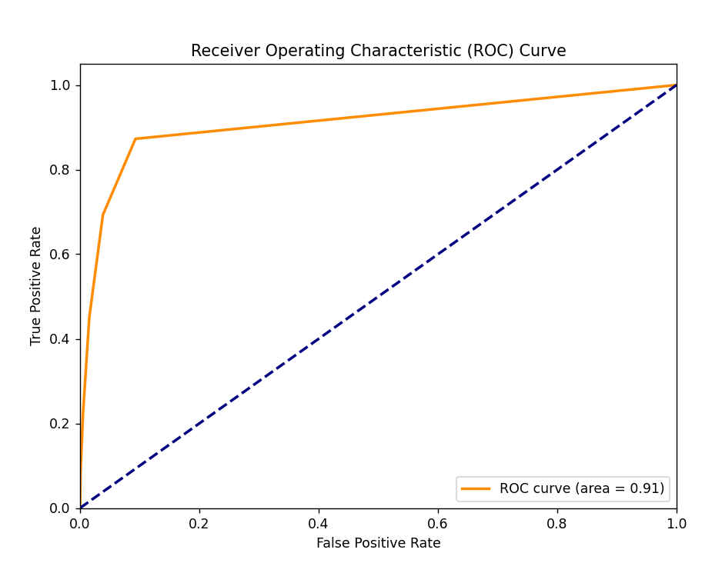
k nearest neighbors
KNN Results
R² | 0.1876
ROC/AUC | 0.91
F1 Score for Class 0 | 0.97
F1 Score for Class 1 | 0.54
RMSE | 0.2299
272
223

Slide 14
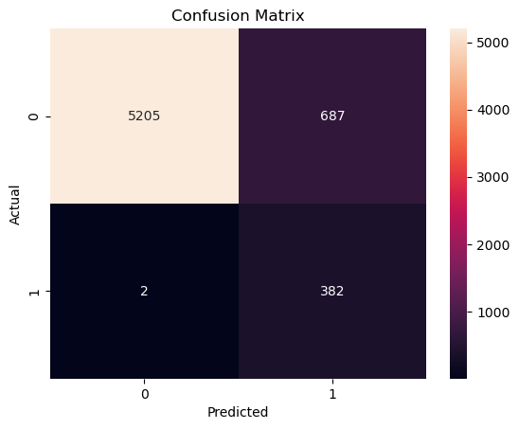
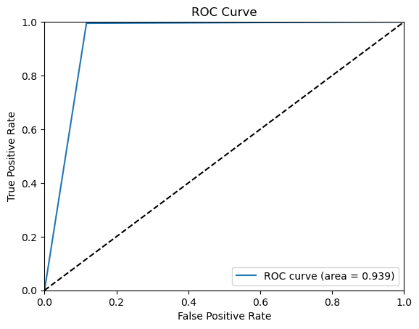
k nearest neighbors Full features & grid search updated (please review)
KNN Results
ROC/AUC | 0.94
F1 Score | 0.53
Accuracy | 0.89
Metric | Manhattan distance
N Neighbors | 11
Weights | Distance
272
223

Slide 15
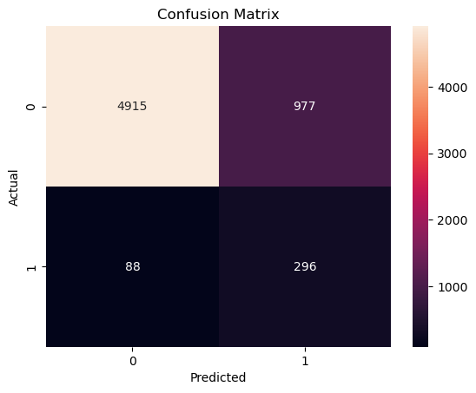
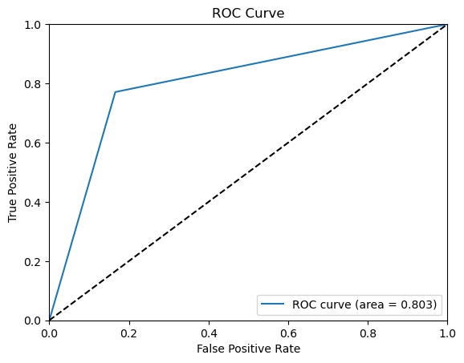
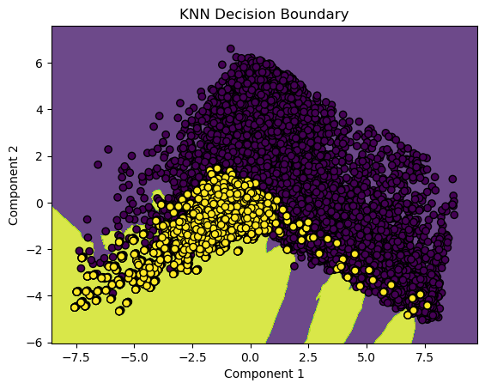
k nearest neighbors 2-component pca updated (please review)
KNN PCA Results
ROC/AUC | 0.80
F1 Score | 0.36
Accuracy | 0.83
272
223

Slide 16
Gradient boosting machine
Gradient boosting machines rely on sequentially training weak decision tree learners. At each iteration, a new tree is fit to the gradient (negative derivative) of the loss function and the new estimator is added to the previous according to some learning rate or calculated weight.
We used GridSearch with 5-fold cross validation to select the best hyperparameters for each model
LightGBM – faster convergence, prone to overfitting
XGBoost – optimized with parallel computing
CatBoost – balanced trees with the same conditions in each tree
Model | Best GS Parameters | F1 | Runtime
LGBM | Lr = 0.1 N_est=100 Max_depth = 5 Num_leaves =31 | 0.885 | <5m
XGB | Lr = 0.1 N_est=100 Max_depth = 5 | 0.866 | <2m
CatB | Lr = 0.1 N_est = 200 Max_depth=7 | 0.986 | <15m

Slide 17
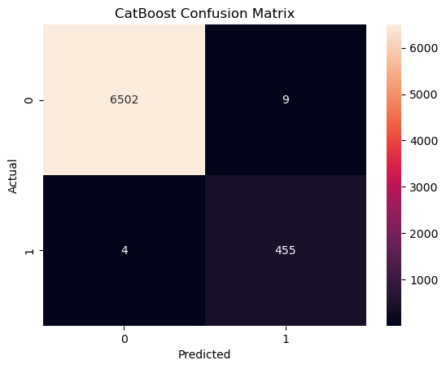
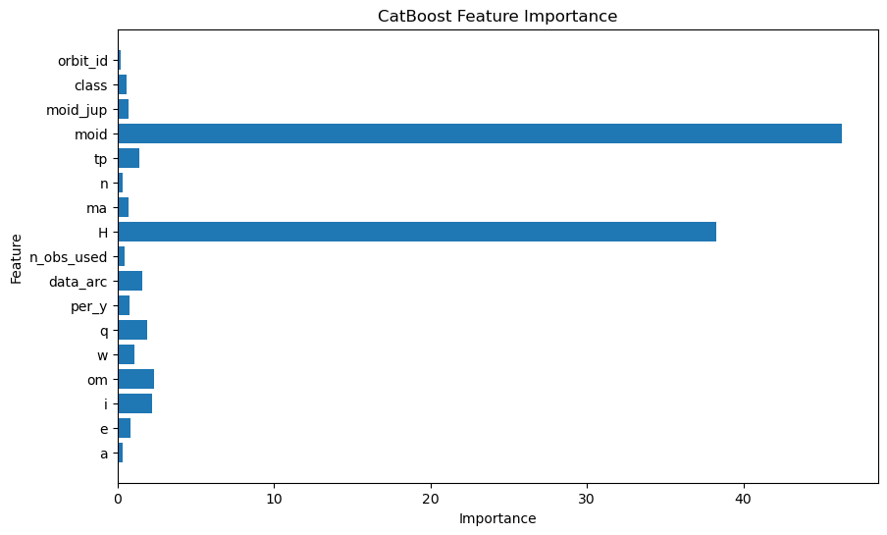
GBM Results catboost has the best overall performance
Notes:
One key reason Catboost tends to perform better than other methods is that is uses Shapley Additive Values( SHAP) for feature selection.
CatBoost uses SHAP (SHapley Additive exPlanations) to break a prediction value into contributions from each feature. It calculates feature importance by measuring the impact of a feature on a single prediction value compared to the baseline prediction.

Slide 18
Neural network
Model results in a table
Some info about the model/how it works

Slide 19
The analysis
Comparing model costs and benefits

Slide 20
Final model selection
Model | Accuracy | F1 | Runtime
Logistic Regression | 92% | 0.04 | <1m
KNN | 89.0% | 0.53 | <5m
LDA | 91.7% | 0.05 | <1m
QDA | 92% | 0.096 | <1m
SVM | 92.5% | 0.093 | <1m
GBM | 99.8% | 0.99 | <15m
NN
Based on accuracy, F1 score, and runtime as a measure of efficiency, our conclusion is that XXX is the best model for predicting potentially hazardous asteroids.

Slide 21
Learnings and conclusions
Simple models, such as the bivariate models, seemed to perform well initially with high accuracy rates when cross validated. F1 scores, however, suggest generalizability may be poor.
GBMs appear to offer the best performance and F1 score, but this comes at the cost of runtime, which was drastically larger for this model.

Slide 22
references
Hastie, T., Tibshirani, R., & Friedman, J. (2017). Elements of Statistical Learning (2nd ed.). Springer. https://doi.org/10.1007/b94608
NASA (n.d.). Small Bodies. Jet Propulsion Lab California Institute of Technology Solar System Dynamics. https://ssd.jpl.nasa.gov/sb/
John, B. (2023, August 7). When to Choose CatBoost Over XGBoost or LightGBM [Practical Guide]. Neptune Blog. https://neptune.ai/blog/when-to-choose-catboost-over-xgboost-or-lightgbm

Slide 23
THANK YOU
For more information, please see our code base on GitHub.

