Slide 1
Identifying hazardous asteroids
Team: Asteroid M
Erin Valdes, Marc Papandreadis,
Matthew Waring, Emily Payne

Slide 2
Agenda
Project Statement
Recap
Models
Analysis
Conclusions

Slide 3
Project Statement
The probability of an asteroid striking Earth and causing serious damage is very remote, but the devastating consequences of such an impact make predicting their trajectories an important study
NASA’s Jet Propulsion Lab Solar System Dynamics group provides orbits and ephemerides (trajectories) for all known natural objects, including near-earth asteroids
The goal of this project is to develop a machine learning model that can predict the label of an asteroid, “Potentially Hazardous” or “Not Potentially Hazardous”, based on orbit and ephemeride attributes

Slide 4
Initial Findings
Recap

Slide 5
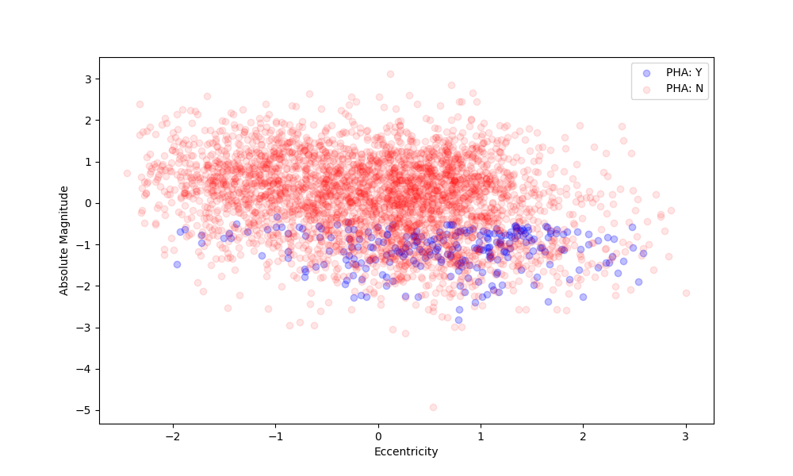
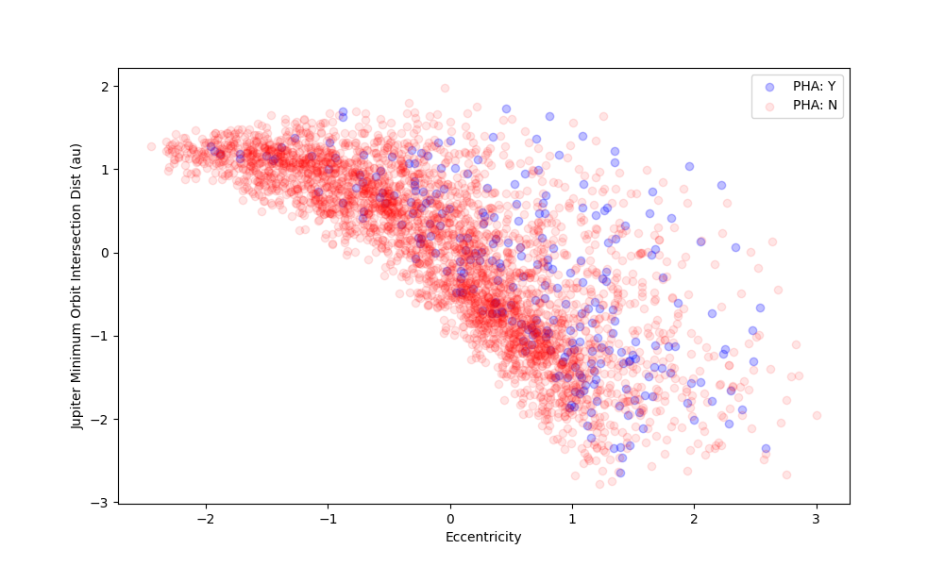
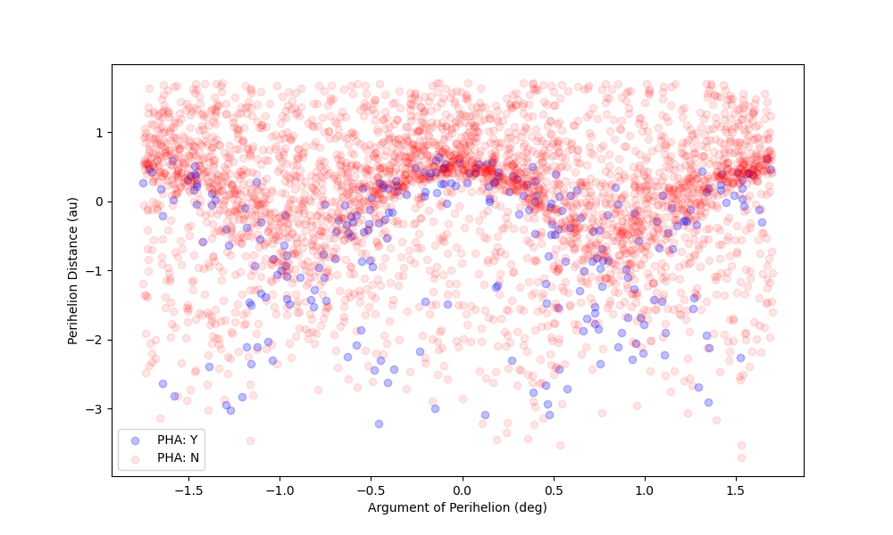
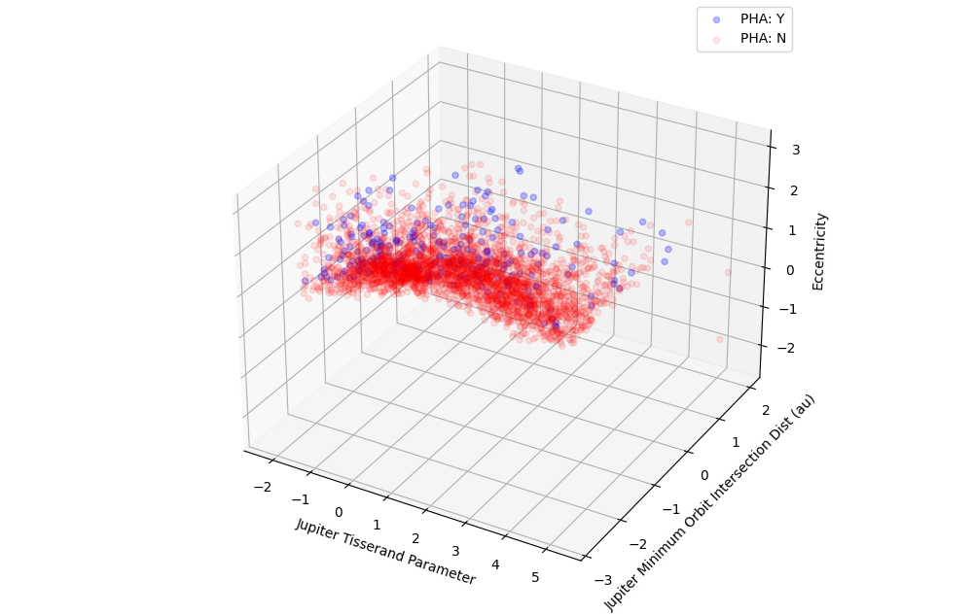
Recap: previous findings
Initial analysis revealed linear and non linear boundaries between Potentially Hazardous Asteroids (PHA) in various dimensions.
Thus we proposed building solutions of varying complexity to solve this binary classification problem.

Slide 6
The Models
Simple to complex

Slide 7
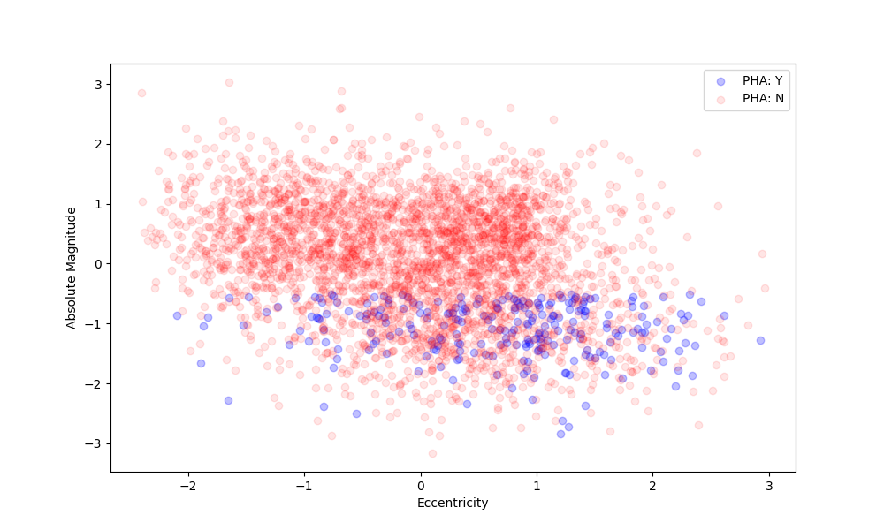
Absolute Magnitude vs. Eccentricity
Visibly linear boundaries suggest simple bivariate linear models would perform well
Logistic Regression, LDA, and SVM with a Linear Kernel would theoretically perform well

Slide 8
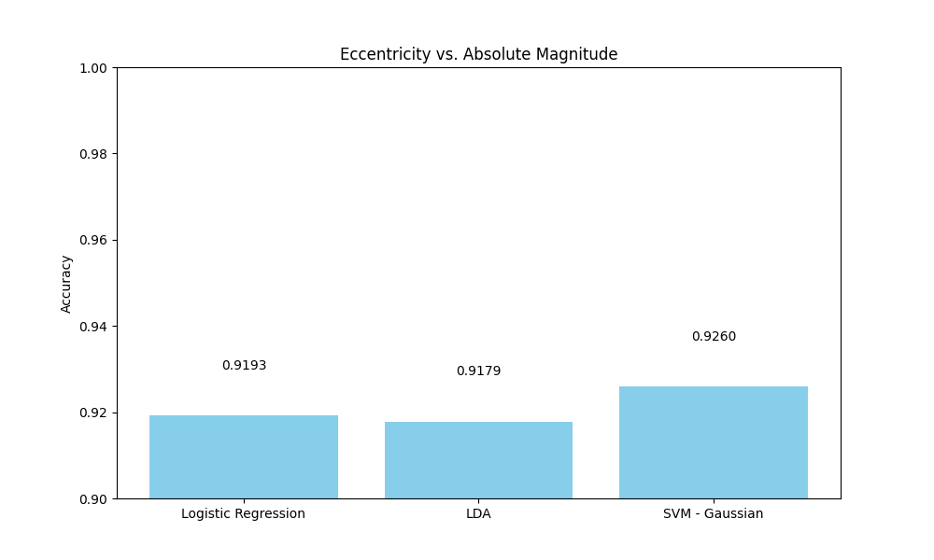
Absolute Magnitude vs. Eccentricity

Slide 9
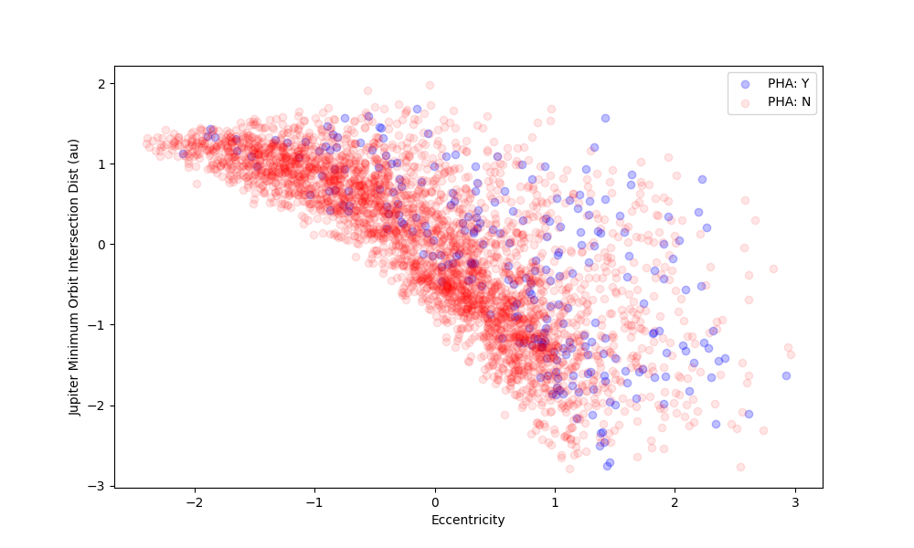
Jupiter Min Orbit Distance vs. Eccentricity
Visibly non-linear boundaries suggest that simple nonlinear models may perform well, even outperforming linear models in the previous section.
QDA, Polynomial Kernel SVM, and Gaussian Kernel SVM may fit well here

Slide 10
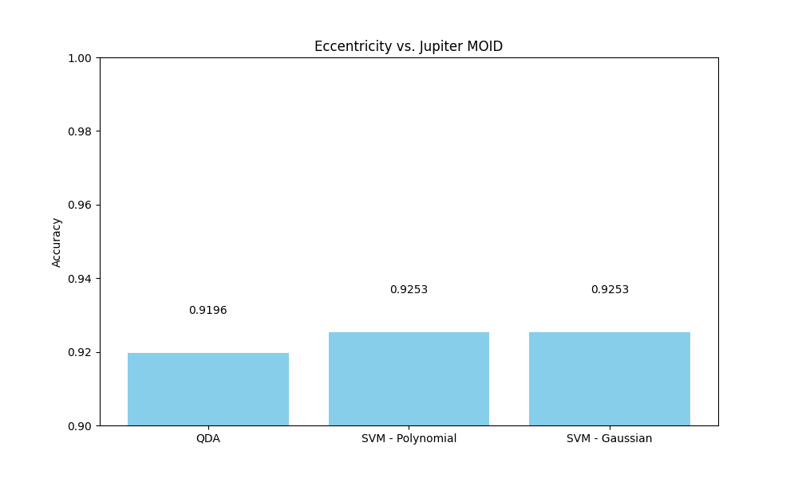
Jupiter Min Orbit Distance vs. Eccentricity

Slide 11
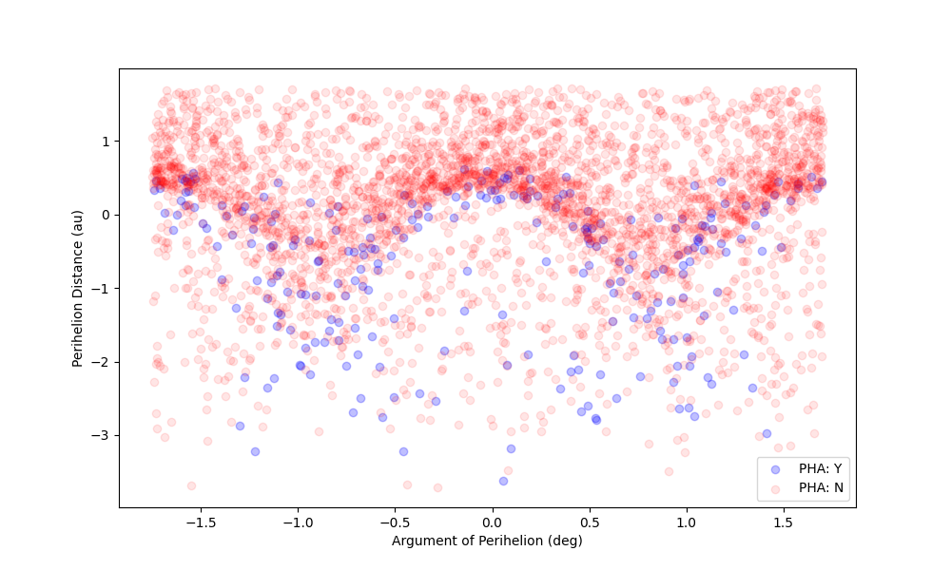
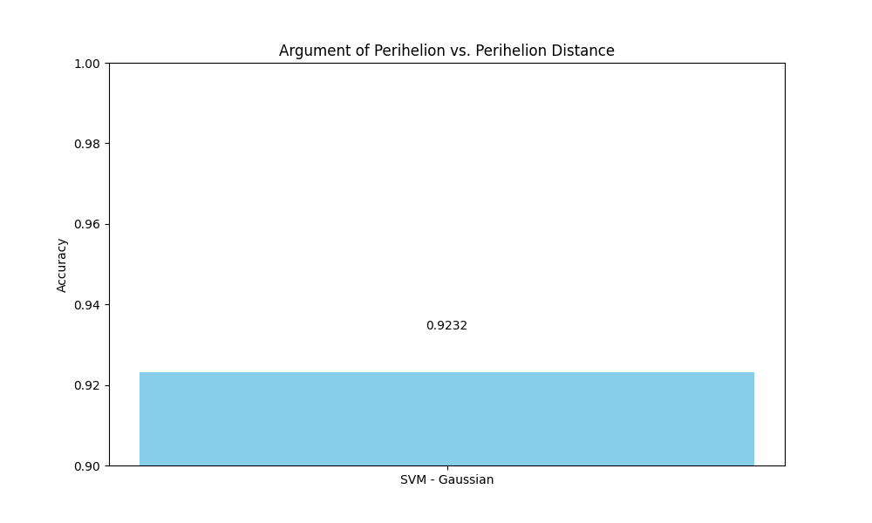
Argument of Perihelion vs. Perihelion Distance

Slide 12
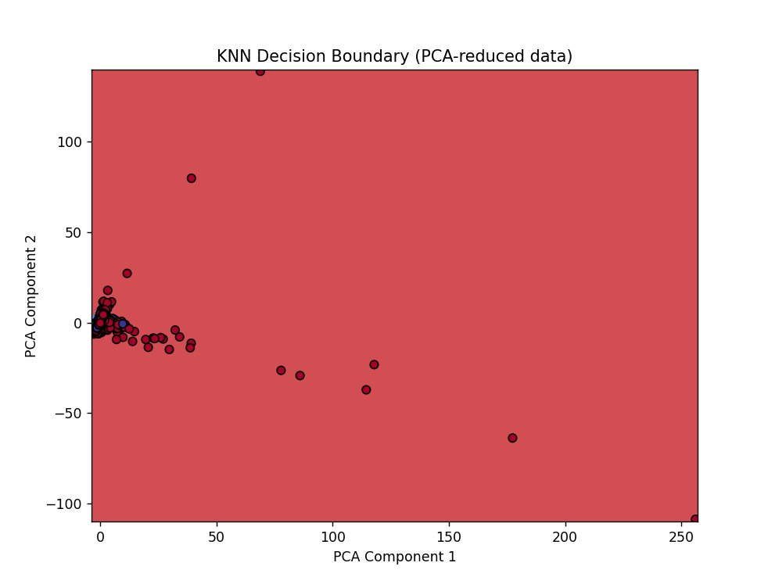
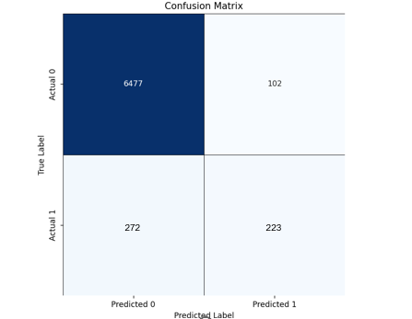
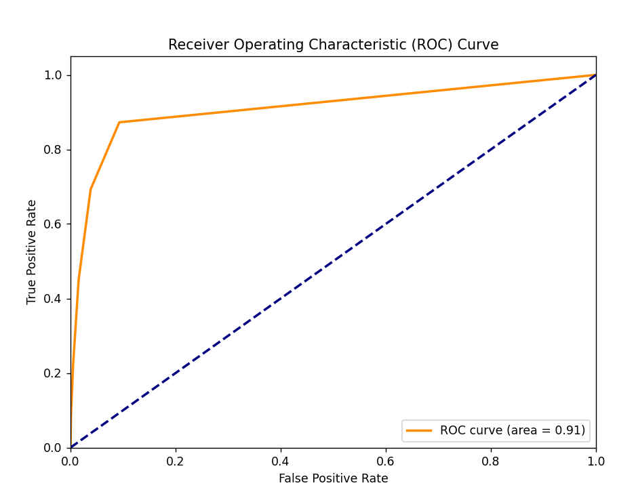
k nearest neighbors
KNN Results
R² | 0.1876
ROC/AUC | 0.91
F1 Score for Class 0 | 0.97
F1 Score for Class 1 | 0.54
RMSE | 0.2299
272
223

Slide 13
Linear discriminant analysis
Model results in a table
Some info about the model/how it works

Slide 14
quadratic discriminant analysis
Model results in a table
Some info about the model/how it works

Slide 15
Support vector machine
Model results in a table
Some info about the model/how it works

Slide 16
Gradient boosting machine
Gradient boosting machines rely on sequentially training weak decision tree learners. At each iteration, a new tree is fit to the gradient (negative derivative) of the loss function and the new estimator is added to the previous according to some learning rate or calculated weight.
Packages Used:
LightGBM – faster convergence, prone to overfitting
XGBoost – optimized with parallel computing
CatBoost – balanced trees with the same conditions in each tree
Model | Best GS Parameters | F1 | Runtime
LGBM | Lr = 0.1 N_est=100 Max_depth = 5 Num_leaves =31 | 0.885 | <5m
XGB | Lr = 0.1 N_est=100 Max_depth = 5 | 0.866 | <2m
CatB | Lr = 0.1 N_est = 200 Max_depth=7 | 0.986 | <15m

Slide 17
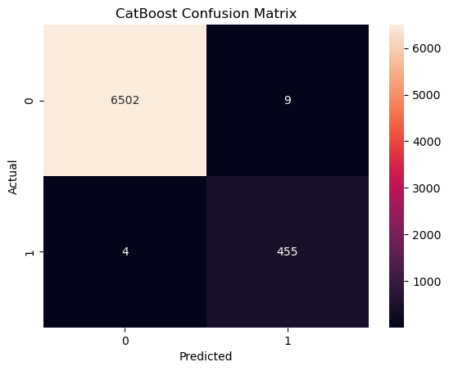
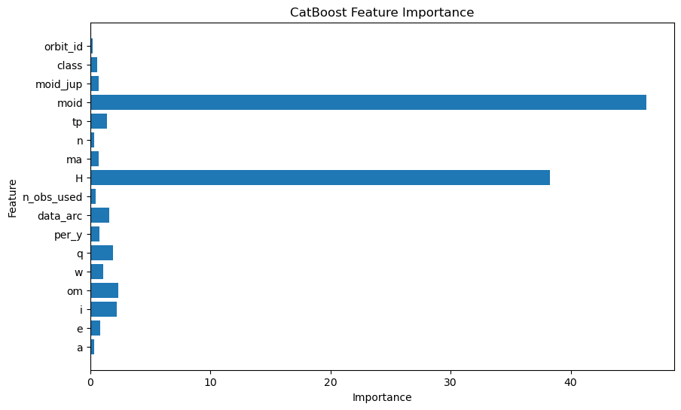
GBM Results

Slide 18
Neural network
Model results in a table
Some info about the model/how it works

Slide 19
The analysis
Comparing model costs and benefits

Slide 20
Final model selection
Model | Accuracy | F1 | Runtime
GBM | 99.8% | 0.986 | <15m
Compare scores for all models here

Slide 21
Learnings and conclusions
Consistent rehearsal
Strengthen your familiarity
Refine delivery style
Pacing, tone, and emphasis
Timing and transitions
Aim for seamless, professional delivery
Practice audience
Enlist colleagues to listen & provide feedback
Seek feedback
Reflect on performance
Explore new techniques
Set personal goals
Iterate and adapt

Slide 22
references

Slide 23
THANK YOU
For more information, please see our code base on GitHub.

