Slide 1
Extended Logo Interpreter
By Erin Clark
Experience Supervisor: Dr. Matthews

Slide 2
Implementation
2 Parts:
  Command Interpreter
    Lots of if statements
  Canvas
    Uses Java's Canvas with Graphics2D

Slide 3
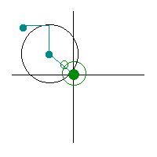
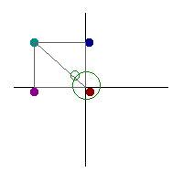
Rectangles and Circles
Circle Rectangle
Left hand corner is always Left hand corner changes with
(centerX – radius, centerY-radius) direction

Slide 4
Repeat Loop
Syntax: Repeat n [commands]
Handles nesting by counting the number of open braces and compares to the number of close braces
when open == close, the command is complete
recurses on the inner commands n times with a for loop

Slide 5
Future plans, Classes
The classes that helped me the most were:
Programming Languages, Trigonometry, Calculus 3
Compilers and Graphics might have been useful too
Future plans for project:
  Variables
  Line wraparound

Slide 6
Sample programs
fd 100 rt 120 fd 100 rt 120 fd 100
repeat 2 [fd 100 rt 120] fd 100
clear
repeat 3 [fd 100 rt 120 repeat 4 [circle 30 rt 90]]

