Slide 1
Modeling implicit theories in achievement contexts
Team Mindsets
Models of Social Behavior
6/2/14

Slide 2
[Attention Getter Here]
Achievement context
Failure scenario?
Task choice scenario?
Implicit theory guiding behavior, like science theory

Slide 3
Roadmap
Implicit theories and their role in
guiding behavior
Modeling implicit theories in achievement contexts
Elicitation experiment: goals, theory of performance, theory of improvement

Slide 4
Implicit theories
Like scientific theories, lay theories guide interpretation of incoming information
Theories are implicit
Notes:
Implicit beliefs → inferences, judgments, reactions in the face of negative events

Slide 5
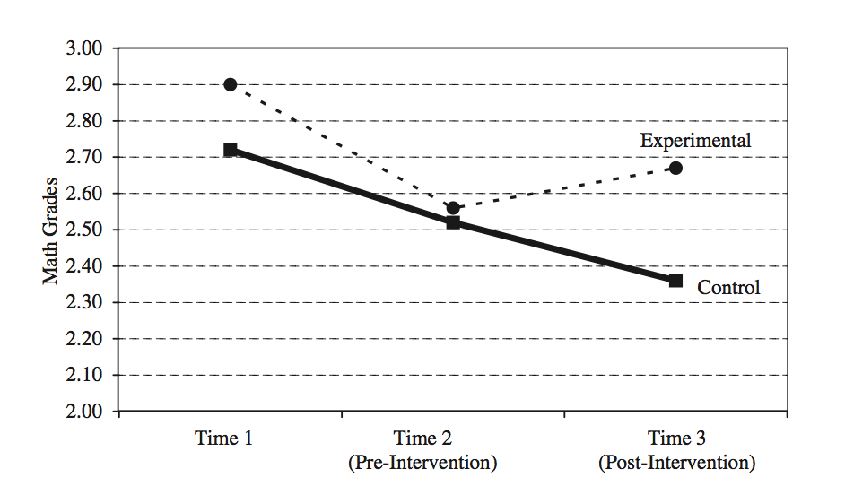
Implicit theories matter
[Table with links between theories, goals, behavior patterns]
Notes:
Implicit beliefs → inferences, judgments, reactions in the face of negative events

Slide 6
Measuring implicit theories
Notes:
Implicit beliefs → inferences, judgments, reactions in the face of negative events

Slide 7
Implicit theories – verbal model
Dweck & Leggett, 1988
Dweck, Chiu, & Hong, 1995
Notes:
Implicit beliefs → inferences, judgments, reactions in the face of negative events

Slide 8
Roadmap
Implicit theories and their role in
guiding behavior
Modeling implicit theories in achievement contexts
Elicitation experiment: goals, theory of performance, theory of improvement

Slide 9
Modeling Mindsets
Notes:
Implicit beliefs → inferences, judgments, reactions in the face of negative events

Slide 10
Roadmap
Implicit theories and their role in
guiding behavior
Modeling implicit theories in achievement contexts
Elicitation experiment: goals, theory of performance, theory of improvement

Slide 11
Goal elicitation
Notes:
Implicit beliefs → inferences, judgments, reactions in the face of negative events

Slide 12
Theory elicitation
Notes:
Implicit beliefs → inferences, judgments, reactions in the face of negative events

Slide 13
[Return to Attention Getter Here]
Achievement context
Failure scenario?
Task choice scenario?
Implicit theory guiding behavior, like science theory

