Slide 1
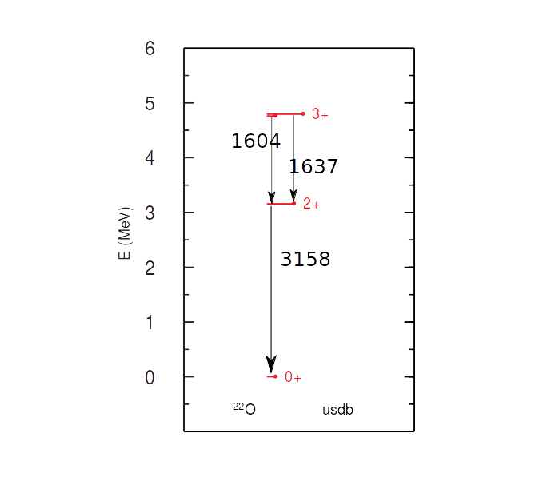
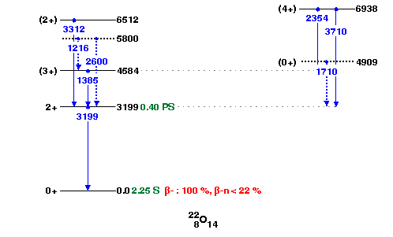
T_{1/2}=0.453864ps
B(E2)=3.968
T_{1/2}=0.453864ps
B(E2)=3.968
T_{1/2}=0.40 (15)ps
B(E2)=4.212

Slide 2
²³O 1/2+
-M1 moment = -1.052 μn
-the single-particle value:
l+1/2 -1.913 μn
l-1/2 0.637 μn

