Slide 1
Dealing with Duplicative Data
Erin Grand
25 April, 2025

Slide 2

About me…
Based in NYC
Data Scientist for 10ish years
Working in the non-profit space in education and mental health
Freelancing in the education field, working with smaller schools without in-house data teams
Lover of cats

Slide 3
Diving into Data Problems

Slide 4
Possible Data Challenges... and Solutions
Challenges:
Missing/Incomplete data
Different data sources without matching IDs
Alignment of data and data processes
Changing IDs
Human data reporting error
Historical data quality
DUPLICATES
Fixable:
Messy Excel sheets (historical or human-entered)
Column names that don’t apply anymore
Lack of historical documentation
Vanishing leading zeros
Finding and fixing duplicates

Slide 5
First, we think about what the data would look like if there were no duplicates

Slide 6
Uniqueness

Slide 7
What is data uniqueness?

Slide 8
Which columns should this table be unique by?
teachers
teacher_id | name | school_id
6775709 | Sally | 1
6103451 | Tim | 2
8932487 | Naveen | 1
6775709 | Rachel | 1
5198032 | Carlos | 2

Slide 9
Which columns should this table be unique by?
student_teacher_map
student_id | teacher_id | cource
6775709 | 32432432 | ELA
6103451 | 24443521 | Math
8932487 | 32432432 | ELA
6775709 | 24443521 | Math
5198032 | 32432432 | Homeroom

Slide 10
Straight Duplicate(s)
Same information across the full row
These are the ones that solved with a “distinct” or excel’s “remove duplicates” functions
teacher_id | name | school_id
2421432 | Sally | 1
324546 | Sally | 1
564564 | Naveen | 1
345232 | Rachel | 1
6574552 | Carlos | 2

Slide 11
Which columns should this table be unique by?
student_exams
student_id | grade | subject | score
6775709 | 5 | ELA | 100
6103451 | 7 | ELA | 72
8932487 | 5 | Math | 50
6775709 | 5 | Math | 88
5198032 | 8 | Math | 97

Slide 12
Example 3: Which columns is this table unique by?
students
student_id | grade | entry_date | exit_date
6775709 | 5 | 2021-02-21 | 2021-03-23
6103451 | 7 | 2020-06-31 | 2021-05-30
8932487 | 5 | 2021-01-12 | 2021-06-01
6775709 | 6 | 2021-02-21 | 2021-03-23
5198032 | 8 | 2022-06-31 | 2023-05-10

Slide 13
Why do we get Dupes? (It’s not your fault)

Slide 14
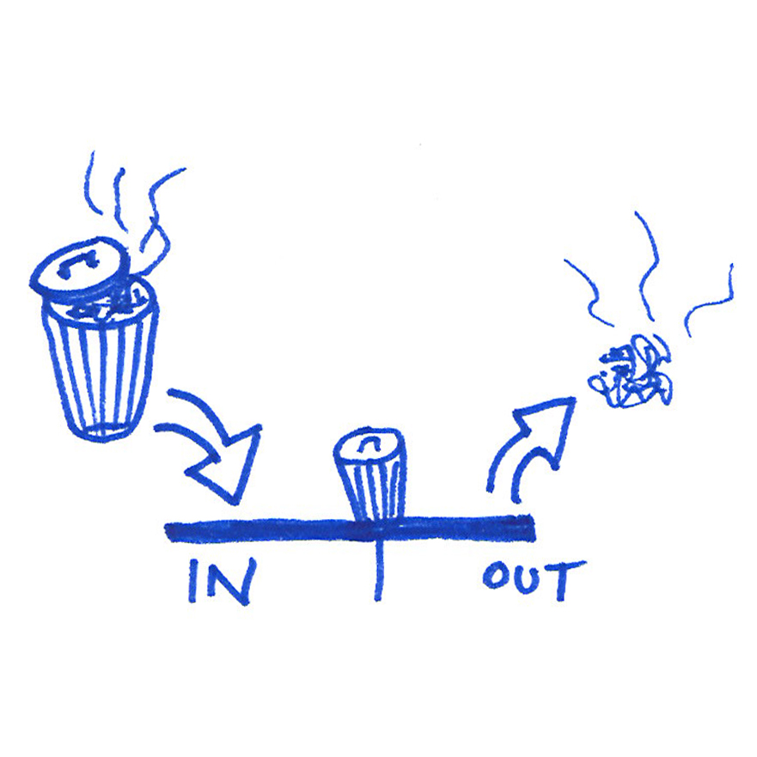
Data Processes are most important!
If your organization doesn’t have the right data processes to start with, messy data will continue to flow no matter how much you code.
Your organization must work on the overall processes AS WELL as the individual errors.

Slide 15
How to fix some data organizational problems?
1: Database Engineering
2: Regular data audits
Use a database system that allows for a PRIMARY KEY
Unique constraints on “surrogate” keys
Structure tables and documentation so that joins between tables are clear
Even with identifiers, duplicates can still happen (ex, the same person with two emails), use other fields to audit for duplicates
Names, emails, birthdays, phone numbers, and home addresses are good places to check, but they’ll likely need their own cleaning

Slide 16
Remove the Duplicates from the Source Data
Combine or delete records to fix the duplicative information
Make sure these changes are DOCUMENTED so that there are no future questions about what happened
I suggest a ”duplicate records” setup that may look like
Of course, this table itself may have dupes – so it should be audited
primary_key_1 | primary_key_2 | what_happened | date
18745 | 19745 | Merged 2 into 1; Removed 2 | 2025-01-01
46204 | 42310 | Removed 2 | 2025-01-02

Slide 17
What about organizations that are not advanced enough for a full database?
Train your people in structures and processes to reduce errors
For example, your school system has two schools. A student, JAMES, moved from School A to School B midyear.
A bad process: School B records JAMES entering the week before, so his records can start, but School A doesn’t record his exit until a week after, in case he decides to come back. Now your records have him at both schools for 2 weeks!
A better process: School B records JAMES in their system with the correct start date, so that he is in the system to start creating class schedules. School A records JAMES as having left on his last day, and if he comes back will start a new record.
Make sure that JAMES has the same ID in School A and School B through audits.

Slide 18
Why do we get Dupes? (This time it is your fault)

Slide 19
Sometimes it’s us who creates unexpected duplicates…
Joining – using the incorrect fields
pivot_wider – including too may columns in the select
pivot_longer – including too many columns in the pivot
etc…

Slide 20
Joining Example
What is this going to produce?
student_id | grade | subject | score
6775709 | 5 | ELA | 100
6103451 | 7 | ELA | 72
8932487 | 5 | Math | 50
5198032 | 8 | Math | 97
student_id | teacher_id | course
6775709 | 32432432 | ELA
6103451 | 24443521 | Math
8932487 | 32432432 | ELA
6775709 | 24443521 | Math
5198032 | 32432432 | Homeroom
+
left_join(student_exams, student_teachers)

Slide 21
student_id | grade | subject | score | teacher_id | course
6775709 | 5 | ELA | 100 | 32432432 | ELA
6775709 | 5 | ELA | 100 | 24443521 | Math
6103451 | 7 | ELA | 72 | 32432432 | ELA
8932487 | 5 | Math | 50 | 24443521 | Math
5198032 | 8 | Math | 97 | 32432432 | Homeroom
What is the problem?
left_join(student_exams, student_teachers,
by = join_by(“student_id”))

Slide 22
Duplicate example…
student_id | grade | subject | score | teacher_id | course
6775709 | 5 | ELA | 100 | 32432432 | ELA
6775709 | 5 | ELA | 100 | 24443521 | Math
left_join(student_exams, student_teachers,
by = join_by(“student_id”))

Slide 23
Joining Example: Is this the fix? If not what is?
student_id | grade | subject | score
6775709 | 5 | ELA | 100
6103451 | 7 | ELA | 72
8932487 | 5 | Math | 50
5198032 | 8 | Math | 97
student_id | teacher_id | course
6775709 | 32432432 | ELA
6103451 | 24443521 | Math
8932487 | 32432432 | ELA
6775709 | 24443521 | Math
5198032 | 32432432 | Homeroom
+
left_join(student_exams, student_teachers,
by = join_by(student_id,
subject == course))

Slide 24
Finding Duplicates (using R)

Slide 25
Looking at Duplicates with Janitor
Janitor was built with beginning-to-intermediate R users in mind and is optimized for user-friendliness. Advanced users can already do everything covered here, but they can do it faster with janitor and save their thinking for more fun tasks. (Sam Firke)
If you’re experienced with Tidyverse in general, you should be able to do everything inside janitor on your own, but we don’t have the time to always clean up data without help.

Slide 26
Benefits to using Janitor package over writing your own code
Functions are tested
Generally obeys Hadley’s official style guide
Turn many lines of code into one or two
Pipe-able functions
Written for the education data space

Slide 27
get_dupes()
data %>% get_dupes(…)
Names of columns to check for duplicates
Data frame with possible duplicates
Notes:
Incredibly important function to check our data for duplicates

Slide 28
Example Dataset: students
student_id | grade | entry_date | exit_date
6775709 | 5 | 2021-02-21 | 2021-03-23
6103451 | 7 | 2020-06-31 | 2021-05-30
8932487 | 5 | 2021-01-12 | 2021-06-01
6775709 | 6 | 2021-02-21 | 2021-03-23
5198032 | 8 | 2022-06-31 | 2023-05-10

Slide 29
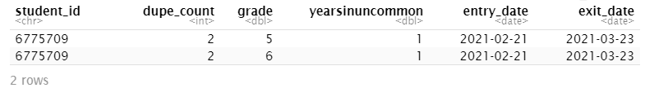
get_dupes() example
students %>% get_dupes(student_id)
Data frame with possible duplicates
Names of columns to check for duplicates
get_dupes() returns the records that have dupes by the field(s) specified
The fields that we are checking appear first, followed by a column called dupe_count that shows the number of duplicates by the specified fields
What is the data duplicated by?
Notes:
It shows us the dupes by the fields we included in the function call
It also adds a dupe count column right after the fields in the function call

Slide 30
What does get_dupes do?
select
arrange
filter
mutate
group_by
summarize
Notes:
Use the students data to write code that can get the dupes by student_id
5 minutes
students %>%
group_by(student_id) %>%
mutate(dupe_count = n() ) %>%
ungroup() %>%
filter(dupe_count > 1) %>%
select(student_id, dupe_count, everything() )

Slide 31
Answer – get_dupes with dplyr verbs
students %>%
group_by(student_id) %>%
mutate(dupe_count = n() ) %>%
ungroup() %>%
filter(dupe_count > 1) %>%
select(student_id, dupe_count, everything() )
group_by columns to check for duplicates
mutate
Count the # of rows in each “group”
filter
Keep only rows that have duplicates
select
Reorder the columns

Slide 32
Correcting Duplicates

Slide 33
Correcting Duplicates
Method 1: Correct the dupes individually with if_else or case_when and then distinct() to remove the straight dupes
students_clean <- students %>%
mutate(grade = if_else(student_id == 6775709, 5, grade)) %>%
distinct()
Method 2: Systematically remove dupes by taking the min or max of the duplicate causing column.
students_clean <- students %>%
group_by(student_id) %>%
summarize(grade = min(grade)) %>% ungroup()
Notes:
Method 1 – we usually look up records in a source system like PS or Illuminate to make a decision on how to correct it.
Method 1 – we make the duped row match the correct record. Then when we distinct, it goes away since it is not distinct from the correct row any more.
Method 2 – You need a business rule to make systematic decisions about the data

Slide 34
Correcting Duplicates continued
Method 3: Flag the dupes individually with if_else or case_when, filter to them, and then anti_join
dupes_remove <- students %>%
mutate(remove = if_else(student_id == 6775709 & grade == 6,
1, 0)) %>%
filter(remove == 1)
# anti_join the dupes to REMOVE them
students_clean <- anti_join(students, dupes_remove)
Notes:
We are only going to use this method if there aren’t a lot of dupes to flag
If you have another column as a source of truth you can also find the records that don’t match it and anti_join them on. Like if you had PS enrollment in here, you could see where the grade doesn’t mat
What notice about the anti_join here?
When we’re anti_joining here we already know that they contain the same columns and we want them to remove the rows based on everything they match by (you could explicitly call out all of the columns = cols they should join by). This is called a natural join, where they join by all columns that they share
R will give you a message about what you joined by
Could avoid anti_joining by filtering to 0

Slide 35
Correcting Duplicates cont.
Method 4: Output the duplicates, manually choose which version to remove, and then anti_join those on. Same concept as Method 3, but when there are a lot more duplicates, using a lookup table is better than using a case_when.
# Write out the dupes
get_dupes(students, student_id) %>%
write_csv("../QC/student_id_dupes.csv", na = "")
# Open the file in Excel, add a column called remove with a 0 or flag
# to indicate whether or not you should remove it from the dataset
# Then save it as student_id_dupes_corrected.csv in the Input folder
# Read in the annotated file
# Filter to the row(s) you want to remove
dupes_remove <- read_csv("../Input/student_id_dupes_corrected.csv") %>%
filter(remove == 1)
# anti_join the dupes on
students_clean <- anti_join(students, dupes_remove)
Notes:
Method 3 = outputted Method 1
Notice I am using the pipe and the dot to write out the dupes into a csv.
In general this is a helpful method of QC, it is used in SAT with missing IDs, state tests with id issues

Slide 36
Duplicates example
Find duplicates in the Practice Exam data
Take a look at the data. What do you think the data is/should be unique by?
Are there dupes? How many? What are they by?
What business rule do you think you should apply to correct these duplicates? Do they need correcting?
Notes:
4 minutes
student_number, subject, cycle
16 duplicates (sat_exam /exam_grade)
Keep exam_grade that matches the student grade
# Code to generate Practice SAT datea
results_raw %>%
select(student_number, cycle, academic_year, name, school,
grade, sat_exam,
test_version, subject, subject_percent_correct
) %>%
distinct() %>%
mutate_at(vars(subject_percent_correct), as.numeric) %>%
rename(percent_correct = subject_percent_correct) %>%
write_csv("../Input/practice_sat_cycle1.csv", na = "")

Slide 37
Answer – Duplicates example
Find duplicates in the Practice Exam data
get_dupes(prac_exam, student_number, subject)
Take a look at the data. What do you think the data is/should be unique by?
Should be unique by student_number & subject
Are there dupes? How many? What are they by?
16 duplicates, by exam grade
What business rule should you apply to correct these duplicates? Do they need correcting?
Keep the rows where the exam grade matches the grade level of the student.
OR
Confirm that students can take multiple tests in different grades and keep them all
OR
Keep the highest score
Notes:
student_number, subject, cycle
16 duplicates (sat_exam /exam_grade)
Keep exam_grade that matches the student grade
# Code to generate Practice SAT datea
results_raw %>%
select(student_number, cycle, academic_year, name, school,
grade, sat_exam,
test_version, subject, subject_percent_correct
) %>%
distinct() %>%
mutate_at(vars(subject_percent_correct), as.numeric) %>%
rename(percent_correct = subject_percent_correct) %>%
write_csv("../Input/practice_sat_cycle1.csv", na = "")

Slide 38
Correcting duplicates example
Correct the duplicates in the Practice SAT data by only keeping the rows where the exam grade matches the student’s grade level. Check that there are no dupes in your corrected data.
Name your tibble of dupes dupes_remove
Notes:
Hint – Method 3
dupes_remove <- prac_sat %>%
get_dupes(student_number, subject, cycle) %>%
filter(exam_grade != grade)
prac_sat_clean <- prac_sat %>%
anti_join(dupes_remove,
by = c("student_number", "subject",
"cycle", "exam_grade"))
get_dupes(prac_sat_clean,
student_number, subject, cycle)
student_number, subject, cycle
16 duplicates (sat_exam / exam_grade)
Keep the rows where the exam_grade matches the student grade

Slide 39
Answer - Correcting duplicates example – Step 11
dupes_remove <- prac_exam %>%
get_dupes(student_number, subject) %>%
filter(exam_grade != grade)
prac_sat_clean <- p prac_exam %>%
anti_join(dupes_remove)
get_dupes(prac_sat_clean,
student_number, subject)
Notes:
You can also use a mutate to write a flag using an if_else and then filter
You didn’t need to add the join by clause it would work without
It is safer to apply the filter to only the dupes. There maybe someone who only took one exam and it purposely didn’t match their grade. We wouldn’t want to remove that record.

Slide 40
Managing Data Changes on a Re-Run
Using get_dupes and verify() from the assertr package is a great way to put in checks in case the data changes (which it will).
If a student ID changes, or new duplicates occur, the code will STOP at this step, alerting that something is off
check <- prac_sat_clean %>% get_dupes(student_id, subject) %>% verify(nrow(.) == 0)

Slide 41
Q&A
@astroeringrand

