Slide 1
Music Recommendation System
Million Song Dataset from Kaggle
Erin Grand, Justin Law, Jordan Rosenblum

Slide 2
Introduction
Recommendation systems allow for users to discover things of interest, ideally with zero to little effort
We focus on collaborative filtering approaches without the need for metadata
User feedback (i.e. number of plays) is used instead
We explore

Slide 3
Data and Statistics

Slide 4
Evaluation and Baseline

Slide 5
Matrix Factorization

Slide 6
Matrix Factorization

Slide 7
Matrix Factorization

Slide 8
User-based CF

Slide 9
Item-based CF

Slide 10
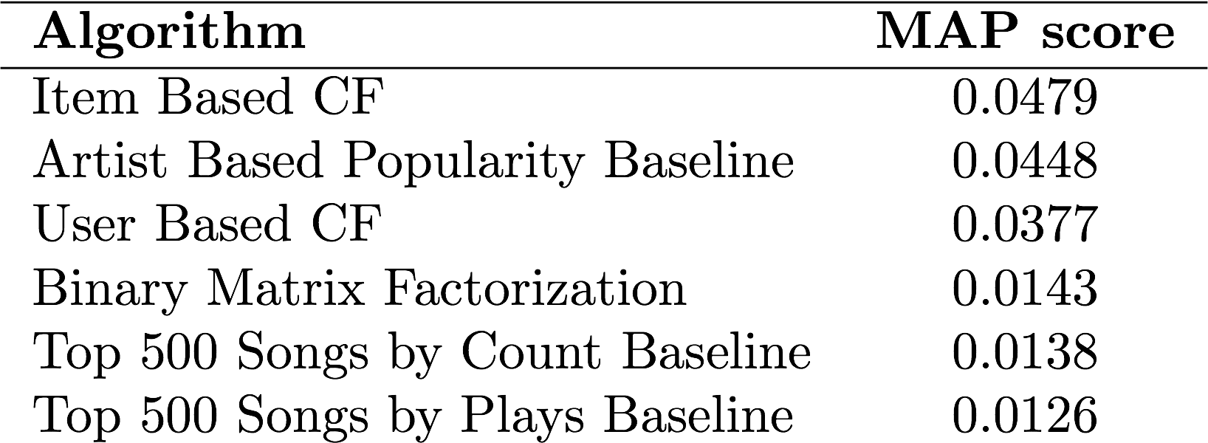
Results and Next Steps
Next Steps
Incorporate tags and metadata present in the dataset (e.g. year, genre, audio metadata)
Expand the size of the subset and distribute the workload to multiple machines

