Slide 1
Music Recommendation System
Million Song Dataset from Kaggle
Erin Grand, Justin Law, Jordan Rosenblum

Slide 2
Introduction
Recommendation systems allow for users to discover things of interest, ideally with zero to little effort
We focused on collaborative filtering approaches without the need for metadata
User feedback (i.e. number of plays) is used instead
We explored matrix factorization and user and item based collaborative filtering

Slide 3
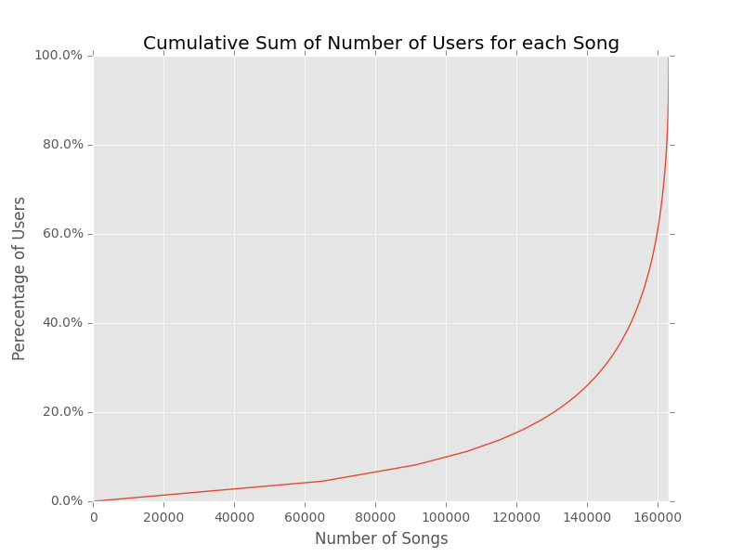
Data and Statistics
The sample dataset had 110,000 users and 163,206 songs
We subset the data to users with > 27 songs played and songs with > 22 users listening to them -> 8,130 users and 11,861 songs (10% of orig.)
Sparsity was 0.16%

Slide 4
Evaluation and Baseline
Benchmarked our algorithms using a mean average precision score truncated at 500 recommendations
MAP@500 takes into account the first 500 recommendations given to each user and calculates the number of true positives vs. the test set against the total number of recommended songs at each position, averaged together. It is then averaged across all users
We used two baseline methods, recommending:
the 500 most popular songs (MAP = 0.0138)
the 500 most popular songs ordered by the artists that the user had already listened to at the front (MAP = 0.0448)

Slide 5
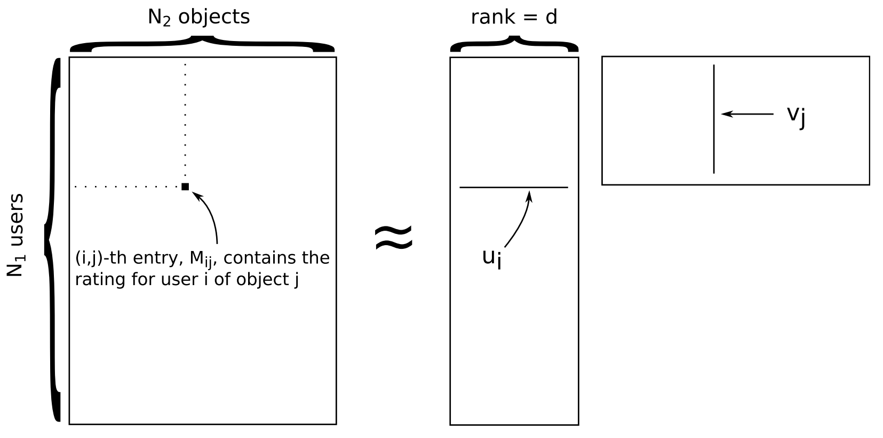
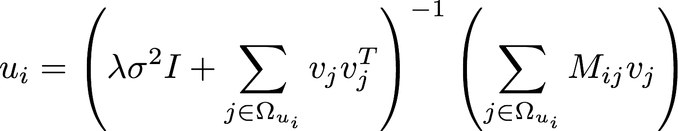
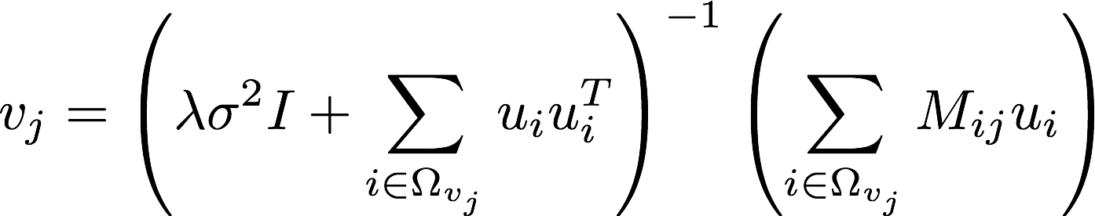
Matrix Factorization Hyperparameters
Alternating least squares optimization
Hyperparameters
Rank
Variance
Iterations
Lambda set to 10

Slide 6
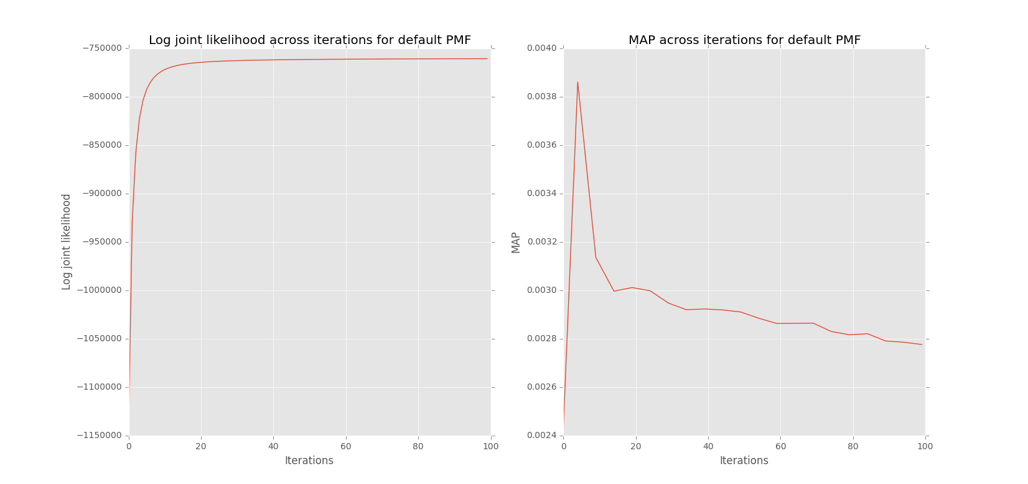
Matrix Factorization Initial Results
Using rank = 80 and variance = 1.0 with play count values
MAP values were significantly below the popularity baseline
MAP values were poor and did not change significantly across iterations
Log joint likelihood converged sufficiently within 30 iterations
Implicit feedback issue required testing of normalization schemas

Slide 7
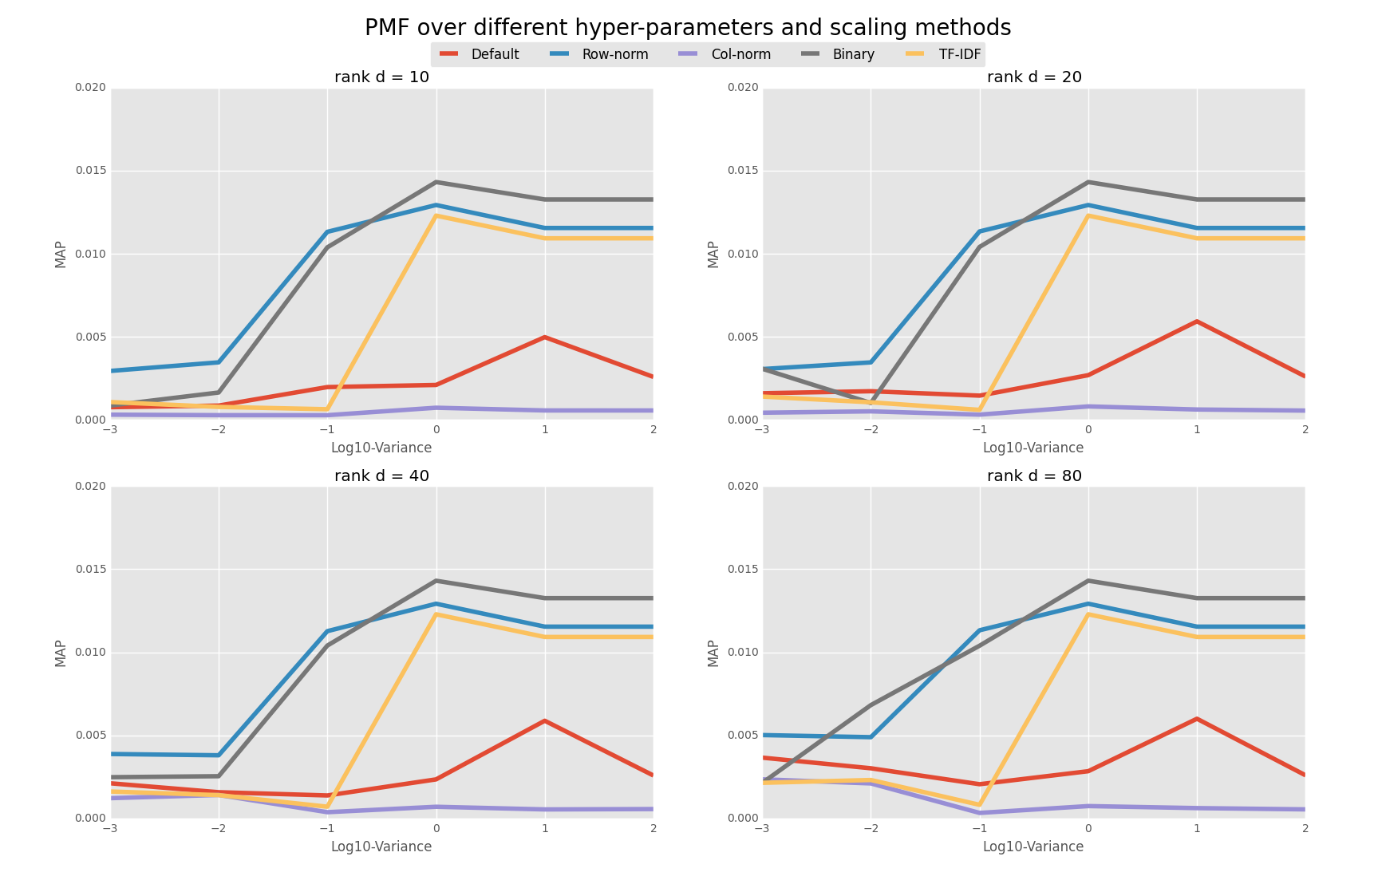
Matrix Factorization Normalization Schemas
Rank had marginal impact
Variance had some correlation with the normalization used
Binary scheme provided the best MAP value of 0.0143
Data was likely too sparse for matrix factorization to identify biases

Slide 8
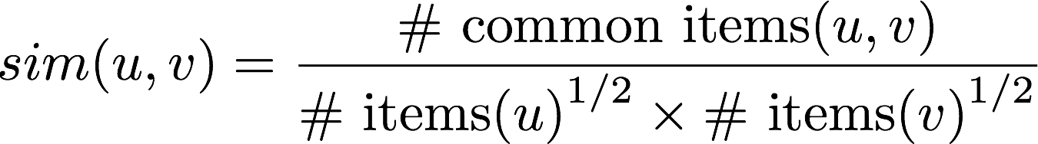
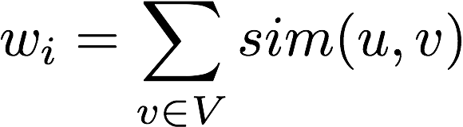
User-based CF
Calculated similarity of every pair of users in the subset
Determined the weight on each song, i, for a particular user, u, by summing the similarity scores between user u and all users v who listened to song i
Recommended songs with highest weights in descending order

Slide 9
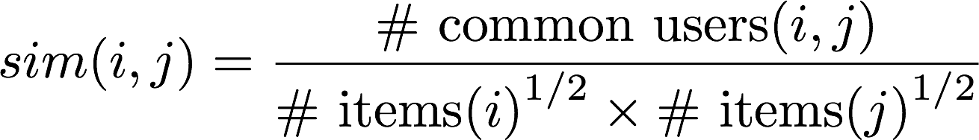
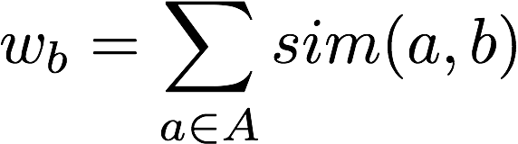
Item-based CF
Calculated similarity of every pair of songs in the subset
For each song, b, that was found to be similar to one of the songs, a, that a user listened to, we calculated the weight for that song: since the same song will likely come up multiple times for a different song, a, we then summed similarity scores for each similar song, b, across all songs, a
Recommended songs with highest weights in descending order

Slide 10
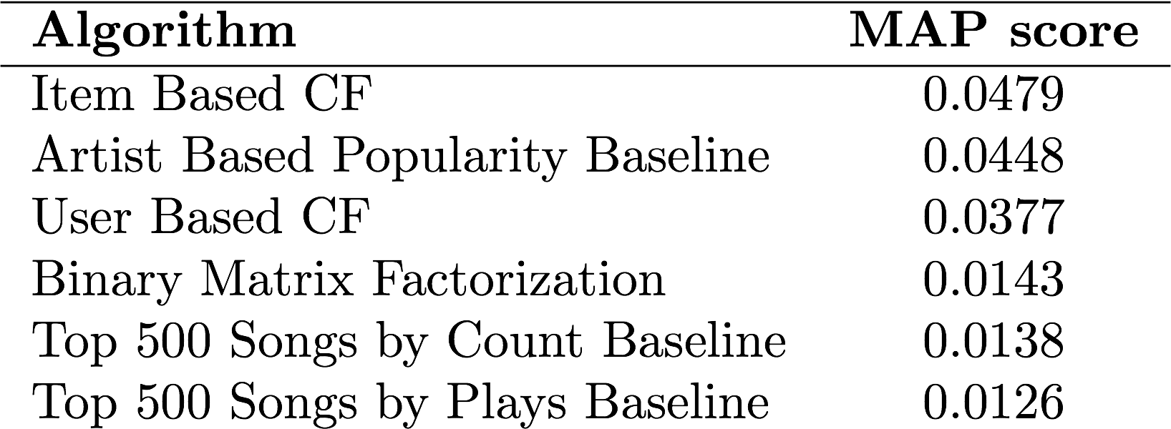
Results and Next Steps
Next Steps
Incorporate tags and metadata present in the dataset (e.g. year, genre, audio metadata)
Expand the size of the subset and distribute the workload to multiple machines

Slide 11
Matrix Factorization: Equations

