Slide 1
Music Recommendation System
Million Song Dataset from Kaggle
Erin Grand, Justin Law, Jordan Rosenblum

Slide 2
Introduction
Recommendation systems allow for users to discover things of interest, ideally with zero to little effort
We focused on collaborative filtering approaches without the need for metadata
User feedback (i.e. number of plays) is used instead
We explored matrix factorization, and user and item based collaborative filtering against a popularity baseline

Slide 3
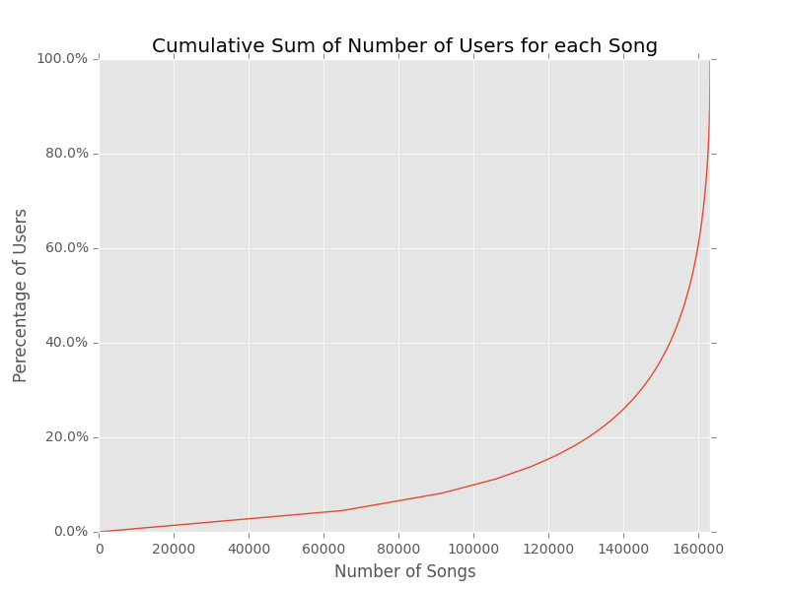
Data and Statistics
The sample data set had 110,000 users and 163,206 songs
Subset the data to users with > 27 songs played and songs with > 22 users listening to them -> 8,130 users and 11,861 songs (10% of orig.)
Sparsity was 0.16%

Slide 4
Evaluation and Baseline
Benchmarked our algorithms using a mean average precision score truncated at 500 recommendations
MAP@500 takes into account the first 500 recommendations given to each user and calculates the number of true positives against the total number of recommended songs at each position
We used two baseline methods:
Recommend the 500 most popular songs (MAP = 0.0138)
Most popular songs from the artists that the user had already listened to (MAP = 0.0448)

Slide 5
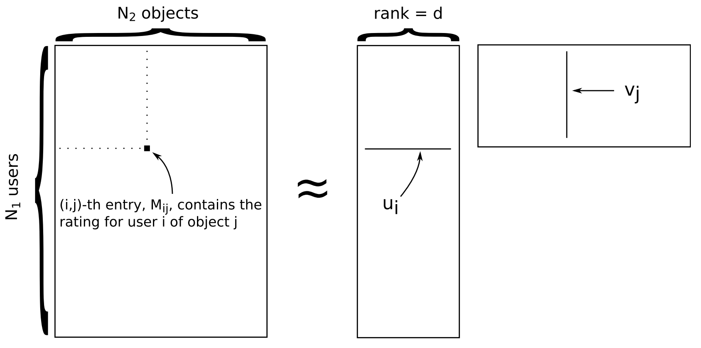
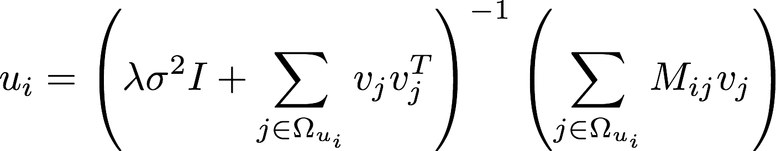
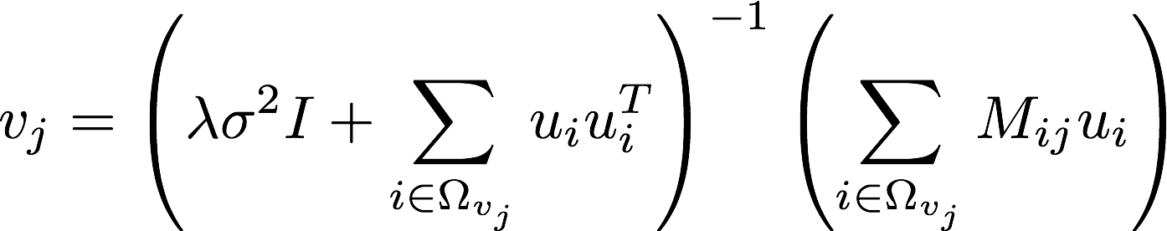
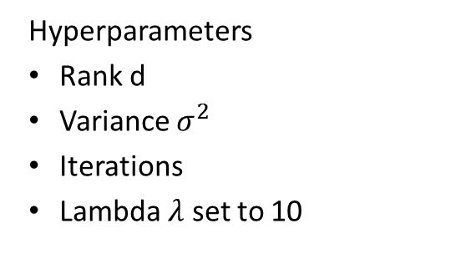
Matrix Factorization Hyperparamters
Alternating least squares optimization
Hyperparameters
Rank d
Variance $σ^{2}$
Iterations
Lambda $λ$ set to 10

Slide 6
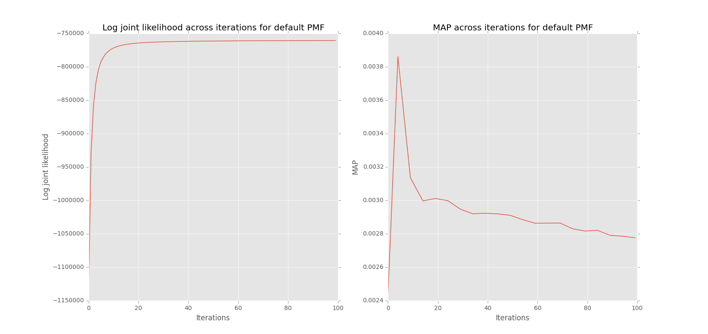
Matrix Factorization Initial Results
Using rank = 80 and variance = 1.0 with play count values
MAP are significantly below the popularity baseline
MAP values are poor and does not change significantly across iterations
Log joint likelihood converges sufficiently within 30 iterations
Implicit feedback issue require testing of normalization schemas

Slide 7
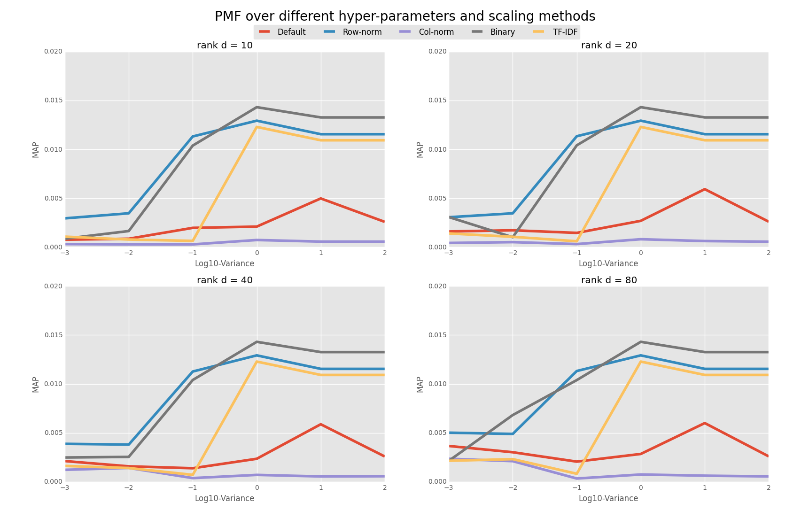
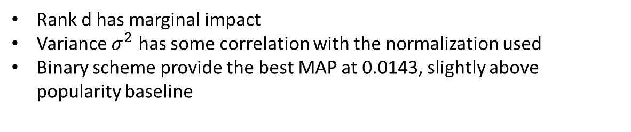
Matrix Factorization Applying Normalization Schemas
Rank d has marginal impact
Variance $σ^{2}$ has some correlation with the normalization used
Binary scheme provide the best MAP at 0.0143, slightly above popularity baseline

Slide 8
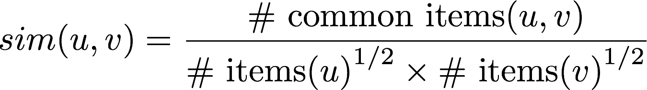
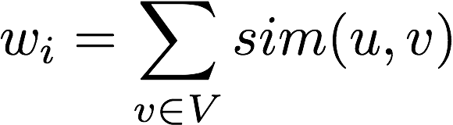
User-based CF

Slide 9
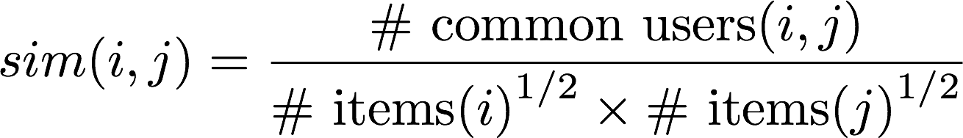
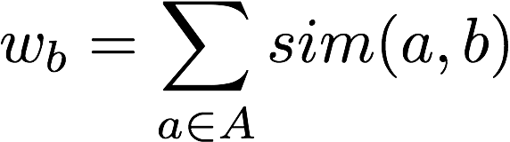
Item-based CF

Slide 10
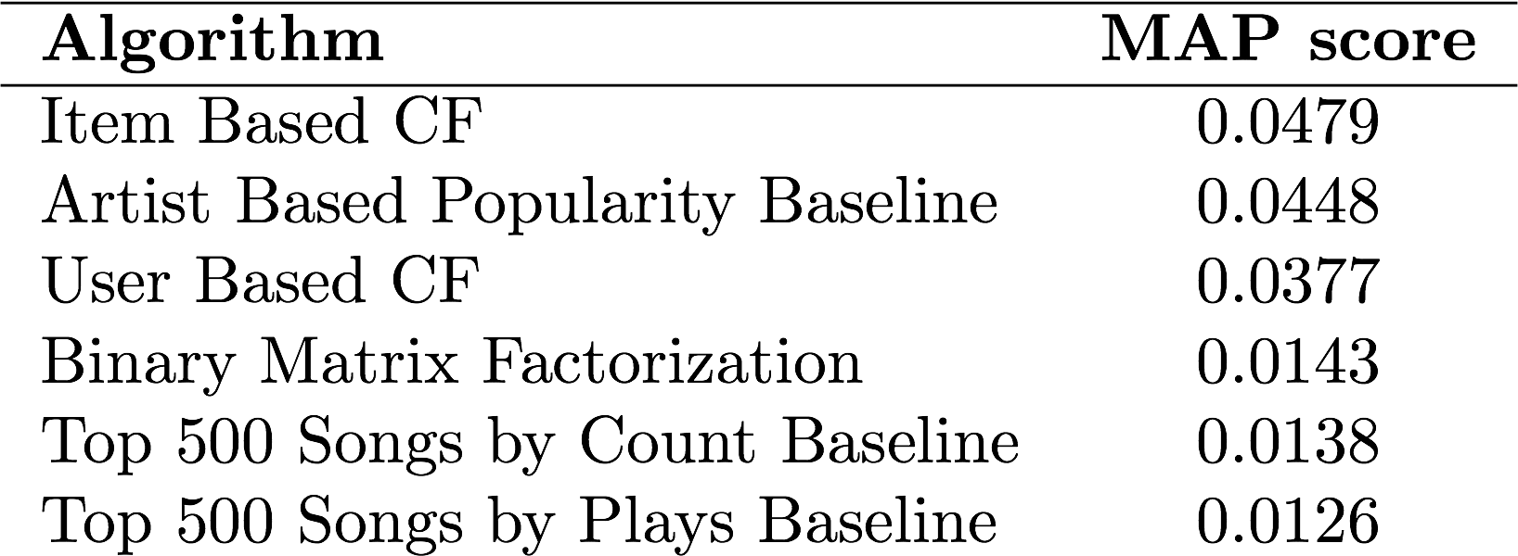
Results and Next Steps
Next Steps
Incorporate tags and metadata present in the dataset (e.g. year, genre, audio metadata)
Expand the size of the subset and distribute the workload to multiple machines

Slide 11
Matrix Factorization

