Slide 1
Car accident severity

Slide 2
INTRODUCTION
Most car accidents happens in the same circumstances, they can be predicted and avoided.
The accidents severity usually depends on the weather, the road condition, light conditions,… .

Slide 3
DATA
The used data is the given dataset https://s3.us.cloud-object-storage.appdomain.cloud/cf-courses-data/CognitiveClass/DP0701EN/version-2/Data-Collisions.csv
The metadata of the dataset: https://s3.us.cloud-object-storage.appdomain.cloud/cf-courses-data/CognitiveClass/DP0701EN/version-2/Metadata.pdf

Slide 4
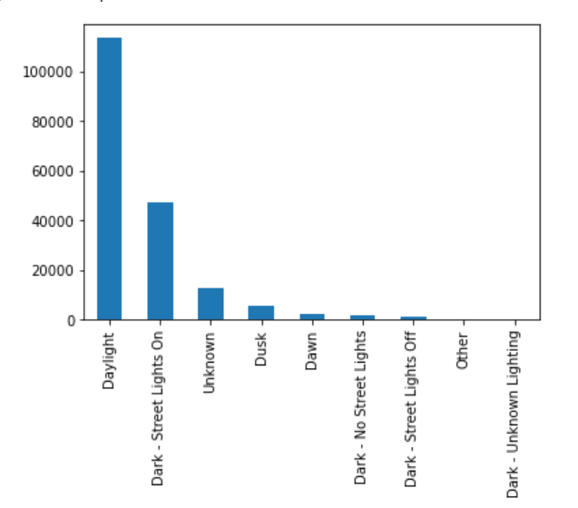
Most accidents happen in the daylight.

Slide 5
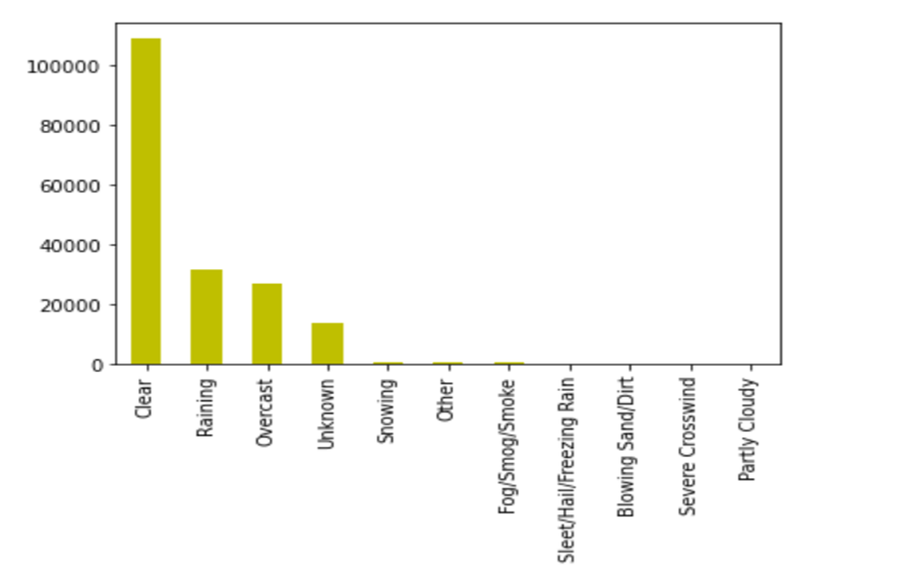
Most accidents happen in clear weather.

Slide 6
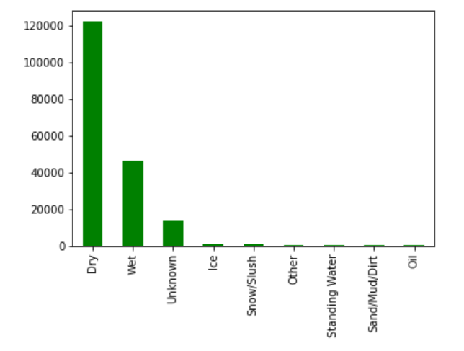
Most accidents happen on dry roads.

Slide 7
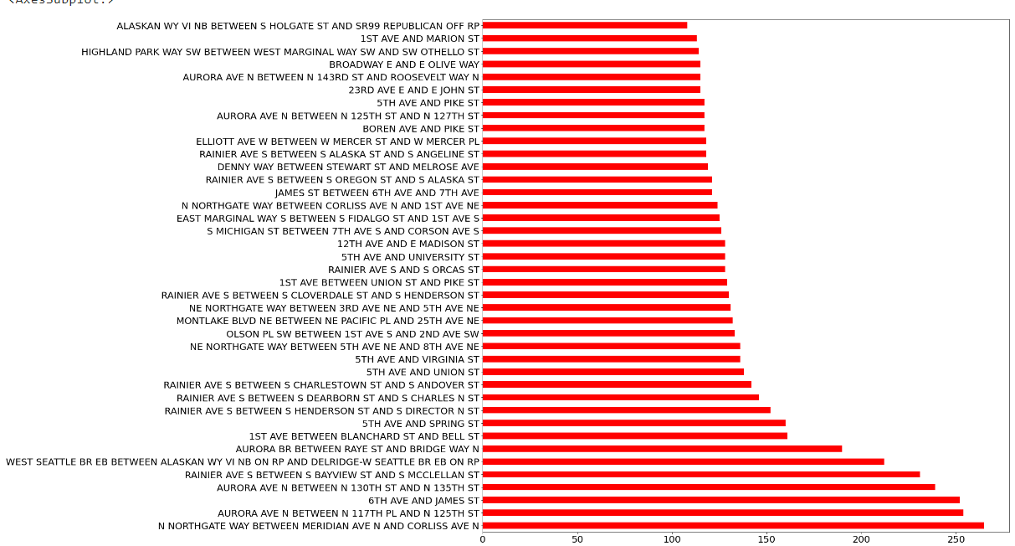
Most accidents happen in these locations.

