Slide 1
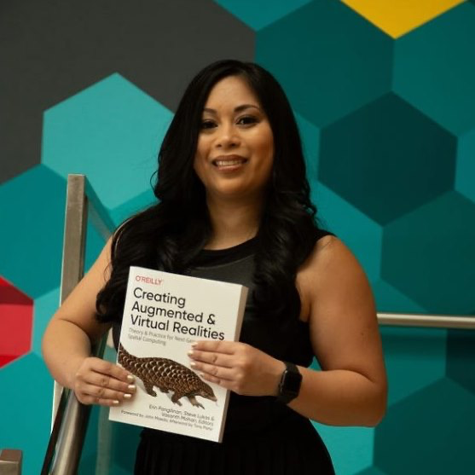
FEEDBACK FORM FOR CREATING AR VR BOOK #2
Give feedback and win a free book be a book reviewer or get featured https://bit.ly/CARVRSC-Fdbk24

Slide 2
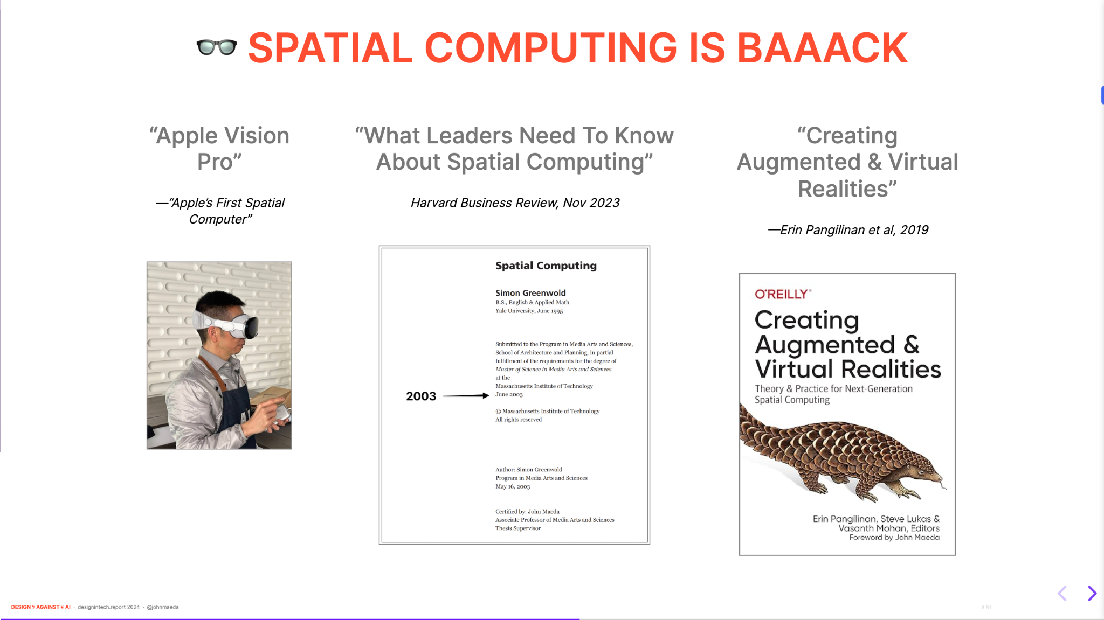
FEEDBACK FORM FOR CREATING AR VR BOOK #2
Give feedback and win a free book: be a book reviewer or get featured https://bit.ly/CARVRSC-Fdbk24

Slide 3
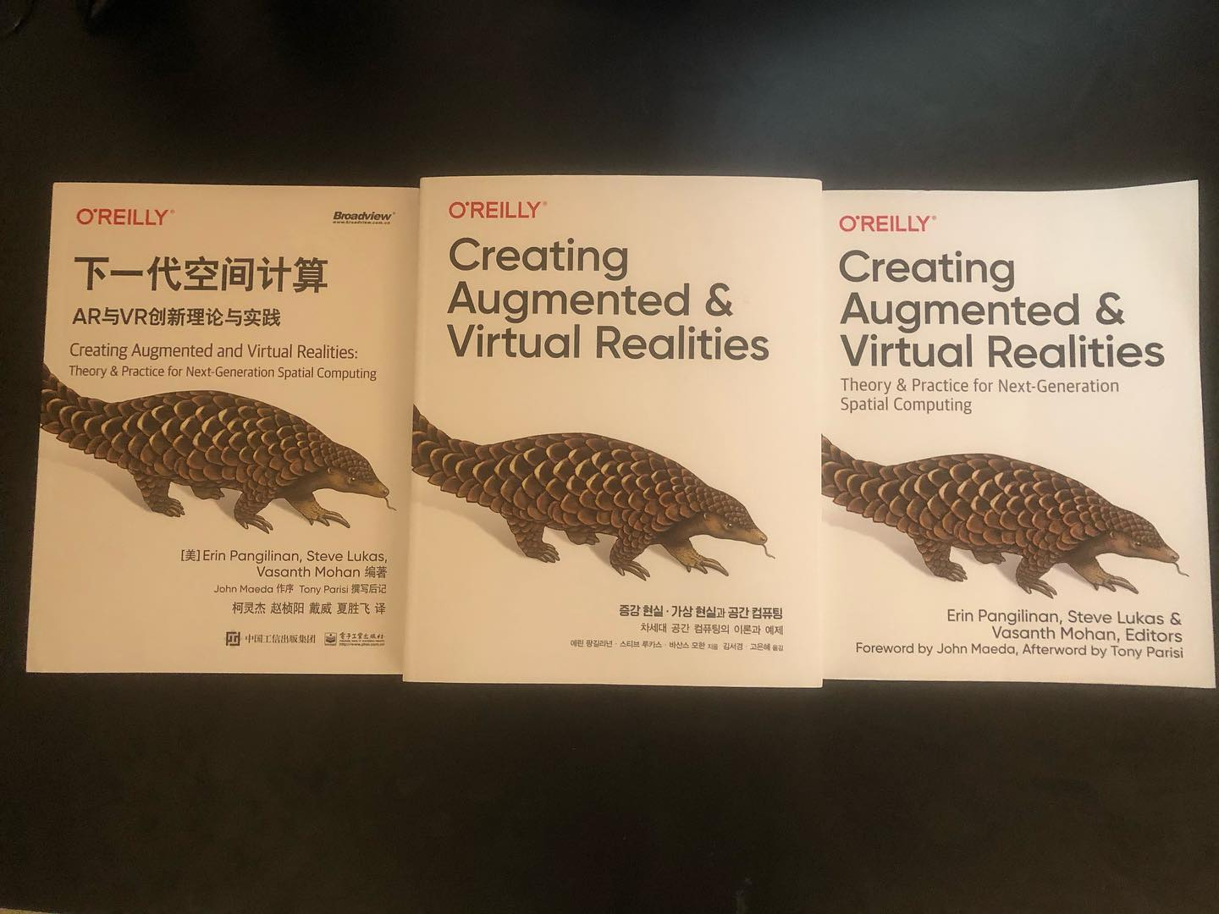
CREATING AR VR BOOK #1
creatingarvr.com + on O’Reilly Media (Safari Platform), Amazon etc., in English, Chinese, Korean

Slide 4
🎥🎞️👓🕶️
HIRING

Slide 5
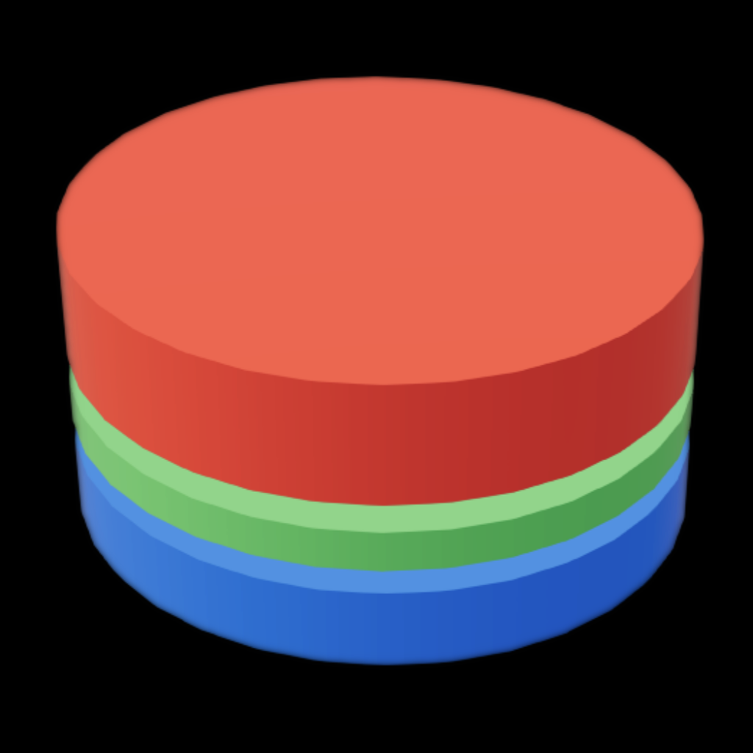
TimeCake
TimeCake is a VisionOS productivity app to keep you on task.
Stay Focused, Stay Sweet: Turn Tasks into Treats with CakeRings
Erin Pangilinan I Andre Cunha I Steven Pease
Special Thanks: Paige Sun, John Haney

Slide 6
PROBLEM
Timeblindness. Hard to track your day for everyone and especially neurodivergent (ND) individuals (ex. ADHD, NVLD (Non-Verbal Learning Disorder).
Data and time remains lost and uncaptured.
People waste too much time on the wrong things.

Slide 7
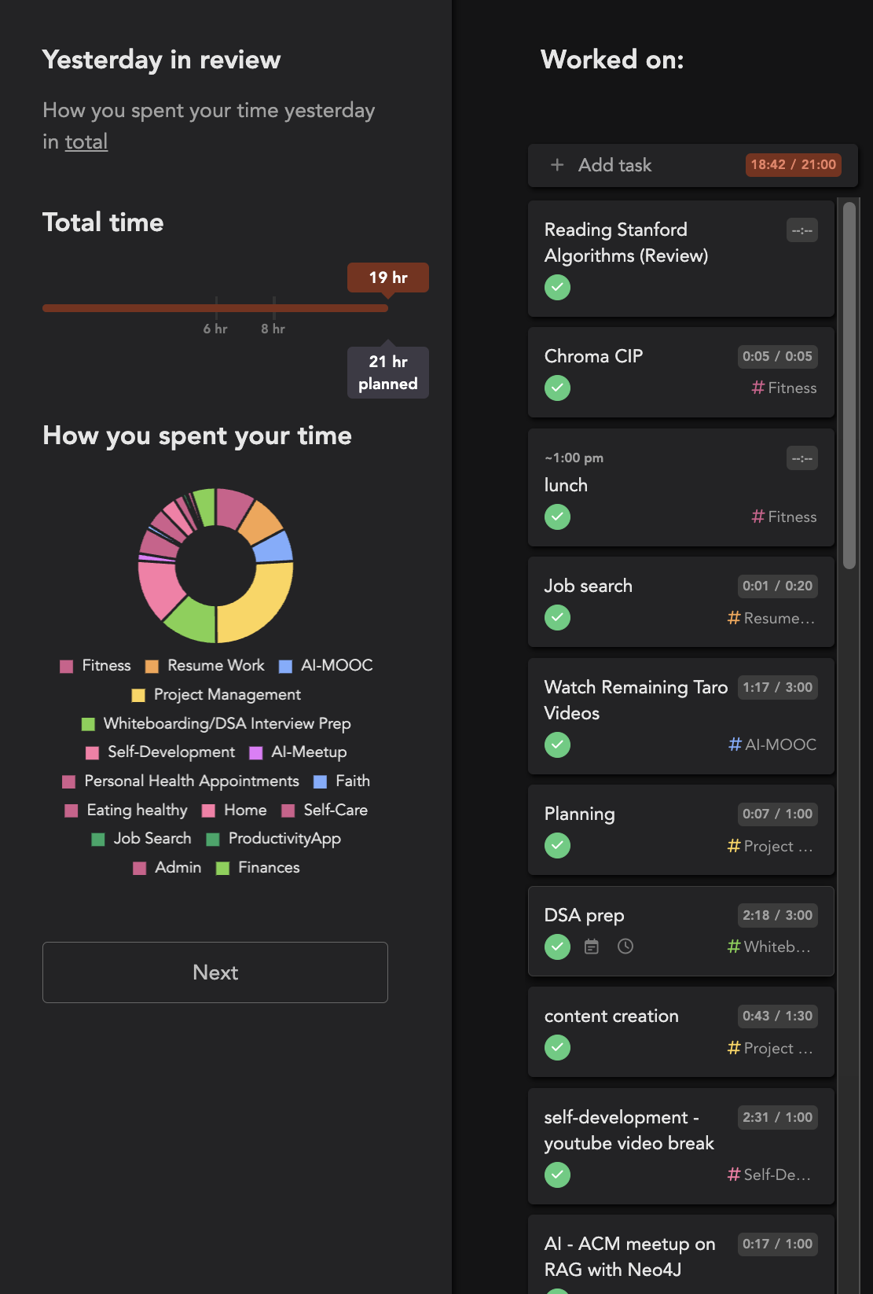
Sunsama
UI is flat and hard to estimate time even for product management and time tracking software built for ND individuals.

Slide 8
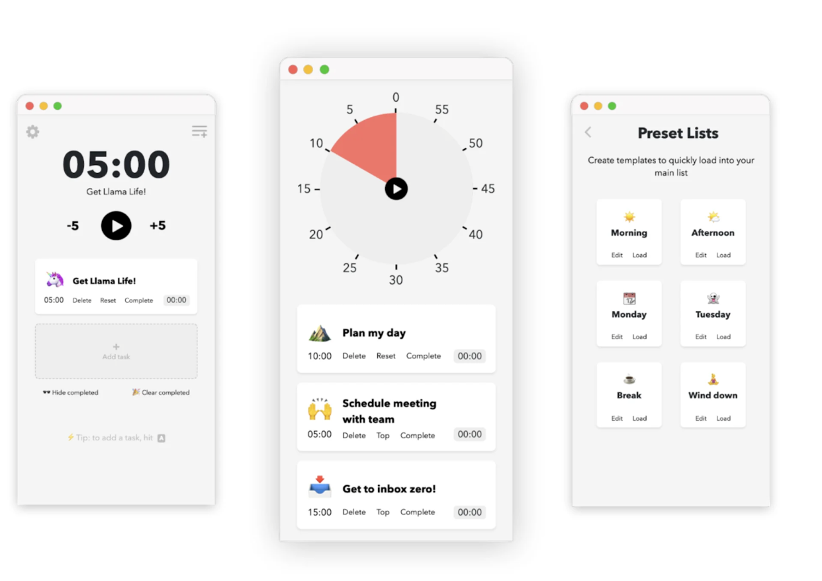
Context switching is where you lose lots of time, and if you don’t write or track it, it is hard to know if you are on target.
LlamaLife

Slide 9
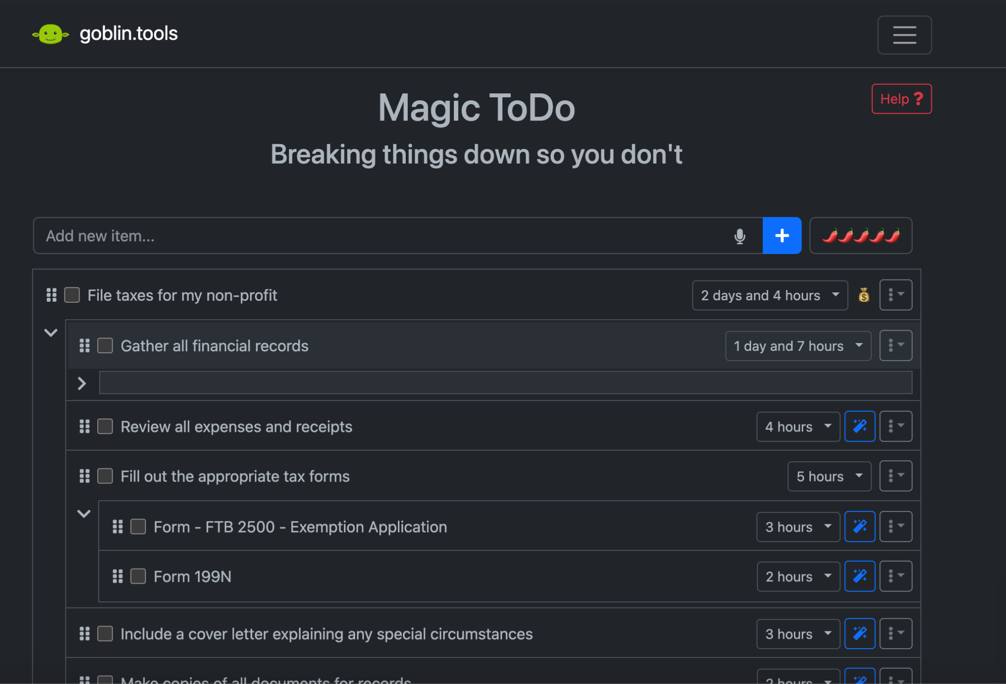
Even with AI ClickUpAI and ND friendly software tools (GoblinTools), it is hard to find ND-friendly time tracking software that estimates time usage.

Slide 10
How do we want to track time?

Slide 11
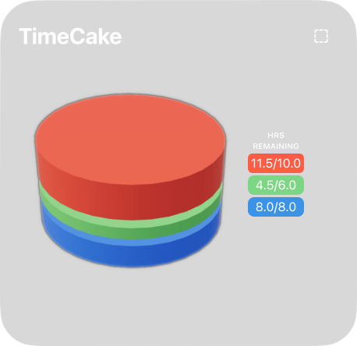
SOLUTION

Slide 12
FEATURES
Intuitive 3D data visualization tracking productivity app in real time for time boxing personal, professional (work), and play
Shared app integrating with other Apple ecosystem for tools you already use
Interactivity: Users upon gaze can select their activity and view insights about their day and where time is spent on each activity.

Slide 13
Changing Activity
Hours Elapsed
UI Decimal Display
Clock Time
WORK
7:30AM - 7:00PM | 11:30/10:00 | 11.5/10.0
7:00PM - 11:30PM | 4:30/6:00 | 4.5/6.0
11:30PM - 7:30AM | 8:00/8:00 | 8.0/8.0
PERSONAL
SLEEP

Slide 14
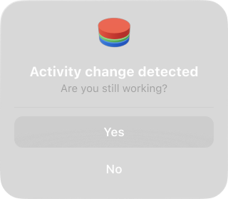
Timecake automatically tracks time with your change in activity.

Slide 15
BUILT WITH
Tools:
We built this with XCode, RealityKit, SwiftUI, Gimp, Figma, Bezi in AVP.
GitHub
https://github.com/erinjerri/VisionDevCamp-timecake

Slide 16
FUTURE INTEGRATIONS
Apple Calendar API
Apple HealthKit (Sleep Analysis)
Apple Fitness API
ScreenTime API
WatchKit
Apple Watch notifications reminders
(get more sleep, work on another project)
Dashboard for other project categories

Slide 17
CONNECT WITH US
GH/X/IG/LinkedIn
@erinjerri
LinkedIn
linkedin.com/in/sepease
Andre
linkedin.com/in/andrercunha

