Slide 1
Stream dream team
Steph, Erin, Dietrich, naila

Slide 2
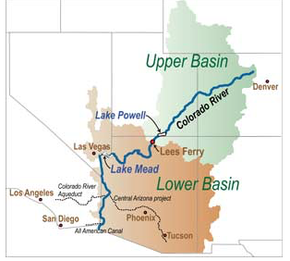
Phosphorus in Colorado river watershed
How does TDP, TP vary with stream size and land use?
Predictions:
1) Increasing homogeneity in P variability with increasing stream size
2) increasing quantity with increased human influence

Slide 3
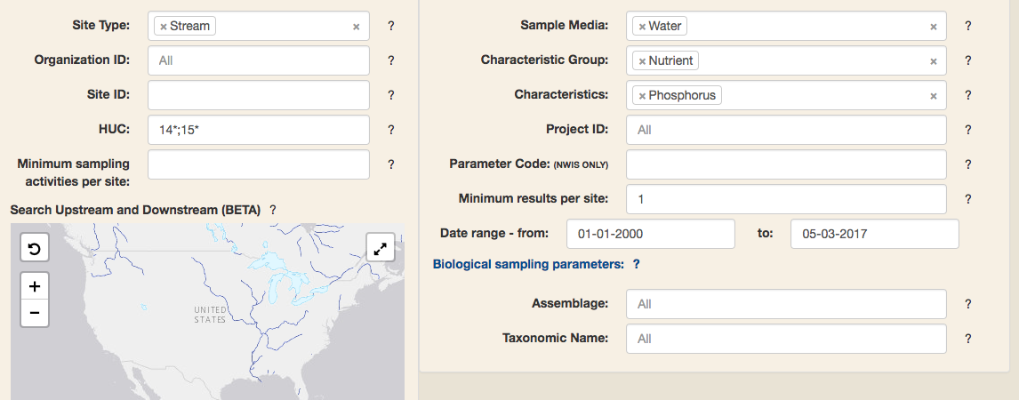

Data
Phosphorus: National Water Quality Monitoring Council
Land Use: EPA Wadeable Streams Assessment (2004-2005)

Slide 4
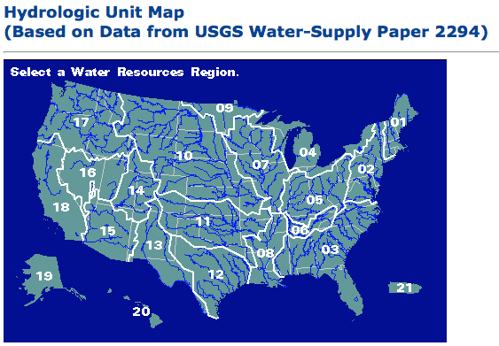
(Trying to) USe THE TOOLS WE SAW IN CLASS
Joined site information and samples for each separate data set (SQL)
Excluded large rivers and included only TP, TDP (OpenRefine), included Stable Base Flow and Routine Sampling (no floods, or hurricanes, or earthquakes)
Joined by HUC8 (SQL) → mistake because NOT unique identifier
Thought: join by latitude, longitude, but not good idea
Averaged land use using dplyr (in R)
Rejoined P + Land Use by HUC8 (SQL)
Set up GitHub repository
Shared things

Slide 5
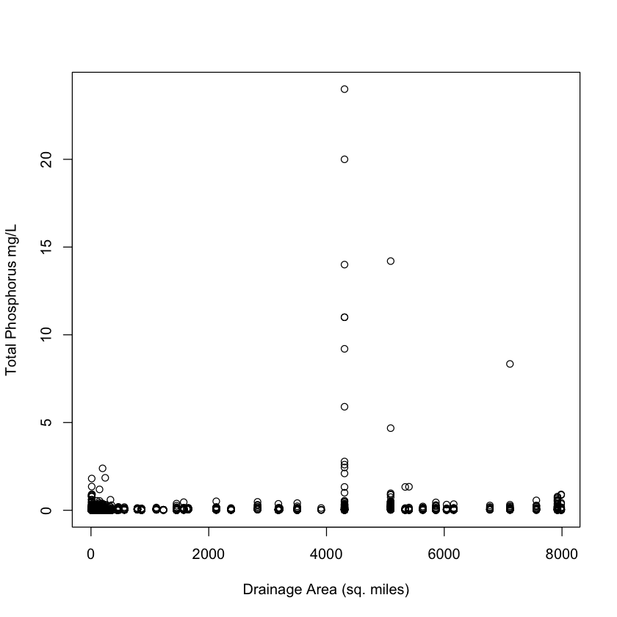
Results 1.0 (aka 20.0)

Slide 6
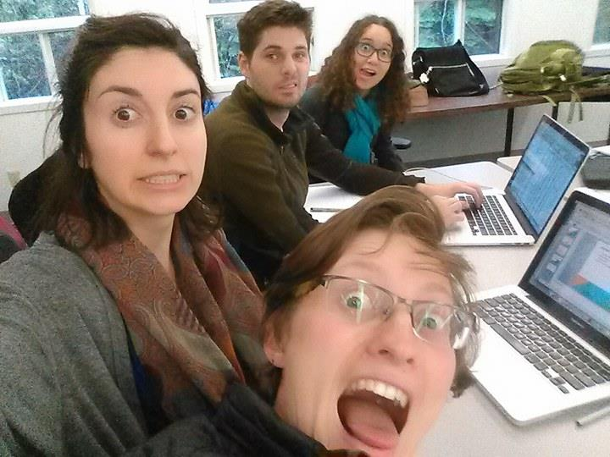
The next 36 hours
Time series analyses of sites (multiple data points per site, 2000 – 2017)
Model selection → stream order vs landuse to see which affects P variability
Make nice figures
Continue to commit to Github (it works well)

