Slide 1
Erin Levesque Co-Op Final Presentation July-December 2021

Slide 2
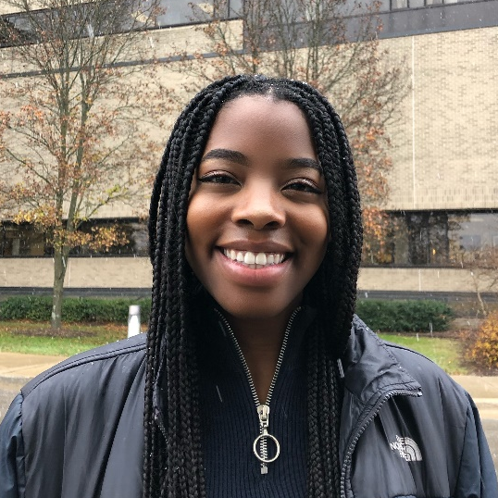

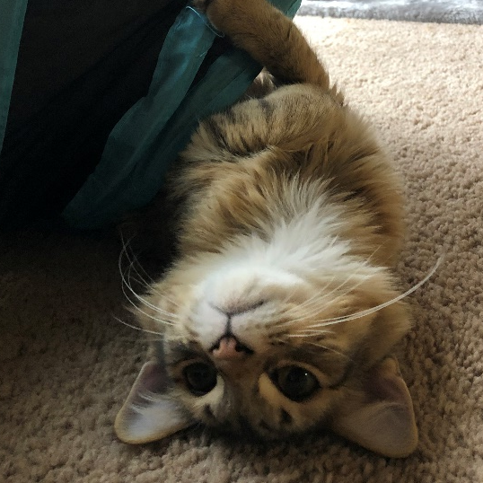
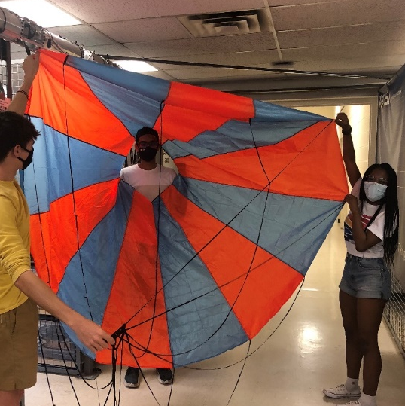
About Me
Senior at University of Michigan (GO BLUE!)
Aerospace Engineering Major
Graduating undergraduate in May 2022
Starting Master’s degree in Fall 2022
Student organizations
Michigan Aeronautical Science Association, project lead
Black Students in Aerospace (BSA); co-founder, board member
INvent Michigan; Instructor, former board member
Previous work:
STAR-CCM+ intern - Siemens DISW
Astrophysics REU program – University of Chicago

Slide 3
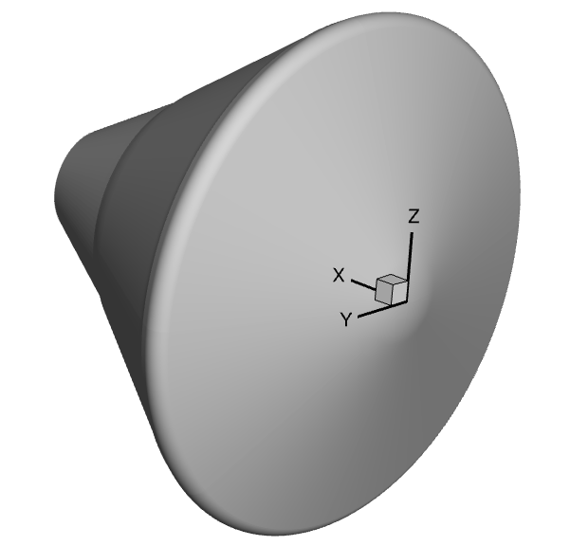
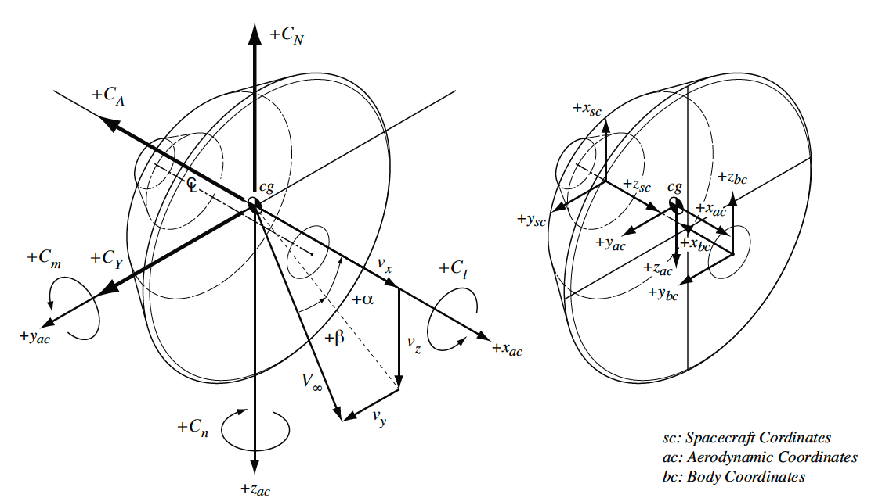
Project 1: Newtonian Estimation Tool
Develop a MATLAB tool that calculates pressure forces and aerodynamic coefficients on a vehicle
Goal: understand how geometric asymmetry will affect SRL aerodynamics
Source: https://arc.aiaa.org/doi/10.2514/1.A32794

Slide 4
Project 1: Newtonian Estimation Tool
Calculations based on Modified Newtonian Theory:
Using pressure distribution of air flowing over a surface to calculate forces and moments at hypersonic speeds
Most accurate for blunt bodies
How the tool works:
Read in an STL file (geometry broken up into small triangles)
Plots normal vectors of each triangle
Calculates surface area, CP, CA, CN, CM, CD, and CL
Plots CP on the body’s surface
Notes:
the flow consists of a large number of individual particles which impact the surface and then move tangentially to the surface. During collision with the surface, the particles lose their component of momentum normal to the surface, but the tangential component is preserved. The time rate of change of the normal component of momentum equals the force exerted on the surface by the particle impacts

Slide 5
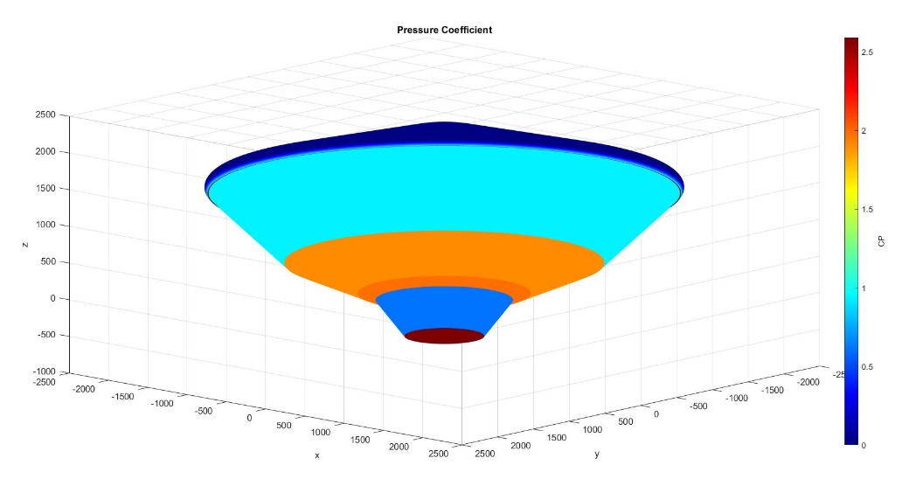
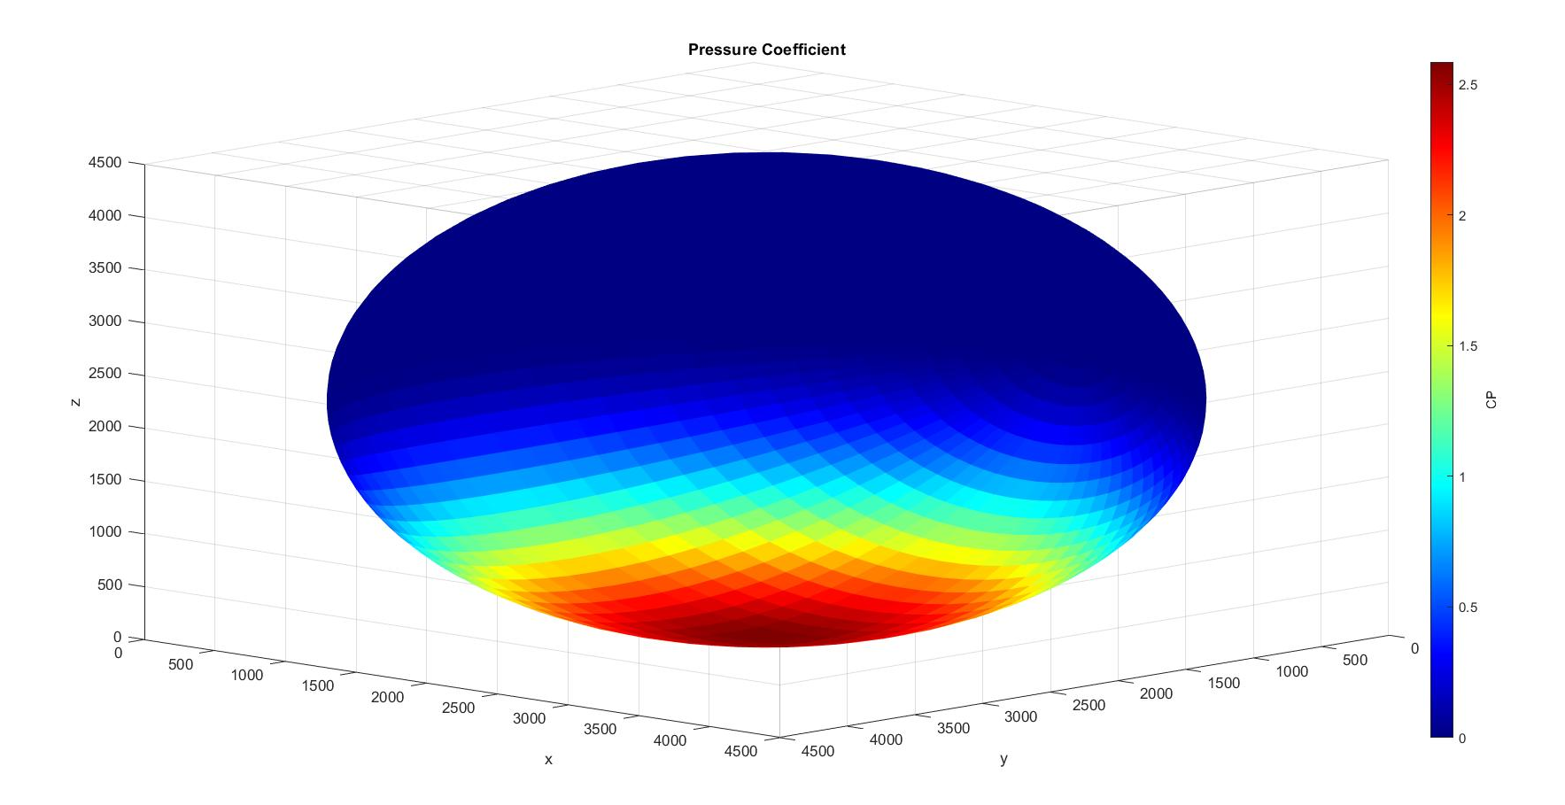
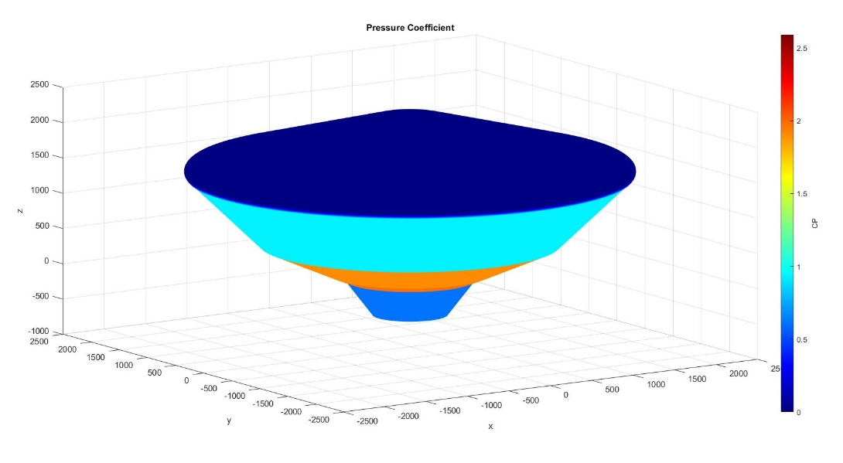
Project 1: Newtonian Estimation Tool
Test Cases: Sphere and vehicle body
Mach 24, Freestream velocity in the – z direction
Tool is generating expected CP values
Next steps: generate SRL models with trim tab and analyze roll torque effects

Slide 6
Project 2: Parachute Loads
Goal: Better understand parachute opening loads to better inform SRL early design decisions
Debug previous MATLAB simulation that determines the appropriate parachute opening loads cases for the MSL entry body
Verify using M2020 inputs, then run simulation on SRL system
Project concluded

Slide 7
Project 2: Parachute Loads
Bridle loads: forces bridles impart to vehicle in response to the parachute force and the pull angle
Loads distributed unevenly
System constraint: Parachute must withstand Flight Limit Load
Simulation assumptions:
Entry body modeled as a 4DOF system
3 bridles modeled as rigid trusses
θ_{p}
F_{p}
F_{b1}
F_{b2}
θ_{b}
Source: Parachute Single Bridle Requirement Presentation by Tanner, Siegel, O’Farrell

Slide 8
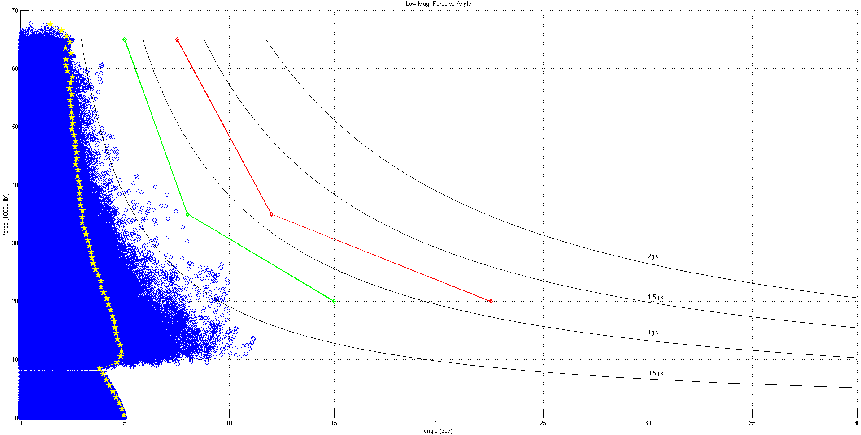
Project 2: Sample output, MSL Low Magnitude: 10 Events
Baseline Load Case:
(green)
65k lbs – 5 deg
35k lbs – 8 deg
20k lbs – 15 deg
With 50% angle margin:
(red)
65k lbs – 7.5 deg
35k lbs – 12 deg
20k lbs – 22.5 deg
Baseline Case
Iso-lateral acceleration & Iso-angular acceleration due to “Fsin(θ)”
50% Margin Case
Triple Bridle Loading Region
Single Bridle Loading Region
Double Bridle Loading Region
99th percentile curve for 1000lbs load steps
Iso-lateral acceleration & Iso-angular acceleration due to “Fsin(θ)”

Slide 9
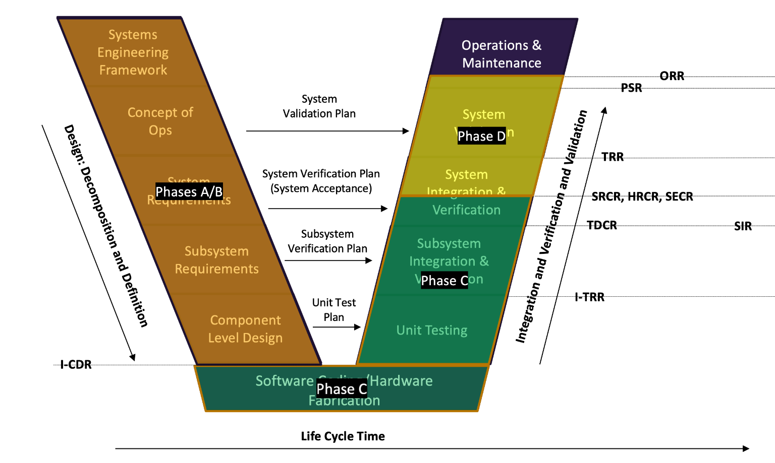
Non-Technical Work
Helping team prepare for SRR by organizing System Verification Library
Locating L4 and L5 Requirement matrices from project leads
Locating HRCR forms, presentations, and supporting documentation from online databases
Source: https://systems-engineering-cms.jpl.nasa.gov/process/verification-and-validation/

Slide 10
What I’ve Learned During My Co-Op
Newtonian Method for hypersonics
New MATLAB skills
How parachute bridle loads are analyzed
How lots of moving pieces have to come together to get to Mars!
Time management
Balancing full-time work with project teams/clubs, socializing, and a course
Not to be afraid to reach out for help (still a work in progress)
What I’d do differently: connect with people on my team that I didn’t work on projects with

Slide 11
Additional Highlights
Mock Interviews
B.E.S.T. employee resource group
ERG mentorship program
Student Lunch & Learn
Everyone I had the chance to work with!

Slide 12
JPL Potential Improvements
More intern activities during semester terms
Speaker/seminar series
More frequent events like Student Lunch & Learn
Widespread across all the different JPL missions

Slide 13
THANK YOU!!
Notes:
Thank you!!
Dream come true
Hope to see you all again

