Slide 1
Python in Four Hours
James R. Bradley

Slide 2
Python in Four Hours
What can you learn about Python in 4 hours?
Excite you about Python
Examples of what you can do
Don’t worry about understanding the code
Get started with programming basics
We’ll work a problem to motivate skills

Slide 3
What is Programming?
Sequence of instructions for the computer to execute
Sequential execution, top-down
Specifically, the Central Processing Unit (CPU)

Slide 4
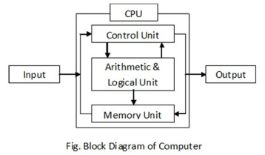
What is Programming?
Program statements direct the CPU’s control of:
Input
Hard drive files, keyboard, from memory/ethernet
Output
Monitor, hard drive files
Maintain program variables
CPU and RAM memory
Communication
Ethernet cable, wifi
http://www.vidyagyaan.com/computer-knowledge/block-diagram-of-computer/

Slide 5
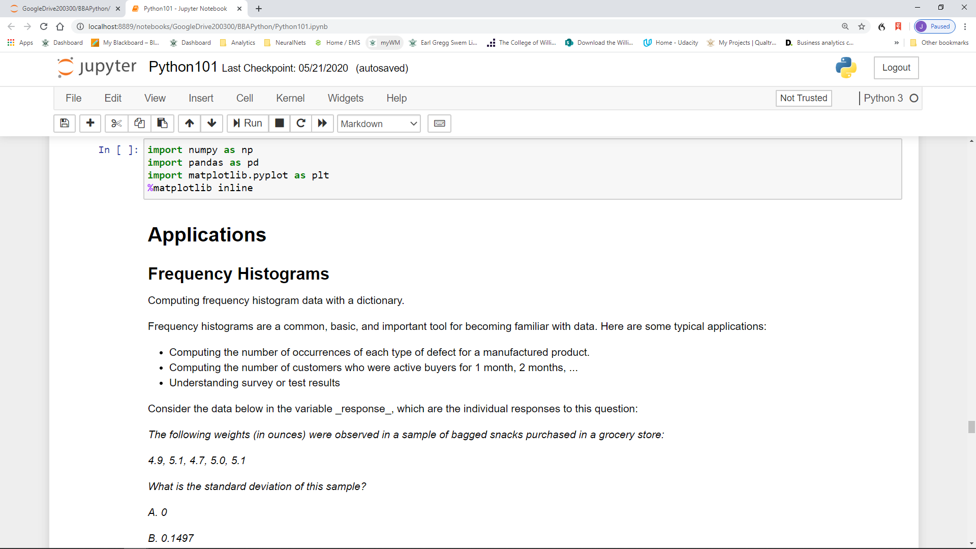
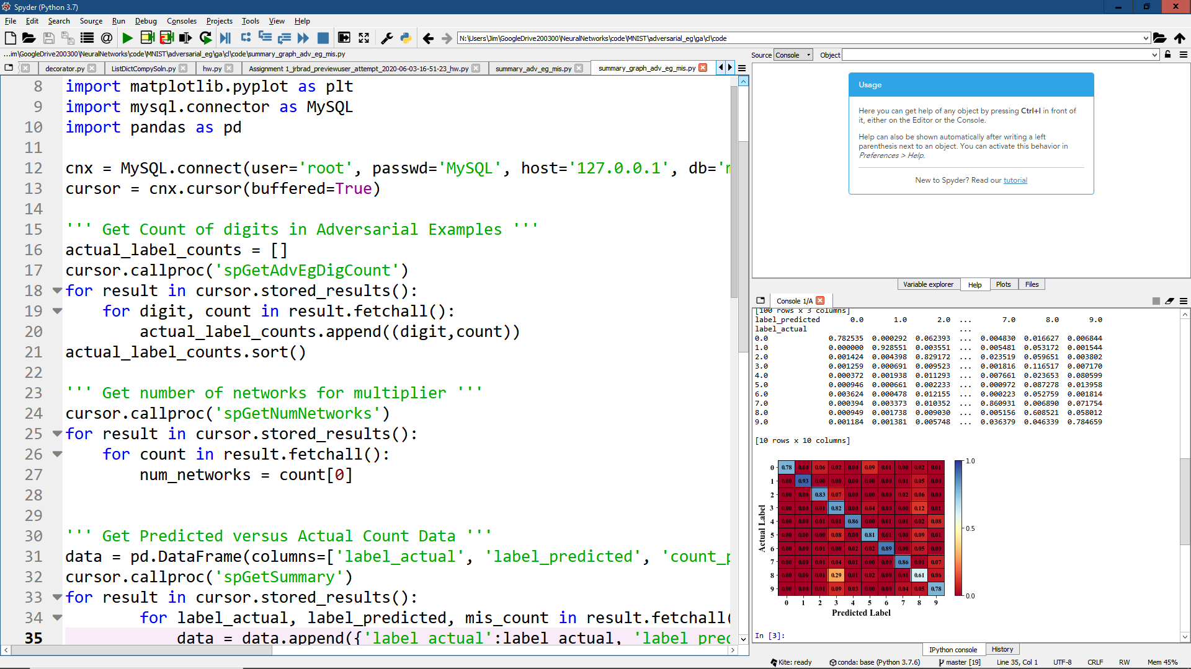
How Do We Do Python?
An engine interprets Python statements for the CPU
We type the instructions into an editor
Jupyter notebook or Spyder
Jupyter Notebook
Spyder

Slide 6
Why Program, in Python?
Why do we need computers?
Computers are faster than humans
Humans can’t do tasks with lots of data/computation
Important in analytics
Python and R are the most used languages in data science/analytics
Python is very understandable
More straightforward that other languages
Very expressive: can do a lot with few statements

Slide 7
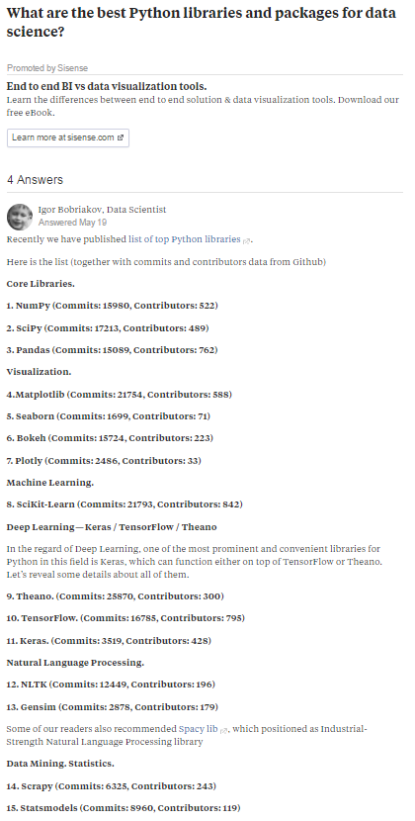
Why Python?
Open source
Web page for popular Python packages

Slide 8
Installing Python
Instructions for installing Python (Anaconda) and downloading course files
https://jrbrad.people.wm.edu/msbi/
Windows and Mac instructions
Follow instructions to ensure that you can start and shutdown Jupyter.

Slide 9
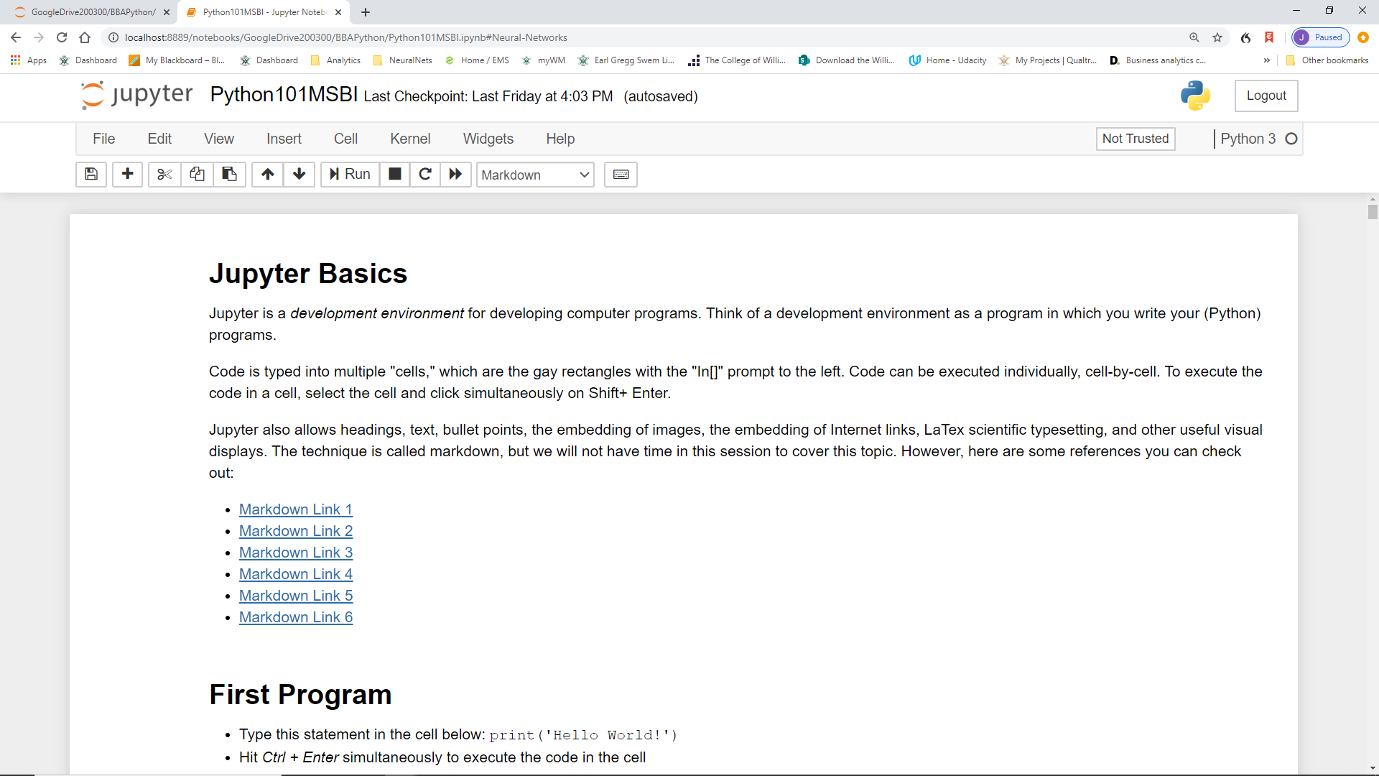
Installing Python
Open Jupyter
Open Python101MSBI.ipynb
Contains course content

Slide 10
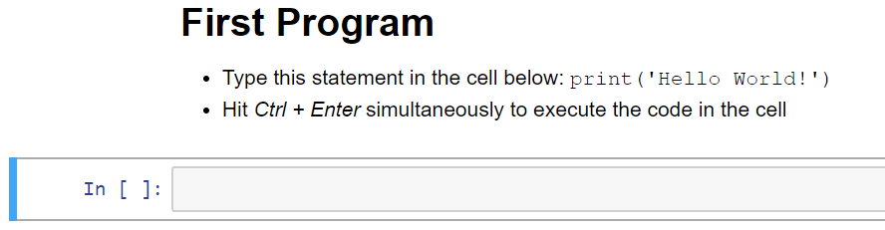
Installing Python
Execute a program

Slide 11
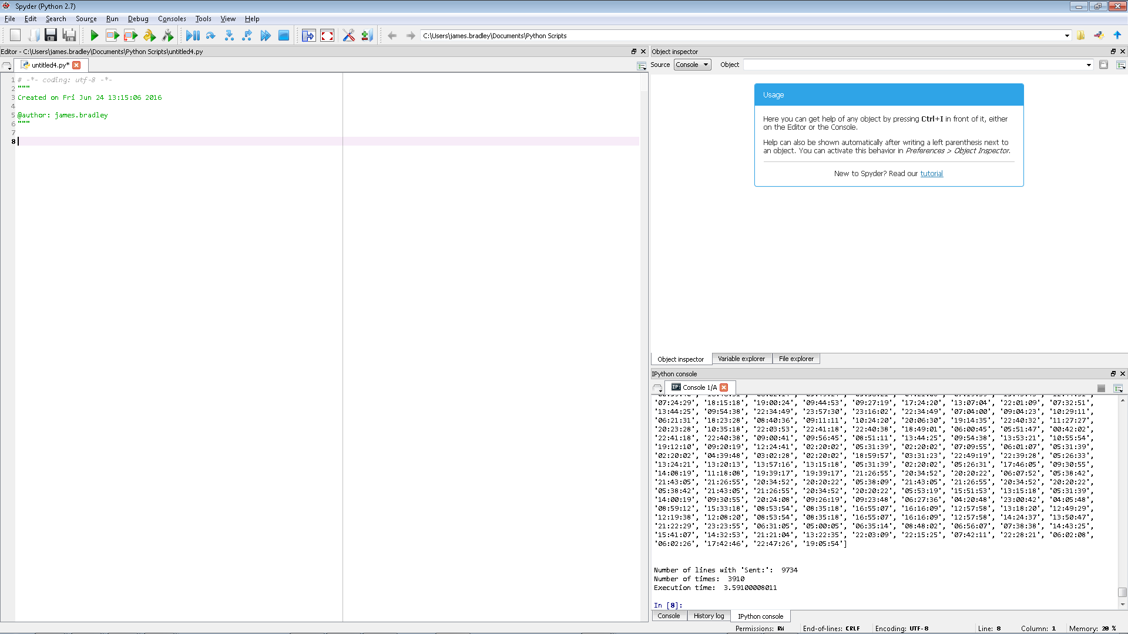
Spyder
Object Explorer
Script Editor
Write many lines of code for sequential execution here
Console
Run 1 statement here
See results from print() statements

Slide 12
Python Educational Resources
Python
https://www.udemy.com/course/complete-python-developer-zero-to-mastery/
https://www.coursera.org/learn/python
pandas package
https://www.udemy.com/data-analysis-with-pandas/
Software APIs on MSBA page
https://mason.wm.edu/current/mymsba/software_installation/index.php
W&M:
Computer Science CSCI 140, 141, 241
Mason School, BUAD 468 Prescriptive Analytics (20-21)
Mason School MSBA Program

