Slide 1



Input
Output
Text File
Text File

Slide 2
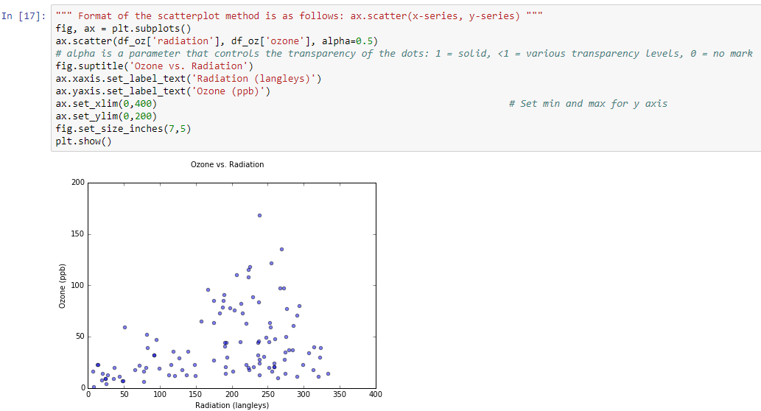

Slide 3
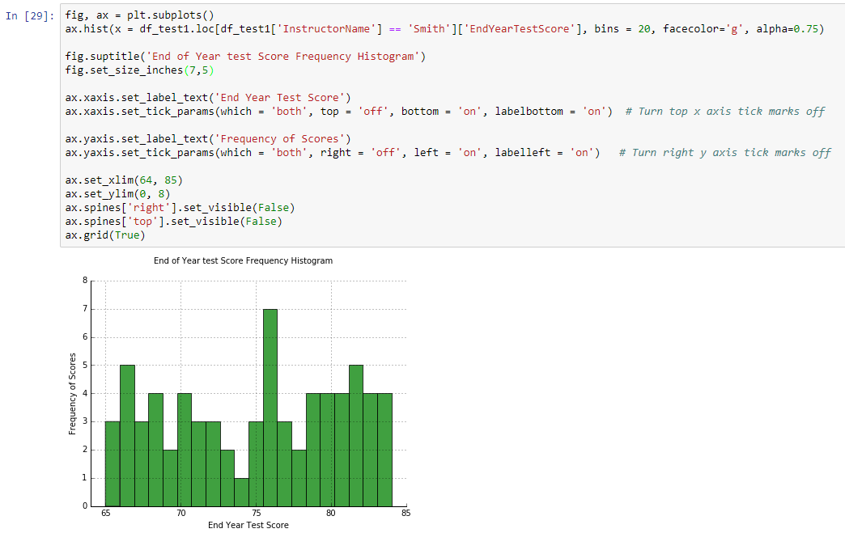

Slide 4
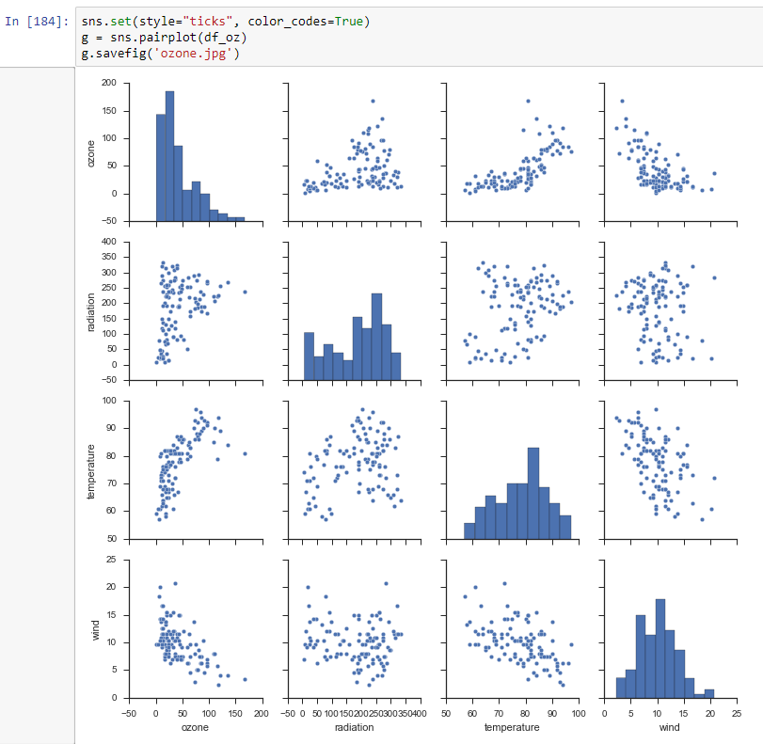

Slide 5
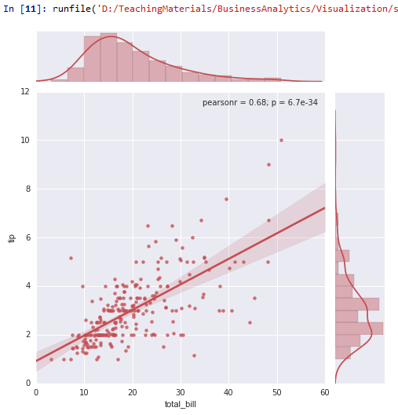

Slide 6
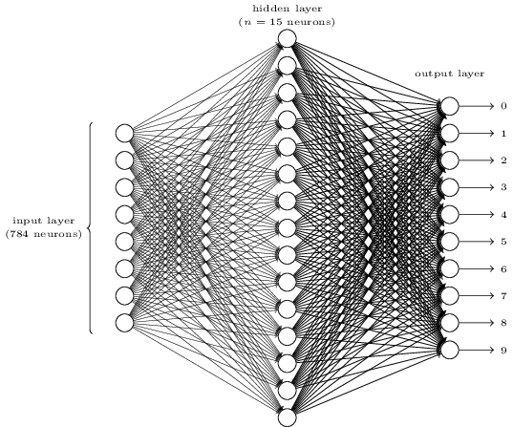
MNIST Handwriting Recognition Dataset
From: http://neuralnetworksanddeeplearning.com/chap1.html

